Slide 1
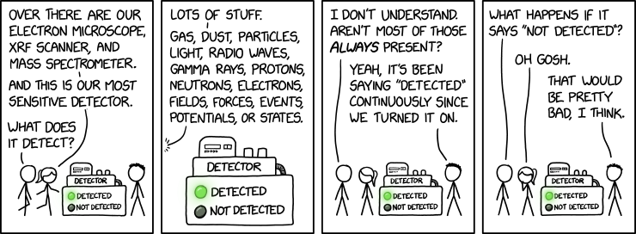
Sensors
SWE 4211
Notes:
https://xkcd.com/3254/

Slide 2
Outcomes
Explain how an IR sensor operates.
Explain how an IR sensor can be used to detect collisions.
Explain the required sampling rate for a system
Identify common mistakes in source code implementation
Identify root causes of problems within source code.

Slide 3
Midterm
1 page, 8.5 by 11 inch of notes, front and back
Exam: combination of multiple choice, short answer, problems
  Will likely have half multiple choice
  Will have box at end for comments on MC questions (partial credit)
  Yes, some code, but not full systems and not focused on GPIO libraries
    Code questions will focus on concepts, not C/C++ syntax
    … but being close on syntax helps!!
Focus on terminology in my notes
  Weekly term guides can help, but may not always match…
I may use genAI for question ideas, but will be responsible for all answers

Slide 4
Black vs. White
Black
  In pigments (paint), theoretically the adsorption of all light
  In practice, adsorb most light – hence the warmth of black surfaces
White
  In light, all colors mixed together
  Fresh snow: reflects nearly all visible rays (but scatters them), close to a pure white
  In practice, opposite of black

Slide 5
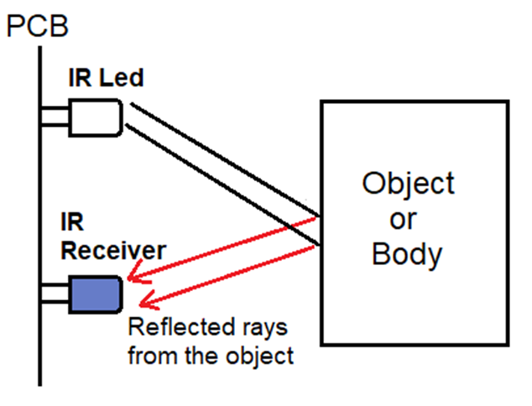
Optical Sensor
Question: how to spoof an IR sensor?
That is, make something invisible
Notes:
Ways:
Make sure body has a rough surface
Have a bright light that overwhelms the reflected rays

Slide 6
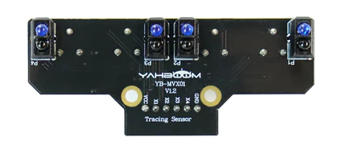
IR sensors on the robots – 4 pairs
Notes:
each pair: a light and a sensor

Slide 7
Following a Line
CL
CR
R
L
L | CL | CR | R | Direction
0 | 1 | 1 | 0 | straight
0 | 1 | 0 | 0 | ?
0 | 0 | 1 | 0 | ?
0 | 0 | 0 | 1 | ?
1 | 0 | 0 | 0 | ?
0 | 0 | 1 | 1 | ?
1 | 1 | 0 | 0 | ?
0 | 1 | 1 | 1 | ?
1 | 1 | 1 | 0 | ?
1 | 1 | 1 | 1 | ?
0 | 0 | 0 | 0 | ?
1 | 0 | 0 | 1 | ?
0: white
1: black
Target:

Slide 8
Following a Line
CL
CR
R
L
L | CL | CR | R | Direction
0 | 1 | 1 | 0 | straight
0 | 1 | 0 | 0 | left
0 | 0 | 1 | 0 | right
0 | 0 | 0 | 1 | further right
1 | 0 | 0 | 0 | further left
0 | 0 | 1 | 1 | right
1 | 1 | 0 | 0 | left
0 | 1 | 1 | 1 | strong right
1 | 1 | 1 | 0 | strong left
1 | 1 | 1 | 1 | stop
0 | 0 | 0 | 0 | ? - search
1 | 0 | 0 | 1 | ? - undefined
0: white
1: black
0: white
1: black
Target:
Notes:
“stop” case: robot going up to perpendicular
1 0 0 1 case: someone spilled paint on the line?

Slide 9
The stroboscopic effect
See https://commons.wikimedia.org/wiki/File:Propeller_strobe.ogv
Up to 80 Hz: just flicker
80 to 2000 Hz: stroboscopic effect
  Useful for film!
LEDs: use PWM to control brightness
  Square wave means each turns on and off quickly
  Result: visible strobing
What causes this illusion? – guess!
  Undersampling: missing key events resulting in inaccurate “picture”
Question: how fast do we need to sample to get an accurate picture?
Our understanding
of the physics
From https://en.wikipedia.org/wiki/Stroboscopic_effect
Notes:
Draw an example showing when this might happen with a rotating wheel
https://www.cs.ucdavis.edu/~koehl/Teaching/ECS17/Chapters/Chapter1/wagon.html
note “picture” meaning our understanding

Slide 10
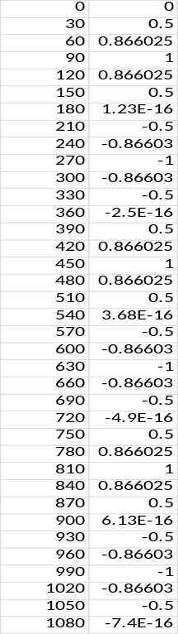
Nyquist-Shannon Sampling Theorem
Sample once per cycle: just see one point, miss the cycle
Question: how often do we need to sample?
Assumptions
  bandlimited: content in signal limited to a frequency range
  no aliasing: extreme high frequency waves that overwhelm intended data – filter it out
https://en.wikipedia.org/wiki/Nyquist%E2%80%93Shannon_sampling_theorem
Notes:
If this represents 1 second, what happens if we sample 3 times per second?
https://en.wikipedia.org/wiki/Nyquist%E2%80%93Shannon_sampling_theorem

Slide 11
Nyquist-Shannon Sampling Theorem
Theorem: if function x(t) contains no frequencies higher than B hertz, it can be completely determined from its sampled values spaced less than 1/(2B) seconds apart
  That is, sample at 2B hertz
Nyquist frequency: f_{s}/2
Sample twice as fast highest frequency component
https://en.wikipedia.org/wiki/Nyquist%E2%80%93Shannon_sampling_theorem
Notes:
If this represents 1 second, what happens if we sample 3 times per second?
https://en.wikipedia.org/wiki/Nyquist%E2%80%93Shannon_sampling_theorem

Slide 12
Nyquist-Shannon Sampling Theorem
Why this matters:
  Could sample (say) 10 times faster
  Doing so burns processing power/time
  This limits other computations that can take place
https://en.wikipedia.org/wiki/Nyquist%E2%80%93Shannon_sampling_theorem

Slide 13
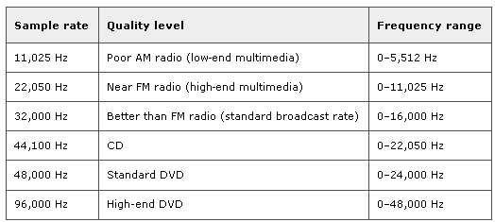
Sampling Theorem
Nyquist Criterion
=> f_{s} > 2B
Nyquist Rate: 2B
Audio Sampling:
Telephone -> 8 KHz, max frequency 3.2 KHz
Notes:
Telephone -> 8 KHz, max frequency 3.2 KHz

Slide 14
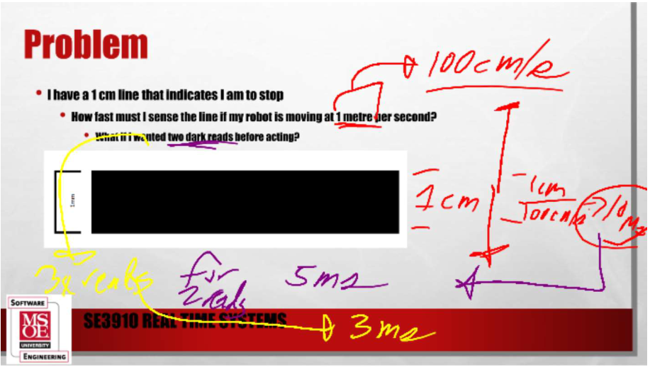

Problem
I have a 1 cm line that indicates I am to stop
  How fast must I sense the line if my robot is moving at 1 meter per second?
  What if I wanted two dark reads before acting?

Slide 15
Sensing Lines
I would like to sense whether we are on a line
Notes:
Circle that we need multiple readings with the four sensor array

Slide 16
Sensing Lines
I would like to sense whether we are on a line
  What happens if I sample too slowly – say 2 samples per segment
Notes:
If sample (say) 2 samples on the down slope, will miss the bend

Slide 17
Application
I have a wheel that is encoded to sense rotation speed
  Half of the wheel is black; half is white
  Assume max speed is 10 revolutions per second
  How fast must I poll if I would like accurately compute the speed?
Assume: need 1 black reading, 1 white reading for each rotation
From Gemini: revolution frequency: 10 Hz, 100 ms / rotation
  White is 50 ms, black is 50 ms
  2 transitions per revolution, must detect frequency of 20 Hz
  Nyquist theorem: sample at 40 Hz – but this will be a rough measure
  Moderate accuracy: need 200 Hz
  High accuracy: 400 Hz
Notes:
https://gemini.google.com/app/486c6b6ba3afe75d

Slide 18
Basics of embedded system
What do we typically have?
  Inputs: sensors
  Outputs: actuators
Sensor:
  “An electronic sensor detects and measures a physical phenomenon, such as temperature, pressure, force, or acceleration, and provides a corresponding output, usually in the form of an electronic signal.”

Slide 19
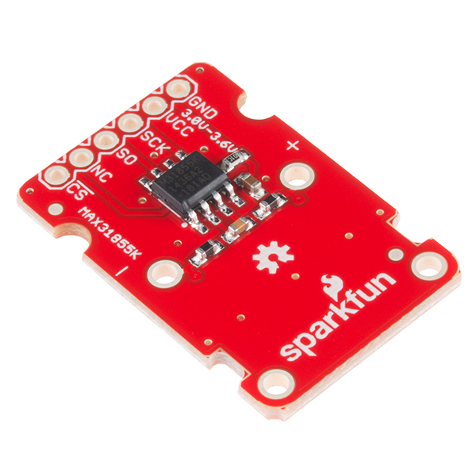
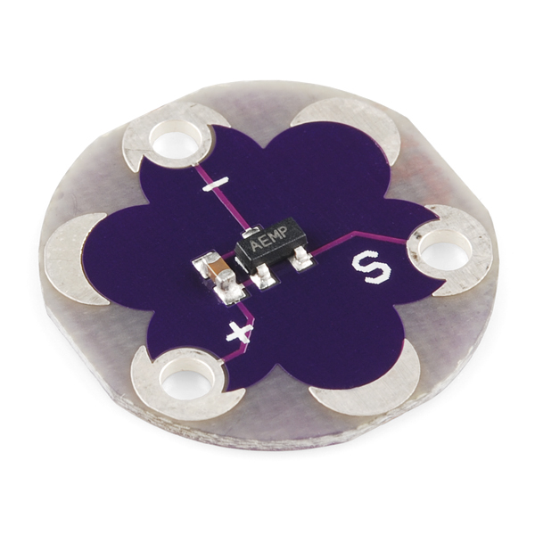
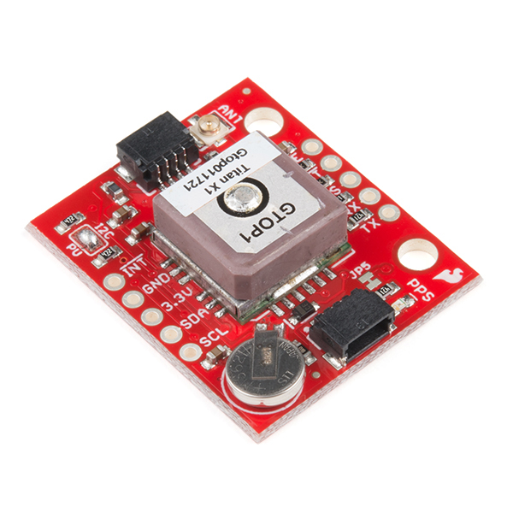
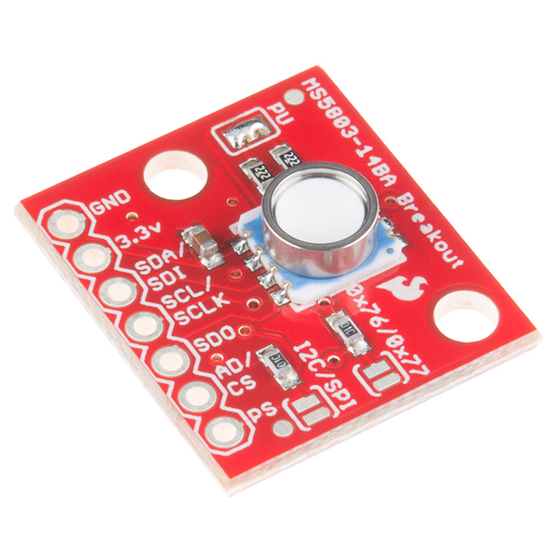
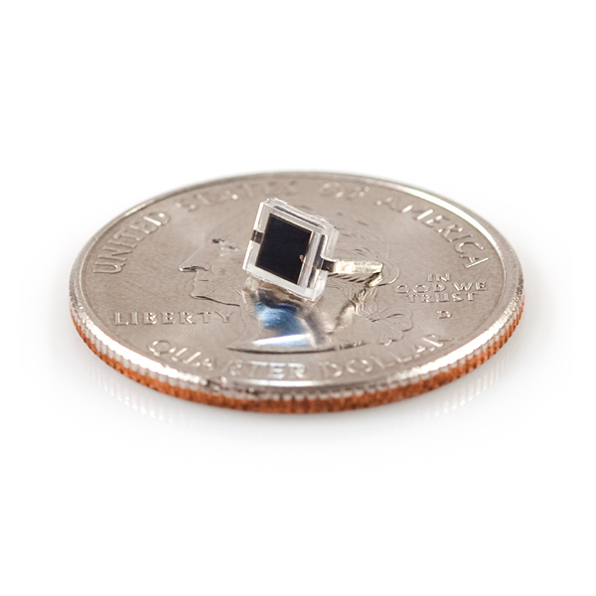
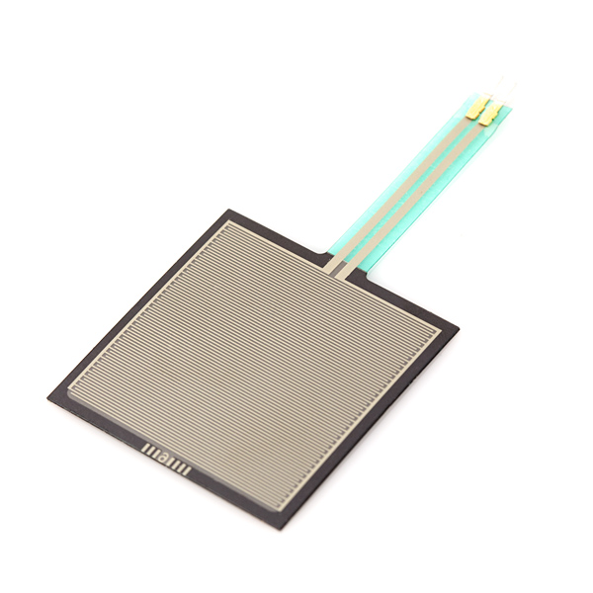
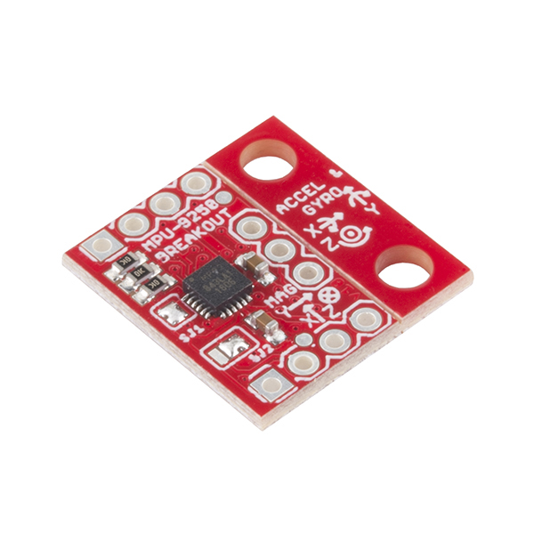
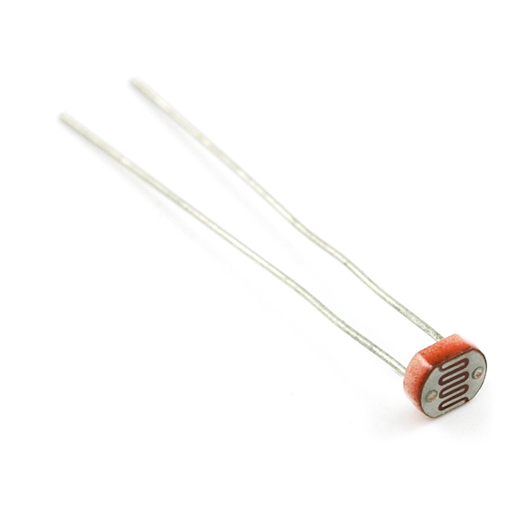
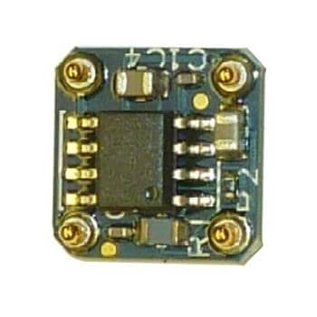
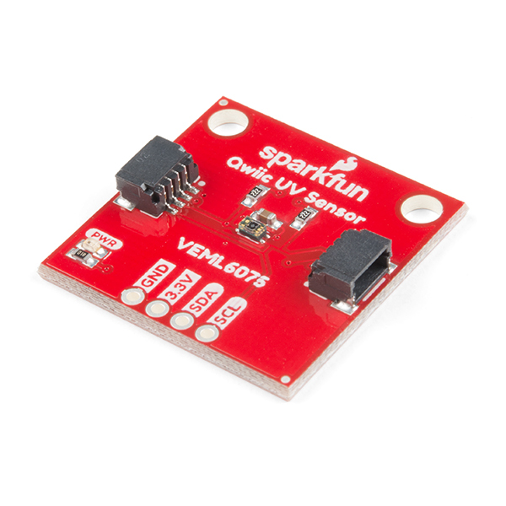
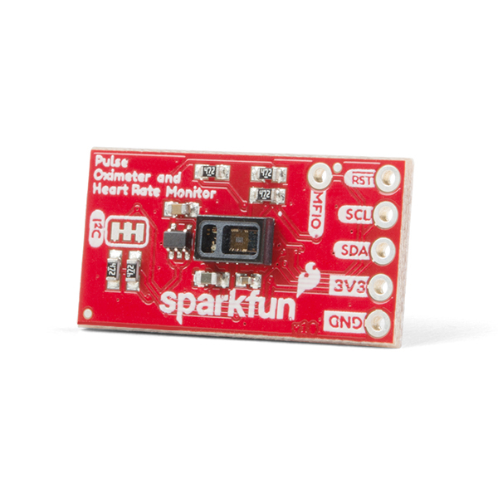
Sensor types
Temperature Sensors
  Thermocouples (Voltage generated based upon temperature)
  Thermistors (Resistance varies based upon temperature)
Location sensors
  GPS (latitude and longitude)
  Magnetic field sensor (compass heading)
Pressure sensors
  Barometric pressure sensors (air pressure / altitude)
  Strain gauge (force on a material)
Motion sensors
  Accelerometer (Changes in motion)
  Gyroscope (changes in motion)
Light sensors
  Photo resistor (high resistance if dark, low if lit)
  Solar cell (voltage changes based on light)
  UV Sensor
Biometrics
  Pulse Ox (measures oxygen in body)
  ECG (heart rate)
https://www.embedded.com/sensor-basics-types-functions-and-applications/

Slide 20
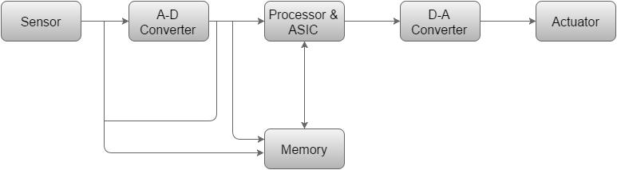
Basic structure of an embedded system
Traditional
computer
Sensor
  Measures physical quantity, converts to electrical signal
  Typically, sensor output sent to A-D converter to convert into digital signal (value that can be processed by computer)
A-D Converter
  An analog-to-digital converter converts the analog signal sent by the sensor into a digital signal.
Processor & ASICs
  ASIC: Application-Specific Integrated Circuit
  Processor: compute the results
D-A Converter
  Convert from digital back to analog signal
Actuator
  Converts analog signal (voltages) into actions; eg, turn motor, turn on light, activate solenoid
*https://www.tutorialspoint.com/embedded_systems/es_overview.htm

Slide 21
Problem
How to measure a building’s height?
Solutions based on having a barometer:
  Physics prof: Measure pressure at bottom, at top, compute distance
  Engineer: drop it off the side, count seconds
  Philosopher: use it to bribe the janitor for the information
We’re going for the engineering solution…

Slide 22
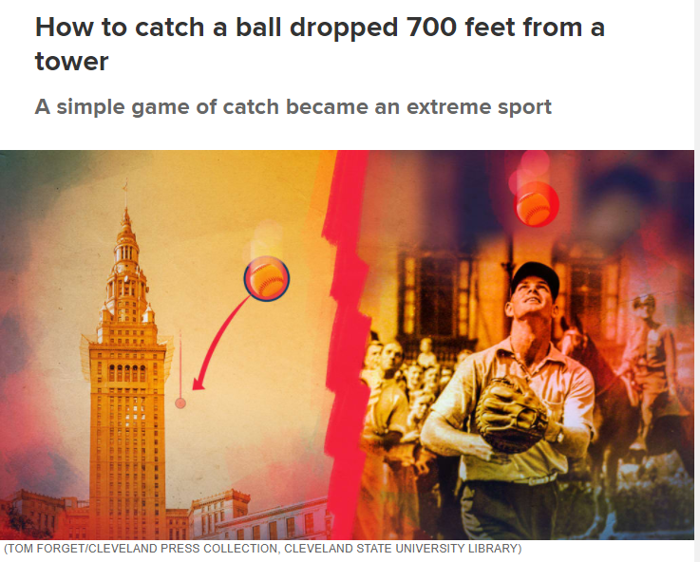

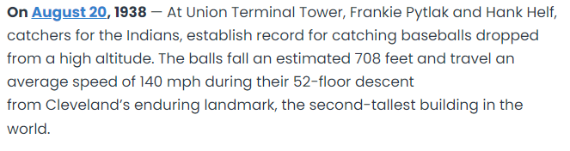
Inspiration
https://thisdayinbaseball.com/at-union-terminal-tower-frankie-pytlak-and-hank-helf-catchers-for-the-indians-establish-record-for-catching-baseballs-dropped-from-a-high-altitude-the-balls-fall-an-e/
By Erik Drost - Cleveland Public Square, CC BY 2.0, https://commons.wikimedia.org/w/index.php?curid=66564837
Notes:
picture from https://www.mlb.com/news/indians-players-caught-ball-dropped-from-cleveland-tower

Slide 23
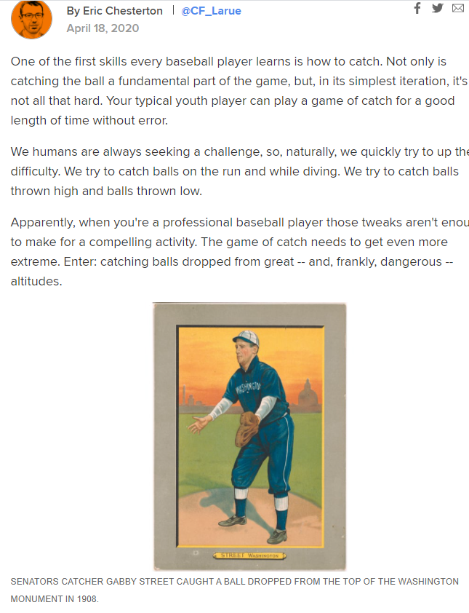
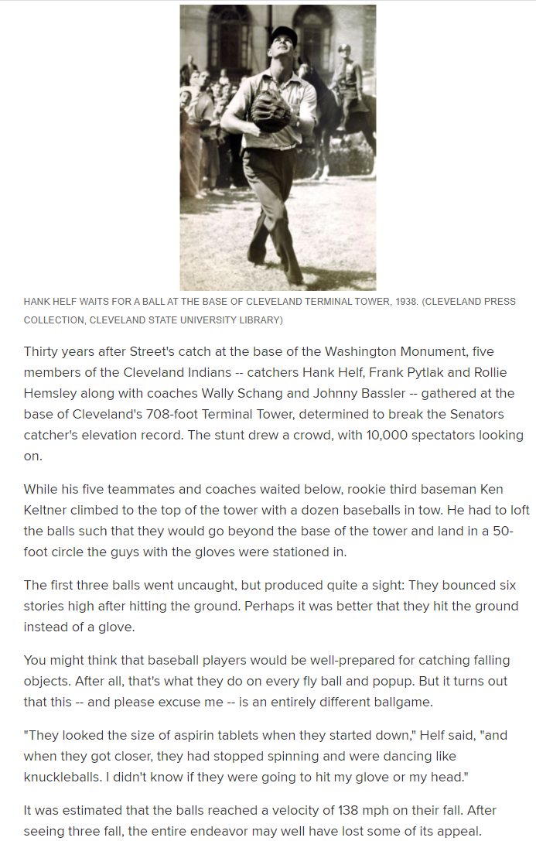
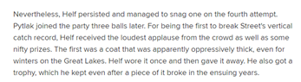
https://www.mlb.com/news/indians-players-caught-ball-dropped-from-cleveland-tower

Slide 24

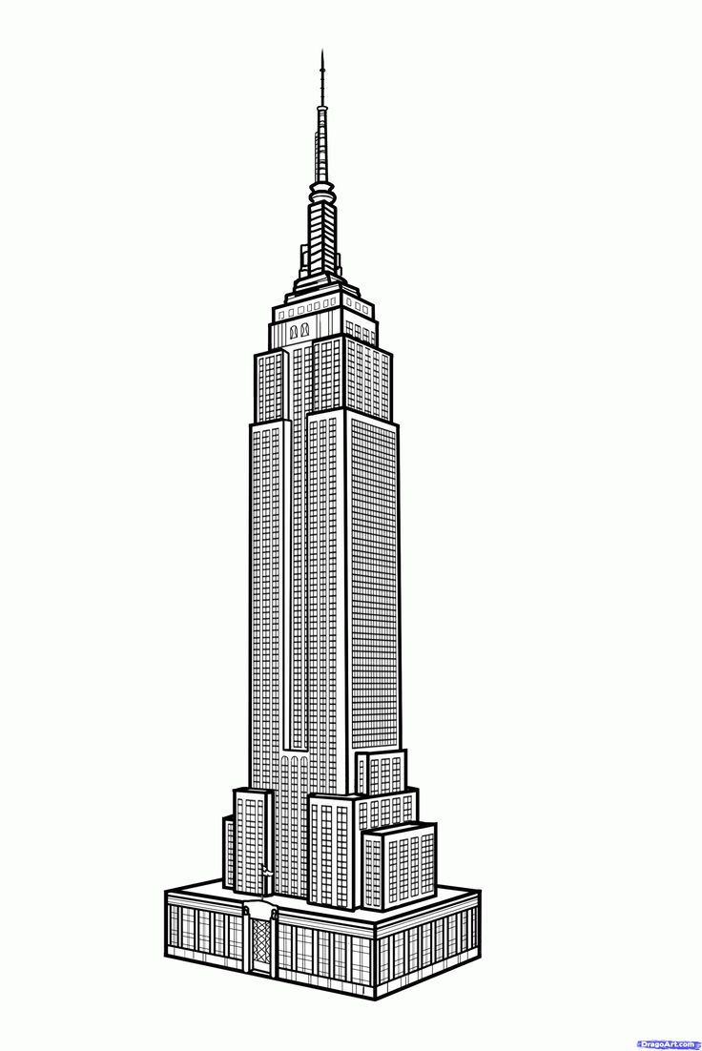
Empire state building and a soccer ball
Drop a soccer ball off of the top floor
Ball falls and bounces back up
17.677s later, the soccer ball is caught by the person who dropped it
How tall is the building in feet?

Slide 25

Drop a soccer ball off of the top floor
Ball falls and bounces back up
17.677s later, the soccer ball is caught by the person who dropped it
How tall is the building?
$d=V_{o}t+0.5at^{2}$
$d=0t+0.5∗32∗{8.838}^{2}$
D=1249.7 -> 1250

Slide 26
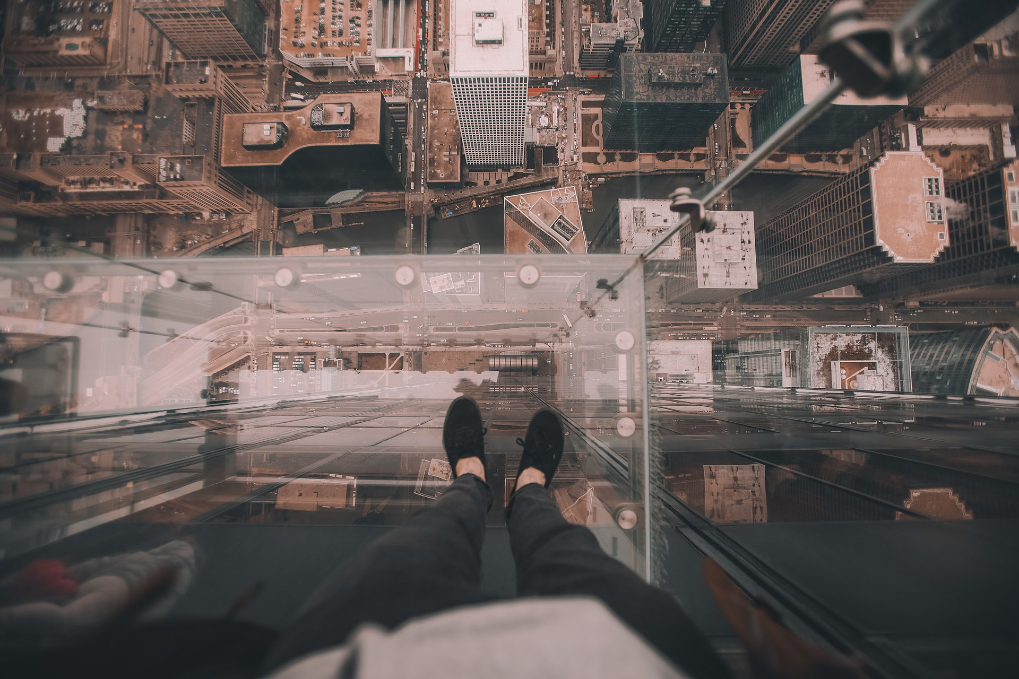
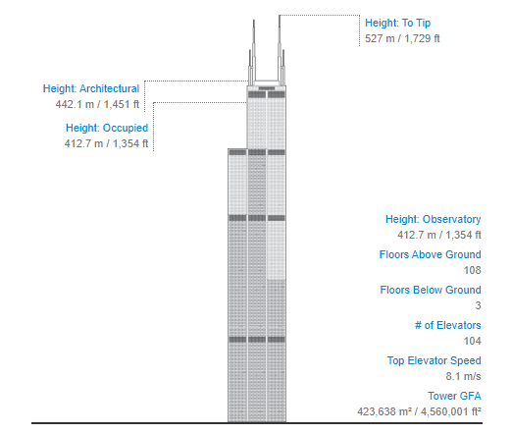
Maybe we shouldn’t try this…
Tim Trad timtrad - https://unsplash.com/photos/AIwlyvpQJ18 Image at the Wayback Machine (archived on 9 May 2017) Gallery at the Wayback Machine (archived on 29 April 2017)

Slide 27
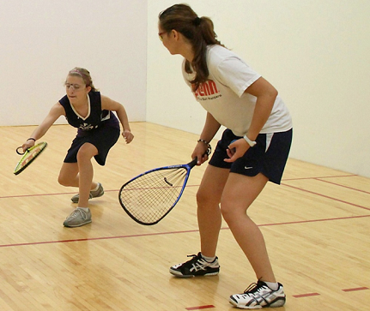
How would I measure how far I am standing from the wall?

Slide 28
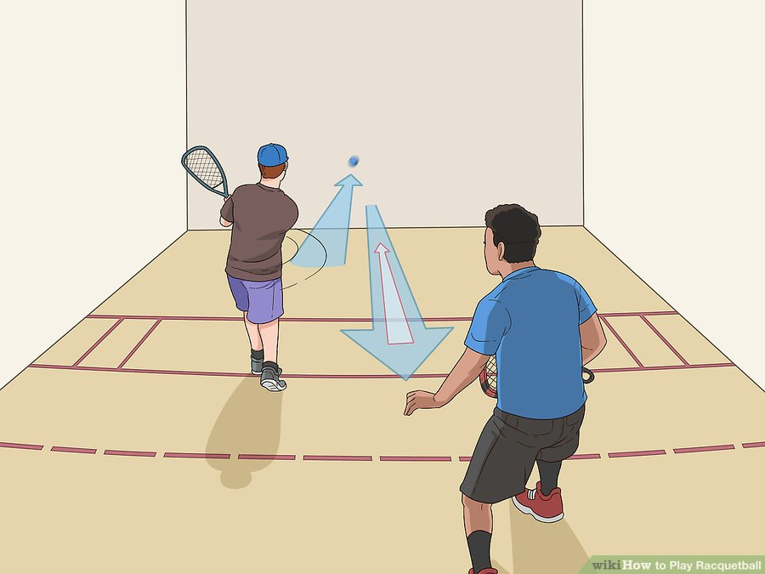
Racquetball
Ball moving at 120 mph
Passes the server 228 ms later
How far is the server from the wall?

Slide 29
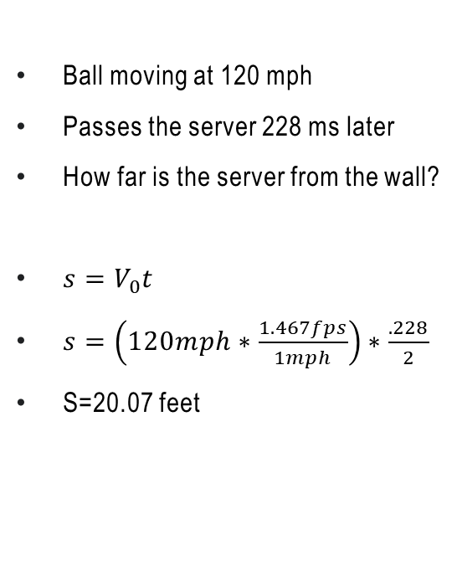
Racquetball
Ball moving at 120 mph
Passes the server 228 ms later
How far is the server from the wall?
$s=V_{0}t$
$s=\left(120mph∗\frac{1.467fps}{1mph}\right)∗\frac{.228}{2}$
S=20.07 feet

Slide 30


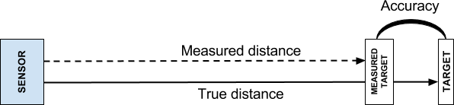
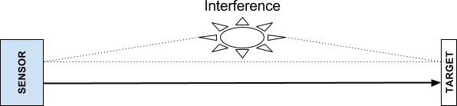

Issues in distance measurements
Range of usefulness
Accuracy
Environmental noise
Variance across measurements

Slide 31
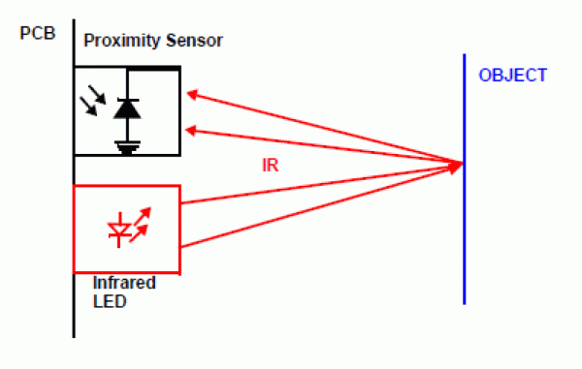
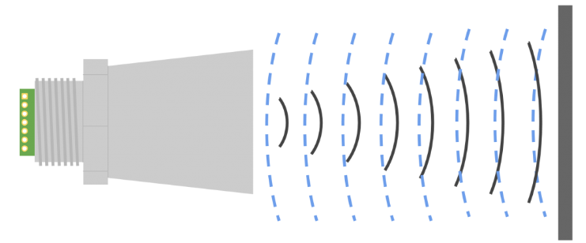

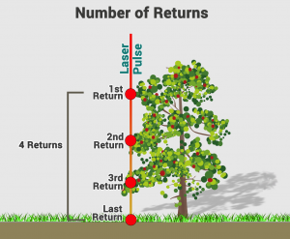
Measuring Distance
Infrared
  Uses reflected light
  Disadvantage: sensitive to ambient light, particles
Ultrasonic
  Uses reflecting sound
  Not affected by ambient light, dust, smoke, etc.
  High environmental noise may interfere
LIDAR
  Light Detection and Ranging
  Uses a pulsed laser
  May have multiple returns…
    Lots of precise data, must smoothen it
  Disadvantage: expensive

Slide 32
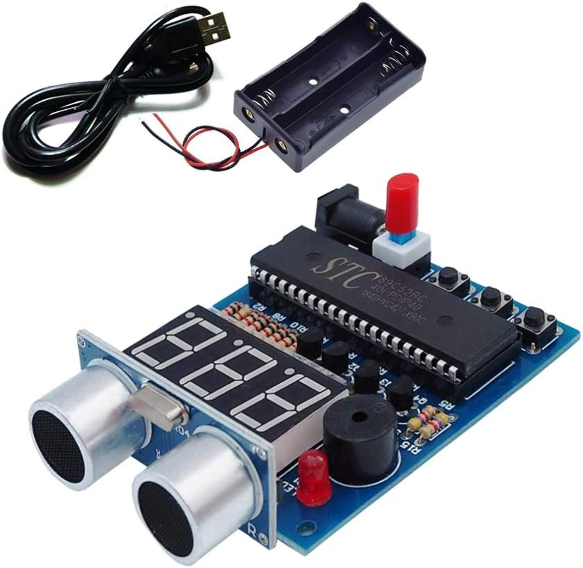
Sample Kit

Slide 33
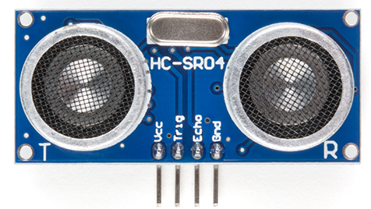
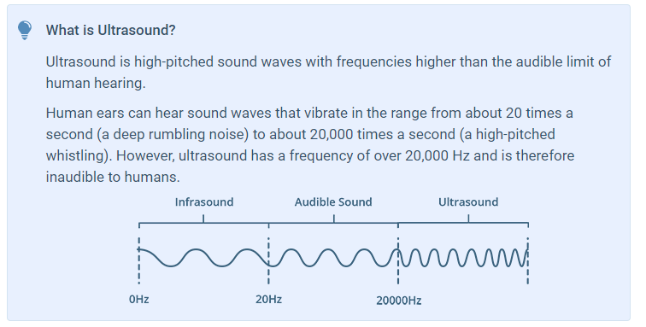
Ultrasonic
Our ultrasonic sensor: HC-SR04
speaker microphone
https://lastminuteengineers.com/arduino-sr04-ultrasonic-sensor-tutorial/

Slide 34
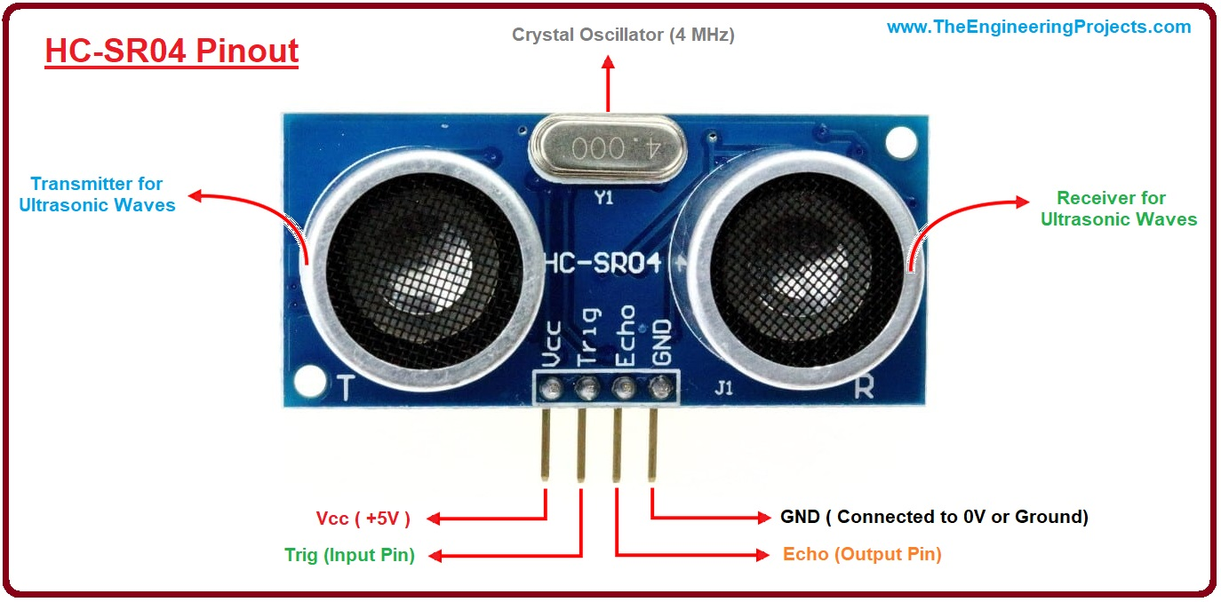
Device Pin Usage
No. Pin Name Pin Description
1 VCC Power supply pin: 5V DC
2 Trig Pin Triggers sending waves; keep high for 10 microseconds
3 Echo Pin Indicates receiving ultrasonic waves
4 Ground

Slide 35
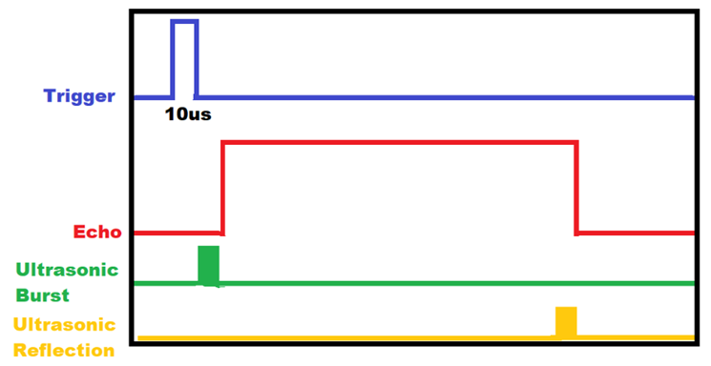
Software Control Algorithm
#1 Set the trigger pin high for a minimum of 10 microseconds
#2 Set the trigger pin back low. Mark time
#3 Wait for the echo pin to go high (not a busy wait!)
#4 Stop timing when the echo pin goes low again

Slide 36
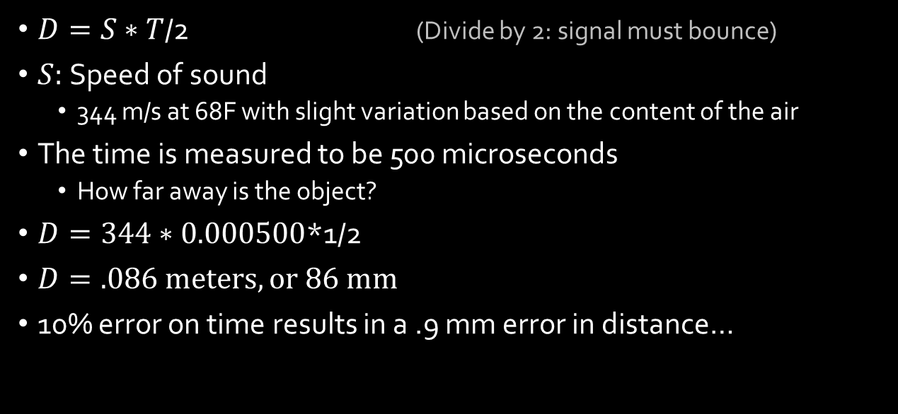
Calculations…
$D=S∗T$/2 (Divide by 2: signal must bounce)
$S:$Speed of sound
  344 m/s at 68F with slight variation based on the content of the air
The time is measured to be 500 microseconds
  How far away is the object?
$D=344∗0.000500$*1/2
$D=.086 meters, or 86 mm$
10% error on time results in a .9 mm error in distance…

Slide 37
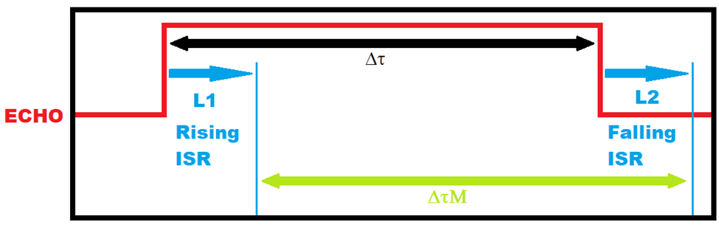
Problem: Latency
What will latency do to the measurements?
Scenarios:
  What happens if L1 ~= L2?
  What happens if L1 > L2?
  What happens if L1 < L2?

Slide 38
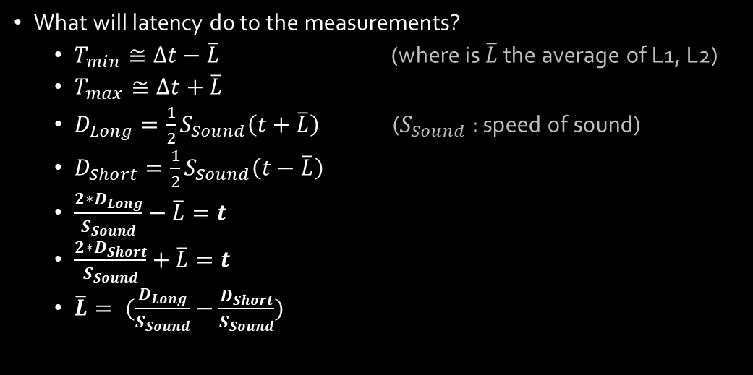
Problem: Latency
What will latency do to the measurements?
  $T_{min}≅∆t−\overline{L}$ (where is $\overline{L}$ the average of L1, L2)
  $T_{max}≅∆t+\overline{L}$
  $D_{Long}=\frac{1}{2}S_{Sound}\left(t+\overline{L}\right)$ ($S_{Sound}$: speed of sound)
  $D_{Short}=\frac{1}{2}S_{Sound}\left(t−\overline{L}\right)$
  $\frac{{2∗D}_{Long}}{S_{Sound}}−\overline{L}=t$
  $\frac{{2∗D}_{Short}}{S_{Sound}}+\overline{L}=t$
  $\overline{L}= (\frac{D_{Long}}{S_{Sound}}−\frac{D_{Short}}{S_{Sound}})$

Slide 39
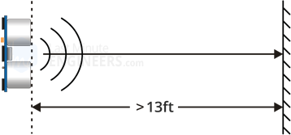
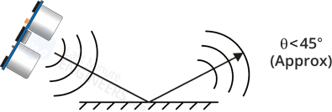
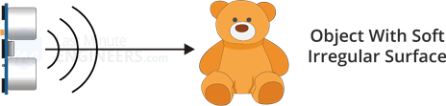

Sensor Limitations
Max Distance:
Too Small of an object
Shallow Angle
Soft Objects
https://lastminuteengineers.com/arduino-sr04-ultrasonic-sensor-tutorial/

Slide 40
Other Issues
Humidity
  If temperature and humidity are known, adjust the speed calculation
  Speed of sound m/s = 331.4 + (0.606 * Temp) + (0.0124 * Humidity)
*https://www.circuitbasics.com/how-to-set-up-an-ultrasonic-range-finder-on-an-arduino/

Slide 41
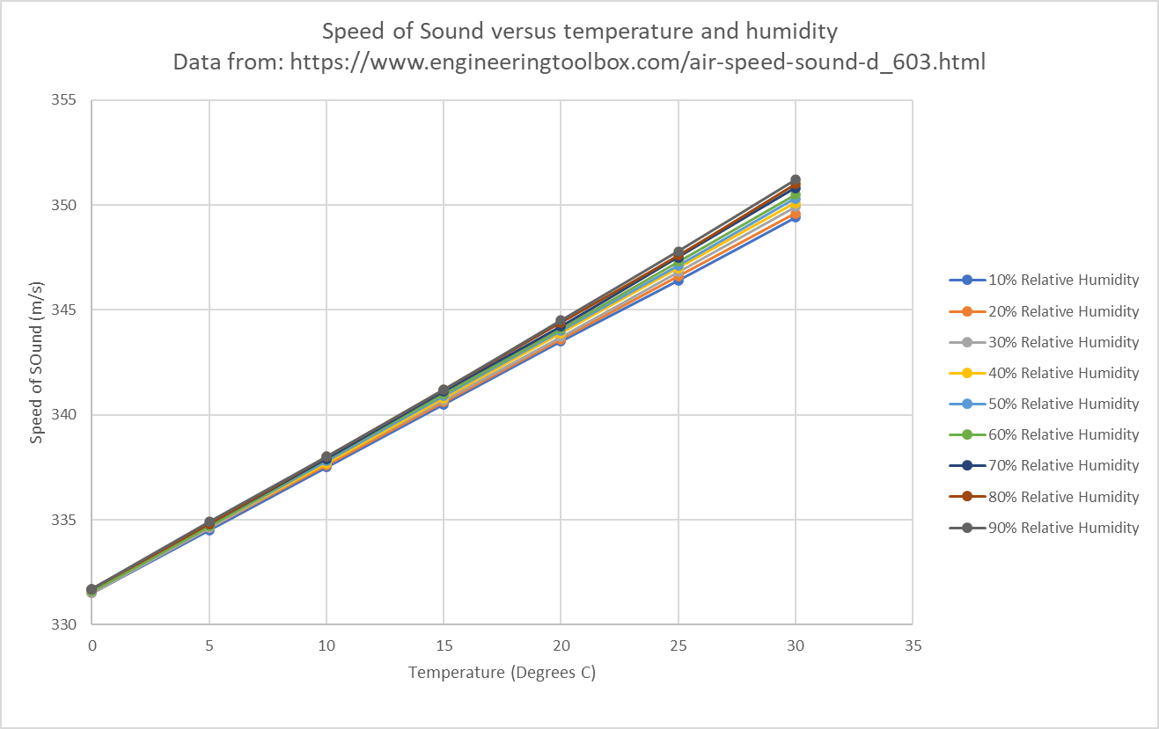
Temperature and Humidity
Note: humidity has small impact, temperature has large impact

Slide 42
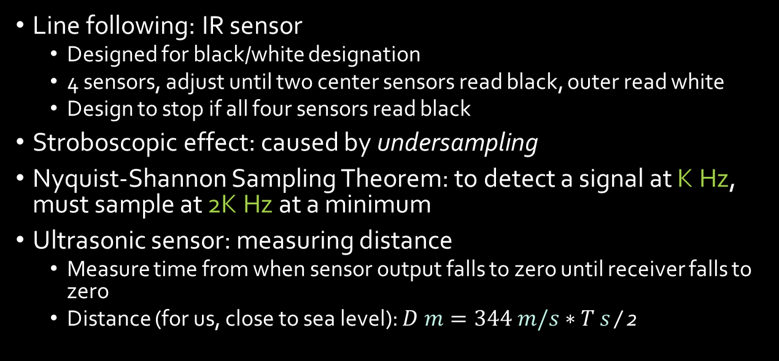
Review
Line following: IR sensor
  Designed for black/white designation
  4 sensors, adjust until two center sensors read black, outer read white
  Design to stop if all four sensors read black
Stroboscopic effect: caused by undersampling
Nyquist-Shannon Sampling Theorem: to detect a signal at K Hz, must sample at 2K Hz at a minimum
Ultrasonic sensor: measuring distance
  Measure time from when sensor output falls to zero until receiver falls to zero
  Distance (for us, close to sea level): $D m=344 m/s∗T$ $s$ / 2

Slide 43
Exam
8.5 by 11 sheet of paper – single page!
I will make the calculator available in the Lockdown Browser
You must be in the classroom or at the testing center

