Slide 1
CPU Utilization and RMA
SWE 4211

Slide 2
Outcomes
Explain the difference between CPU time and wall time, systime and user time
Define jiffy ← Some write this as “jiffie”
Given a set of processes, calculate net CPU utilization.
Draw the task state diagram
Explain the difference between pre-runtime and runtime scheduling
Explain how RMA determines priorities for tasks
Explain how the scheduler operates with RMA based systems
Calculate the ability to schedule RMA systems based on the number of tasks
Define harmonic in terms of periods of processing
Define jitter

Slide 3
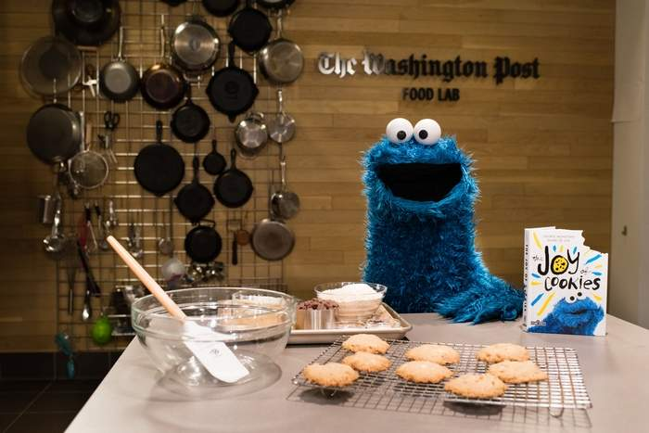
Cookies
How long does it take to bake cookies?
Are you working the whole time?
Which is more important, the total time for the process or the time you work?
  Which is more important for the Cookie Monster?
How does this apply to computing?
Notes:
Typically, if practiced: about 12 minutes
Total time: find ingredients + prep (with mix) + cleanup + cooling time

Slide 4
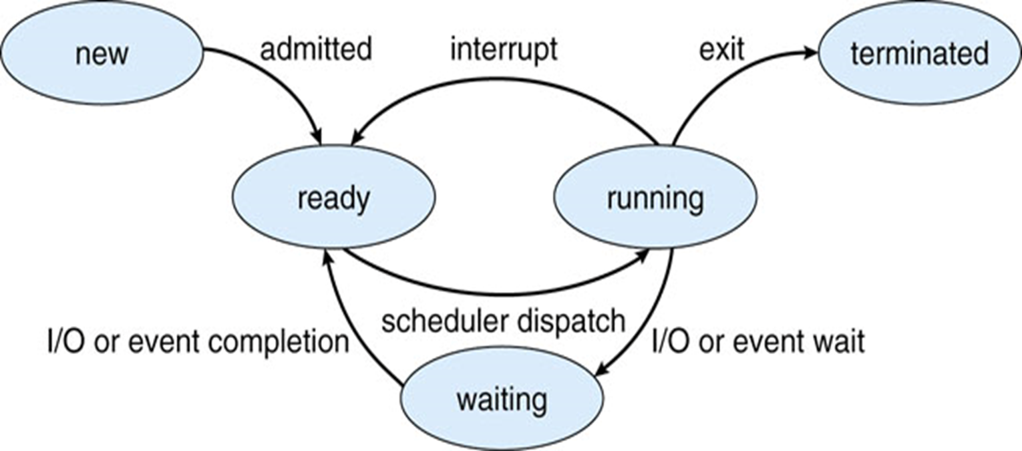
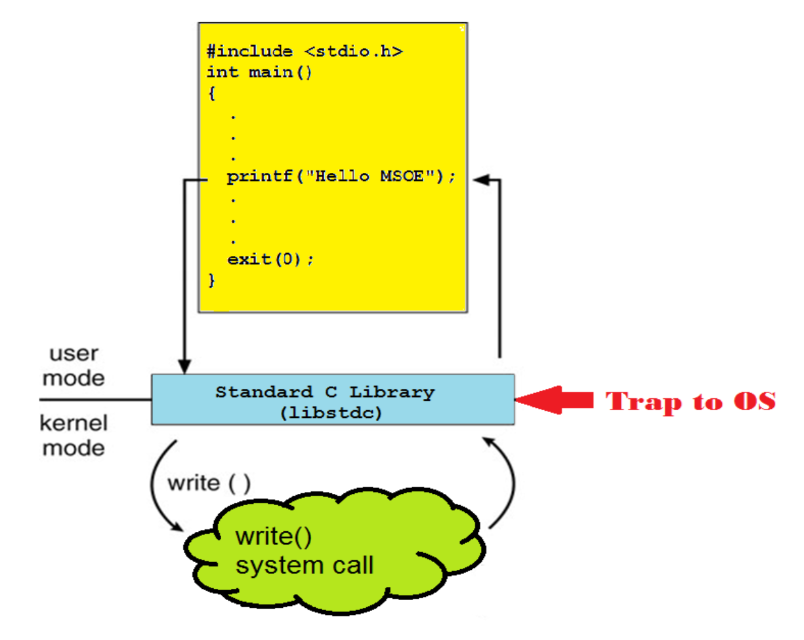
Definitions
CPU Time
  The time a task executes on a CPU
    running on the chart
  Measures work
Wall Clock Time
  Start to finish time for a task
  Includes both execution and wait times
  Typically, how long the user waits
User Time
  Running time (on CPU) while in user mode
system or sys Time
  Running time (on CPU) while in kernel mode

Slide 5
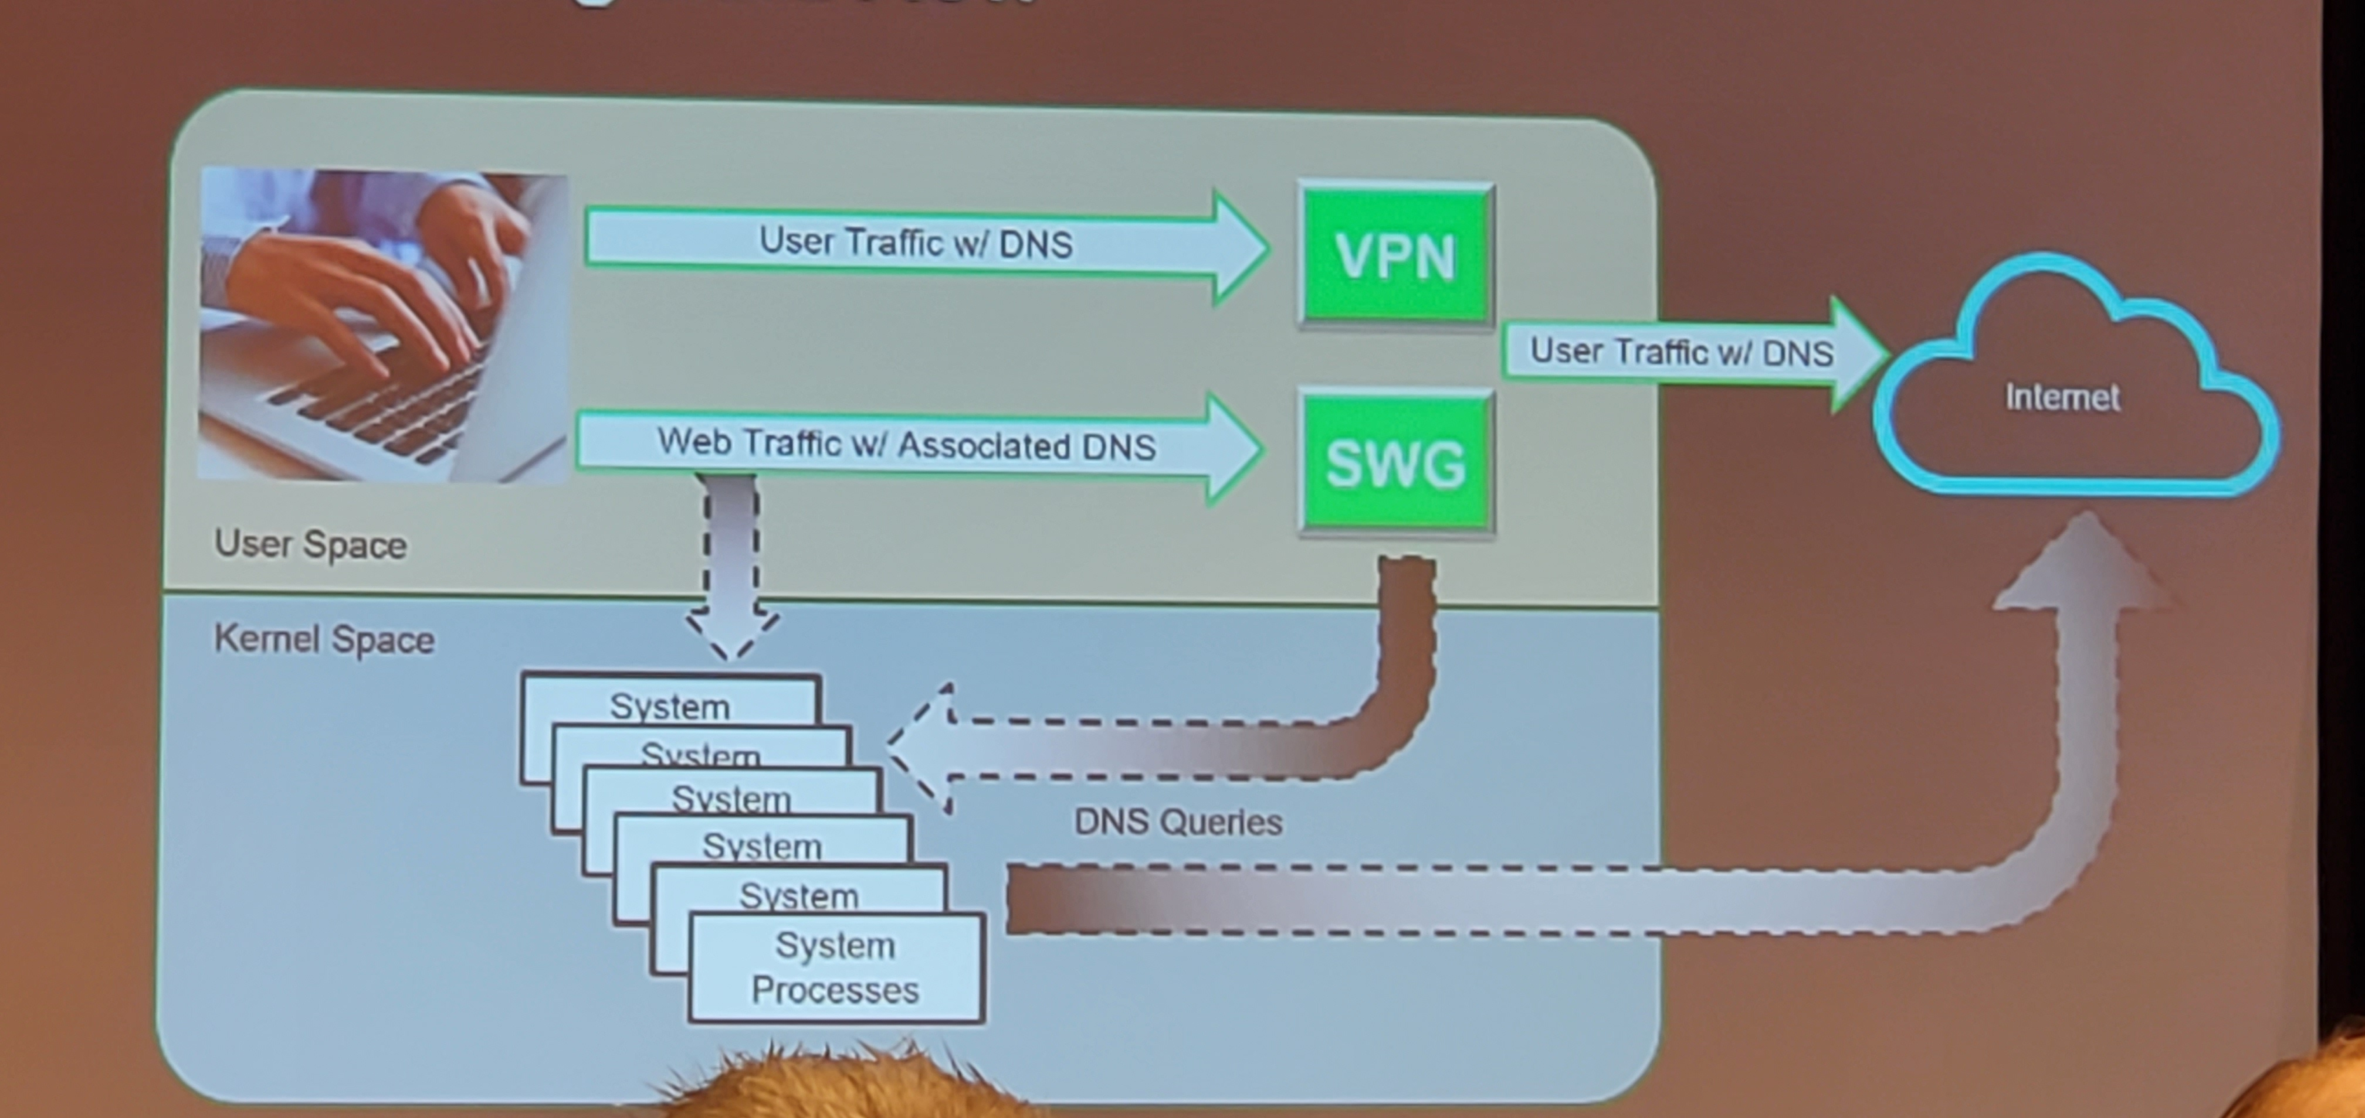
Any Ideas what this is?

Slide 6
How Measured
CPU time
  Job scheduler measures start, stop times when job allocated CPU
Wall time
  Capture clock at job start, job exit
  Impacted by other running jobs
Jiffy
  Typically, a single clock tick in a system
  Some early Commodore computers: 1/60th of a second
  Linux: 1 ms to 10 ms
  End result: a small unit of time based on processor speed
Why is this useful?
Why the different measurements?
How do we improve these?
* https://www.yourkit.com/docs/java/help/times.jsp

Slide 7
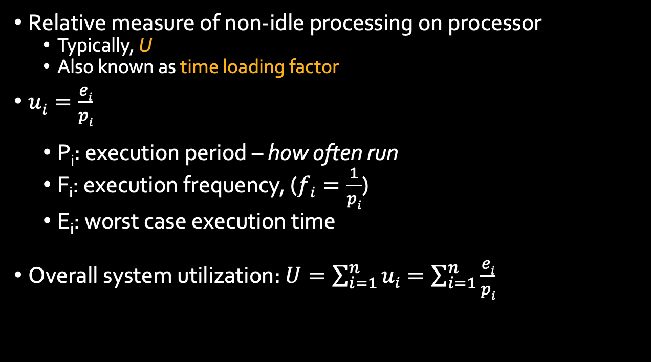
CPU Utilization Definition
Relative measure of non-idle processing on processor
  Typically, U
  Also known as time loading factor
$ui=\frac{ei}{pi}$
  P_{i}: execution period – how often run
  F_{i}: execution frequency, ($fi=\frac{1}{pi}$)
  E_{i}: worst case execution time
Overall system utilization: $U=\sum_{i=1}^{n}{ui}=\sum_{i=1}^{n}{\frac{ei}{pi}}$

Slide 8
Example
What is the overall utilization if a system has four processes:
  Process 1: Measure wheel slip (p1=100ms, e1=12ms)
  Process 2: Measure traction capabilities of wheel (p2=50ms, e2=5ms)
  Process 3: Monitor system diagnostics (p3=200ms, e3=5ms)
  Process 4: Send system messages over network (p4=25ms, e4=1ms)
Answers:
  1: 12 / 100 12%
  2: 5 / 50 10%
  3: 5 / 200 2.5%
  4: 1/25 4%
  Total: 28.5%

Slide 9
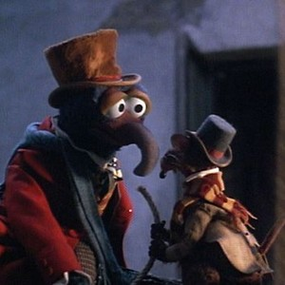
Lets put ourselves in the right mood…
That one thing, you must remember, or nothing that follows will seem wondrous.
Um, why are you whispering?
It's for dramatic emphasis.

Slide 10
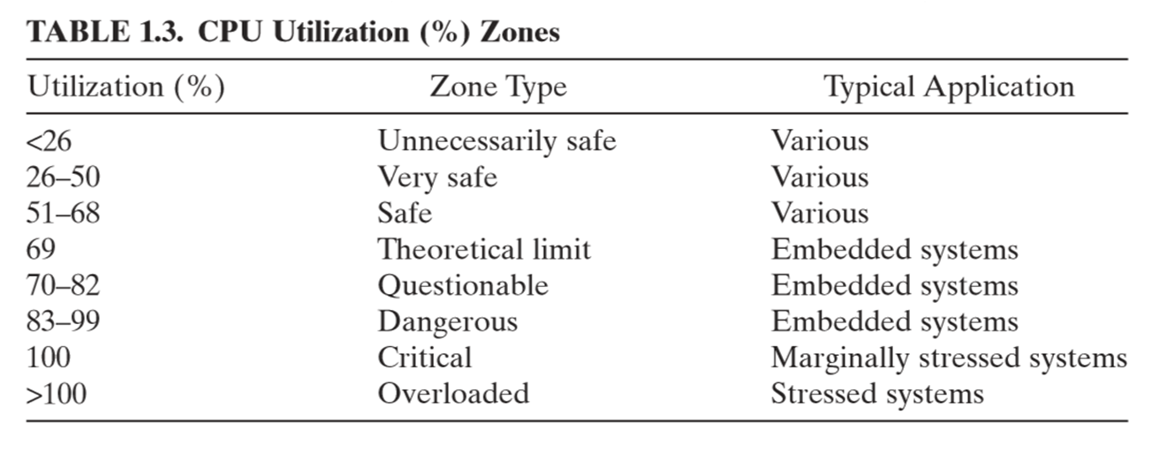
Another reason to care:
more
analysis
needed
Notes:
“more analysis needed” meaning we may hit deadlines or not, and we can’t just depend on the previously computed result to tell

Slide 11

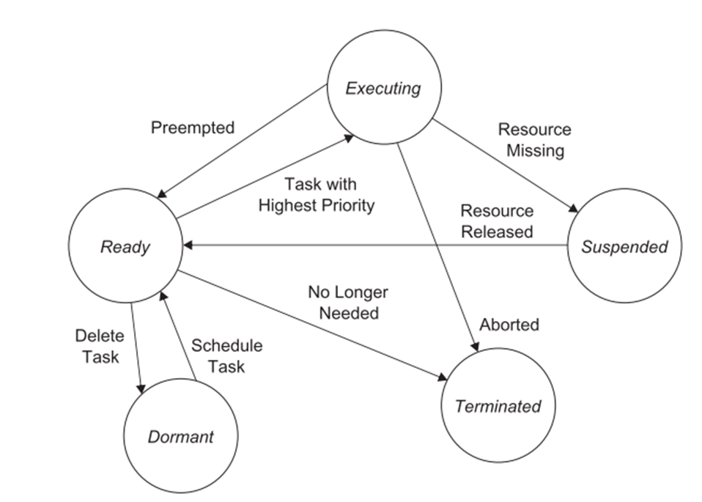
CPU Waiting to run versus Waiting for IO
Can get work done, but do not have CPU
Waiting on external data/information

Slide 12
Scheduling Framework
Pre-runtime:
  Create a feasible schedule offline, prior to execution (i.e., during design)
  Requires prediction of the worst case performance for the system
  Accounts for context switch overhead
  Tries to avoid resource conflicts
Runtime scheduling:
  Priorities (fixed or dynamic) are assigned, resources are allocated
  Allows for tasks to be interrupted
  Allows for resources to be demanded periodically, aperiodically, or sporadically
Notes:
YODER: Corrected “aperiodically” now misspelled.

Slide 13
Deadlines
Hard Deadline
  AKA “hard real-time”
  Must be met for system to function successfully
  Failing to meet: lost of resources, life
Soft Deadlines
  All other deadlines
  Missing does not imply failure
Most real-time systems: many soft deadlines, a few hard deadlines

Slide 14
Scheduling Policies
Fixed Priority Preemptive Scheduling:
  Every task: fixed priority that does not change unless the specifically changed by application
Dynamic-Priority Preemptive Scheduling:
  Priority of tasks change (quickly) to meet response time objective
Rate-Monotonic Scheduling:
  Fixed-priority, preemptive scheduling: higher frequency given higher priority
    Recall: frequency is inverse of period
  Optimal assuming deadline of periodic task is same as its period
Deadline-Monotonic Scheduling:
  A generalization of the rate-monotonic scheduling policy
  Deadline set by a fixed time from start of period; use this deadline to set priority (as for rate-monotonic)
Earliest-Deadline-First Scheduling:
  Deadline set by when task must be done; use deadlines to set priority
  Dynamic priority, preemptive scheduling
Least Slack Scheduling:
  Slack: absolute deadline minus worst-case execution time
  Set deadlines by slack; dynamic, non-preemptive scheduling policy

Slide 15
Assumptions for Rate-Monotonic Analysis
All tasks in the task set considered are strictly periodic
The relative deadline of a task is equal to its period
All tasks are independent; there are no precedence constraints
No task has any nonpreemptible section, and the cost of preemption is negligible
Only processing requirements are signiﬁcant; memory and I/O requirements are negligible
Theoretical

Slide 16
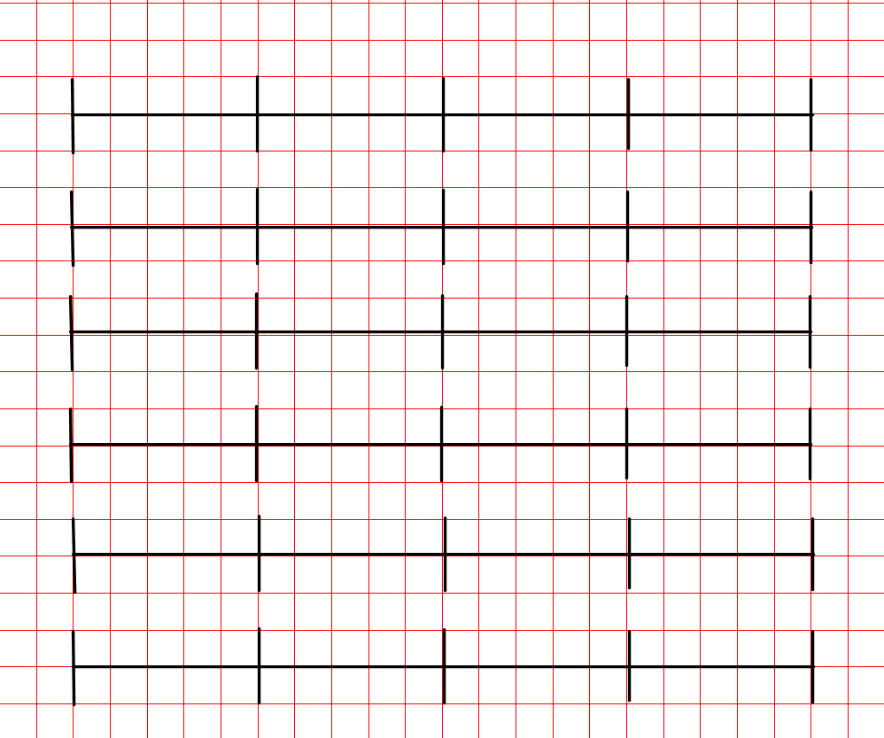
A General Example (PB > PA)
i.e., T_{B} has higher priority
Both request
Task | Execution Time | Period
TA | 25 | 50
TB | 40 | 100
20
40
60
80
100
120

Slide 17
A General Example (PB > PA)
i.e., T_{B} has higher priority
Both request
Task | Execution Time | Period
TA | 25 | 50
TB | 40 | 100
20
40
60
80
T_{B} runs first for 40 ms, then T_{A}
T_{A} runs for 20 ms; needs 5 more
Need to be able to run T_{A} again at 50 ms
Missed deadline!
100
120

Slide 18
Change so PB < PA
i.e., T_{A} has higher priority
Task | Execution Time | Period
TA | 25 | 50
TB | 40 | 100
20
40
60
80
100
120

Slide 19
Change so PB < PA
i.e., T_{A} has higher priority
Task | Execution Time | Period
TA | 25 | 50
TB | 40 | 100
20
40
60
80
T_{A} runs first for 25 ms, then T_{B}
T_{B} runs for 25 ms; A interrupts
T_{A} runs for 25 ms
T_{B} completes after 15 ms
All complete at 90 ms
unused
100
120

Slide 20
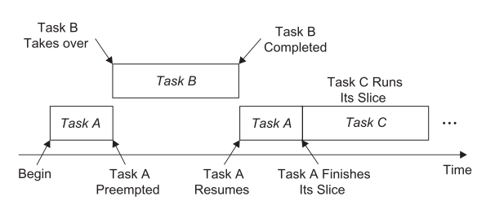
Round Robin Scheduling

Slide 21
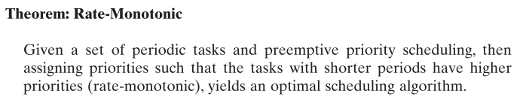
Rate Monotonic Analysis
The priority of each periodic task is fixed relative to other tasks

Slide 22
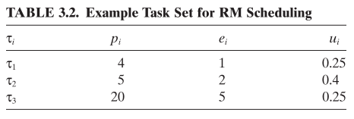
Example Task Set
Calculation: What is the processor utilization for this problem?
Based on RMA, what are their relative priorities?

Slide 23
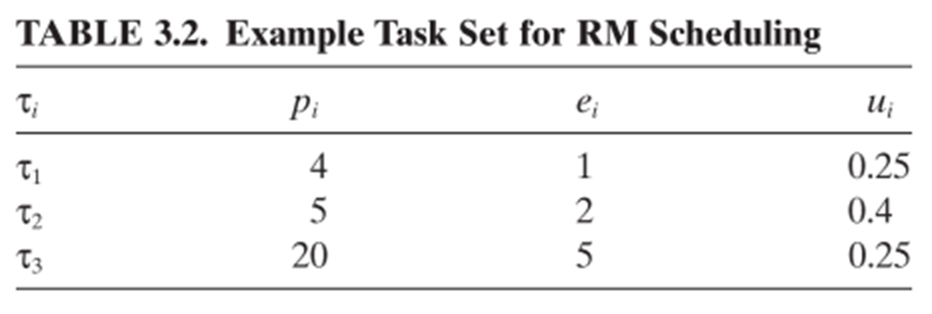
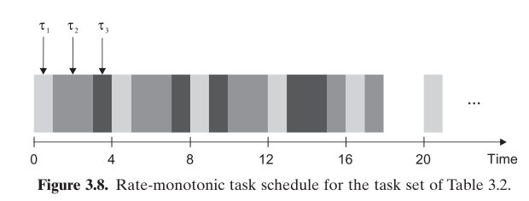

Slide 24
Harmonic Period
This means that for each task, its period is an exact multiple of every other task that has a shorter period.
  The more harmonic the tasks are, the more accommodating they are to scheduling
BTW: this is also true for memory management
  Memory management in Lisp is trivial: all objects fit two words

Slide 25
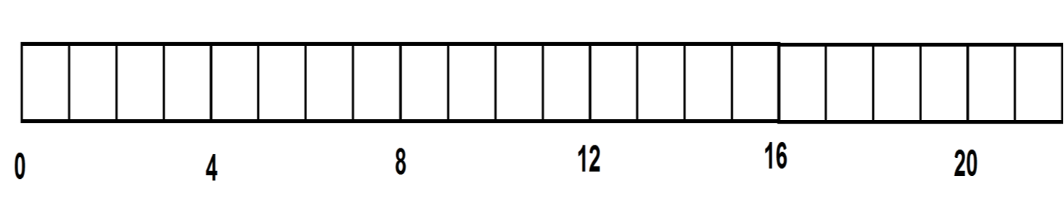
Example 2
ti | pi | ei | Ui
T1 | 4 | 2
T2 | 3 | 1
T3 | 7 | 1

Slide 26
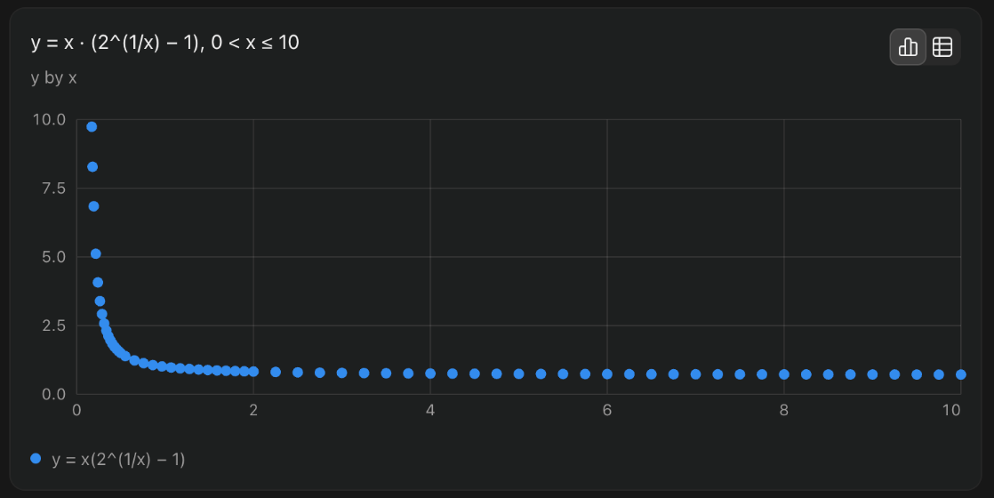

RMA Bound
Theorem, Liu & Layland, 1973: Given n periodic tasks, if the total utilization
U = $\sum_{i=1}^{n}{Ui}$ = $\sum_{i=1}^{n}{C_{i}/T_{i}}$
satisfies
  $U≤n∗{(2}^{\frac{1}{n}}−1)$
then a schedule meeting all deadlines always exists.
note: $\lim_{n→∞}{n∗{(2}^{\frac{1}{n}}−1)=ln⁡ 2≈0.69 }$
Notes:
https://en.wikipedia.org/wiki/Rate-monotonic_scheduling
ln 2: natural log of 2

Slide 27

The Chart Again

Slide 28
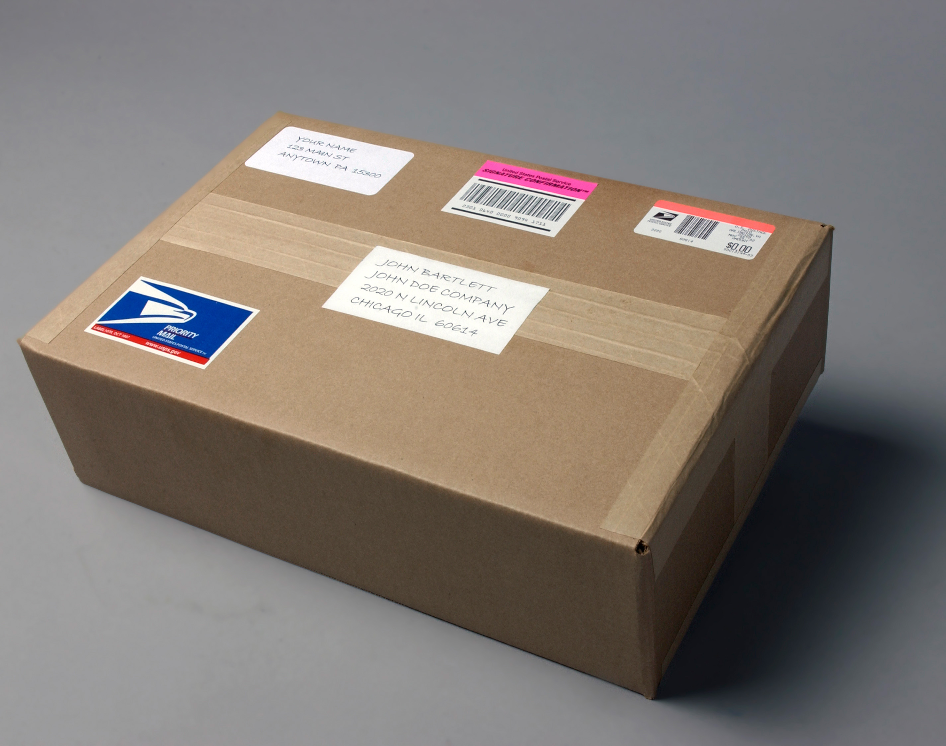
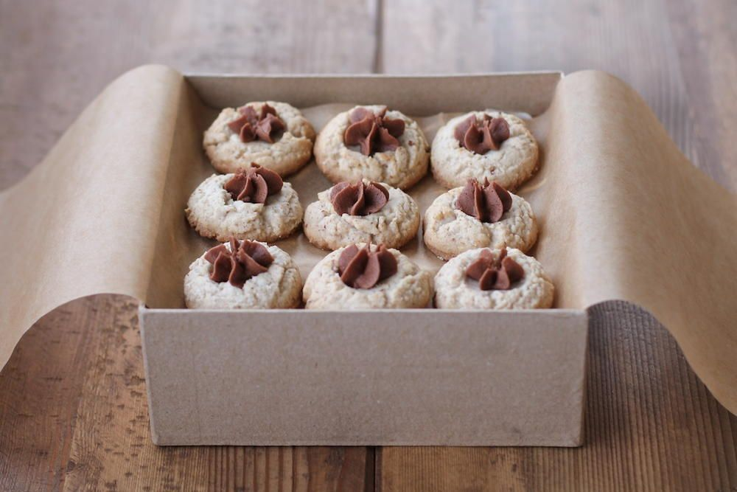
Jitter – Real World
Freshman year, your grandmother shipped you a care package of home-made cookies
What impacted how long it took for the cookies to arrive in your dorm?

Slide 29
Jitter
From dictionary.com: random variation in the timing of a signal, especially a clock
In our context
  The delay between the invocation (or arrival) of a task, and its release (when it actually starts to execute)
Example #1: Large distributed system:
  A sensor at site A triggers a task at site B
  Message is sent over a complex network
  May take a varying amount of time to arrive
  The difference between the earliest and latest possible release times of the task at site B is jitter

Slide 30
Jitter
From dictionary.com: random variation in the timing of a signal, especially a clock
In our context
  The delay between the invocation (or arrival) of a task, and its release (when it actually starts to execute)
Example #2: Operating systems
  Kernel preempts user processes at regular intervals (10 ms), and that you want a task to run every 23 ms
  OS scheduler will not be able to satisfy your request exactly
  In Theory, should run at times 0, 23, 46... In practice, it will run at 0, 30, 50...
  The variation of the actual release times is jitter (0, 7, 4, ... in this example)

Slide 31
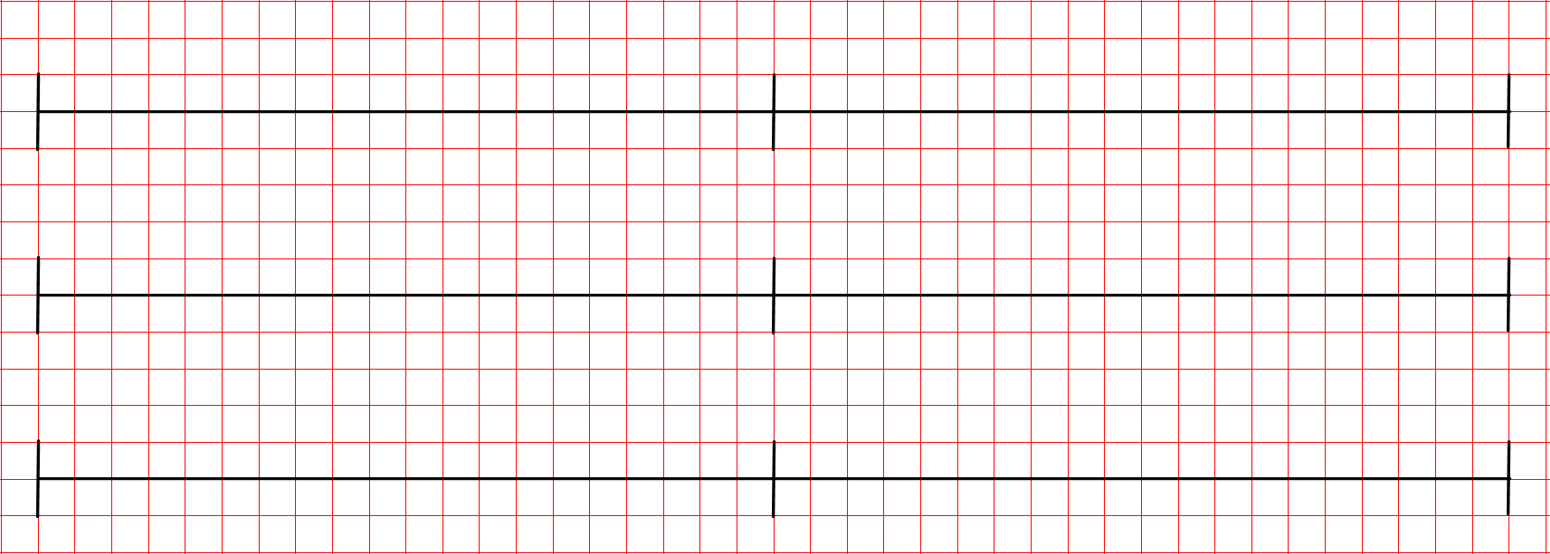
Jitter in our case – The Servo Motor

