Slide 1
OpenCV
SWE 4211

Slide 2
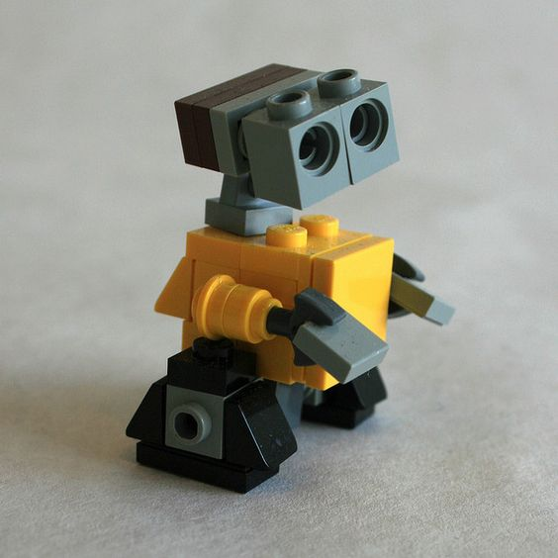


Robot Stopping
velocity
When to stop?
What power/speed?
How much friction?
How far will it coast?
What is the latency?

Slide 3
What causes latency?
Types:
Speed of light, sound
  Speed of light doesn’t matter much in air, but does in a circuit!
Sensor latency
Processor latency
  Task being scheduled
  Queue latency – work to process the queue
  Context switch latency

Slide 4
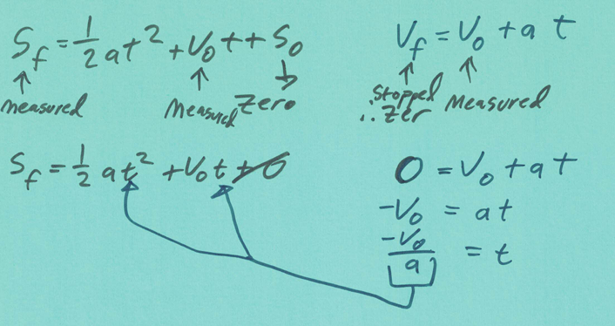
Velocity = 0: stopped

Slide 5
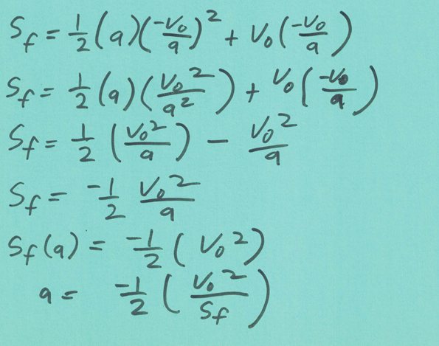

Slide 6
Dr. Schilling’s Results
Duty Cycle | Time | Runoff | Speed (m/s) | A (m/s^2) | A (cm/s^2)
26% | 13.9 | 5 | 0.18 | 0.010 | 97.04467
50% | 6.51 | 12 | 0.38 | 0.018 | 184.3436
76% | 5.06 | 23 | 0.49 | 0.016 | 159.1998
100% | 3.74 | 46 | 0.67 | 0.015 | 145.7036
 |  |  |  | 0.015 | 152.452
Duty Cycle | Time | Runoff | Speed (cm/s) | A (m/s^2) | A (cm/s^2)
24% | 6.04 | 5 | 0.24 | 0.017 | 166.3761
50% | 3.03 | 19 | 0.47 | 0.017 | 173.9786
74% | 2.18 | 23 | 0.65 | 0.028 | 277.6476
100% | 1.78 | 64 | 0.80 | 0.015 | 149.6631
 |  |  |  | 0.017 | 170.1773
2024 (5 m)
2025 (2.5 m)

Slide 7
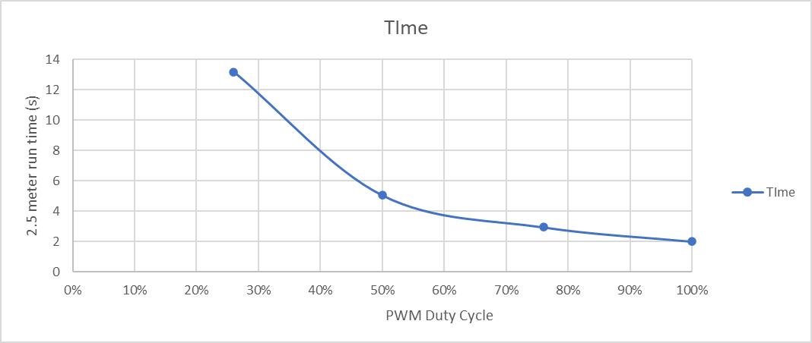
Dr. Schilling’s Results

Slide 8
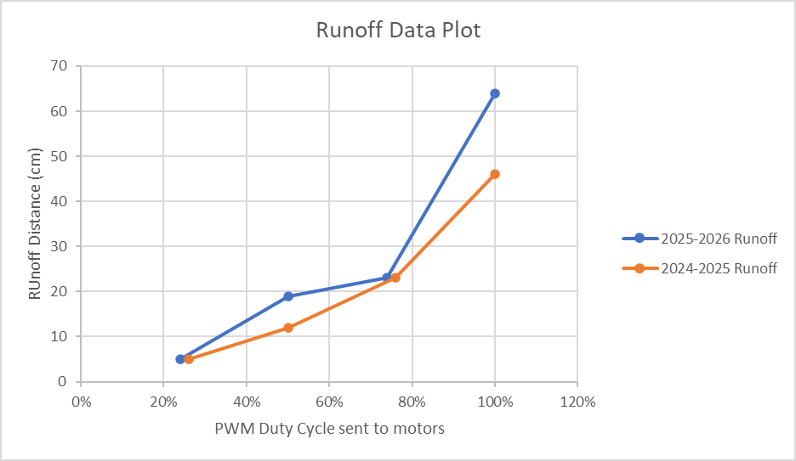

Slide 9
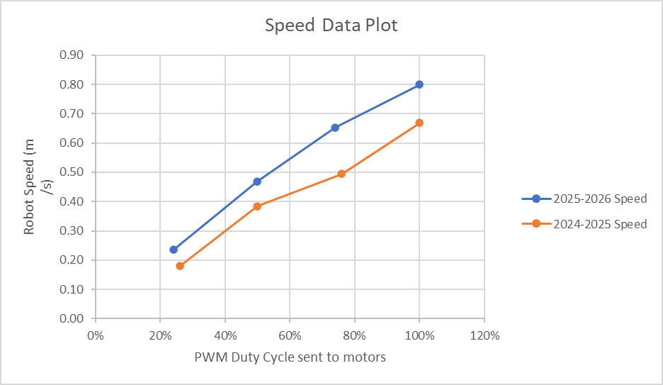

Slide 10
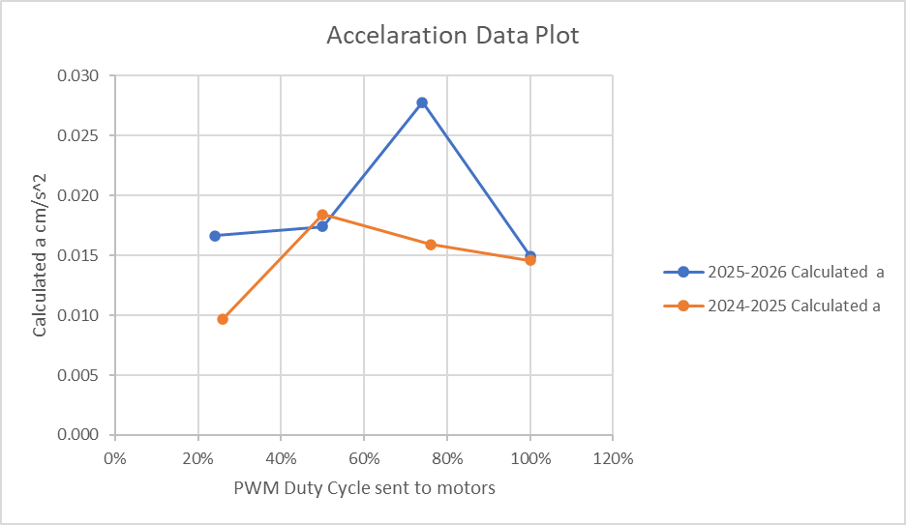

Slide 11
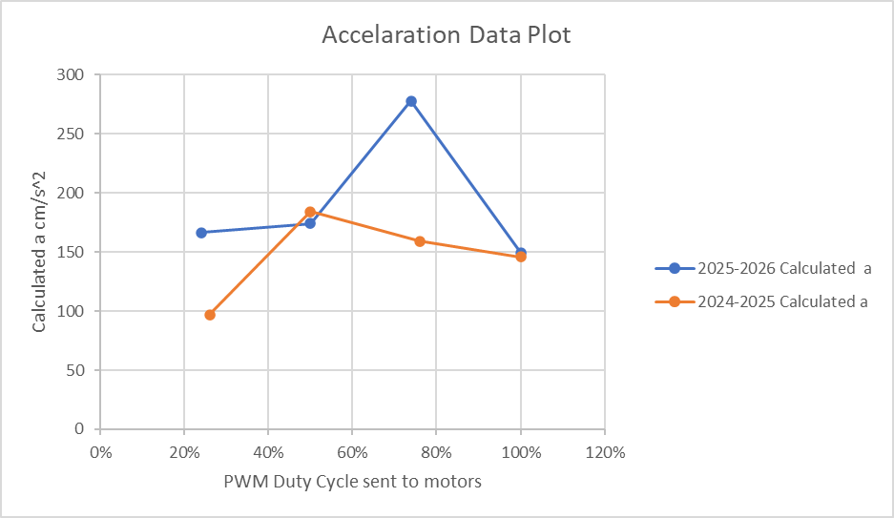

Slide 12
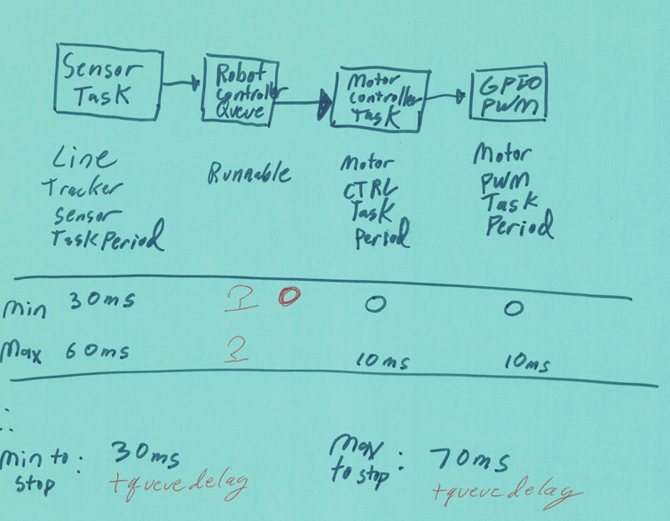
How much latency?
v = 0.5 m/s
30 ms:
0.5 * .030 = 0.015 m
70 ms:
0.5 * .070 = 0.035 m
Average: 0.025 m

Slide 13
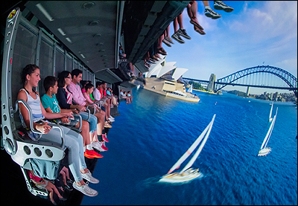
Disney Soarin
Laser projection
  8K image resolution (8000 x 6000)
  120 frames per second
  32 bits per pixel color
What is the bandwidth that is needed to send the data to the projector from the storage device in bytes per second?
Length of Soarin movie: 4 min, 51 sec

Slide 14
Disney Soarin
Laser projection
  8K image resolution (8000 x 6000)
  120 frames per second
  32 bits per pixel color
What is the bandwidth that is needed to send the data to the projector from the storage device in bytes per second?
How big is the Soarin movie, which is 4 minutes and 51 seconds?
Image: 8000 * 6000 = 48,000,000
120 frames / sec: 5,760,000,000 pixels/second
Each pixel: 32 bits of color (likely an overestimate)
  4 bytes per pixel, assuming 8-bit byte
5,760,000,000 * 4 = 23,040,000,000 bytes/sec
291 seconds: 6,704,640,000,000 byte xfer
  6.7 terabytes,
Assumes no compression!

Slide 15
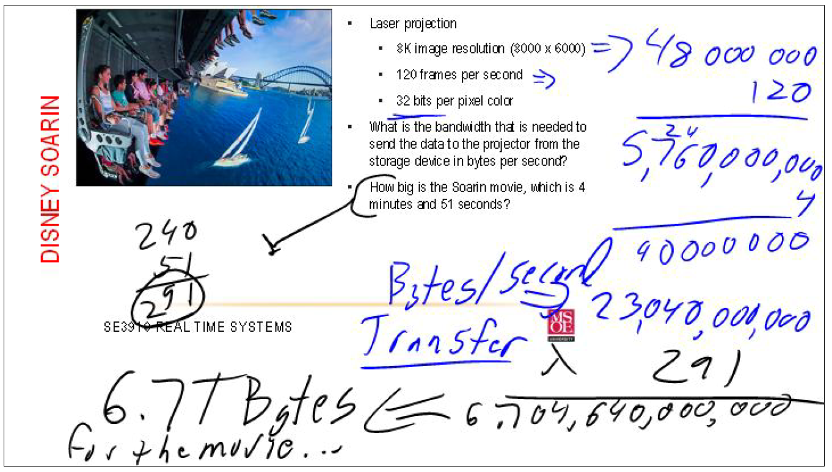

Slide 16
Today’s Objectives
Explain the purpose for the OpenCV Library.
Explain the purpose for the Mat class within opencv.
Explain what can be done to an image with OpenCV.
Construct a simple openCV application which uses OpenCV Capabilities.

Slide 17
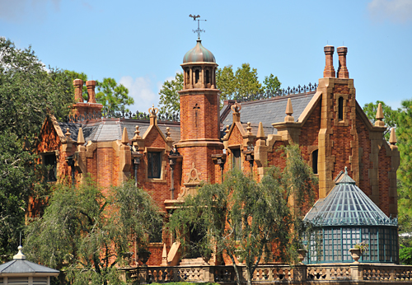
The Haunted Mansion
https://www.youtube.com/watch?v=8IPFGGVZ1eg

Slide 18
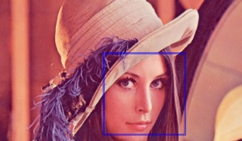
Introduction to OpenCV
Lena
Notes:
This image of Lena was a standard image used for years
Apparently from a Playboy centerfold! But you wonder if that was the best image for a multicultural world…

Slide 19
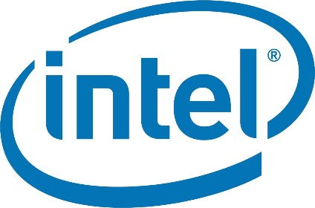

Open CV
OpenCV
  Image Processing library
  created by Intel
  maintained by Willow Garage
Available for C, C++, Python
Open Source, free
Easy to use (??) and install

Slide 20
BASIC OPENCV STRUCTURES
  Point, Point2f - 2D Point
  Size - 2D size structure
  Rect - 2D rectangle object
  RotatedRect - Rect object with angle
  Mat - image object

Slide 21
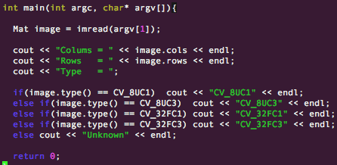

cv::Mat
The primary data structure in OpenCV is the Mat object. It stores images and their components.
Main items
  rows, cols - length and width (int)
  channels - 1: grayscale, 3: BGR
  depth: CV_<depth>C<num chan>
See the manuals for more information
Endianness!

Slide 22
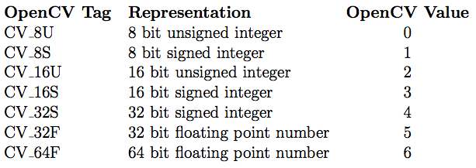
Image TYPES
The TYPE is a very important aspect of OpenCV
Represented as CV_<Datatype>C<# Channels>
Example Datatypes/ Depths

Slide 23
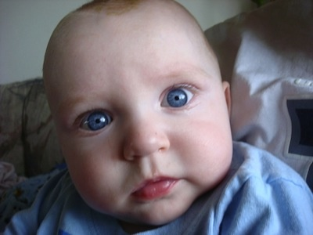
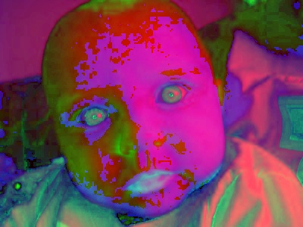
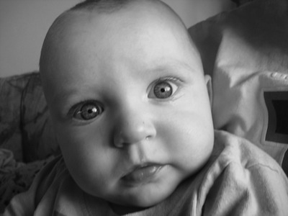
Pixeltypes
PixelTypes: how the image is represented in data
  BGR: default color of imread(). Normal, 3-channel color (blue-green-red)
  HSV: Hue is color, Saturation is amount, Value is lightness: 3 channels
  GRAYSCALE: Gray values, single channel
OpenCV requires that images be in BGR or Grayscale in order to be shown or saved
  If not, undesirable effects may appear

Slide 24
RGB vs HSV Formats
Aspect | RGB | HSV
Color Components | Red, Green, Blue | Hue, Saturation, Value
Lighting Sensitivity | High | Low
Ease of Color Segmentation | Low | High
Use Cases | Display, Graphics | Image Detection, Filtering
Component Separation | Mixed | Distinct
Notes:
In digital image processing, understanding different color spaces is essential for effective analysis and manipulation. The RGB (Red, Green, Blue) color model is widely used in computer graphics and imaging devices. It represents colors through combinations of red, green, and blue light intensities. Each pixel in an RGB image is defined by three values corresponding to these primary colors. While RGB is intuitive and closely aligned with how screens display images, it is not always ideal for image detection tasks due to its sensitivity to lighting variations.
On the other hand, HSV (Hue, Saturation, Value) is a cylindrical color model that separates image luminance from color information. Hue represents the type of color, saturation indicates the intensity or purity of the color, and value corresponds to the brightness. This separation allows for more robust image analysis, especially in scenarios where lighting conditions vary. HSV is particularly useful in applications like object tracking, color segmentation, and filtering, where consistent color detection is crucial.
The slide visually compares an image in RGB and HSV formats using OpenCV. The RGB image displays solid blocks of red, green, and blue, while the HSV image shows how these colors are represented in the HSV space. This comparison highlights the structural differences between the two formats and sets the stage for understanding the practical advantages of HSV in image detection tasks.

Slide 25
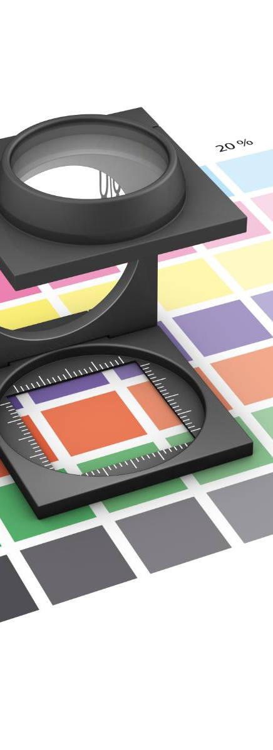
Why HSV is Better for Detection Tasks
Separation of Color and Brightness
    HSV separates color information from brightness, improving resilience to lighting changes
Stable Hue for Detection
    Hue remains stable in HSV even under different lighting, enabling consistent color detection
Fine-tuning with Saturation and Value
    Adjusting saturation and value filters noise and improves detection accuracy
Simplified Color Masking
    HSV allows easy creation of color masks by defining hue ranges, unlike complex RGB ranges
Notes:
HSV (Hue, Saturation, Value) offers several advantages over RGB when it comes to image detection and analysis. One of the primary benefits is its ability to separate color information from brightness, which makes it more resilient to changes in lighting conditions. In RGB, all three components are affected by lighting, making it difficult to isolate specific colors consistently. HSV addresses this by allowing the hue component to remain relatively stable even when brightness varies.
This stability is particularly useful in color segmentation tasks. For example, when detecting a red object in varying lighting, the hue value in HSV remains consistent, enabling more accurate detection. Saturation and value can be adjusted to fine-tune the detection process, filtering out noise and irrelevant details. This makes HSV ideal for applications such as object tracking, where consistent color identification is crucial.
Additionally, HSV simplifies the process of creating masks for specific colors. By defining a range of hue values, developers can easily isolate colors without worrying about the influence of brightness. This is not as straightforward in RGB, where color ranges are more complex and less intuitive. Overall, HSV enhances the robustness and accuracy of image detection tasks, making it a preferred choice in many computer vision applications.

Slide 26
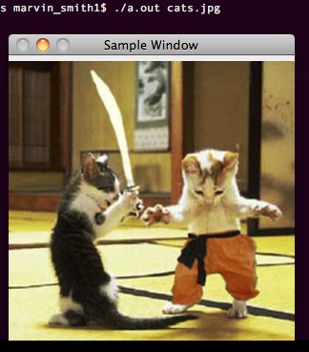
HELLO WORLD
//Loads image and displays
//call by ./a.out image.jpg
//
#include <cv.h>
#include <cvaux.h>
#include <highgui.h>
using namespace cv;
int main(int argc, char* argv[])
{
Mat image = imread(argv[1]);
namedWindow(“Sample Window”);
imshow(“Sample Window”, image);
waitKey(0);
return 0;
}
This program will load and show an image

Slide 27
Image I/O
OpenCV provides simple and useful ways to read and write images.
Note that there are many extra options to these commands which are available on the wiki.
waitKey( int x ) has two main features.
  if x > 0, then waitKey will wait x milliseconds
  if x = 0, then waitKey will not move until key is pressed
Examples
//Read an image
Mat image = imread( <string>, <0 -gray, 1 -BGR>)
//Note 1 is default
//Write an image
imwrite( <string filename> , image );
//Create window for output
namedWindow( <window name> );
//Output image to window
imshow( <window name> , <image Mat to show> );
//pause program for input
key = waitKey( 0 );

Slide 28
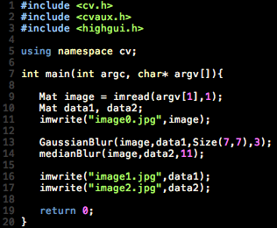
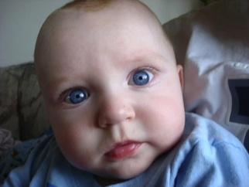


Image Smoothing
Image smoothing is used to reduce the the sharpness of edges and detail in an image.
OpenCV includes most of the commonly used methods.
void GaussianBlur(imagein, imageout, Size ksize, sig);
  Note that there are more options, however this should keep things simple
void medianBlur (imagein, imageout, Size ksize);
Other functions include generic convolution, separable convolution, dilate, and erode.
Original
Gaussian Blur
Median Blur

Slide 29
Lets look at an example
The program will
  Capture an image from the Raspberry PI Camera
  Resize the image
  Convert it to Grayscale
  Detect edges
  Write the results out to some files

Slide 30
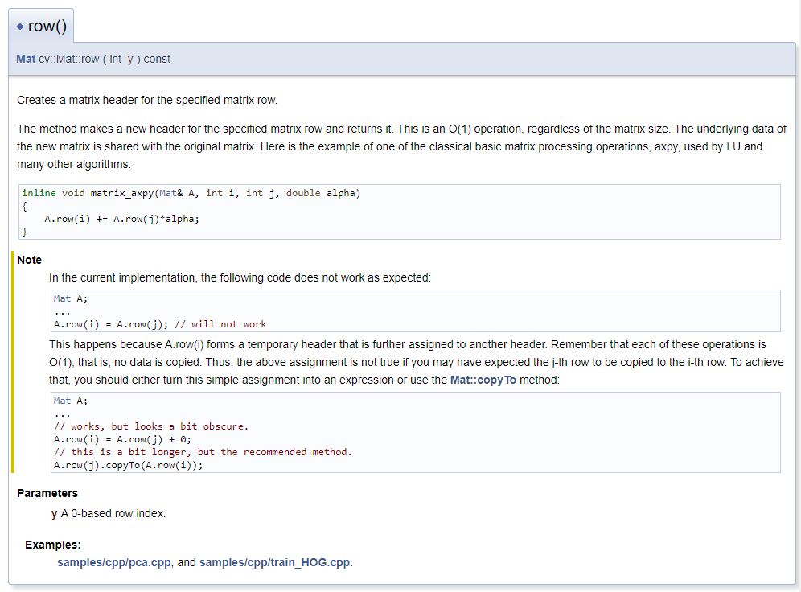
Open CV Row Call

Slide 31
The Key Thing
Example
#
Mat (Matrix) is an n-dimensional array that can be used to store various type of data, such as RGB, HSV or grayscale images, vectors with real or complex values, other matrices etc.
A Mat contains the following information: width, height, type, channels, data, flags, datastart, dataend and so on.
It has several methods, some of them are: create, copyTo, convertTo, isContinious etc.
https://riptutorial.com/opencv/example/28255/mat

Slide 32
UDP versus TCP
TCP is reliable, UDP is unreliable
TCP is stream oriented, UDP is message oriented
TCP is slower than UPD, but UDP has some signal loss
(https://wsvincent.com/tcp-vs-udp/)

Slide 33
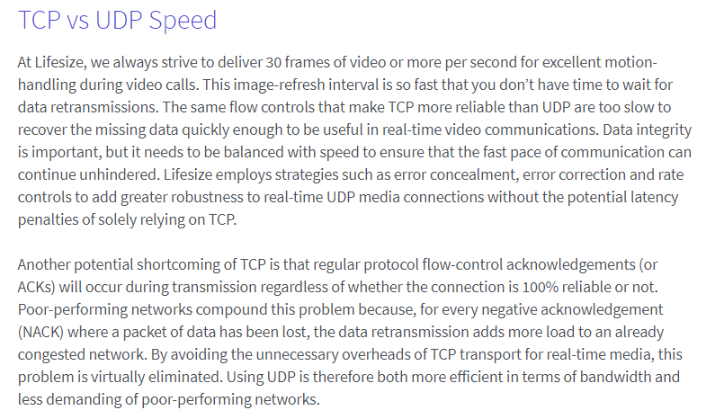
TCP vs. UDP for Real-Time Data Transfer
(https://www.lifesize.com/en/video-conferencing-blog/tcp-vs-udp)

Slide 34
What limitations do we have with UDP?

Slide 35
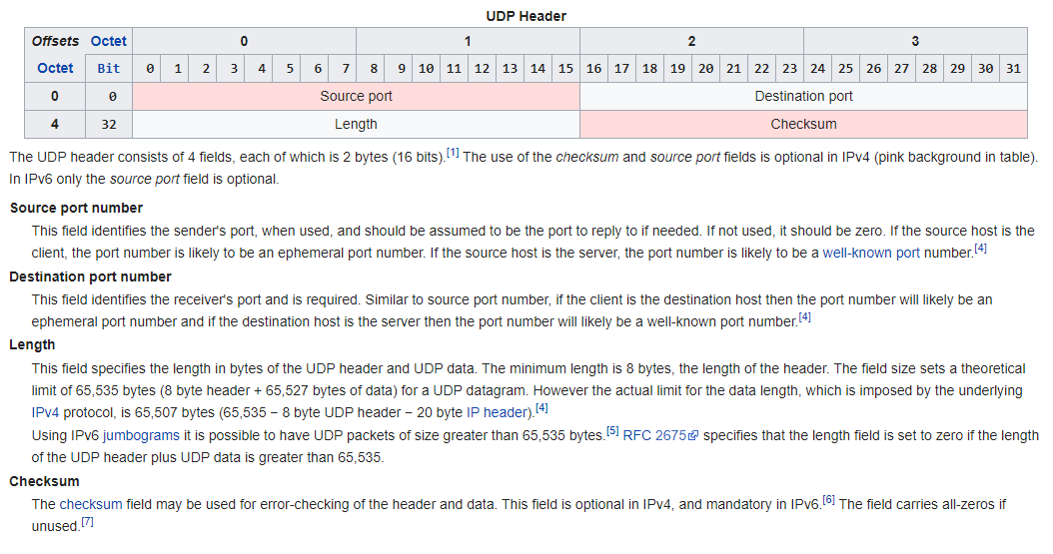
UDP Header
https://en.wikipedia.org/wiki/User_Datagram_Protocol

Slide 36
UDP Header
Length field: size in bytes of the UDP header plus UDP data
  Minimum is 8 bytes (the header alone)
  Theoretical limit: 65,535 bytes (8-byte header + 65,527 bytes of data)
  Actual data limit, imposed by IPv4: 65,507 bytes (65,535 − 8-byte UDP header − 20-byte IP header) [4]
IPv6 jumbograms allow UDP packets larger than 65,535 bytes [5]
  RFC 2675: the length field is set to zero if the UDP header plus data exceeds 65,535
https://en.wikipedia.org/wiki/User_Datagram_Protocol

Slide 37
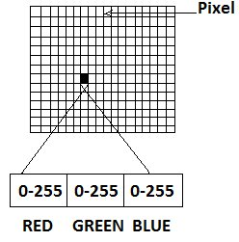
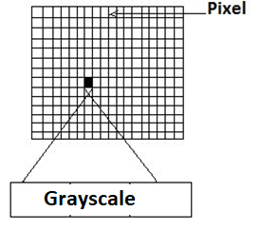
Can we send an entire image in a single UDP datagram?
Color image
  65,527 / 3 -> 21842 pixels
  If the picture is square, a 147 x 147 pixel image can be sent in a single datagram….
Grayscale
  65,527 / 1 -> 65527 pixels
  If the picture is square, a 255 x 255 pixel image can be sent in a single datagram….
*https://www.researchgate.net/publication/268186582_An_Image_Based_Colorimetric_Technique_for_Portable_Blood_Gas_Analysis/figures?lo=1

Slide 38
Design Consideration
What if we sent each column as an individual datagram?

Slide 39
Design Model
What if we sent each row of an image as a datagram?

Slide 40
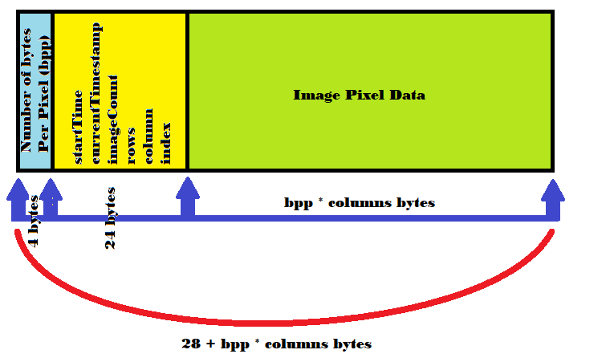
Protocol Design

Slide 42
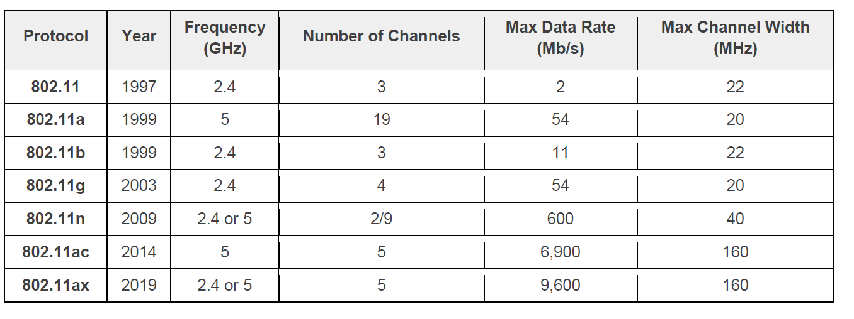
Bandwidth

Slide 43
Lets see it at work…

Slide 44
Why this format?
You can easily understand it!
  Compression makes things perform better, but is HARD
Java readily will reconstruct images in RGB format
  That makes parts easier to deal with
Is this ideal
  Definitely not!

