Slide 1

CE-2800: Embedded Systems Software I
The Watchdog timer

Slide 2
The operation of the Atmega32 can be reset due to various events
Power-on Reset
  The MCU is reset when the supply voltage is below the Power-on Reset threshold (VPOT).
External Reset
  The MCU is reset when a low level is present on the RESET pin for longer than the minimum pulse length.
Brown-out Reset
  The MCU is reset when the supply voltage VCC is below the Brown-out Reset threshold (VBOT) and the Brown-out Detector is enabled.
JTAG AVR Reset
  The MCU is reset as long as there is a logic one in the Reset Register, one of the scan chains of the JTAG system. Refer to the section “IEEE 1149.1 (JTAG) Boundary-scan” on page 225 for details.
Watchdog Reset
  The MCU is reset when the Watchdog Timer period expires and the Watchdog is enabled.
Notes:
Power-on Reset. The MCU is reset when the supply voltage is below the Power-on Reset
threshold (VPOT).
External Reset. The MCU is reset when a low level is present on the RESET pin for longer
than the minimum pulse length.
Watchdog Reset. The MCU is reset when the Watchdog Timer period expires and the
Watchdog is enabled.
Brown-out Reset. The MCU is reset when the supply voltage VCC is below the Brown-out
Reset threshold (VBOT) and the Brown-out Detector is enabled.
JTAG AVR Reset. The MCU is reset as long as there is a logic one in the Reset Register,
one of the scan chains of the JTAG system. Refer to the section “IEEE 1149.1 (JTAG)
Boundary-scan” on page 225 for details.

Slide 3
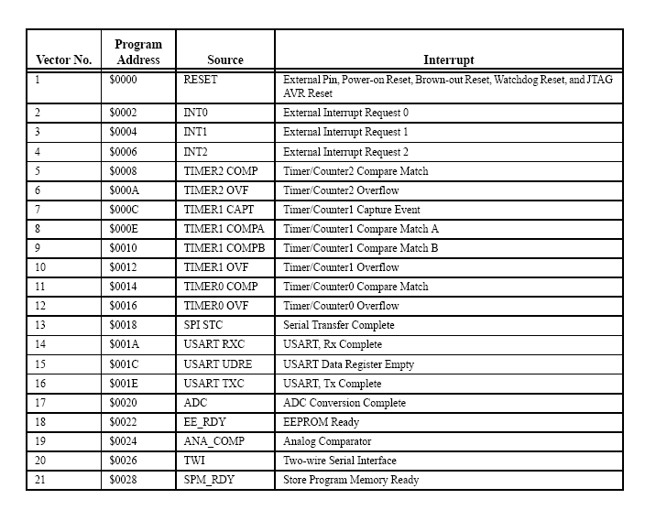
All resets cause the PC to vector to address 0

Slide 4
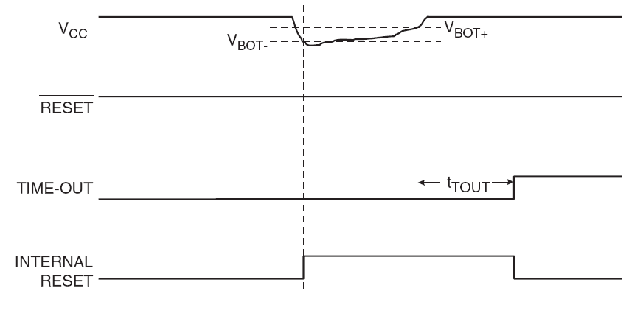
Brown Out Detection -> Why is it necessary?
Notes:
What is a brownout:
A brownout is considered to have occurred when the incoming voltage available to the microprocessor has dropped to a level where the microprocessor should not continue operating. The brownout ends when the voltage has risen back above the brownout level. A hysteresis or latching scheme can be used to prevent oscillation at the brownout level.
Why brown out detection:
Low voltages may scramble values in registers
Errors or partly functional conditions may occur in the logic or storage elements.
The brownout detector can reset or freeze the operation of the microprocessor to avoid improper operation. In a practical application, the microprocessor must be protected against brownout conditions that can cause the logic to enter unknown states and thereby corrupt the operation of the processor.

Slide 5
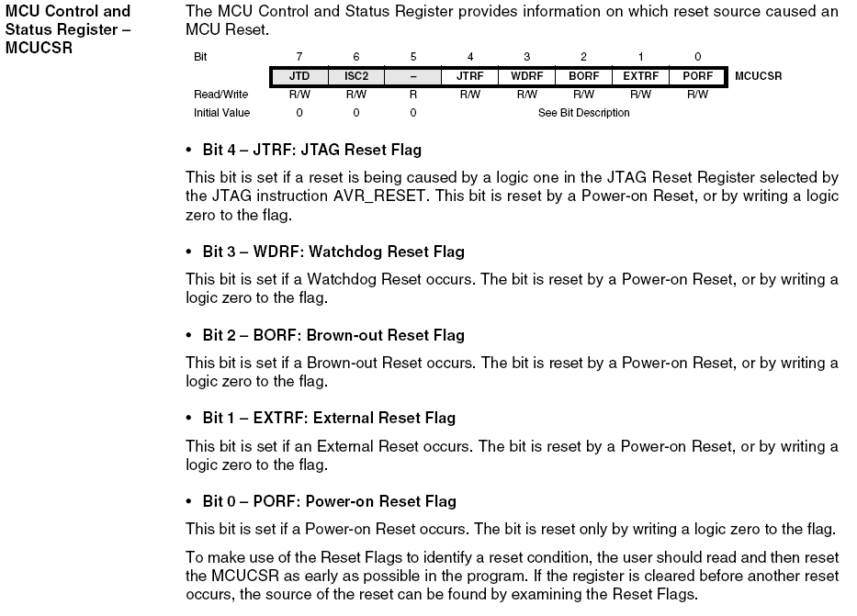
When a reset occurs the MCUCSR Status Register contains the reason for the reset

Slide 6
What is the watchdog timer?
A special timer that, once configured and enabled, counts down to 0
When expired, causes the CPU to reset
The countdown can be restarted at any time before expiration
If periodically restarted, the expiration will never occur, and the reset will never happen.
Notes:
A watchdog timer is a piece of hardware, often built into a microcontroller that can cause a processor reset when it judges that the system has hung, or is no longer executing the correct sequence of code. This article will discuss exactly the sort of failures a watchdog can detect, and the decisions that must be made in the design of your watchdog system. The first half of the article will assume that there is no RTOS present. The second half covers a scheme for making use of a watchdog in a multi-tasking system. The hardware component of a watchdog is a counter that is set to a certain value and then counts down towards zero. It is the responsibility of the software to set the count to its original value often enough to ensure that it never reaches zero. If it does reach zero, it is assumed that the software has failed in some manner and the CPU is reset.
In other texts you will see various terms for restarting the timer: strobing, stroking or updating the watchdog. However, in this article we will use the more visual metaphor of a man kicking the dog periodically-with apologies to animal lovers. If the man stops kicking the dog, the dog will take advantage of the hesitation and bite the man.
It is also possible to design the hardware so that a kick that occurs too soon will cause a bite, but in order to use such a system, very precise knowledge of the timing characteristics of the main loop of your program is required. What errors are caught
A properly designed watchdog mechanism should, at the very least, catch events that hang the system. In electrically noisy environments, a power glitch may corrupt the program counter, stack pointer, or data in RAM. The software would crash almost immediately, even if the code is completely bug free. This is exactly the sort of transient failure that watchdogs will catch.
Bugs in software can also cause the system to hang, if they lead to an infinite loop, an accidental jump out of the code area of memory, or a dead-lock condition (in multitasking situations). Obviously, it is preferable to fix the root cause, rather than getting the watchdog to pick up the pieces. In a complex embedded system it may not be possible to guarantee that there are no bugs, but by using a watchdog you can guarantee that none of those bugs will hang the system indefinitely.

Slide 7

Why use a watchdog timer?
Embedded systems must be able to cope with both hardware and software anomalies to be truly robust.
In many cases, embedded devices operate in total isolation and are not accessible to an operator.
Manually resetting a device in this scenario when its software “hangs” is not possible.
In extreme cases, this can result in damaged hardware or loss of life and incur significant cost impact.
Notes:
A watchdog timer is a piece of hardware, often built into a microcontroller that can cause a processor reset when it judges that the system has hung, or is no longer executing the correct sequence of code. This article will discuss exactly the sort of failures a watchdog can detect, and the decisions that must be made in the design of your watchdog system. The first half of the article will assume that there is no RTOS present. The second half covers a scheme for making use of a watchdog in a multi-tasking system. The hardware component of a watchdog is a counter that is set to a certain value and then counts down towards zero. It is the responsibility of the software to set the count to its original value often enough to ensure that it never reaches zero. If it does reach zero, it is assumed that the software has failed in some manner and the CPU is reset.
In other texts you will see various terms for restarting the timer: strobing, stroking or updating the watchdog. However, in this article we will use the more visual metaphor of a man kicking the dog periodically-with apologies to animal lovers. If the man stops kicking the dog, the dog will take advantage of the hesitation and bite the man.
It is also possible to design the hardware so that a kick that occurs too soon will cause a bite, but in order to use such a system, very precise knowledge of the timing characteristics of the main loop of your program is required. What errors are caught
A properly designed watchdog mechanism should, at the very least, catch events that hang the system. In electrically noisy environments, a power glitch may corrupt the program counter, stack pointer, or data in RAM. The software would crash almost immediately, even if the code is completely bug free. This is exactly the sort of transient failure that watchdogs will catch.
Bugs in software can also cause the system to hang, if they lead to an infinite loop, an accidental jump out of the code area of memory, or a dead-lock condition (in multitasking situations). Obviously, it is preferable to fix the root cause, rather than getting the watchdog to pick up the pieces. In a complex embedded system it may not be possible to guarantee that there are no bugs, but by using a watchdog you can guarantee that none of those bugs will hang the system indefinitely.

Slide 8
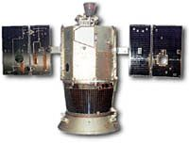
The Clementine
In 1994, a deep space probe, the Clementine, was launched to make observations of the moon and a large asteroid (1620 Geographos).
After months of operation, a software exception caused a control thruster to fire continuously for 11 minutes, which depleted most of the remaining fuel and caused the probe to rotate at 80 RPM.
Control was eventually regained, but it was too late to successfully complete the mission.
This caused some money to be wasted

Slide 9
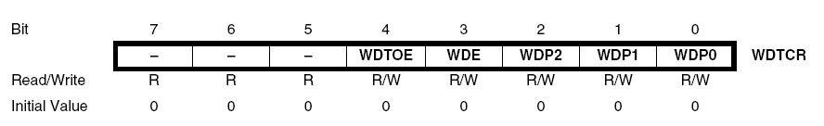
Enabling the Watchdog Timer
Bits 7..5 – Res: Reserved Bits
  These bits are reserved bits in the ATmega32 and will always read as zero.
Bit 4 – WDTOE: Watchdog Turn-off Enable
  More on subsequent slide
Bit 3 – WDE: Watchdog Enable
  When set, the Watchdog Timer is enabled.
Bits 2..0 – WDP2, WDP1, WDP0: Watchdog Timer Prescaler 2, 1, and 0
  The WDP2, WDP1, and WDP0 bits determine the Watchdog Timer prescaling when the Watchdog Timer is enabled. The different prescaling values and their corresponding Timeout Periods are shown on the next slide.
Notes:
Bits 7..5 – Res: Reserved Bits
These bits are reserved bits in the ATmega32 and will always read as zero.
• Bit 4 – WDTOE: Watchdog Turn-off Enable
This bit must be set when the WDE bit is written to logic zero. Otherwise, the Watchdog will not
be disabled. Once written to one, hardware will clear this bit after four clock cycles. Refer to the
description of the WDE bit for a Watchdog disable procedure.
• Bit 3 – WDE: Watchdog Enable
When the WDE is written to logic one, the Watchdog Timer is enabled, and if the WDE is written
to logic zero, the Watchdog Timer function is disabled. WDE can only be cleared if the WDTOE
bit has logic level one. To disable an enabled Watchdog Timer, the following procedure must be
followed:
1. In the same operation, write a logic one to WDTOE and WDE. A logic one must be written
to WDE even though it is set to one before the disable operation starts.
2. Within the next four clock cycles, write a logic 0 to WDE. This disables the Watchdog.
• Bits 2..0 – WDP2, WDP1, WDP0: Watchdog Timer Prescaler 2, 1, and 0
The WDP2, WDP1, and WDP0 bits determine the Watchdog Timer prescaling when the Watchdog
Timer is enabled. The different prescaling values and their corresponding Timeout Periods
are shown in Table 17.
Bit 7 6 5 4 3 2 1 0
– – – WDTOE WDE WDP2 WDP1 WDP0 WDTCR
Read/Write R R R R/W R/W R/W R/W R/W
Initial Value 0 0 0 0 0 0 0 0
Table 17. Watchdog Timer Prescale Select

Slide 10
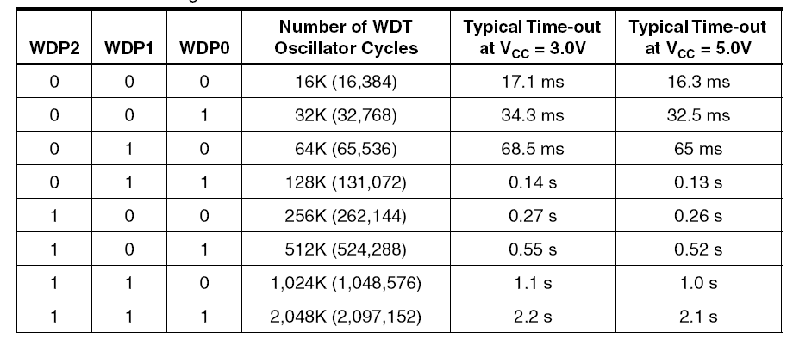
Setting the watchdog timer timeout
Driven by internal 1 MHz clock
Prescaler bits WDPx determine timeout

Slide 11
Resetting the Watchdog timer
A single instruction!
  WDR
  When executed, causes the timer to reset and start counting over

Slide 12
Disabling the Watchdog timer
Bit 4 – WDTOE: Watchdog Turn-off Enable
  This bit must be set before the WDE bit is written to logic zero. Otherwise, the Watchdog will not be disabled. Once written to one, hardware will clear this bit after four clock cycles. Refer to the description of the WDE bit for a Watchdog disable procedure.
Bit 3 – WDE: Watchdog Enable
  When set, the Watchdog Timer is enabled. WDE can only be cleared if the WDTOE bit is set first. To disable an enabled Watchdog Timer, the following procedure must be followed:
  1. In the same operation, set both WDTOE and WDE. A logic one must be written to WDE even if it is already set before the disable operation starts.
  2. Within the next four clock cycles, clear WDE. This disables the Watchdog.
Notes:
Bits 7..5 – Res: Reserved Bits
These bits are reserved bits in the ATmega32 and will always read as zero.
• Bit 4 – WDTOE: Watchdog Turn-off Enable
This bit must be set when the WDE bit is written to logic zero. Otherwise, the Watchdog will not
be disabled. Once written to one, hardware will clear this bit after four clock cycles. Refer to the
description of the WDE bit for a Watchdog disable procedure.
• Bit 3 – WDE: Watchdog Enable
When the WDE is written to logic one, the Watchdog Timer is enabled, and if the WDE is written
to logic zero, the Watchdog Timer function is disabled. WDE can only be cleared if the WDTOE
bit has logic level one. To disable an enabled Watchdog Timer, the following procedure must be
followed:
1. In the same operation, write a logic one to WDTOE and WDE. A logic one must be written
to WDE even though it is set to one before the disable operation starts.
2. Within the next four clock cycles, write a logic 0 to WDE. This disables the Watchdog.
• Bits 2..0 – WDP2, WDP1, WDP0: Watchdog Timer Prescaler 2, 1, and 0
The WDP2, WDP1, and WDP0 bits determine the Watchdog Timer prescaling when the Watchdog
Timer is enabled. The different prescaling values and their corresponding Timeout Periods
are shown in Table 17.
Bit 7 6 5 4 3 2 1 0
– – – WDTOE WDE WDP2 WDP1 WDP0 WDTCR
Read/Write R R R R/W R/W R/W R/W R/W
Initial Value 0 0 0 0 0 0 0 0
Table 17. Watchdog Timer Prescale Select

