Slide 1
Addition and Subtraction
Explain the relationship between addition and subtraction with twos complement numbering systems
Explain the concept of numeric overflow when dealing with twos complement numbers.
Explain the concept of an exception.
Define multiplier and multiplicand.
Explain the concept of left and right shifting.
Explain how a computer may use left and right shifting to perform arithmetic multiplication sequentially.
Explain the advantage of using left or right shifts when multiplying or dividing by a power of 2.
Explain how hardware can be added to improve multiplication times.
Compare and contrast the time complexity of multiplication with addition and subtraction.
Explain how a computer deals with signed multiplication.
Explain the size relationship between the multiplier, multiplicand, and the product.

Slide 2
Survey
Say you are given various arithmetic problems to solve:
Addition of two 10-digit values
Subtraction of two 10-digit values
Multiplication of two 10-digit values
Division of a 10 digit value by a smaller 10-digit value
You will have 10 minutes to work as many problems as is possible, and get paid per problem (regardless of type).
In what order will you solve the problems?
Why?

Slide 3
Addition
Add 7 + 6 as 5 bit numbers:
7=> 0 0111
6 => 0 0110
Note the sign bit is a 0, since these are both positive numbers.
Notes:
Note the sign bit is a 0, since these are both positive numbers.

Slide 4
Binary Addition
Add 15 + 14 as 5-bit unsigned numbers
Add 15 + 14 as 5-bit signed numbers
0 1111
0 1110
1 0001
What happened? Overflow cause sign change.
What happens: Overflow!

Slide 5
Overflow
Overflow if result out of range
Adding positive and negative operands
No overflow is possible, since the result will always be in the range of legal values
Adding two positive operands
Overflow if result sign is 1
Adding two negative operands
Overflow if result sign is 0
Overflow can generate an exception
An unscheduled event (interrupt) that disrupts program execution, used to detect overflow.
Interrupt
An exception that comes from outside of the processor
E.g. a mouse click

Slide 6
Subtraction
Take the number that is to be added and calculate the two’s-complement
Then, simply add the two numbers together
Example:
15
4

Slide 7
Multiplication Definitions (Pg 230)
Multiplicand
The first operand of a multiplication operation
Multiplier
The second operand of a multiplication operation
Product
The final result of a multiplication operation
14
5
---
70

Slide 8
Multiplication
First approach (Long Multiplication)
10011
X 10110

Slide 9
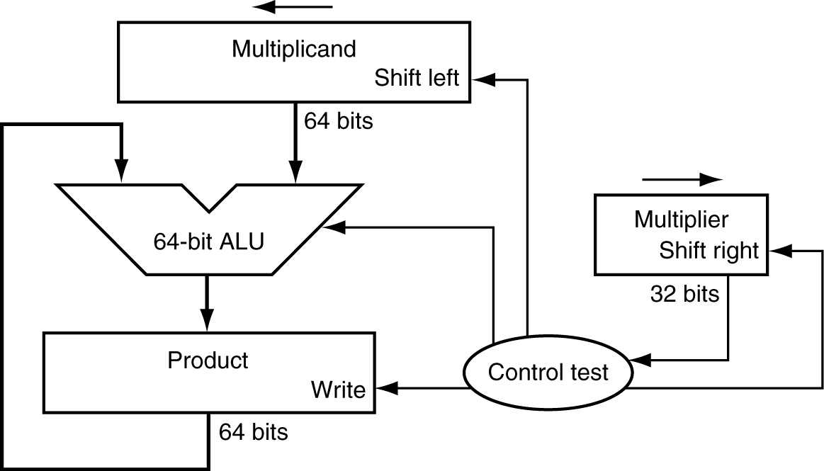
Abstract Multiplication Hardware
How long would take to calculate two 32-bit numbers?

Slide 10
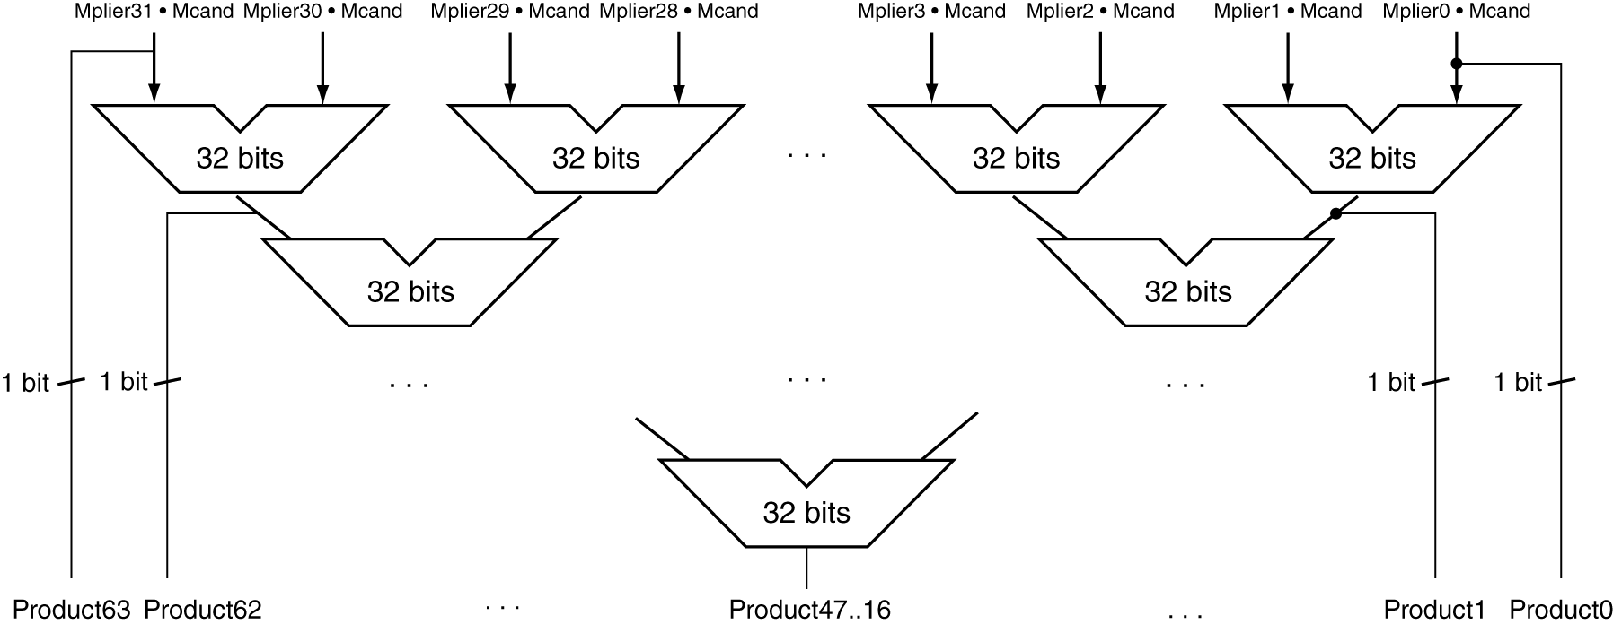
A Faster Multiplier
Uses multiple adders
O(log2 nbits) performance
Cost/performance tradeoff?

Slide 11
MIPS Multiplication
Two 32-bit registers for product (can’t overflow)
HI: most-significant 32 bits
LO: least-significant 32-bits
Instructions
mult rs, rt / multu rs, rt
64-bit product in HI/LO
mfhi rd / mflo rd
Move from HI/LO to rd
Can test HI value to see if product overflows 32 bits
mul rd, rs, rt
Least-significant 32 bits of product –> rd
MIPS multiply instructions ignore overflow!

Slide 12
Sidebar:“Poor man’s multiplication”
What happens if a number is shifted to the left one bit?
What happens if a number is shifted to the right one bit?
Notes:
For multiplication and division by a power of 2, always left / right shift to improve performance.

Slide 13
Internals: How the processor multiplies signed numbers
Converts the numbers to positive numbers, remembering the signs
Multiplies them as positive numbers
Converts back to the appropriate sign based on the initial input.

