Slide 1
Spring 2013 Advising
Starts this week!

Slide 2
Floating Point Numbers
Define floating point number.
Define the terms fraction and exponent when dealing with floating point numbers.
Define overflow and underflow in relation to floating point numbers.
Convert a floating point number from binary to decimal format.
Convert a floating point number from decimal to floating point format.
Calculate the result of adding two floating point numbers together.

Slide 3
What is the difference between the following numbers?
3
0.3
3.14
22/7
π

Slide 4
What is the difference between the following numbers?
3 - integer
0.3, 3.14
Real numbers; fractional parts can be expressed perfectly in powers of 10
22/7
3.1428571 1428571 1428571…
Rational, but the fractional part cannot be expressed perfectly in powers of 10, so is infinitely repeating as a decimal (base 10) fraction
π
3.141592653…
Irrational – cannot be expressed as a ratio of integers

Slide 5
Representing a real number: Base 10 vs. Base 2
3.625₁₀ = 3*10⁰ + 6*10⁻¹ + 2* 10⁻² + 5* 10⁻³
. Is called the decimal point
11.101₂ = 1*2¹ + 1*2⁰ + 1*2⁻¹ + 0*2⁻² + 1*2⁻³
. Is called the binary point
The decimal value 3.625₁₀ can be represented perfectly as 11.101₂

Slide 6
Real values in base 10 cannot always be represented perfectly in base 2
Fractions in binary only terminate if the denominator has 2 as the only prime factor.
Ex: 0.3₁₀
As a rational value: 3/10, but the denominator is not a power of 2
The (infinitely repeating) binary fraction is 0.0100110011001100110011…

Slide 7
Definitions
Scientific Notation
A notation which renders numbers with a single digit to the left of the decimal point
91.0 = 9.1 × 10¹
91.0 = 0.91 × 10²
91.0 = 91.0 × 10⁻¹ is not in proper scientific notation
Normalized
A number in proper scientific notation that has no leading zeros
91.0 = 9.1 × 10¹
91.0 = 0.91 × 10² is not normalized
Floating Point
Arithmetic where the decimal/base point is not fixed, which allows us to move the base point around in order to normalize it
Note the top is normalized. The bottom two are not.

Slide 8
Normalized form for base 2
11.101₂ = 11.101₂ * 2⁰ = 1.1101₂ * 2¹ (normalized form)
Fraction
The value, between 0 and 1, placed in the fraction field (1101 in this case)
Exponent
The value that is placed in the exponent field that represents the power to which the base is raised (in this case, exponent is 1; base is 2)
When we normalize a non-zero binary number, we’ll always have a 1 to the left of the binary point!

Slide 9
Major Issue: Finite # of digits
A real value can be approximated as: ±1.xxxxxxx₂ × 2^{yyyy}
Types float and double in C/Java
To represent a real (floating point) number in a fixed number of digits, we need to decide how to allocate some fixed number of bits to both the fraction xxxxxx and the exponent yyyy
This is a tradeoff between precision and range!

Slide 10
Floating Point Standard
Defined by IEEE Std 754-1985
Developed in response to divergence of representations
Portability issues for scientific code
Now almost universally adopted
Two representations
Single precision (32-bit)
Double precision (64-bit)

Slide 11
IEEE Floating Point Standard
single: 8 bits double: 11 bits
single: 23 bits double: 52 bits
S
Biased Exponent
Fraction
S: sign bit of the Fraction (0 for +, 1 for -)
Normalize Fraction: 1.0 ≤ |Fraction| < 2.0
Always has a leading pre-binary-point 1 bit, so no need to represent it explicitly (hidden bit)
Fraction with the hidden “1.” restored is called the significand
BiasedExponent in excess representation =Actual Exponent + Bias
Ensures BiasedExponent is unsigned
Single: Bias = 127; Double: Bias = 1203
BiasedExponent 1-254 represents Actual Exponent of -126 to +127
BiasedExponents 0 and 255 have special meanings (table to follow)

Slide 12
An example in 32 bits
3.625₁₀ = 1.1101₂ * 2¹ (normalized form)
Sign is positive, so S=0 (sign bit 0)
Fraction bits are 1101 (leading 1 is implicit)
BiasedExponent: excess representation =Actual Exponent + Bias
Actual Exponent of 1 means BiasedExponent is 128 (Bias is 127)
Thus, 3.625₁₀ is represented in 32 bits as
0100 0000 0101 1000 0000 0000 0000 0000
0x 4 0 6 8 0 0 0 0
-3.625₁₀ is represented in 32 bits as
1100 0000 0101 1000 0000 0000 0000 0000
0x C 0 6 8 0 0 0 0

Slide 13
Another example in 32 bits
1.0₁₀ = 1.0₂ * 2⁰ (normalized form)
Sign is positive, so S=0 (sign bit 0)
Fraction bits are 0 (leading 1 is implicit)
Exponent: excess representation: actual exponent + Bias
Actual exponent of 0 means Exponent is 127 (Bias is 127)
Thus, 1.0₁₀ is represented in 32 bits as
0011 1111 1000 0000 0000 0000 0000 0000
0x 3 F 8 0 0 0 0 0
And -1.0₁₀ is represented in 32 bits as
1011 1111 1000 0000 0000 0000 0000 0000
0x B F 8 0 0 0 0 0

Slide 14
IEEE Floating Point Encodings
Note that the special value of 0 for Exponent, along with 0 for Fraction, represent 0.0.
A 0 for Exponent, with non-zero for Fraction, represent a denormalized value (always between 0 and 1) – explanation to follow.

Slide 15
Converting a number from Binary to Decimal Floating Point
S | Exponent |  |  |  |  |  |  |  | Fraction
0 | 1 | 0 | 0 | 0 | 0 | 0 | 1 | 0 | 1 | 0 | 0 | 0 | 0 | 0 | 0 | 0 | 0 | 0 | 0 | 0 | 0 | 0 | 0 | 0 | 0 | 0 | 0 | 0 | 0 | 0
Notes:
0100 0001 0100 0000 0000 0000 0000 0000
0x 4 1 4 0 0 0 0 0
Exponent = 1000 0010 = 130 (base 10)
Actual exponent = 130-127 = 3
1+Fraction = 1.100 (base 2)
Thus 1.100 * 2^3 = 1100.0 = 12.0
Largest single-precision value:
0111 1111 0111 1111 1111 1111 1111 1111
0x 7 F 7 F F F F F
Exponent = 1111 1110 = 254 (base 10)
Actual exponent = 254-127 = 127
1+Fraction = 1.1111 1111 1111 1111 1111 111 (base 2)
Thus 1.1111 1111 1111 1111 1111 111 * 2^127 = 3.402E38
Smallest single-precision value:
0000 0000 1000 0000 0000 0000 0000 0000
0x 0 0 9 0 0 0 0 0
Exponent = 0000 0001= 1(base 10)
Actual exponent = 1 - 127= -126
1+Fraction = 1.0 (base 2)
Thus 1.0 * 2^-126 = 1.175E-38

Slide 16
Example: Addition of two binary values (using a 3-bit fraction)
1.001₂ × 2⁷ + 1.110₂ × 2⁷
When exponents match, the fractional parts can simply be added together, giving
=10.111₂ × 2⁷
Then, the result is normalized:
=1.011₂ × 2⁸
The resulting exponent has to be checked for overflow: had the exponent only held 4 bits ( +/- 7 actual exponent range), then this addition would have resulted in a floating-point overflow.
F.P. overflows result in values representing infinity

Slide 17
Addition of two binary values with differing exponents
1.000₂ × 2^{–4} - 1.111₂ × 2^{–5}
Since the exponents are different, the fractional parts cannot simply be added.
Instead, we first denormalize the value with the smaller exponent (which may result in dropped bits):
1.000₂ × 2^{–4} - 0.111₂ × 2^{–4}
= 0.001₂ × 2^{–4}
Then, we renormalize the result
1.000₂ × 2^{–8}
& check for underflow (BiasedExponent=0)

Slide 18
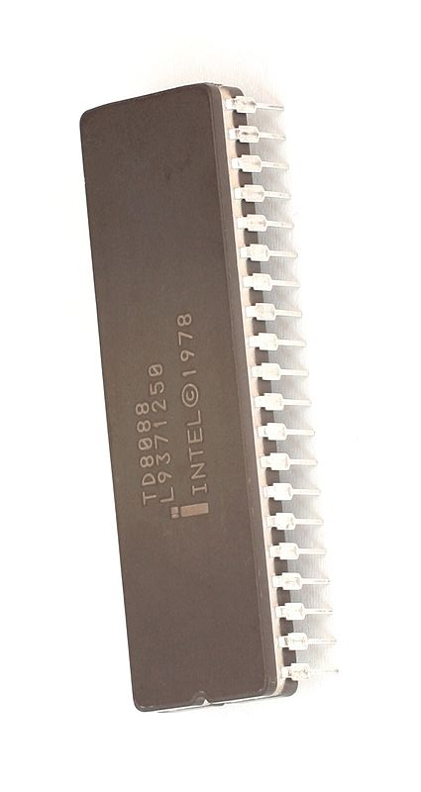
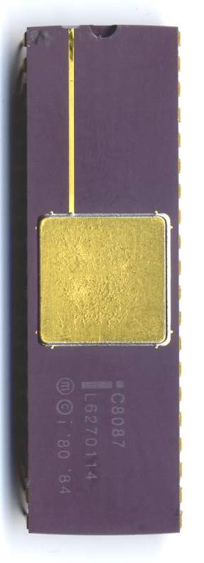
Floating Point Hardware

Slide 19
FP Instructions in MIPS
FP hardware is coprocessor 1
Adjunct processor that extends the ISA
Separate FP registers
32 single-precision: $f0, $f1, … $f31
Paired for double-precision: $f0/$f1, $f2/$f3, …
Release 2 of MIPs ISA supports 32 × 64-bit FP reg’s
FP instructions operate only on FP registers
Programs generally don’t do integer ops on FP data, or vice versa
More registers with minimal code-size impact
FP load and store instructions
lwc1, ldc1, swc1, sdc1

Slide 20
FP Instructions in MIPS
Single-precision arithmetic
add.s, sub.s, mul.s, div.s
e.g., add.s $f0, $f1, $f6
Double-precision arithmetic
add.d, sub.d, mul.d, div.d
e.g., mul.d $f4, $f4, $f6
Single- and double-precision comparison
c.xx.s, c.xx.d (xx is eq, lt, le, …)
Sets or clears FP condition-code bit
e.g. c.lt.s $f3, $f4
Branch on FP condition code true or false
bc1t, bc1f
e.g., bc1t TargetLabel

Slide 21
Example: Multiplication of two binary values (using a 3-bit fraction)
1.100₂ × 2³ * 1.110₂ × 2⁴
The fractional parts can simply be multiplied together, while the exponents are added together
=10.101₂ × 2⁷
Then, the result is normalized (with loss of precision):
=1.010₂ × 2⁸
The resulting exponent has to be checked for overflow: had the exponent only held 4 bits ( +/- 7 actual exponent range), then this addition would have resulted in a floating-point overflow.
F.P. overflows result in values representing infinity

Slide 22
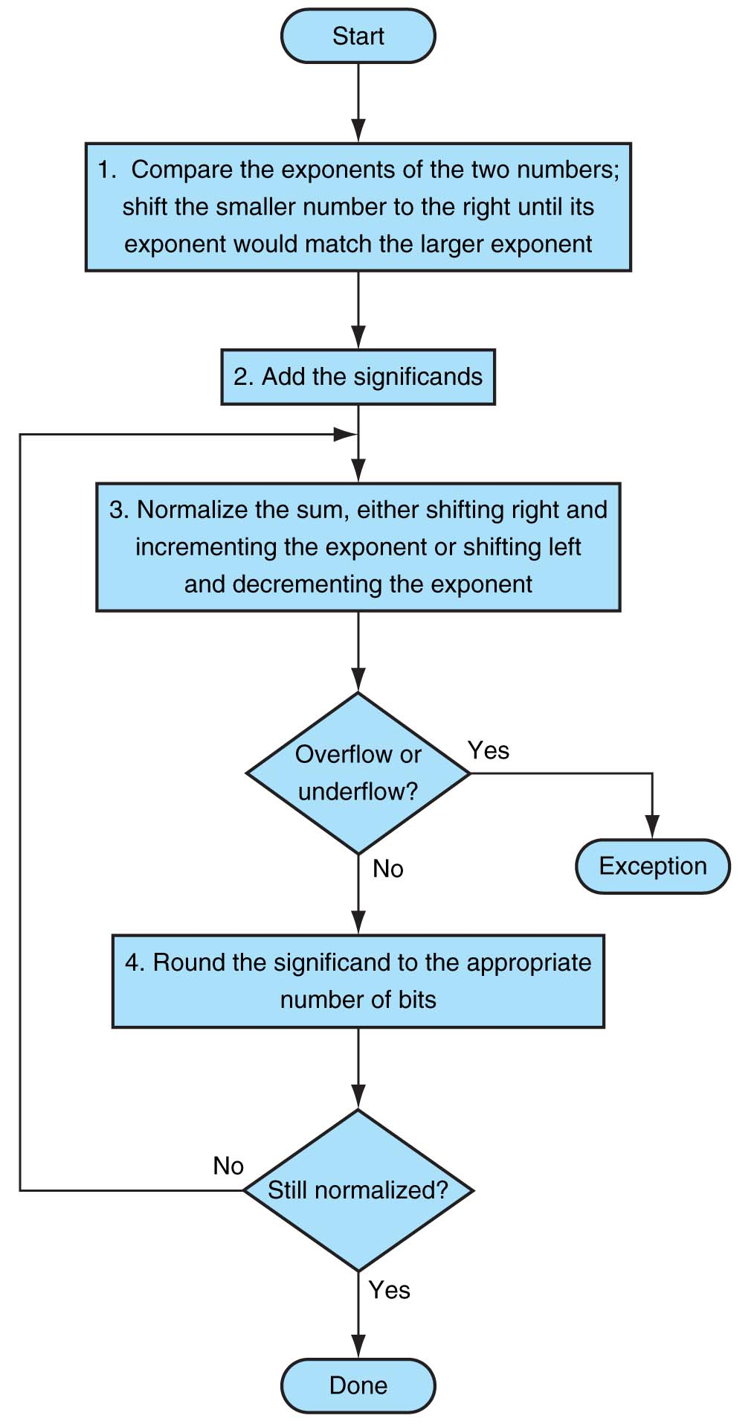
Scientific Notation Addition Algorithm

Slide 23
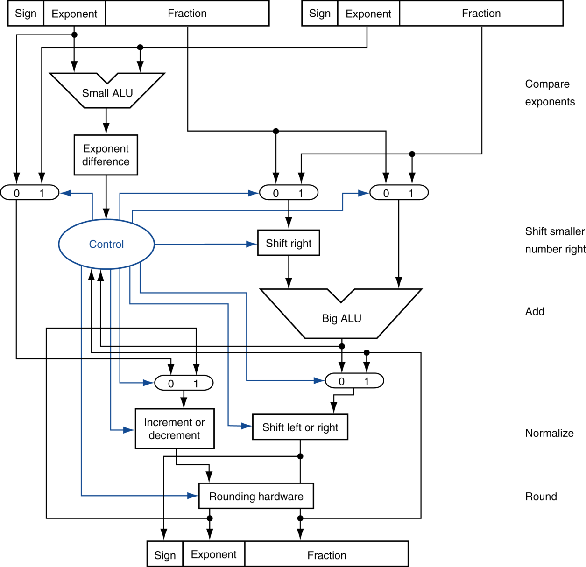
FP Adder Hardware
Step 1
Step 2
Step 3
Step 4

