Slide 1
The Processor and its Datapath
Define datapath
Explain the function of various datapath elements
Compare and contrast combinational elements with state elements.
Define edge triggered clocking.
Define the term program counter.
Draw the datapath segment responsible for fetching instructions and incrementing the program counter.
Define sign extend.
Define branch target address

Slide 2
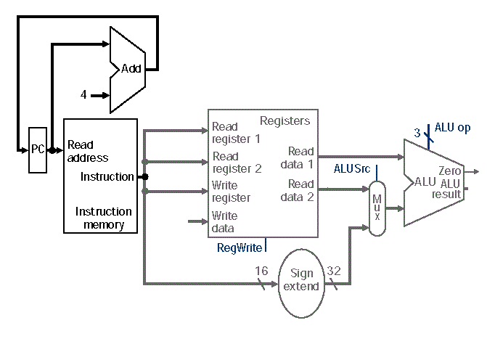
Datapath - A collection of datapath elements within a CPU that perform various data processing operations
Datapath Element
A functional unit used to operate on or hold data within a processor
Elements that operate on data are all combinational elements
Elements that hold data are state elements

Slide 3
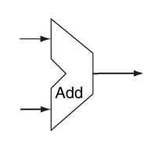
Combinational Elements
The output of a combinational element depends only on the current input(s)
No “memory” of past inputs
Given the same input, a combinational element always produces the same output
In MIPS, nearly all inputs and outputs are 32 bits wide
X
32
X+Y
32
Y
32

Slide 4
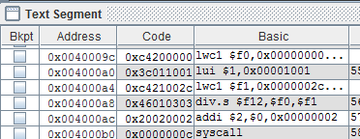
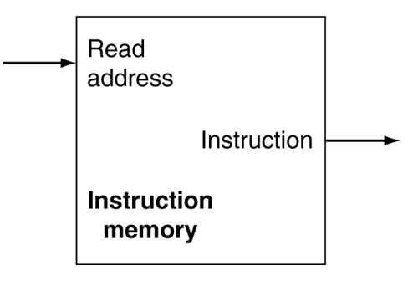
State Elements
Output(s) depends on both input(s) and current state
Contain internal storage
Internal state may be lost on power loss
Internal state can be saved and restored
0x00400a0
0x3c011001 (differs based on what is in instruction memory)

Slide 5
A clocking methodology defines when signals (inputs and outputs) can be read and written
Edge Triggered Clocking
A clocking scheme in which all state changes occur on a clock edge
One of the clock edges (rising or falling) is chosen to be the active clock edge (by the designers)
States are stable at the active clock edge, and in transition between
The Clock cycle time is determined by the slowest datapath operation
Since every datapath element takes some finite amount of time to function
Read
Write
Rising clock
edge
Clock cycle
Show rising and falling edges
Notes:
Show rising and falling edges

Slide 6
Multiple clock cycles are needed for operations involving multiple state elements
Read
Write
Read
Write
Clock cycle
Clock cycle
Show rising and falling edges
Notes:
Show rising and falling edges

Slide 7
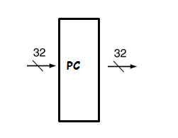
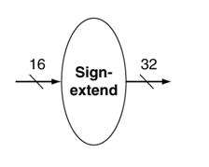
More datapath elements
Program counter (PC)
A special-purpose register containing the address of the instruction in the program being executed
Sign extender
Increases the size of a data item (e.g. from 16 to 32 bits) by replicating the high order sign bit of the original data item to the high order bits of the larger destination data item
0x00400a0
0x00400a0
Write
Read
0xf3a0
0xfffff3a0
Write
Read
0x74b2
0x000074b2

Slide 8
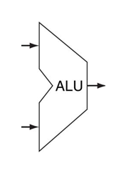
ALU: Arithmetic/Logic Unit
Arithmetic
Logical comparison
Load from memory to register
Store from register to memory
Branching

Slide 9
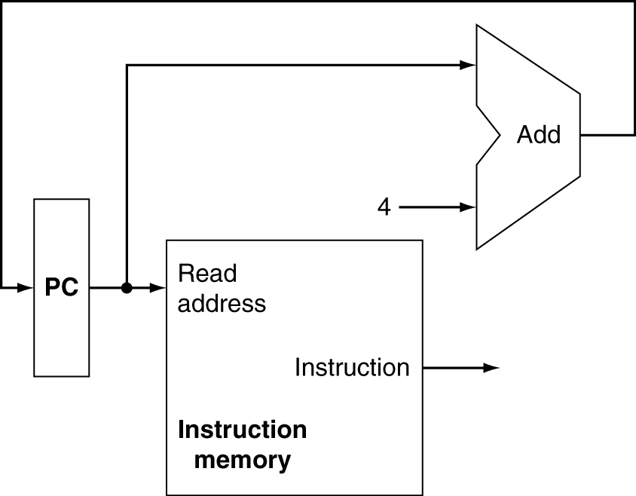
First step in executing an instruction: Instruction Fetch Determines the next instruction to execute; takes 1 cycle
0x004000a4 (next instruction address)
Note: The signal going back to the PC is greatly simplified here. The
actual signal is more complex.
Start of clock cycle
End of clock cycle
0x004000a0
0x3c011001
0xc421002c (next
instruction
Code)

Slide 10
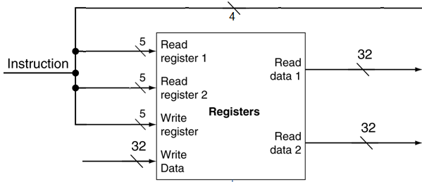
Step 2: Instruction Decode and Register Fetch
Consider add $t1, $s1, $s2 whose instruction code is 0x2824820
Extract register numbers (17,18,8)
Extract part of op and funct (0, 32) and recombine as 4-bit ALU Opcode
Present to ALU (not shown)
Takes 1 cycle
0
17
18
8
0
32
6 bits
5 bits
5 bits
5 bits
5 bits
6 bits
ALU Opcode for add
17
18
Value in $17
8
32-bit result to be placed in $8 will
arrive here in 2 more cycles
Value in $18

Slide 11
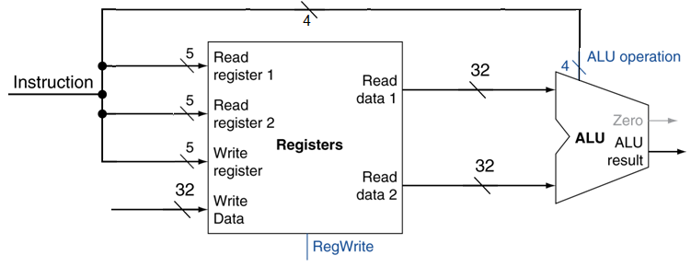
Step 3: Execute
Perform operation (in this example, add $t1, $s1, $s2)
The ALU adds the values in $17 and $18 presented to it from the Instruction Decode/Register Fetch of Step 2
Takes 1 cycle
ALU Opcode for add
17
18
Value in $17
8
32-bit result to be placed in $8 in a subsequent cycle
32-bit result to be placed in $8 will
arrive here in a subsequent cycle
Value in $18

Slide 12
Step 4: Memory access
In add $t1, $s1, $s2, memory is not accessed.
Instead: consider sw $t1, ($s1), where the data at the memory address contained in $s1 needs to be stored (or fetched, as in the case of lw)
The ALU sends the data in $t1 to the address stored in $s1, which takes 1 cycle
For lw, the ALU fetches the data from memory into a cache
Although add does not access memory, 1 cycle is still consumed (idle)
ALL instructions consume 1 cycle for step 4, whether they access memory or not!
This is done uniformly for all instructions for uniformity so that every instruction takes 5 steps
ALU Opcode for sw
17
Address in $17
8
Addr in $17
Not used
Value in $8

Slide 13
Step 5: Register writeback
Back to add $t1, $s1, $s2
The result from the add is written back to $8 ($t1) in step 5
For an sw instruction, nothing happens in this cycle
For an lw instrcution, the value is transferred from the cache to $8
Consumes 1 cycle in all cases
ALU Opcode
17
18
Value in $17
8
32-bit result of add
Value in $18

Slide 14
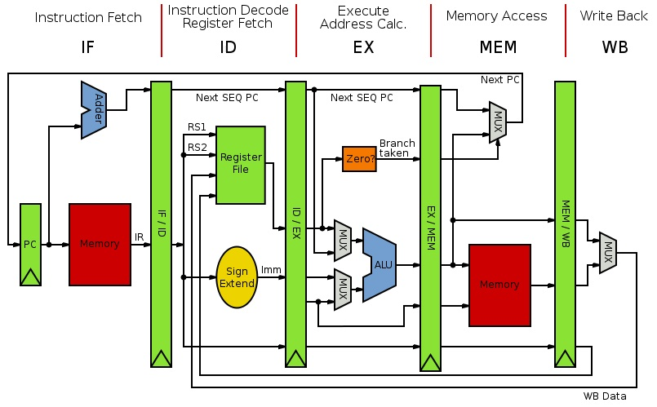
A complete instruction in MIPS requires 5 steps/cycles. This is true for all instructions, whether the instruction needs to do something in each step or not!

Slide 15
Example times for various datapath element functions (step times)
Step 1 | Step 2 | Step 3 | Step 4 | Step 5
Instruction Fetch | Register Read | ALU Operation | Data Access | Register Write
200ps | 100ps | 200ps | 200ps | 100ps
If executed sequentially, requires a total time of 800ps
…and, the step times are non-uniform!

