Slide 1
Pipelining
Define pipelining
Calculate the speedup achieved by pipelining for a given number of instructions.
Define how pipelining improves computer performance.
Define structural hazard, data hazard, and control hazard.
Define the term stall.
Explain the concept of forwarding (bypassing).

Slide 2
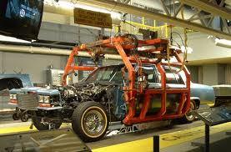
Automotive Assembly Steps
Build body
Paint body
Build engine assembly
Attach engine assembly
Add interior lining
Add interior seats
Add dash board
Test vehicle

Slide 3
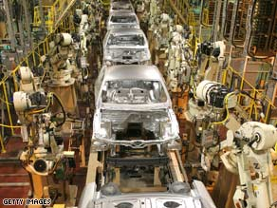
Assembly Line concept (conceived by Henry Ford)

Slide 4
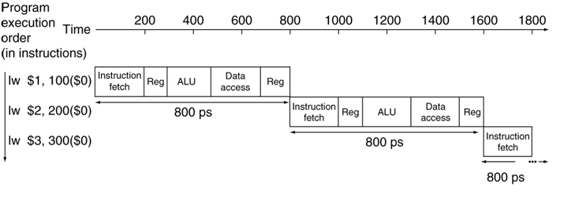
Sequential instruction execution
Five stages (steps)
IF: Instruction fetch from memory (200ps)
ID: Instruction decode & register read (100ps)
EX: Execute operation/calculate address (200ps)
MEM: Access memory operand (200ps)
WB: Write result back to register (100ps)

Slide 5
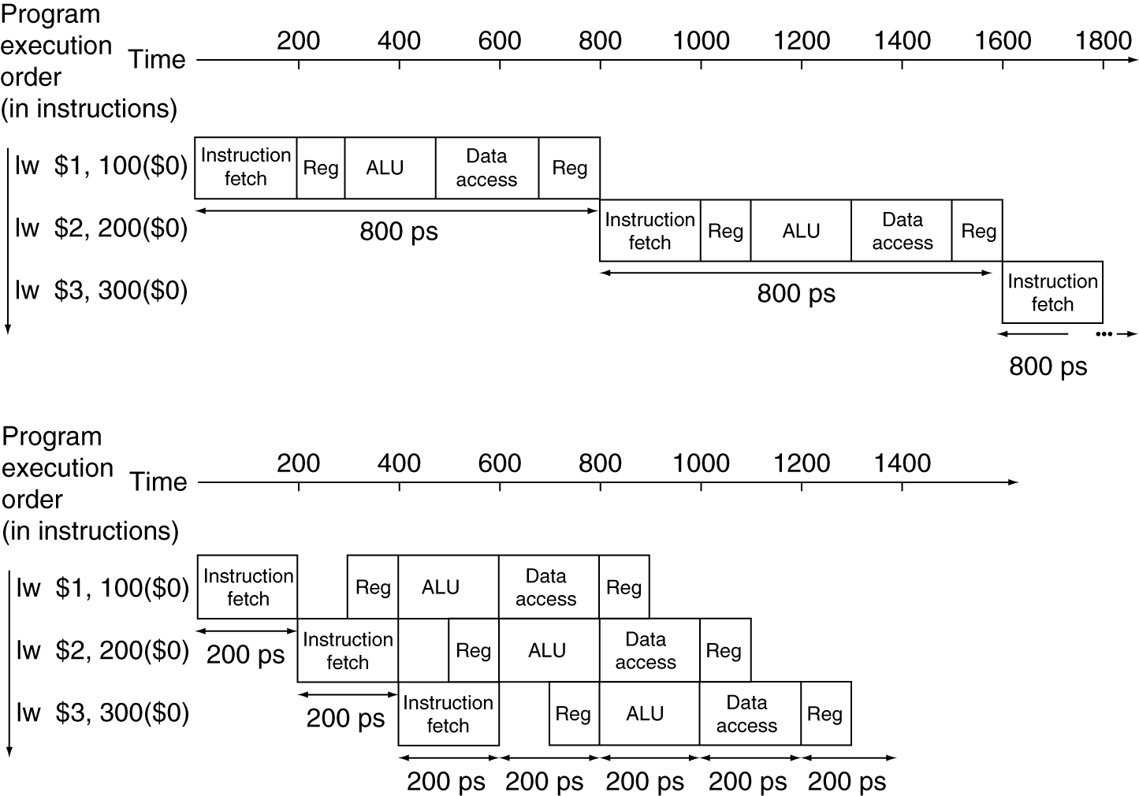
Pipelining is an implementation technique in which the stages of multiple instructions overlap
Single-cycle (T_{c}= 800ps)
Stage duration varies
Pipelined (T_{c}= 200ps)
All stages of equal duration

Slide 6
Pipeline speedup
Ideal conditions
All stages are balanced (equal)
If not balanced, speedup is less
Speedup due to increased throughput
Latency (time for each instruction) does not decrease

Slide 7
MIPS ISA is designed for pipelining
All MIPS instructions are 32-bits
Easier to fetch and decode in one cycle
Intel x86: 1- to 17-byte instructions
Few and regular instruction formats
Can decode and read registers in one step
Simple Load/Store addressing
Can calculate address in 3rd stage, access memory in 4th stage
Consistent alignment of memory operands
Memory access takes only one cycle

Slide 8
Pipelining has hazards - situations that prevent starting the next instruction in the next cycle
Structure hazards
A required resource is busy
Data hazard
Need to wait for previous instruction to complete its data read/write
Control hazard
Deciding on control action depends on previous instruction

Slide 9
Structure Hazards
Conflict for use of a resource
In MIPS pipeline with a single memory
Load/store requires data access
Instruction fetch would have to stall for that cycle
Would cause a pipeline “bubble”
Hence, pipelined datapaths require separate instruction/data memories
Or separate instruction/data caches

Slide 10
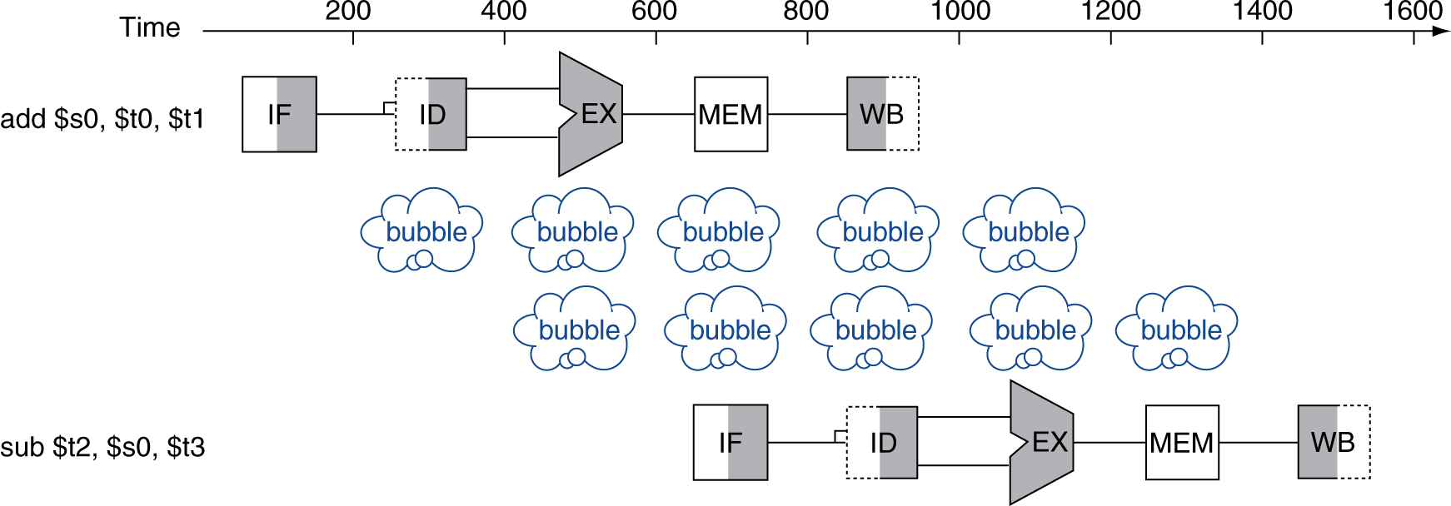
Data Hazards
An instruction depends on completion of data access by a previous instruction
add $s0, $t0, $t1 sub $t2, $s0, $t3
$s0 is written here
$s0 is read here

Slide 11
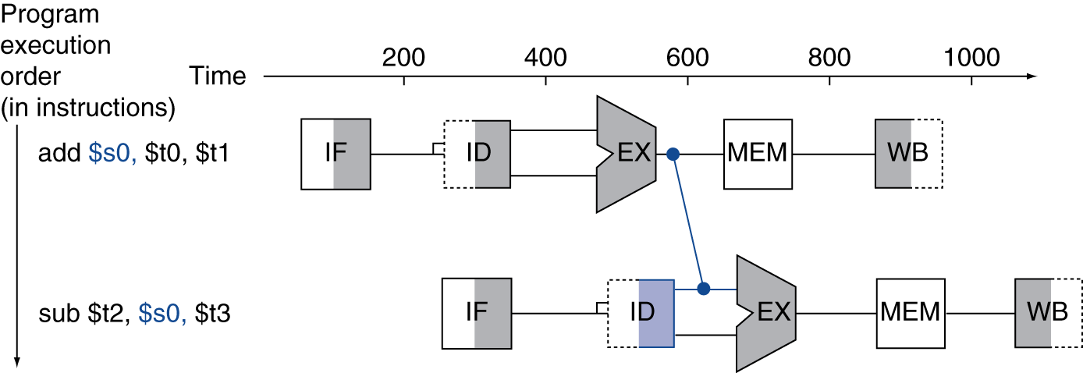
Workaround: Forwarding (aka Bypassing)
Use result when it is computed
Don’t wait for it to be stored in a register
Requires extra connections in the datapath

Slide 12
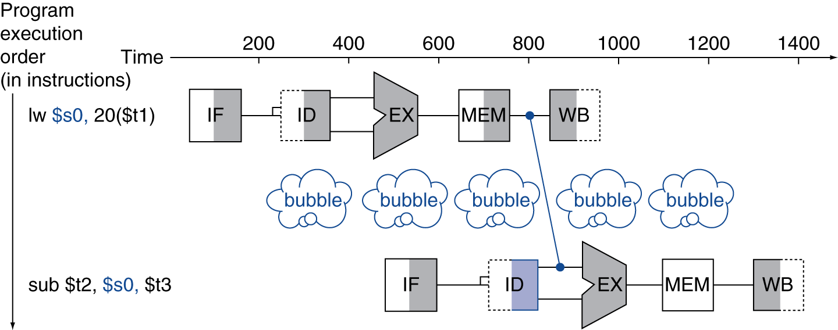
Load-Use Data Hazard
Can’t always avoid stalls by forwarding
If value not computed when needed
Can’t forward backward in time!

Slide 13
Code Scheduling to Avoid Stalls
Reorder code to avoid use of load result in the next instruction
C/Java code for A=B+E; C=B+F;
Done in software by the compiler
lw $t1, 0($t0) #t1=B
lw $t2, 4($t0) #t2=E
add $t3, $t1, $t2 #B+E
sw $t3, 12($t0) #t3=A
lw $t4, 8($t0) #t4=F
add $t5, $t1, $t4 #B+F
sw $t5, 16($t0) #t5=C
lw $t1, 0($t0) #t1=B
lw $t2, 4($t0) #t2=E
lw $t4, 8($t0) #t3=F
add $t3, $t1, $t2 #B+E
sw $t3, 12($t0) #A
add $t5, $t1, $t4 #B+F
sw $t5, 16($t0) #>C
stall
stall
13 cycles including 2 stalls
11 cycles, no stalls
Notes:
Note that this is done in software by the compiler

Slide 14
Control Hazards
Branch determines flow of control
Fetching next instruction depends on branch outcome
Pipeline can’t always fetch correct instruction
Still working on ID stage of branch!
In MIPS pipeline
Need to compare registers and compute target early in the pipeline
Add hardware to do it in ID stage (more complex!)

Slide 15
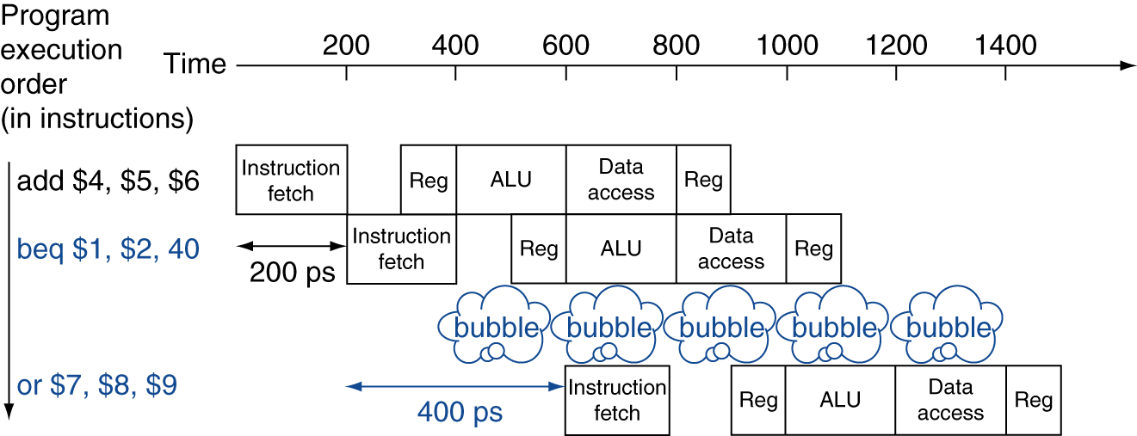
Stall on Branch
Wait until branch outcome determined before fetching next instruction
Is this the best possible outcome?
Can you think of another alternative to avoid stalling?

Slide 16
Performance needs
17% of instructions executed in the SPECint2006 benchmark are branch instructions
If we always stalled for 1 clock cycle on the branch, what performance penalty would we have?
Other instructions: CPI of 1
Branches would take 2
.83 * 1 + 2*.17 = 1.17 CPI
17% slowdown
Notes:
Other instructions: CPI of 1
Branches would take 2
.83 * 1 + 2*.17 = 1.17 CPI
17% slowdown

Slide 17
Branch Prediction
A method of resolving branch hazards that assumes a given outcome for the branch and proceeds from that assumption rather than waiting to ascertain the actual outcome

