Slide 1
CS-2710 Computer Organization
Dr. Mark L. Hornick
email: hornick@msoe.edu
web: faculty-web.msoe.edu/hornick
CS-2710 info syllabus, homework, labs…
My schedule/office hours
Office: L-341
Phone: 277-2417

Slide 2
Logistics
Class roster, attendance policy
Book, schedule, policies, grading
Course web site

Slide 3
Course Description
This course provides students with an introduction to the structure of computer hardware, including the components of a modern computer system as well as the tradeoffs necessary to construct such a system. Specific course topics include numeric systems, the role of performance in designing computer systems, Amdahl's Law, instruction formats, addressing modes, computer arithmetic with both fixed and floating point numbers, single cycle and multi-cycle data-path design, pipelining, the memory hierarchy, caching, and parallel processing using SIMD and MIMD formats. Students will develop small, assembly language programs on a simulator as a means of exploring instruction formats and data-path operation. (prereq: CE-1900)

Slide 4
Course Outcomes
1. (Comprehension) Understand the relationship between input, output, memory, the processor, the data path, and the control path within a computer.
2. (Comprehension) Explain how signed and unsigned numbers and floating point numbers are represented internally within a computer and perform these operations.
3. (Comprehension) Explain the memory hierarchy within a computer and quantify its impact on computer performance.
4. (Application) Explain how variables are allocated in memory and the relationship between variables and pointers.
5. (Application) Compute performance related metrics for a computer based system or implemented program.
6. (Analysis) Critique the design and implementation of a processor based upon design parameters.
7. (Synthesis) Write simple assembly language routines using MIPS assembly language.

Slide 5
Lecture Objectives
Draw the relationship between hardware, systems software, and applications software as a hierarchy
Explain the concept of a compiler
Draw a flowchart showing the basic steps of compilation for code.
Explain the relationship between high level languages, assembly language, and machine language

Slide 6
Computer Classification
How would you classify computing applications?

Slide 7
Classes of Computers
Desktop computers
General purpose, variety of software
Subject to cost/performance tradeoff
Server computers
Network based
High capacity, performance, reliability
Range from small servers to building sized
Embedded computers
Hidden as components of systems
Stringent power/performance/cost constraints

Slide 8
Classes of Computers
Desktop computers
General purpose, variety of software
Subject to cost/performance tradeoff
Server computers
Network based
High capacity, performance, reliability
Range from small servers to building sized
Embedded computers
Hidden as components of systems
Stringent power/performance/cost constraints

Slide 9
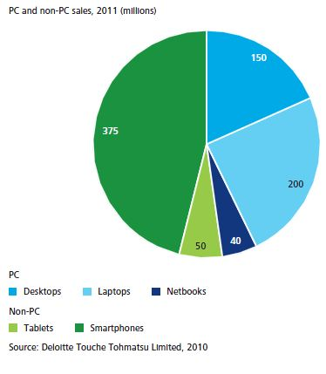

Slide 10
Consumer Usage by device (http://services.google.com/fh/files/blogs/Google_Ipsos_Mobile_Internet_Smartphone_Adoption_Insights_2011.pdf)

Slide 11
Performance
Say you want to drive between Milwaukee and Chicago.
What parameters affect your goal?
Discuss the impact of the route taken-> Algorithm
Discuss the impact of the vehicle -> Determines maximum speed
Discuss the energy – governs how much of the speed can be used
This all boils down to performance

Slide 12
What impacts software performance?
Algorithm
Determines number of operations executed
Programming language, compiler, architecture
Determine number of machine instructions executed per operation
Processor and memory system
Determine how fast instructions are executed
I/O system (including OS)
Determines how fast I/O operations are executed
Note: Hardware impacts some of these, as does software.

Slide 13
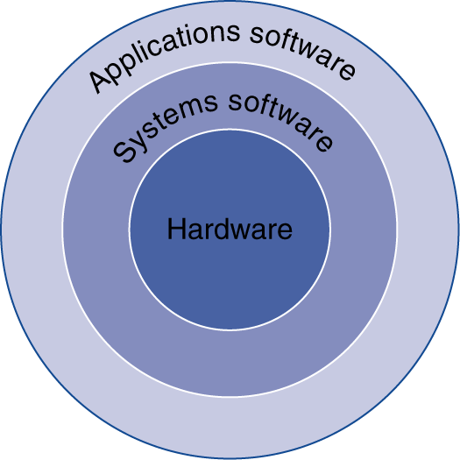
Your program
Application software
Written in high-level language
System software
Compiler: translates HLL code to machine code
Operating System: service code
Handling input/output
Managing memory and storage
Scheduling tasks & sharing resources
Hardware
Processor, memory, I/O controllers

Slide 14
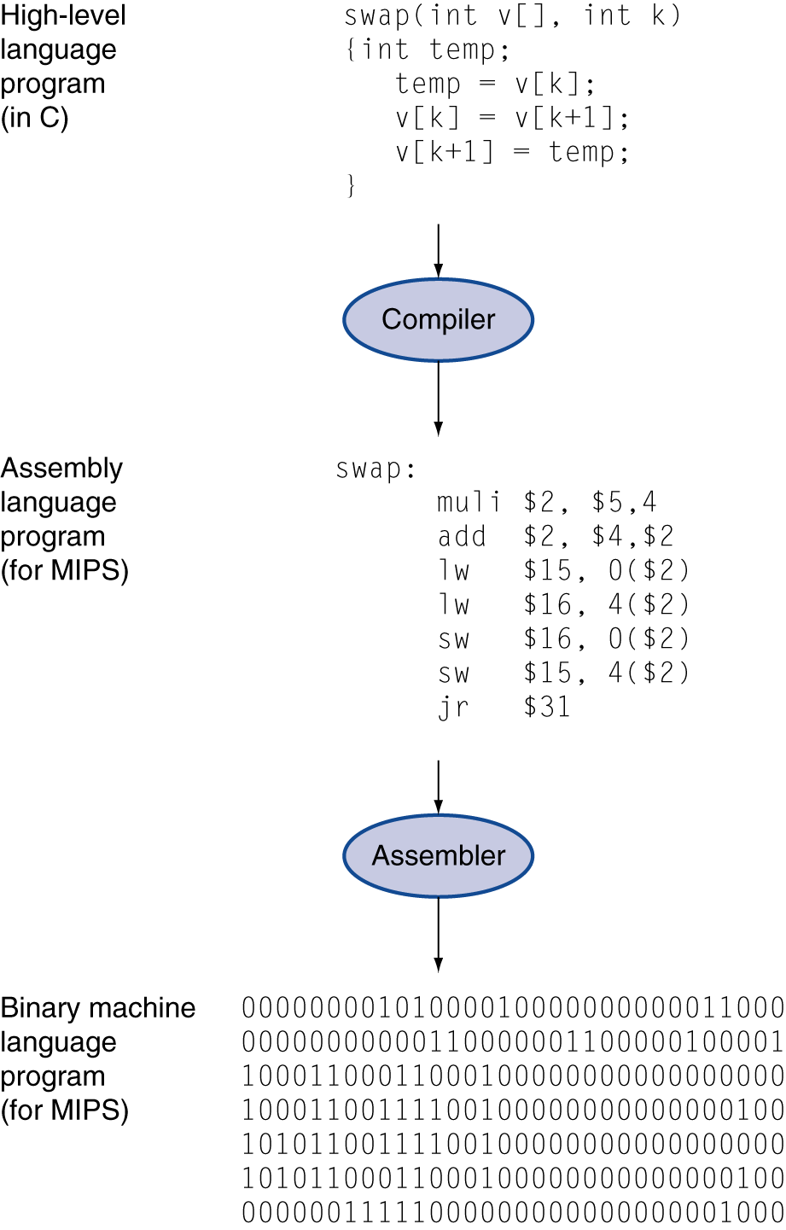
Levels of Program Code
High-level language
Level of abstraction closer to problem domain
Provides for productivity and portability
Assembly language
Textual representation of instructions
Hardware representation
Binary digits (bits)
Encoded instructions and data

Slide 15
Discussion
How does source code go from source code to an executable program?
Use javac to compile a .java program to .class
Use javap –c to “disassemble” a .class file into byte code mnemonics

Slide 16
Preprocessors, Compilers, Assemblers, and Linkers
C/C++
Skeletal Source Program
Preprocessor
Source Program
Try for example:
gcc -v myprog.c
Compiler
Target Assembly Program
Assembler
Relocatable Object Code
Linker
Libraries and
Relocatable Object Files

