Slide 1
Cache Basics
Define temporal and spatial locality.
Define hit rate and miss rate.
Define the term cache
Explain how a direct mapped cache determines the location in the cache.
Given a memory address and cache size information, perform the calculations to convert an address to a cache block number.

Slide 2
Memory access time - exercise
Recall: The MEM stage of the MIPS pipeline takes 200ps.
Is it actually possible to request and retrieve (i.e. make a round trip) a word of memory in that period of time (assume that the memory chip is 60mm away from the CPU)?
Notes:
C=300,000,000 m/s = 3E8m/s = 3E11mm/s in a vacuum; assume 2/3 that in a conductor, or 2E11mm/s
T = x/c = 60/2E11 = 3E-10s = 0.3ns = 300ps
Round trip is thus 600ps (3x the MEM duration), and that’s not counting the time it takes the memory chip to respond to the request and produce the data to be sent back.
To make a round trip in 200ps, the distance would have to be <20mm (<~3/4 inch), and that’s still assuming 0ps for chip response time.

Slide 3
Definitions
Temporal Locality
The principle stating that if a data location is referenced then it will again be referenced soon.
Spatial Locality
The locality principle stating that if a data location is referenced, data locations with nearby addresses will tend to be referenced soon.

Slide 4
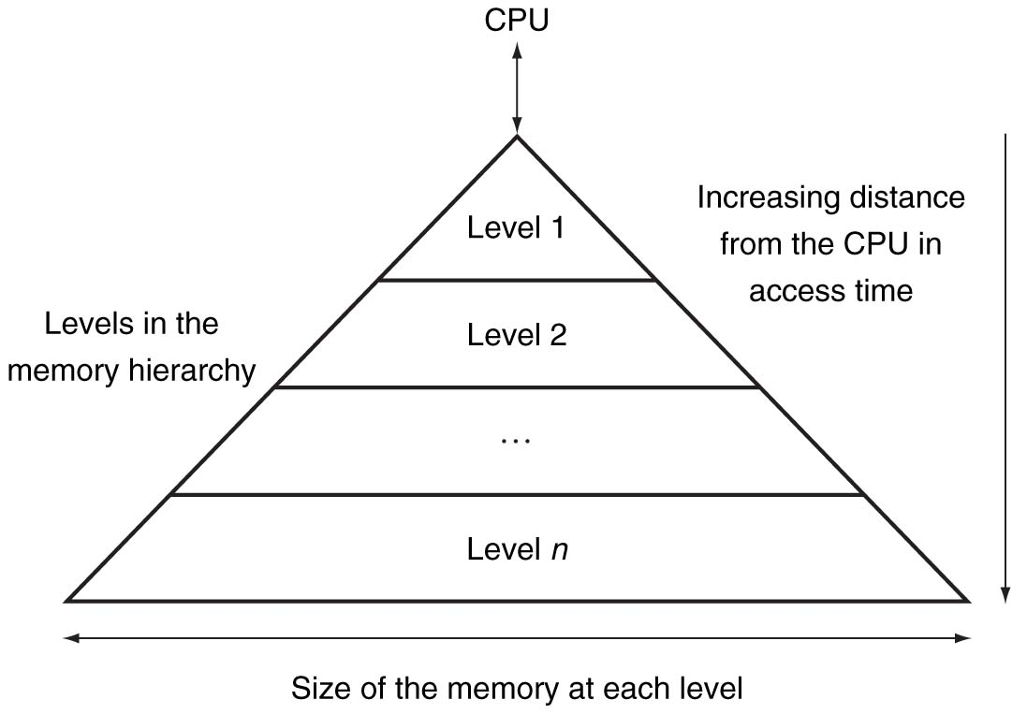
Computer memory hierarchy
Notes:
Note the various levels

Slide 5
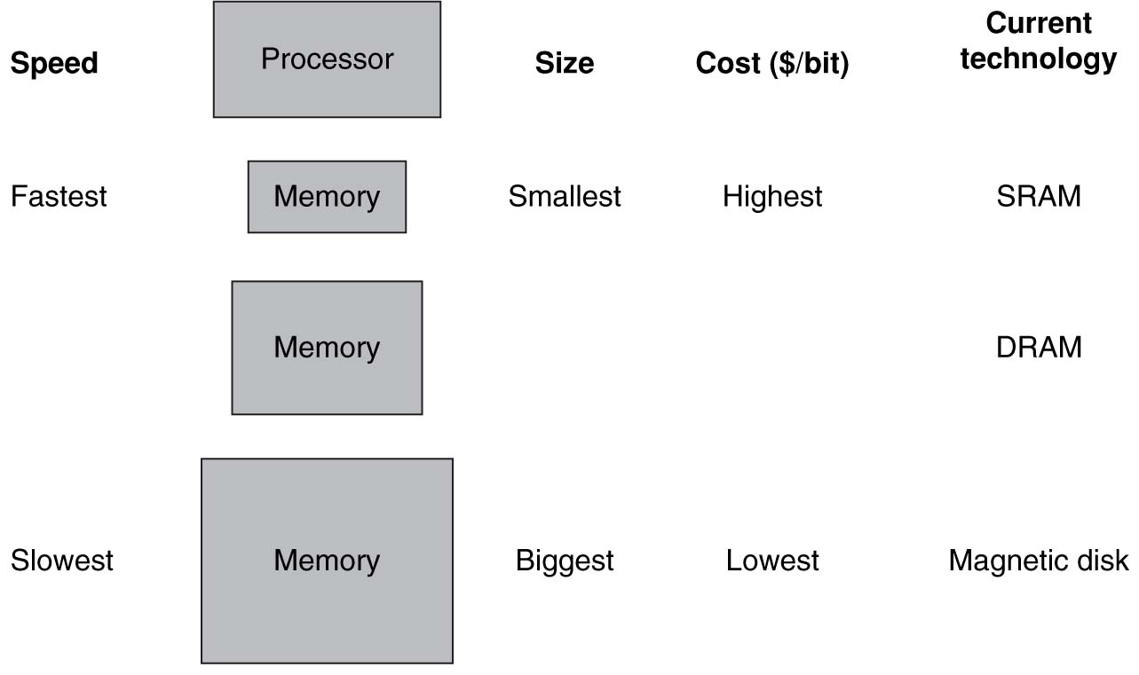
SYX SG-125 Gaming PC
Intel Core i7 2600 3.4 GHz, Genuine Windows® 7 Professional 64 Bit, 1GB NVIDIA GeForce GTX 550 Ti, 8GB DDR3, 1TB 7200rpm HDD, Blu-Ray, USB 3.0
4 x 256 KB L2 Cache
8MB Cache
8 GB System Memory
1 TB Hard Drive Space
Many Many internal registers
Notes:
4 x 256 KB L2 Cache
8MB Cache
8 GB System Memory
1 TB Hard Drive Space
Many Many internal registers

Slide 6
Definitions
Block
The minimum unit of information that can be either present or not present in the cache
Hit Rate
The fraction of memory accesses found in the level of the memory hierarchy
Miss Rate
The fraction of memory accesses not found in a level of the memory hierarchy
Miss penalty
The time required to fetch a block into a level of memory hierarchy from the lower level.

Slide 7
Cache Memory
The level of memory closest to the Processor

Slide 8
Determining where to look
Direct Mapped Cache
Block to access Cache Location (16 blocks)
0x01
0x05
0x15
0x22
0x37
0x3F
0x3D

Slide 9
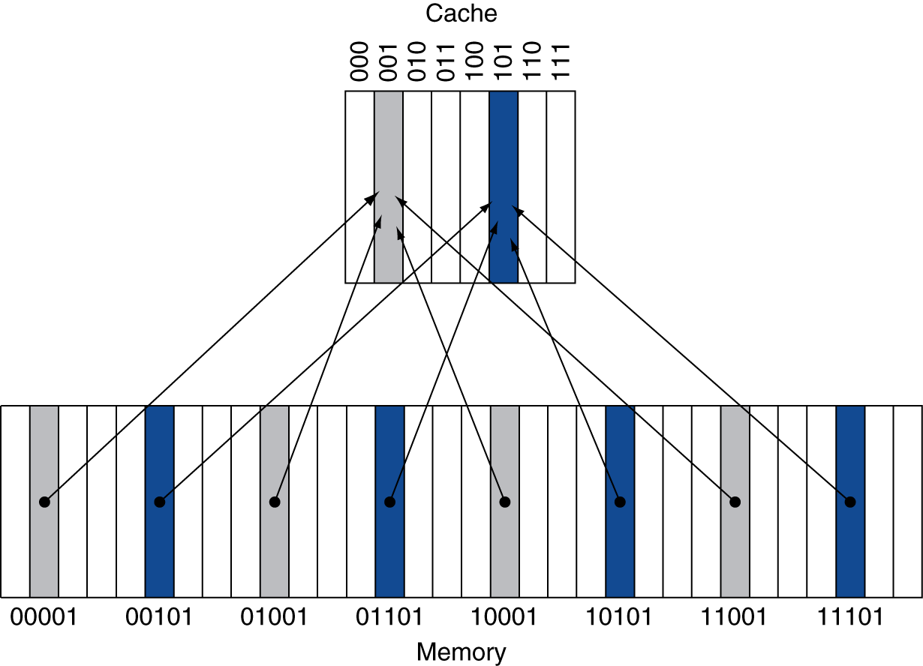
Direct Mapped Cache
#Blocks is a power of 2
Use low-order address bits

Slide 10
Tags and Valid bits
If we search the cache, how do we know if the data is valid or not?
How do we know which specific block in in the cache?
Valid Bit
Indicates the data in the associated block is valid
Tag: A field in the table containing the address information required to identify if the associated block is the correct block.
The upper bits of the address

Slide 11
Example Address stream
Index | V | Tag | Data
000 | N
001 | N
010 | N
011 | N
100 | N
101 | N
110 | N
111 | N
10110, 11010, 10000, 10110, 00011, 10010,

Slide 12
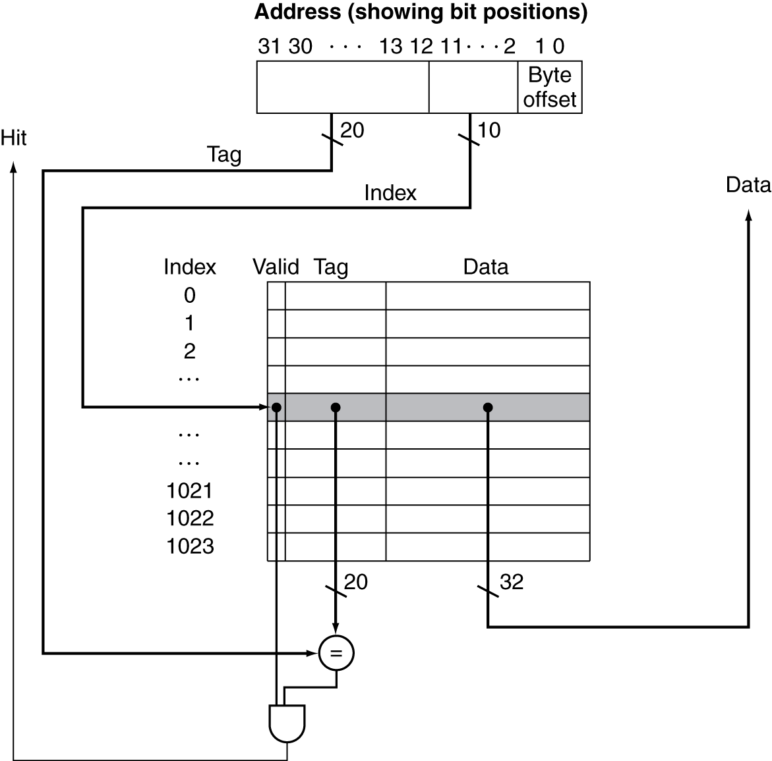
Address Subdivision

Slide 13
Determining Sizes

Slide 14
Minute Quiz
Which of the following statements is generally false?
Caches primarily take advantage of temporal locality
On a read, the value returned depends upon which blocks are in the cache
Most of the capacity of the memory hierarchy is at the lowest level
The most expensive portion of the memory hierarchy is at the highest level

