Slide 1
Cache Performance
Explain the relationship between miss rate and block size in a cache.
Construct a flowchart explaining how a cache miss is handled.
Compare and contrast write through and write back caching schemes.
Define the term write buffer.
Perform cache related calculations to analyze the impact of having a cache on a computer system.

Slide 2
Consider the lw instruction that loads a word from memory to a register:
0x1001004F
0x1001004E
0x1001004D
0x1001004C
0x1001004B
0x1001004A
0x10010049
23
lw $t0, ($t1) # $t1=0x10010048 After loading, $t0 will contain the value 0x2e0267ce.
A direct load from main memory would consume many CPU cycles, resulting in a long stall of every lw instruction.
40
01
20
ce
Word
67
02
0x10010048
0x10010047
0x10010046
0x10010045
0x10010044
2e
78
63
74
69

Slide 3
Ex: Direct Address cache, block size of 16B, #blocks=256 (4KB total) lw $t0, ($t1) # t1=0x1001 0048 (4-byte address) The Cache Index is computed from Memory Block Address 0x1001004. The cache block at that index is initially empty (Valid bit=0), resulting in a miss. The cache manager loads a block of 16 bytes into cache index 04, from main memory addresses 0x10010040 – 0x1001004F. This initial load from main to cache memory consumes many CPU cycles (~100), resulting in a long stall of this particular lw instruction.
Index (1 byte)
00
01
02
03
04
…
FF
Dirty (1 bit) | Valid (1 bit) | Tag (20 bits) | Data (16 bytes per block, individually addressed by 4 LSB)
0 | 0 | 0x00000 | 0 0 0 0 0 0 0 0 0 0 0 0 0 0 0 0
0 | 0 | 0x00000 | 0 0 0 0 0 0 0 0 0 0 0 0 0 0 0 0
0 | 0 | 0x00000 | 0 0 0 0 0 0 0 0 0 0 0 0 0 0 0 0
0 | 0 | 0x00000 | 0 0 0 0 0 0 0 0 0 0 0 0 0 0 0 0
0 | 0 | 0x00000 | 0 0 0 0 0 0 0 0 0 0 0 0 0 0 0 0
… | … | … | …
0 | 0 | 0x00000 | 0 0 0 0 0 0 0 0 0 0 0 0 0 0 0 0
Cache Index = (Memory Block Address) mod (#Blocks in Cache)

Slide 4
Once the cache block is loaded, the 4 bytes at address 0x10010048 are loaded into t1. lw $t0, ($t1) # t1=0x1001 0048, t0=0x2e02676e The Valid Bit for the block is set to 1 and the Tag Bits are set to 0x10010. Note that the original address of the memory location of the data can be reconstructed from the Tag Bits (10010) + Cache Index (04) + Byte Offset within the Block (8)
Index (1 byte)
00
01
02
03
04
…
FF
Dirty (1 bit) | Valid (1 bit) | Tag (20 bits) | Data (16 bytes per block, individually addressed by 4 LSB)
0 | 0 | 0x00000 | 0 0 0 0 0 0 0 0 0 0 0 0 0 0 0 0
0 | 0 | 0x00000 | 0 0 0 0 0 0 0 0 0 0 0 0 0 0 0 0
0 | 0 | 0x00000 | 0 0 0 0 0 0 0 0 0 0 0 0 0 0 0 0
0 | 0 | 0x00000 | 0 0 0 0 0 0 0 0 0 0 0 0 0 0 0 0
0 | 1 | 0x10010 | 45 20 2E 64 69 74 63 78 2e 02 67 6e 20 01 40 23
… | … | … | …
0 | 0 | 0x00000 | 0 0 0 0 0 0 0 0 0 0 0 0 0 0 0 0

Slide 5
Suppose the next instruction attempts to load the subsequent word into t0 lw $t0, ($t1) # t1=0x1001 0048, t0=0x2e02676e lw $t0, 4($t1) # load next word from 0x1001 004c The Cache Index is (again) computed from Memory Block Address 0x1001004. The cache block at that index is valid (Valid bit=1), and the tags match, resulting this time in a hit. This subsequent load from cache memory consumes only 1 CPU cycle, avoiding a stall of the lw instruction.
Index (1 byte)
00
01
02
03
04
…
FF
Dirty (1 bit) | Valid (1 bit) | Tag (20 bits) | Data (16 bytes per block, individually addressed by 4 LSB)
0 | 0 | 0x00000 | 0 0 0 0 0 0 0 0 0 0 0 0 0 0 0 0
0 | 0 | 0x00000 | 0 0 0 0 0 0 0 0 0 0 0 0 0 0 0 0
0 | 0 | 0x00000 | 0 0 0 0 0 0 0 0 0 0 0 0 0 0 0 0
0 | 0 | 0x00000 | 0 0 0 0 0 0 0 0 0 0 0 0 0 0 0 0
0 | 1 | 0x10010 | 45 20 2E 64 69 74 63 78 2e 02 67 6e 20 01 40 23
… | … | … | …
0 | 0 | 0x00000 | 0 0 0 0 0 0 0 0 0 0 0 0 0 0 0 0

Slide 6
The 3rd instruction loads a word from a different location in memory lw $t0, ($t1) # t1=0x1001 0048, t0=0x2e02676e lw $t0, 4($t1) # load next word from 0x1001 004c lw $t0, ($sp) # sp=0x7FFF EFFC, t0=0x1928ef3c The Cache Index is computed from Memory Block Address 0x7FFFEFF. The cache block at that index is initially empty (Valid bit=0), resulting in another miss. The cache manager loads a block of 16 bytes into cache index FF, from main memory addresses 0x7FFFEFF0 – 0x7FFFEFFF. Then the word at 0x7FFFEFFC is loaded into $t0.
Index (1 byte)
00
01
02
03
04
…
FF
Dirty (1 bit) | Valid (1 bit) | Tag (20 bits) | Data (16 bytes per block, individually addressed by 4 LSB)
0 | 0 | 0x00000 | 0 0 0 0 0 0 0 0 0 0 0 0 0 0 0 0
0 | 0 | 0x00000 | 0 0 0 0 0 0 0 0 0 0 0 0 0 0 0 0
0 | 0 | 0x00000 | 0 0 0 0 0 0 0 0 0 0 0 0 0 0 0 0
0 | 0 | 0x00000 | 0 0 0 0 0 0 0 0 0 0 0 0 0 0 0 0
0 | 1 | 0x10010 | 45 20 2E 64 69 74 63 78 2e 02 67 6e 20 01 40 23
… | … | … | …
0 | 1 | 0x7FFFE | 62 35 21 33 68 27 ad f7 92 c3 4f 45 19 28 ef 3c

Slide 7
The 4th instruction loads a word … lw $t0, ($t1) # t1=0x1001 0048, t0=0x2e02676e lw $t0, 4($t1) # load next word from 0x1001 004c lw $t0, ($sp) # sp=0x7FFF EFFC, t0=0x1928ef3c lw $t0, ($t3) # t3=0x2537 1044 The Cache Index is computed from Memory Block Address 0x2537104. The cache block at that index is currently valid (Valid bit=1), but the tags don’t match, resulting in a miss. The cache manager reloads a block of 16 bytes into cache index 04, from main memory addresses 0x2537140 – 0x243714F. The value 0xaabbccdd is loaded into $t0.
Index (1 byte)
00
01
02
03
04
…
FF
Dirty (1 bit) | Valid (1 bit) | Tag (20 bits) | Data (16 bytes per block, individually addressed by 4 LSB)
0 | 0 | 0x00000 | 0 0 0 0 0 0 0 0 0 0 0 0 0 0 0 0
0 | 0 | 0x00000 | 0 0 0 0 0 0 0 0 0 0 0 0 0 0 0 0
0 | 0 | 0x00000 | 0 0 0 0 0 0 0 0 0 0 0 0 0 0 0 0
0 | 0 | 0x00000 | 0 0 0 0 0 0 0 0 0 0 0 0 0 0 0 0
0 | 1 | 0x25371 | 12 34 56 78 aa bb cc dd 1a 2b 3c 4d 5e 6f 7a 8b
… | … | … | …
0 | 1 | 0x7FFFE | 62 35 21 33 68 27 ad f7 92 c3 4f 45 19 28 ef 3c

Slide 8
Discussion
An engineer is designing a computer system and is designing a system with either 64KB of cache or 256KB of cache. Which will perform better?
Another engineer is designing a system with 16KB of cache, and is trying to decide whether to use a block size of 16 or 64. Which will perform better?

Slide 9
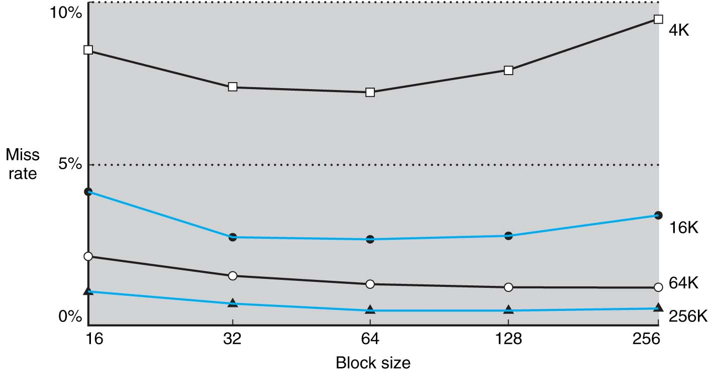
Experimental Results
What does this tell us?
Increasing total cache size decreases cache misses.
Increasing block size decreases miss rate to a point, at which point it starts going up again.
Notes:
What does this tell us?
Increasing total cache size decreases cache misses.
Increasing block size decreases miss rate to a point, at which point it starts going up again.
Note that this profile may be different for each program that executes.

Slide 10
Block size considerations
Larger blocks should reduce miss rate
Due to spatial locality
But in a fixed-sized cache
Larger blocks ⇒ fewer of them
More competition ⇒ increased miss rate
Larger blocks ⇒ pollution
Larger miss penalty
Can override benefit of reduced miss rate
Early restart and critical-word-first can help
Larger blocks exploit spatial locality to lower miss rates.
But miss rates increase when the block size becomes a significant portion of the cache size
Larger miss penalty: the larger the block, the longer it takes to load it
Notes:
Larger blocks should reduce miss rate
Due to spatial locality
But in a fixed-sized cache
Larger blocks ⇒ fewer of them
More competition ⇒ increased miss rate
Larger blocks ⇒ pollution
Larger miss penalty
Can override benefit of reduced miss rate
Early restart and critical-word-first can help

Slide 11
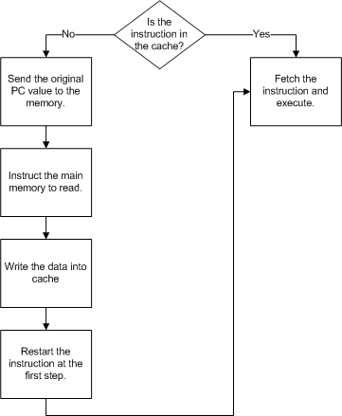
Handling Misses

Slide 12
Suppose the next instruction attempts to write the subsequent word to t1 lw $t0, ($t1) # t1=0x1001 0048, t0=0x2e02676e sw $t0, 4($t1) # now store $t0 to 0x1001 004c The Cache Index is computed from Memory Block Address 0x1001004. The cache block at that index is valid (Valid bit=1), and the tags match, resulting in a hit. This subsequent store to cache memory changes the contents of cache, but the main data memory is still (at this point) unchanged and out of sync with the cache. The change to the cache is noted by setting the Dirty Bit to 1.
Index (1 byte)
00
01
02
03
04
…
FF
Dirty (1 bit) | Valid (1 bit) | Tag (20 bits) | Data (16 bytes per block, individually addressed by 4 LSB)
0 | 0 | 0x00000 | 0 0 0 0 0 0 0 0 0 0 0 0 0 0 0 0
0 | 0 | 0x00000 | 0 0 0 0 0 0 0 0 0 0 0 0 0 0 0 0
0 | 0 | 0x00000 | 0 0 0 0 0 0 0 0 0 0 0 0 0 0 0 0
0 | 0 | 0x00000 | 0 0 0 0 0 0 0 0 0 0 0 0 0 0 0 0
1 | 1 | 0x10010 | 45 20 2E 64 69 74 63 78 2e 02 67 6e 2e 02 67 6e
… | … | … | …
0 | 0 | 0x00000 | 0 0 0 0 0 0 0 0 0 0 0 0 0 0 0 0

Slide 13
Another instruction loads a word … lw $t0, ($t1) # t1=0x1001 0048, t0=0x2e02676e sw $t0, 4($t1) # now store $t0 to 0x1001 004c lw $t0, ($t3) # t3=0x2537 1044 The Cache Index is computed from Memory Block Address 0x2537104. The cache block at that index is currently valid (Valid bit=1), but the tags don’t match, resulting in a miss. The Dirty Bit is also set, indicating that the cache has to be written to main memory before the reload can take place. This results in a double-length stall: first the changed cache has to be written to memory, then the new block needs to be loaded.
Index (1 byte)
00
01
02
03
04 (before) 04 (after)
…
FF
Dirty (1 bit) | Valid (1 bit) | Tag (20 bits) | Data (16 bytes per block, individually addressed by 4 LSB)
0 | 0 | 0x00000 | 0 0 0 0 0 0 0 0 0 0 0 0 0 0 0 0
0 | 0 | 0x00000 | 0 0 0 0 0 0 0 0 0 0 0 0 0 0 0 0
0 | 0 | 0x00000 | 0 0 0 0 0 0 0 0 0 0 0 0 0 0 0 0
0 | 0 | 0x00000 | 0 0 0 0 0 0 0 0 0 0 0 0 0 0 0 0
1 0 | 1 1 | 0x10010 0x25371 | 45 20 2E 64 69 74 63 78 2e 02 67 6e 2e 02 67 6e 12 34 56 78 aa bb cc dd 1a 2b 3c 4d 5e 6f 7a 8b
… | … | … | …
0 | 1 | 0x7FFFE | 62 35 21 33 68 27 ad f7 92 c3 4f 45 19 28 ef 3c

Slide 14
Approaches to Writing Data to memory
But cache and memory would be inconsistent
But writes will take longer
Buffers data writes. Only causes a stall if the buffer is full
Write through
Update cache plus block in main memory
A separate Write Buffer is used
Notes:
On data-write hit, could just update the block in cache
But then cache and memory would be inconsistent
Write through: also update memory
But makes writes take longer
e.g., if base CPI = 1, 10% of instructions are stores, write to memory takes 100 cycles
Effective CPI = 1 + 0.1×100 = 11
Solution: write buffer
Holds data waiting to be written to memory
CPU continues immediately
Only stalls on write if write buffer is already full

Slide 15
Cache Performance
Two different configurations for a cache system are being developed. In both cases, the miss penalty is 100 clock cycles, and the processor has an average CPI of 2 if no memory stalls occur.
The first cache system has a miss rate of 4% in the data cache.
The second system has a miss rate of 2% in the data cache.
36% of instructions are loads and stores.
Determine the performance relationship between processor A and processor B.

Slide 16
Problem solution
CPI_{A} / CPI_{B}=3.44/2.72=1.26
Processor A is 26% slower than Processor B

Slide 17
Average Memory Access Time
Average Memory Access Time (AMAT)
The average of the time (per instruction) it takes to access memory considering both hits and misses.

Slide 18
AMAT Problem
Solve the following:
A processor has a 1ns/inst clock cycle time, a miss penalty of 50 clock cycles, a miss rate of 0.1 misses per instruction, and a cache access time of 1 clock cycle.
Determine the average memory access time per instruction.

Slide 19
Solution

