Slide 1
Cache Design
Define set associative cache and fully associative cache.
Compare and contrast the performance of set associative caches, direct mapped caches, and fully associative caches.
Explain the operation of the LRU replacement scheme.
Explain the three C model for cache.

Slide 2
Direct-mapped Cache (4KB, 256 blocks @ 16 data bytes/block)
lw $t0, ($t1) # t1=0x1001 0048 (4-byte address)
The last four bits correspond to the address of the data within the block. The Cache Index is extracted from Memory Block Address 0x1001004.
The Tag is formed from the remaining digits of the Memory Block address.
All memory address with address digits 0xnnnnn04m will map to index 04 of the cache.
Index (1 byte) | Dirty (1 bit) | Valid (1 bit) | Tag (20 bits) | Data (16 bytes)
00 | 0 | 0 | 0x00000 | 0 0 0 0 0 0 0 0 0 0 0 0 0 0 0 0
01 | 0 | 0 | 0x00000 | 0 0 0 0 0 0 0 0 0 0 0 0 0 0 0 0
02 | 0 | 0 | 0x00000 | 0 0 0 0 0 0 0 0 0 0 0 0 0 0 0 0
03 | 0 | 0 | 0x00000 | 0 0 0 0 0 0 0 0 0 0 0 0 0 0 0 0
04 | 0 | 1 | 0x10010 | 45 20 2E 64 69 74 63 78 2e 02 67 6e 20 01 40 23
… | … | … | … | …
FF | 0 | 0 | 0x00000 | 0 0 0 0 0 0 0 0 0 0 0 0 0 0 0 0

Slide 3
Problems with direct-mapping
A given memory address maps into a specific cache block, based on the mapping formula. (e.g 0x10010048 and 0x25371044)
This can result in:
frequent misses due to competition for the same block
unused blocks of cache if no memory accesses map to those blocks
Index (1 byte) | Dirty (1 bit) | Valid (1 bit) | Tag (20 bits) | Data (16 bytes)
00 | 0 | 0 | 0x00000 | 0 0 0 0 0 0 0 0 0 0 0 0 0 0 0 0
01 | 0 | 0 | 0x00000 | 0 0 0 0 0 0 0 0 0 0 0 0 0 0 0 0
02 | 0 | 0 | 0x00000 | 0 0 0 0 0 0 0 0 0 0 0 0 0 0 0 0
03 | 0 | 0 | 0x00000 | 0 0 0 0 0 0 0 0 0 0 0 0 0 0 0 0
04 | 0 | 1 | 0x10010 0x25371 | 45 20 2E 64 69 74 63 78 2e 02 67 6e 20 01 40 23 12 34 56 78 aa bb cc dd 1a 2b 3c 4d 5e 6f 7a 8b
… | … | … | … | …
FF | 0 | 0 | 0x00000 | 0 0 0 0 0 0 0 0 0 0 0 0 0 0 0 0

Slide 4
Fully-Associative Cache (4KB, 256 blocks @ 16 data bytes/block)
A cache structure in which a block can be placed in any location in the cache.
A given address does not map to any specific location in the cache.
Motivation: Decreases cache misses.
For a given address, the least recently used (LRU) block is allocated. LRU bits are used to maintain a “record” of the last-used block. lw $t0, ($t1) # t1=0x1001 0048
lw $t0, ($t2) # t2=0x2537 1044
LRU (1 byte) | Dirty (1 bit) | Valid (1 bit) | Tag (28 bits) | Data (16 bytes)
01 | 0 | 1 | 0x1001004 | 45 20 2E 64 69 74 63 78 2e 02 67 6e 20 01 40 23
02 | 0 | 1 | 0x2537104 | 12 34 56 78 aa bb cc dd 1a 2b 3c 4d 5e 6f 7a 8b
00 | 0 | 0 | 0x0000000 | 0 0 0 0 0 0 0 0 0 0 0 0 0 0 0 0
00 | 0 | 0 | 0x0000000 | 0 0 0 0 0 0 0 0 0 0 0 0 0 0 0 0
00 | 0 | 0 | 0x0000000 | 0 0 0 0 0 0 0 0 0 0 0 0 0 0 0 0
… | … | … | … | …
00 | 0 | 0 | 0x0000000 | 0 0 0 0 0 0 0 0 0 0 0 0 0 0 0 0

Slide 5
Hit-testing a Fully-Associative Cache
Whenever a new memory access instruction occurs, the cache manager has to check every block that has a valid tag to see if the tags match (indicating a hit). After a very short period of time, every block is valid. If checking is done sequentially, this would take a significant amount of time. Parallel comparison circuitry can help, but such circuitry is expensive (256 comparators needed).
lw $t0, ($t1) # t1=0x1001 0048
lw $t0, ($t2) # t2=0x2537 1044
sw $zero, ($t2) # t2=0x2537 1040
LRU (1 byte) | Dirty (1 bit) | Valid (1 bit) | Tag (28 bits) | Data (16 bytes)
01 | 0 | 1 | 0x1001004 | 45 20 2E 64 69 74 63 78 2e 02 67 6e 20 01 40 23
02 | 1 | 1 | 0x2537104 | 00 00 00 00 aa bb cc dd 1a 2b 3c 4d 5e 6f 7a 8b
00 | 0 | 0 | 0x0000000 | 0 0 0 0 0 0 0 0 0 0 0 0 0 0 0 0
00 | 0 | 0 | 0x0000000 | 0 0 0 0 0 0 0 0 0 0 0 0 0 0 0 0
00 | 0 | 0 | 0x0000000 | 0 0 0 0 0 0 0 0 0 0 0 0 0 0 0 0
… | … | … | … | …
00 | 0 | 0 | 0x0000000 | 0 0 0 0 0 0 0 0 0 0 0 0 0 0 0 0

Slide 6
Miss-handling with LRU in a Fully-Associative Cache
Once the fully-associative cache is full, misses will result in the need to replace existing blocks. This is called a Capacity Miss.
lw $t0, ($t1) # t1=0x1001 0048, oldest access
lw $t0, ($t2) # t2=0x2537 1044
…
lw $s0, ($t4) # t2=0x1130 203c, newest access
The cache manager has to look for the Least Recently Used block (01), and replace that block’s content (writing back first if needed). Searching for the oldest block takes additional time.
LRU (1 byte) | Dirty (1 bit) | Valid (1 bit) | Tag (28 bits) | Data (16 bytes)
01 | 1 | 1 | 0x1001004 | 45 20 2E 64 69 74 63 78 2e 02 67 6e 20 01 40 23
02 | 1 | 1 | 0x2537104 | 00 00 00 00 aa bb cc dd 1a 2b 3c 4d 5e 6f 7a 8b
FF | 0 | 1 | 0xbbbbbbb | N N N N N N N N N N N N N N N N
C0 | 0 | 1 | 0xbbbbbbb | N N N N N N N N N N N N N N N N
32 | 1 | 1 | 0xbbbbbbb | N N N N N N N N N N N N N N N N
… | … | … | … | …
18 | 0 | 1 | 0xbbbbbbb | N N N N N N N N N N N N N N N N

Slide 7
Problems with Fully Associative Caches
Hit-testing requires comparison of every tag in the cache – too slow to do sequentially; expensive if parallel comparator circuitry is implemented.
Thus, hit-testing is slower/more expensive than in a direct-mapped cache.
Miss-handling takes additional time due to LRU determination.
LRU (1 byte) | Dirty (1 bit) | Valid (1 bit) | Tag (28 bits) | Data (16 bytes)
01 | 1 | 1 | 0x1001004 | 45 20 2E 64 69 74 63 78 2e 02 67 6e 20 01 40 23
02 | 1 | 1 | 0x2537104 | 00 00 00 00 aa bb cc dd 1a 2b 3c 4d 5e 6f 7a 8b
FF | 0 | 1 | 0xbbbbbbb | N N N N N N N N N N N N N N N N
C0 | 0 | 1 | 0xbbbbbbb | N N N N N N N N N N N N N N N N
32 | 1 | 1 | 0xbbbbbbb | N N N N N N N N N N N N N N N N
… | … | … | … | …
18 | 0 | 1 | 0xbbbbbbb | N N N N N N N N N N N N N N N N

Slide 8
Set-Associative Cache (8KB, 256 sets/512 blocks@ 16 data bytes/block)
A cache structure that has a fixed number of locations (e.g. two) where a given block can be placed
lw $t0, ($t1) # t1=0x1001 0008 (4-byte address) lw $t0, ($t2) # t2=0x2537 1004 The last four bits correspond to the address of the data within the block. The Set Index is extracted from Memory Block Address 0x1001000.
The Tag is formed from the remaining digits of the Memory Block address.
All memory address with address digits 0xnnnnn00m will map to set 00 of the cache. The LRU bits are set to indicate that the 2nd block was most recently used within the set.
Set Index (1 byte) | Set LRU (1 bit) | Dirty (1 bit) | Valid (1 bit) | Tag (20 bits) | Data (16 bytes)
00 | 0 | 0 | 1 | 0x10010 | 45 20 2E 64 69 74 63 78 2e 02 67 6e 20 01 40 23
 | 1 | 0 | 1 | 0x25371 | 12 34 56 78 aa bb cc dd 1a 2b 3c 4d 5e 6f 7a 8b
01 | 0 | 0 | 0 | 0x00000 | 0 0 0 0 0 0 0 0 0 0 0 0 0 0 0 0
 | 0 | 0 | 0 | 0x00000 | 0 0 0 0 0 0 0 0 0 0 0 0 0 0 0 0
… | … | … | … | … | …
FF | 0 | 0 | 0 | 0x00000 | 0 0 0 0 0 0 0 0 0 0 0 0 0 0 0 0
 | 0 | 0 | 0 | 0x00000 | 0 0 0 0 0 0 0 0 0 0 0 0 0 0 0 0

Slide 9
Hit-testing in a Set-Associative Cache
lw $t0, ($t1) # t1=0x1001 0008 (4-byte address) lw $t0, ($t2) # t2=0x2537 1004
sw $zero,($t3) # t3=0x1001 000c The Cache Set Index is computed from Memory Block Address 0x1001000. Both blocks in the set are occupied (Valid bit=1), so each of the tags is checked. A hit is detected with the first block, and the data is written at address c within the block.
The LRU bits are also flipped to indicate that the first block was more recently used.
(Dirty bit is also set in this case)
Set Index (1 byte) | Set LRU (1 bit) | Dirty (1 bit) | Valid (1 bit) | Tag (20 bits) | Data (16 bytes)
00 | 1 | 1 | 1 | 0x10010 | 45 20 2E 64 69 74 63 78 2e 02 67 6e 00 00 00 00
 | 0 | 0 | 1 | 0x25371 | 12 34 56 78 aa bb cc dd 1a 2b 3c 4d 5e 6f 7a 8b
01 | 0 | 0 | 0 | 0x00000 | 0 0 0 0 0 0 0 0 0 0 0 0 0 0 0 0
 | 0 | 0 | 0 | 0x00000 | 0 0 0 0 0 0 0 0 0 0 0 0 0 0 0 0
… | … | … | … | … | …
FF | 0 | 0 | 0 | 0x00000 | 0 0 0 0 0 0 0 0 0 0 0 0 0 0 0 0
 | 0 | 0 | 0 | 0x00000 | 0 0 0 0 0 0 0 0 0 0 0 0 0 0 0 0

Slide 10
Miss-handling in a Set-Associative Cache
lw $t0, ($t1) # t1=0x1001 0008 (4-byte address) lw $t0, ($t2) # t2=0x2537 1004
sw $zero, ($t1) # t2=0x1001 000c lw $t0, ($t2) # t2=0x3343 1000 The Cache Set Index is computed from Memory Block Address 0x3343100. Both blocks in the set are occupied (Valid bit=1), so each of the tags is checked. A miss is detected. The LRU indicates that the 2nd block is older, so that block is replaced
The LRU bits are again flipped to indicate that the 2nd block was more recently used
Set Index (1 byte) | Set LRU (1 bit) | Dirty (1 bit) | Valid (1 bit) | Tag (20 bits) | Data (16 bytes)
00 | 0 | 1 | 1 | 0x10010 | 45 20 2E 64 69 74 63 78 2e 02 67 6e 00 00 00 00
 | 1 | 0 | 1 | 0x33431 | 80 70 60 50 11 22 33 44 aa bb cc dd 12 34 56 78
01 | 0 | 0 | 0 | 0x00000 | 0 0 0 0 0 0 0 0 0 0 0 0 0 0 0 0
 | 0 | 0 | 0 | 0x00000 | 0 0 0 0 0 0 0 0 0 0 0 0 0 0 0 0
… | … | … | … | … | …
FF | 0 | 0 | 0 | 0x00000 | 0 0 0 0 0 0 0 0 0 0 0 0 0 0 0 0
 | 0 | 0 | 0 | 0x00000 | 0 0 0 0 0 0 0 0 0 0 0 0 0 0 0 0

Slide 11
The degree of associativity specifies how many blocks are in each set of a Set-Associative Cache
2-way set associativity = 2 blocks/set
The degree of associativity usually decreases the miss rate
A direct-mapped cache is really a 1-way set associate cache!
A significant gain is realized by going to 2-way associativity, but further increases in set size have little effect:

Slide 12
The Three Cs model
A Cache model in which all cache misses are classified into one of three categories
Compulsory Misses : arising from cache blocks that are initially empty (aka cold-start miss)
Capacity Misses: in a fully-associative cache, due to the fact that the cache is full
Conflict Miss: in a set-associate or direct-mapped cache, due to the fact that a block is already occupied

Slide 13
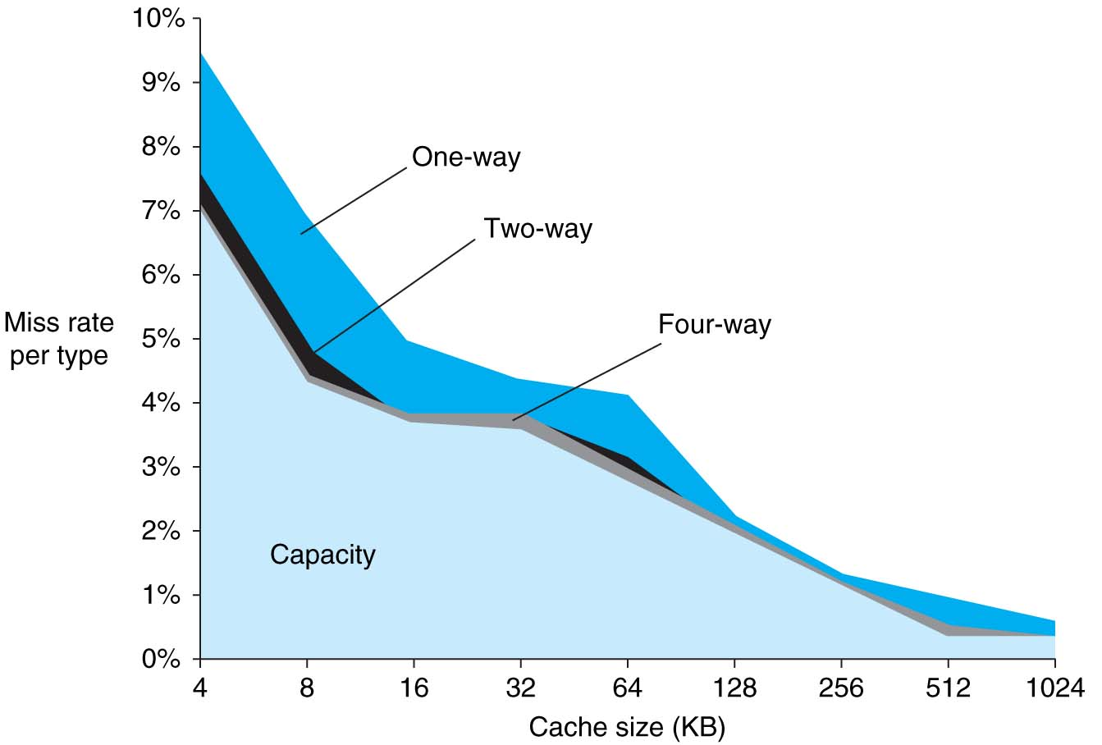
Source of misses
Compulsory misses not visible (0.006%)
Only happens on cold-start, so relatively few

Slide 14
Basic Design challenges
Design Change | Effect on miss rate | Possible negative performance impact
Increase the cache size | Decreases capacity misses | May increase access time
Increase Associativity | Decreases miss rate due to conflict misses | May increase access time
Increase Block Size | Decreases miss rate for a wide range of block sizes due to spatial locality | Increases miss penalty. Very large blocks could increase miss rate.

