Slide 1
IO Introduction and Reliability
Draw a picture showing the connection between the processor and memory mapped IO devices.
Define the terms reliability, dependability, and availability
Compare and contrast MTTF and AFR.
Explain the relationship between MTTF, MTTR, MTBF, and availability.
Given MTTR and MTTF data, calculate availability.

Slide 2
Io Device Classifications
Behavior
Input, output, storage
Partner
Human / Machine
Data Rate
The peak rate at which data can be transferred from one device to another.
Usually expressed in MBits per second (10⁶, not 2²⁰)
FYI: 2²⁰ =1,048,576

Slide 3
What device has the highest data rate?
For each of the following devices:
Keyboard
Scanner
Video Card

Slide 4
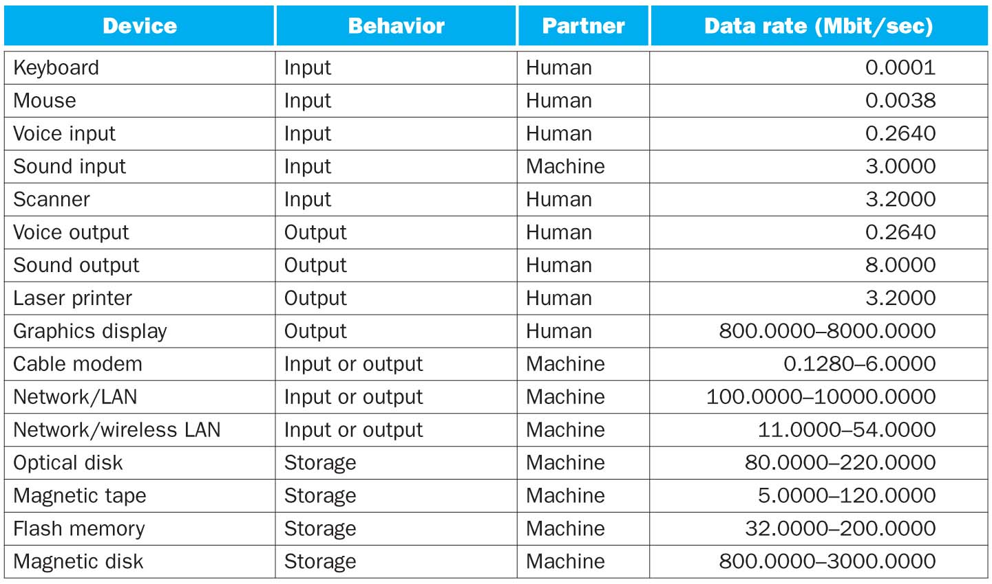
IO Device Diversity

Slide 5
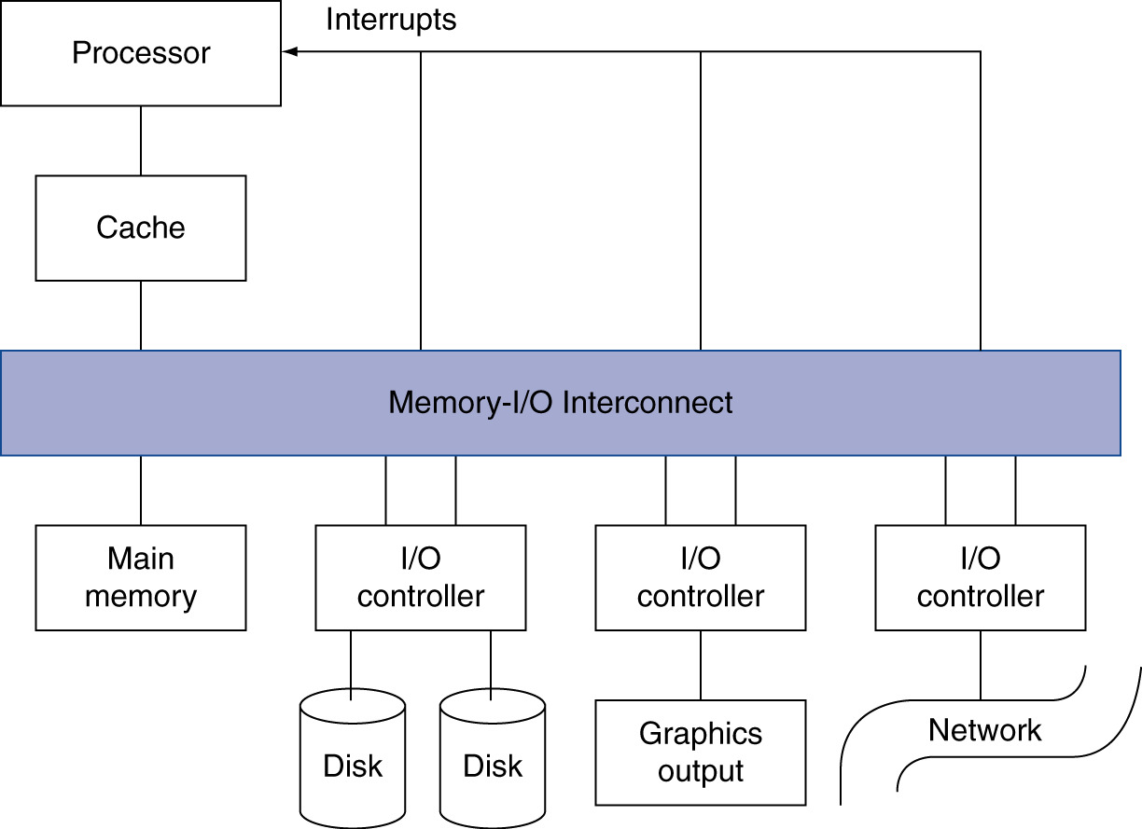
IO Device Interfacing: make devices “look” like memory
Explain that reading and writing to a peripheral is merely like reading and writing to memory.
Notes:
Explain that reading and writing to a peripheral is merely like reading and writing to memory.

Slide 6
Laptop device information

Slide 7
Dependability
The quality of delivered service such that reliance can be justifiably be placed on this service
Reliability
A measure of continuous service accomplishment, or the length of time to failure, from a given reference point
How soon before it breaks?
Availability
A measure of service accomplishment with respect to the alternation between states of accomplishment and states of interruption
Uptime vs. Downtime

Slide 8
More Definitions
Mean Time to Failure (MTTF)
The average time it takes for a system to fail once started
Mean time to repair (MTTR)
The average time it takes to repair a failed system
Mean time between failures (MTBF)
The average time between system failures

Slide 9
Availability

Slide 10
Solve the following:
MSOE is looking to replace its e-mail system. Two systems are being considered.
System 1 (Lookout*) has a mean time to failure of 99 hours and a mean time to repair of 1 hour.
System 2 (Woogle*) has a mean time to failure of 9999 hours and a mean time to repair of .1 hours. Which system is more available? Which system would be the better e-mail system?
*names have been obfuscated to protect the guilty
Notes:
A= MTTF/MTBF = MTTF/(MTTF+MTTR)

Slide 11
Where does failure matter? -Hard Drives
ata set | Type of | Duration | #Disk | # Servers | Disk | Disk | MTTF | Date of first | ARR
 | cluster |  | events |  | Count | Parameters | (Mhours) | Deploym. | (%)
HPC1 | HPC | 08/01 - 05/06 | 474 | 765 | 2,318 | 18GB 10K SCSI | 1.2 | 08/01 | 4.0
" | " | " | 124 | 64 | 1,088 | 36GB 10K SCSI | 1.2 | " | 2.2
HPC2 | HPC | 01/04 - 07/06 | 14 | 256 | 520 | 36GB 10K SCSI | 1.2 | 12/01 | 1.1
HPC3 | HPC | 12/05 - 11/06 | 103 | 1,532 | 3,064 | 146GB 15K SCSI | 1.5 | 08/05 | 3.7
" | HPC | 12/05 - 11/06 | 4 | N/A | 144 | 73GB 15K SCSI | 1.5 | " | 3.0
" | HPC | 12/05 - 08/06 | 253 | N/A | 11,000 | 250GB 7.2K SATA | 1.0 | " | 3.3
HPC4 | Various | 09/03 - 08/06 | 269 | N/A | 8,430 | 250GB SATA | 1.0 | 09/03 | 2.2
" | HPC | 11/05 - 08/06 | 7 | N/A | 2,030 | 500GB SATA | 1.0 | 11/05 | 0.5
" | clusters | 09/05 - 08/06 | 9 | N/A | 3,158 | 400GB SATA | 1.0 | 09/05 | 0.8
COM1 | Int. serv. | May 2006 | 84 | N/A | 26,734 | 10K SCSI | 1.0 | 2001 | 2.8
COM2 | Int. serv. | 09/04 - 04/06 | 506 | 9,232 | 39,039 | 15K SCSI | 1.2 | 2004 | 3.1
COM3 | Int. serv. | 01/05 - 12/05 | 2 | N/A | 56 | 10K FC | 1.2 | N/A | 3.6
" | " | " | 132 | N/A | 2,450 | 10K FC | 1.2 | N/A | 5.4
" | " | " | 108 | N/A | 796 | 10K FC | 1.2 | N/A | 13.6
" | " | " | 104 | N/A | 432 | 10K FC | 1.2 | 1998 | 24.1
1.2 Million hours is approximately 136 years.
Notes:
1.2 Million hours is approximately 136 years.
Bianca Schroeder, Garth Gibson. "Disk failures in the real world: What does an MTTF of 1,000,000 hours mean too you?" 5th Usenix Conference on File and Storage Technologies (FAST 2007).

Slide 12
Failure Root Cause Analysis

