Slide 1
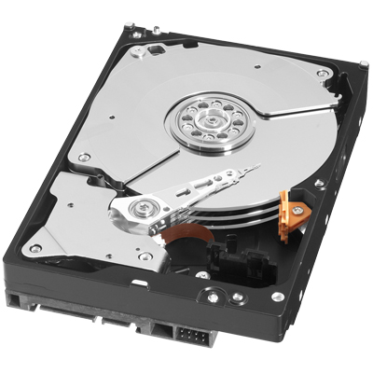
Disk Based Storage
Define the terms track, sector, and seek as pertaining to a nonvolatile storage medium.
Calculate the average rotational for a disk given disk performance criteria.
Calculate the disk read time for a hard drive given performance characteristics for the disk.
Based on desired criteria, choose appropriate performance characteristics for a given drive based on need.

Slide 2
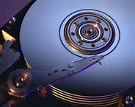
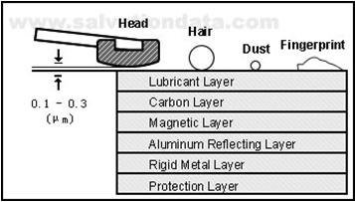
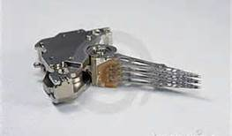

Slide 3
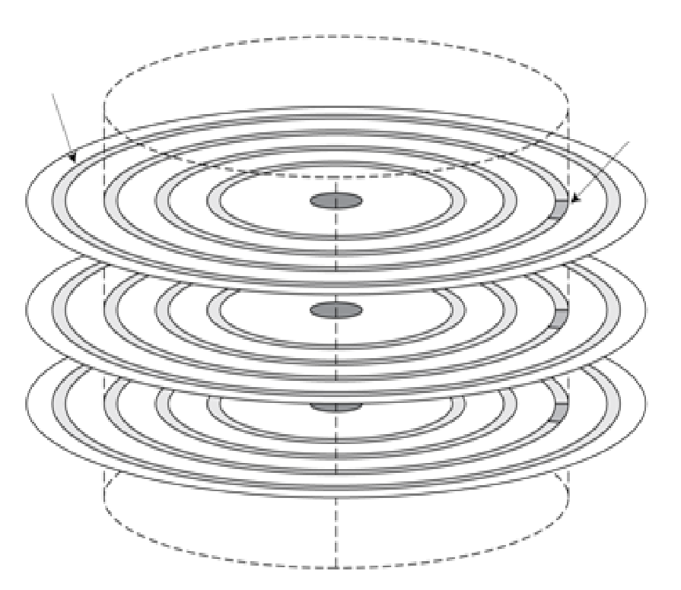
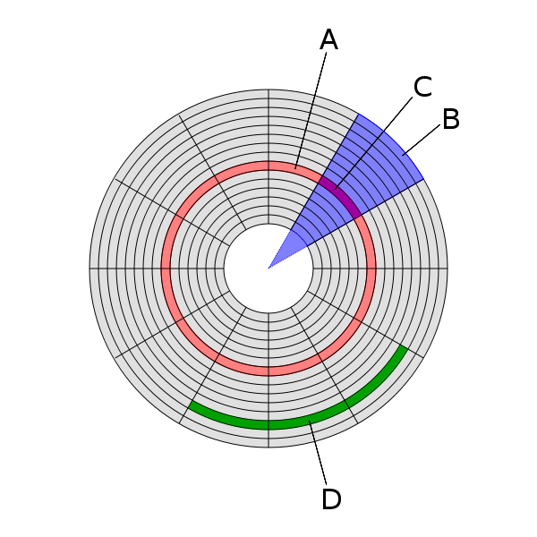
Disk structure
A
C
Track (A)
A concentric circle of data on the surface of a magnetic disk
Sector (C)
A segment of a circular track on a magnetic disk
The smallest amount of information that is read to or written from a disk (512-2048 bytes)
Newest drives use 4096 byte sectors
Multiple adjacent sectors within a track constitute a cluster (D)
Multiple adjacent sectors within a physical section of the disk are called geometric sectors
Disks are nonvolatile storage devices – data retains its value even
when power is removed.
Notes:
Seagate 500GB drive parameters:
7200RPM
976,773,168 sectors total
512 bytes/sector
63 sectors/track
15,504,336 tracks
16 read/write heads
8 2-sided platters: 969,021 tracks/side

Slide 4
Read seek avg: 8.5-11ms
Avg R/W data rate: 125-146MB/s
Bytes/sector 512 - 4096

Slide 5
Definition
Rotational latency
The time required for the desired sector of a disk to rotate under the read/write head
Usually assumed to be half the rotation time
A hard drive spins at 10000 RPM. What is the average rotational latency (in ms)?

Slide 6
How long does it take to read a sector from a disk?
Depends on/is the sum of:
Seek time (time needed to position read head over the correct track)
Rotational latency (time needed for the sector to rotate under the head)
Transfer time (time needed to transfer bits from disk to IO controller)
Overhead of the IO Controller
A hard drive rotates at 15000 RPM and the average seek time is 5 ms. The transfer rate is 75 MB/second, and the controller overhead is 0.5ms.
What is the average time it takes to read a single sector?
Notes:
Seeking:
The process of positioning a read/write head over the proper track on a disk
Solution: AvgReadTime=SeekTime +RotationalLatencyTime +TransferTime + ControllerOverhead
= 5ms + 0.5rotations/15000RPM + 0.5KB/(75MB/s) + 0.5ms
= 5ms + 1/30000 min + ~1/150,000,s + 0.5ms
= 5ms + 1/30000 min * (60000ms/min) + 1/150000 s *1000ms/s + 0.5ms
= 5ms + 2ms + + 0.0067ms +0.5ms
= 7.507ms ( <1/10% of the total time is taken by the actual read op; most time is taken by the mechanical seek)

Slide 7
Why do we care about these numbers?
Desktop PC?
Laptop PC?
Cloud based server?
Make sure to note that the faster the disk spins, the more power (generally) it uses
Notes:
Make sure to note that the faster the disk spins, the more power (generally) it uses

Slide 8
Problem
On the next slide there will be specifications for multiple hard drives.
You are asked to pick a hard drive that would best suit a laptop PC, where power consumption is important. Which drive would you choose and why?
You have been asked to create a system to serve video out over the internet, starting with an estimate storage need of 10 TB. Which hard drive would be your best choice for long term reliability, cost, and performance? Why?

Slide 9
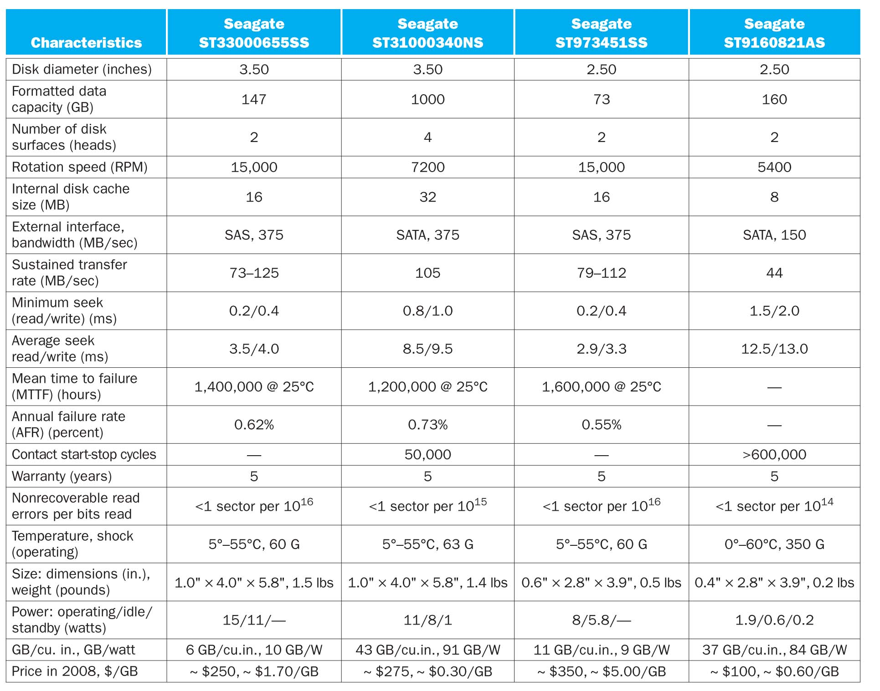
Drive data sheets

