Slide 1
Flash Storage and IO Operation
Explain the limitations of flash memory.
Define wear leveling.
Define the term IO Transaction
Define the terms synchronous bus and asynchronous interconnect.
Explain the difference between polling and interrupts

Slide 2
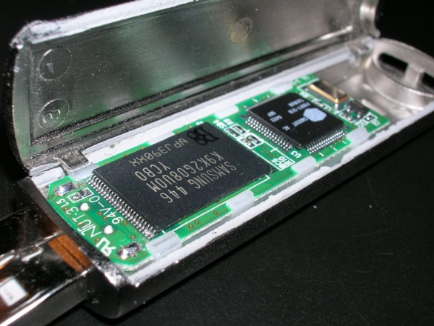
Flash Storage
§6.4 Flash Storage
Nonvolatile semiconductor storage
100× – 1000× faster than disk
Smaller, lower power, more robust
But more $/GB (between disk and DRAM)

Slide 3
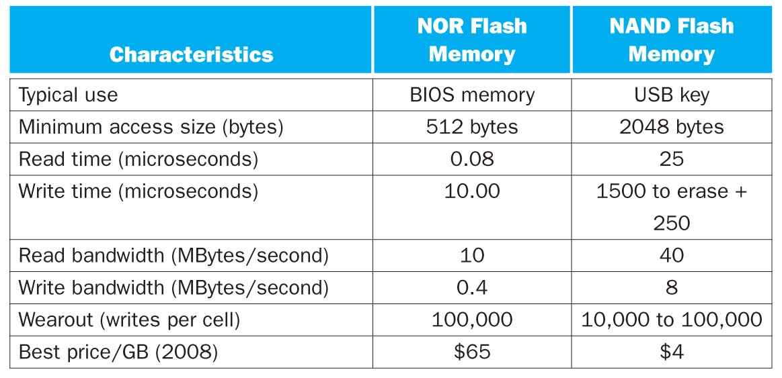
Flash Memory Performance
Limitations
Cost is higher than mechanical drives
Cells wear out over time

Slide 4
Flash memory can only be written to a finite number of times
Write operations begin to fail after 10000-100000 cycles (current technology)
Disk drives or DRAM memory do not have this limitation
Wear leveling
A technique which organizes blocks of data so that blocks which have been rewritten many times are exchanged for blocks which have not been written as often.

Slide 5
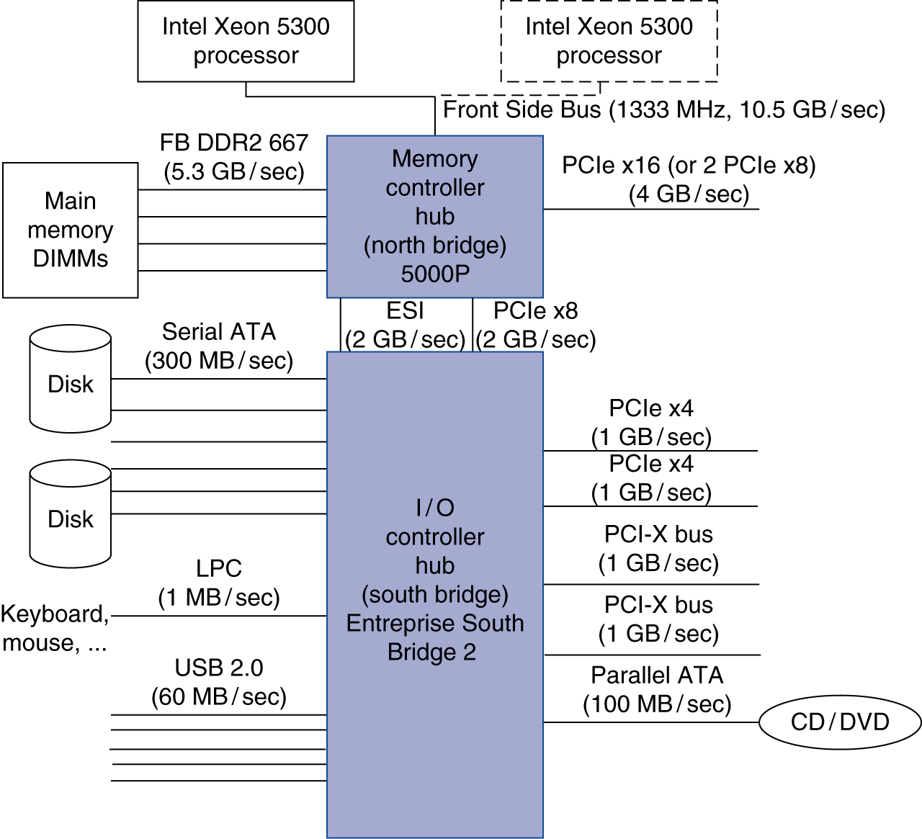

Slide 6
Definitions
Processor memory bus
A bus that connect the processor to the memory, and is generally high speed.
Backplane bus
A bus that is designed to allow processors, memory, and I/O devices to coexist on a single bus
IO Transaction
A sequence of operations over the interconnect that includes a request, and may include a response either of which may carry data.
Synchronous bus
A bus that includes clock and control lines and a fixed protocol for communicating that is relative to the clock
Asynchronous interconnect
A mechanism which uses a handshaking protocol rather than a clock to accommodate devices of varying speeds.

Slide 7
I/O Management
I/O is mediated by the OS
Multiple programs share I/O resources
Need protection and scheduling
I/O causes asynchronous interrupts
Same mechanism as exceptions
I/O programming is fiddly
OS provides abstractions to programs
§6.6 Interfacing I/O Devices …

Slide 8
I/O Commands
I/O devices are managed by I/O controller hardware
Transfers data to/from device
Synchronizes operations with software
Command registers
Cause device to do something
Status registers
Indicate what the device is doing and occurrence of errors
Data registers
Write: transfer data to a device
Read: transfer data from a device

Slide 9
I/O Register Mapping
Memory mapped I/O
Registers are addressed in same space as memory
Address decoder distinguishes between them
OS uses address translation mechanism to make them only accessible to kernel
I/O instructions
Separate instructions to access I/O registers
Can only be executed in kernel mode
Example: x86

Slide 10
Polling

Slide 11
Polling
Periodically check I/O status register
If device ready, do operation
If error, take action
Common in small or low-performance real-time embedded systems
Predictable timing
Low hardware cost
In other systems, wastes CPU time

Slide 12
Interrupts
No! Shut up and I’ll tell you when we are there!

Slide 13
Interrupts
When a device is ready or error occurs
Controller interrupts CPU
Interrupt is like an exception
But not synchronized to instruction execution
Can invoke handler between instructions
Cause information often identifies the interrupting device
Priority interrupts
Devices needing more urgent attention get higher priority
Can interrupt handler for a lower priority interrupt

