Slide 1
Computer Parts and Performance
List the 5 classical components of a computer and show their relationships graphically.
Define instruction set architecture.
Define throughput and response time.
Explain the relationship between user CPU time and System CPU time.
Define the relationship between CPU execution time, CPU clock cycles, and Clock rate.
Given the average CPI for instruction classes, determine which implementation will execute faster.
Given an instruction profile, calculate the average CPI for the program.

Slide 2

Practice Problems for next week’s quiz
Exercise 1.3
Exercise 1.4
Exercise 1.5

Slide 3
Discussion: What are the parts of a computer?
Try and guide the discussion to generate the concepts of input, output, processor, datapath, and control.

Slide 4
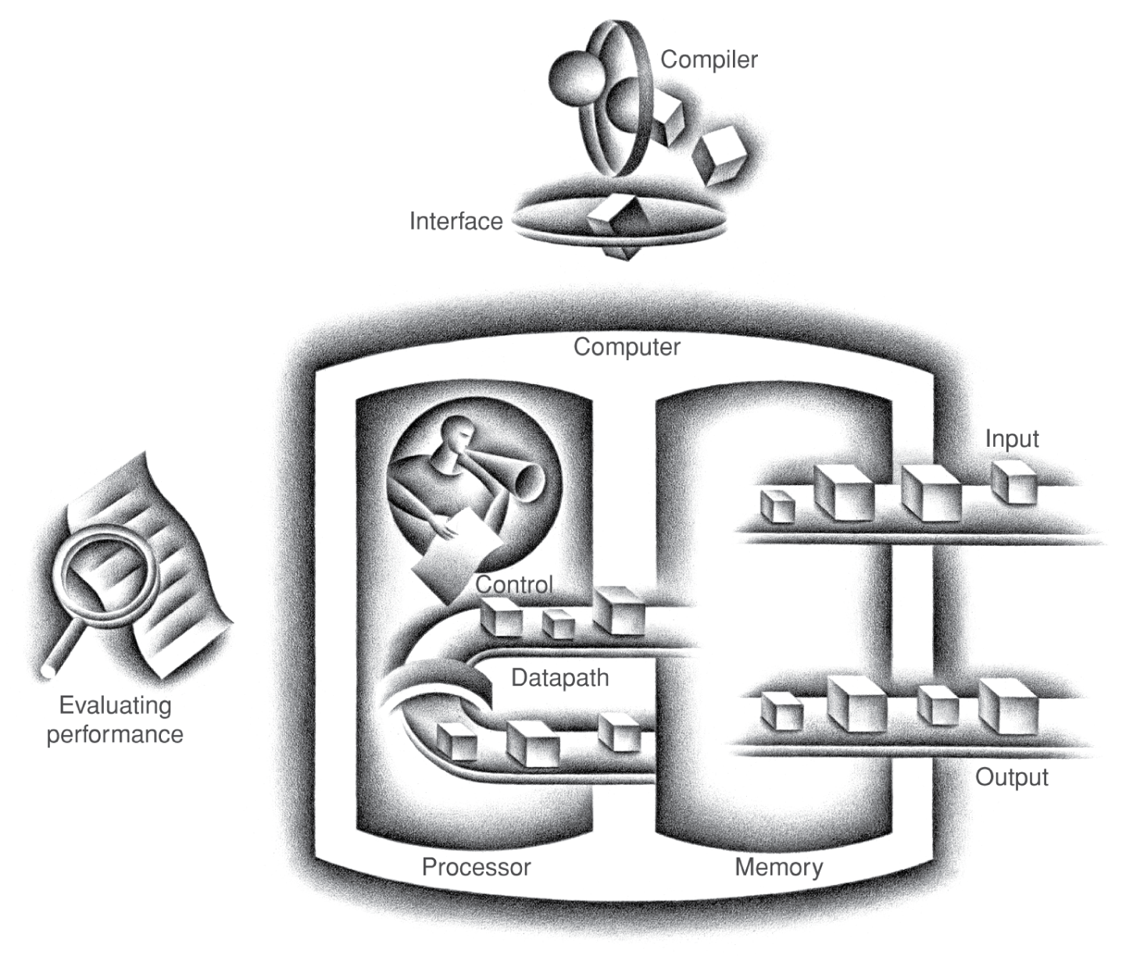
Big Picture: The organization of a computer

Slide 5
Survey Question
The smallest individual element of a picture is called a
  Bit
  Bit map
  Pixel
  Coordinate
  Liquid crystal

Slide 6
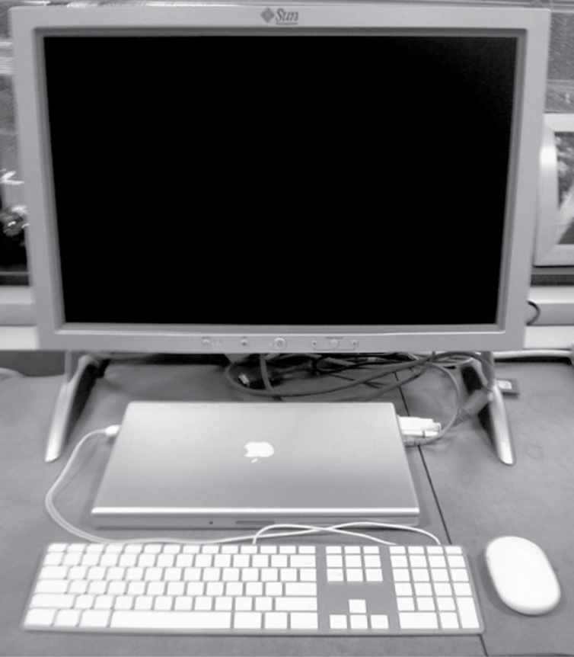
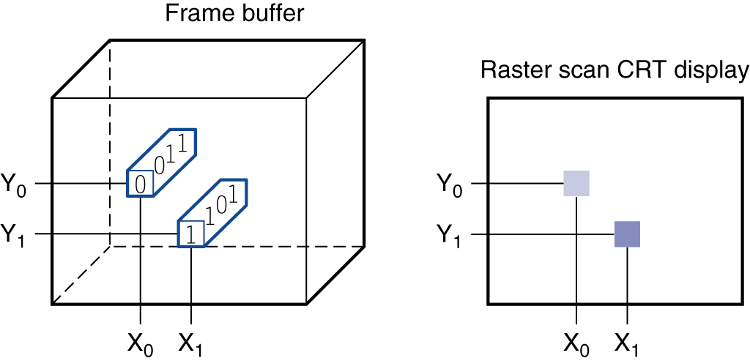
Output Device: An LCD screen
Have students identify input and output devices

Slide 7
Through the Looking Glass
LCD screen: picture elements (pixels)
  Mirrors content of frame buffer memory

Slide 8
Survey Question
The _____ is where the programs are kept when executing and also contains the data necessary to execute the program.
  Motherboard
  Active matrix display
  Memory
  CPU
  controlpath

Slide 9
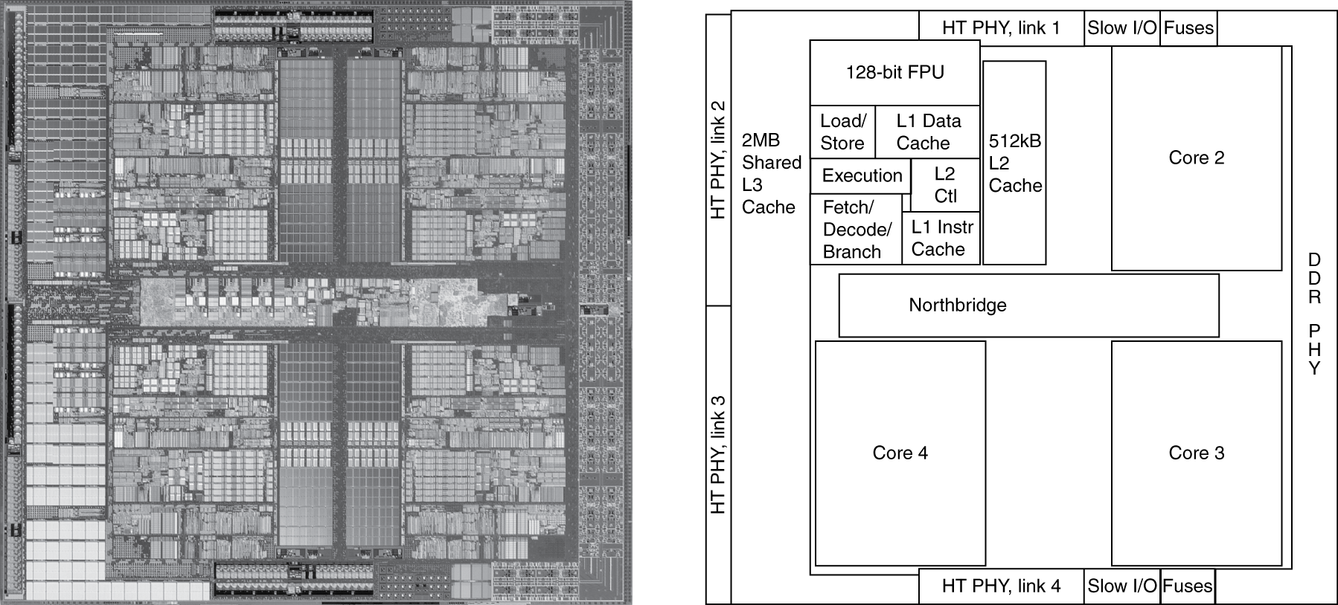
Micrograph of a processor
AMD Barcelona

Slide 10
Instruction set architecture
An abstract interface between the hardware and the low level software

Slide 11
Measuring Performance
You are evaluating lawn cutting. Which are you more concerned about, how long it takes to cut a lawn or how many lawns can be cut in a given amount of time?

Slide 12
Throughput and Response Time
Response Time (Execution Time)
  The total amount of time required for a computer to complete a specific task
Throughput
  The number of tasks completed per unit of time.
Discussion:
Who cares about Response time (We do)
Who cares about throughput (Amazon.com, google, etc.)
Notes:
Discussion:
Who cares about Response time (We do)
Who cares about throughput (Amazon.com, google, etc.)

Slide 13
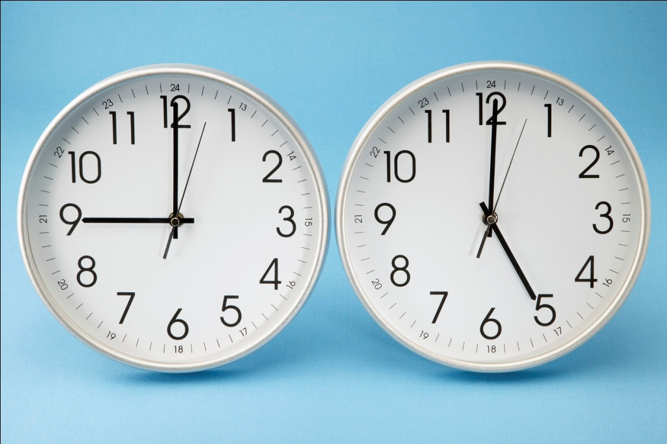
Measuring Performance
The time the CPU spends executing a specific program is
  CPU time
  User CPU Time
  System CPU Time
  Elapsed time
  Wall time

Slide 14
What governs CPU performance?
Q: What are the units of :
ExecutionTime? (s)
ClockCycleTime? (s/cycle)
Performance improved by
  Reducing number of clock cycles
  Increasing clock rate
  Hardware designer must often trade off clock rate against cycle count
Notes:
Performance improved by
Reducing number of clock cycles
Increasing clock rate
Hardware designer must often trade off clock rate against cycle count

Slide 15
CPI
  Clock Cycles Per Instruction
  The average number of clock cycles an instruction take to complete
    What is meant by “average”?
    For example: Some sequence may take 100 clock cycles to execute 40 different instructions. Thus 2.5 clock cycles per instruction
    Note that any individual instruction always takes a fixed number of clock cycles to execute, but different kinds of instructions require a specific number of clock cycles (typically 1-2, but possibly more)
  Allows us to compare two different implementations of a system

Slide 16
Practice problem 1.3
table 1.3 | Processor | Clock Rate | CPI
a | P1 | 3 GHz | 1.5
 | P2 | 2.5 GHz | 1.0
 | P3 | 4 GHz | 2.2
b | P1 | 2 GHz | 1.2
 | P2 | 3 GHz | 0.8
 | P3 | 4 GHz | 2.0
1.3.1: Which processor has the highest performance expressed in instructions per second?

Slide 17
Practice problem 1.4
table 1.4 | Processor | Clock Rate | CPI A | CPI B | CPI C | CPI D
a | P1 | 2.5 GHz | 1 | 2 | 3 | 3
 | P2 | 3 GHz | 2 | 2 | 2 | 2
b | P1 | 2.5 GHz | 2 | 1.5 | 2 | 1
 | P2 | 3 GHz | 1 | 2 | 1 | 1
1.4.1: Given a program with 1E6 instructions divided into classes as follows: 10% class A, 20% class B, 50% class C, and 20% class D, which implementation is faster?

Slide 18
Practice problem 1.5
table 1.5 | Processor | Clock Rate | CPI A | CPI B | CPI C | CPI D | CPI D
a | P1 | 2 GHz | 1 | 2 | 3 | 4 | 3
 | P2 | 4 GHz | 2 | 2 | 2 | 4 | 4
b | P1 | 2 GHz | 1 | 1 | 2 | 3 | 2
 | P2 | 4 GHz | 1 | 2 | 3 | 4 | 3
1.5.1: Assume that the peak performance is defined as the fastest rate that a computer can execute any instruction sequence. What are the peak performances of P1 and P2 expressed in instructions per second?

