Slide 1
Notes: Prior to class, instructor will need to obtain a set of power supplies with current measurement from tech support as well as a set of 50 ohm ¼ W resistors and a set of 50 ohm larger resistors as well.
You will also need a modified SunROM board with interchangeable crystals

Slide 2
Ohms Law and Power
Explain the relationship between current, voltage, and resistance (Ohms Law)
Calculate the power dissipated in a resistor based on voltage and current
Explain the relationship between clock rate and dissipated power.

Slide 3
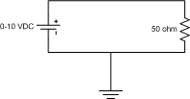
In Class Activity
Your instructor will pass out a power supply and a resistor
  Wire the following circuit (Your instructor will aid you)
  Starting at 0 V, measure the current as you increase the voltage between 0 and 10 V.
  Plot the results

Slide 4
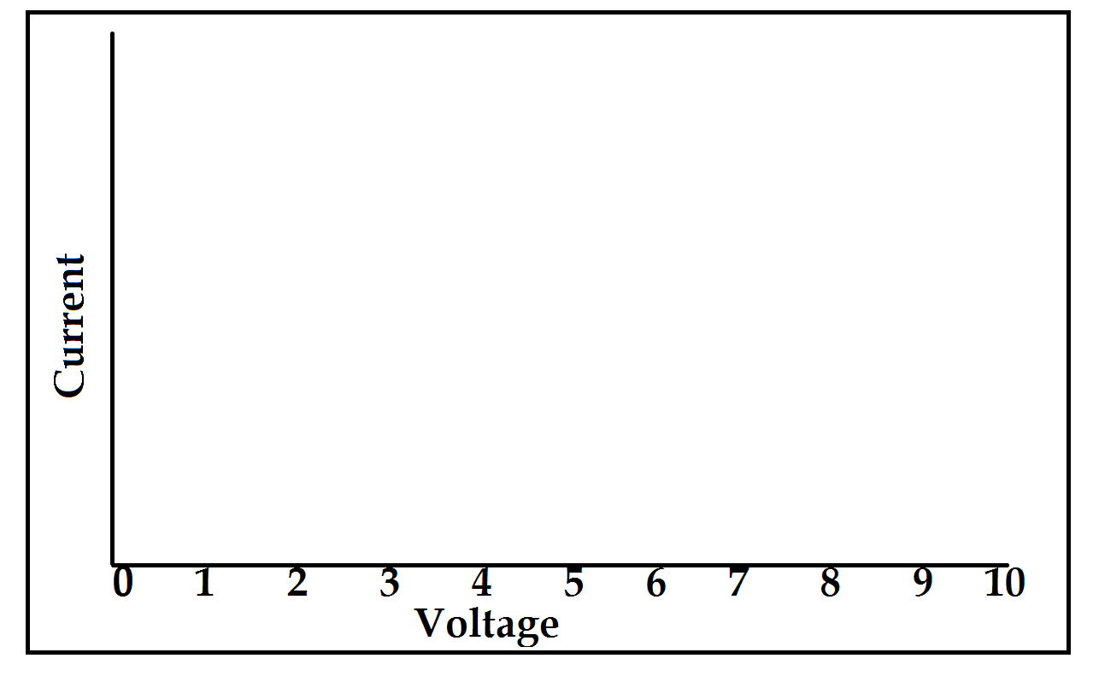
In class activity
Voltage | Current | Voltage | Current
.5 V |  | 4V
1V |  | 5V
1.5V |  | 6V
2V |  | 7V
2.5V |  | 8V
3V |  | 9V
3.5V |  | 10V

Slide 5
Ohms Law
V=> Voltage, which is electrical “pressure”
I=> Current, which is rate of electron flow
R=> Resistance (of a material to flow of electrons through it)wa

Slide 6
Power
W=> Power (Watts), electrical work done per unit time (Joules/s)
V=> Voltage
I=> Current
R=> Resistance

Slide 7
What is power?
Power is the energy used by an electronic device to do work
  For computers, it’s byproduct is heat.

Slide 8
Demo part 2
Using a modified SunROM board, measure the power used to run the board at 1Mhz, 4 Mhz, and 16 MhZ.
Sample code for the program is available.

Slide 11
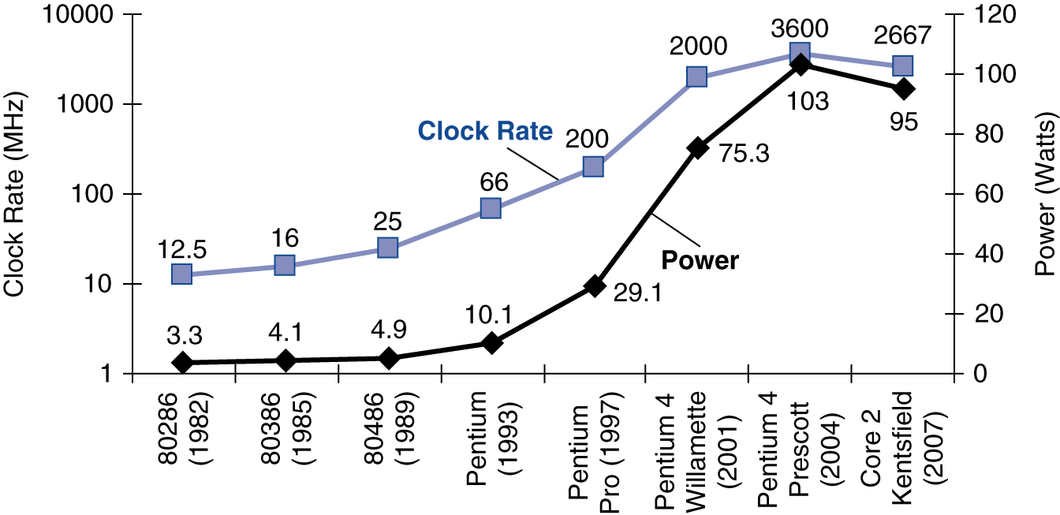
Power and computers

Slide 12
Power Calculation for transistors switching on/off
What will cause power to go up?

Slide 13
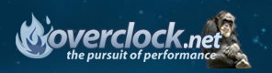
Why do you care?
Overclocking
  Setting your CPU and memory to run at speeds higher than their official speed grade.
  Intel Core i7 860
    2.80GHz out of the box.
    Overclocked if pushed to a clock speed higher than 2.80GHz

