Slide 1
Instruction Set-Intro
Explain the difference between Harvard and Von Neumann architectures in a computer.
Define instruction set
Explain the concept of the source and destination registers for the MIPS instruction set.
Using the MIPS instruction set, explain how to add a set of variables.
Define the term computer register
Define the term data transfer instruction
Using the MIPS instruction set, initialize a register to a fixed value.

Slide 2
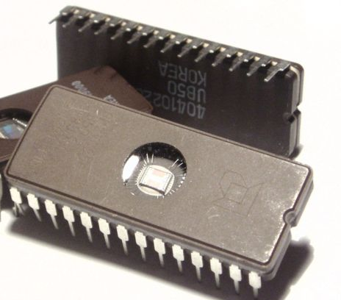
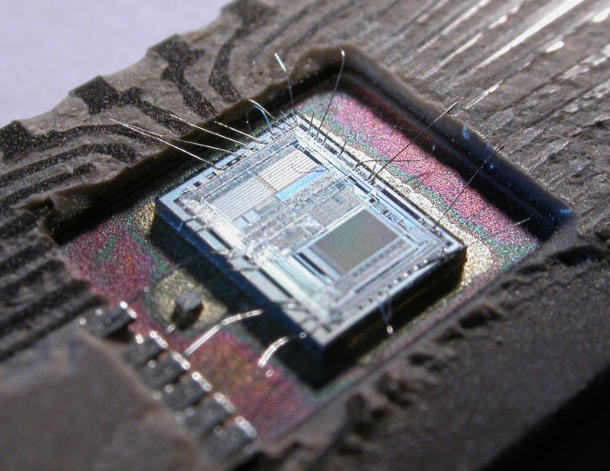

Slide 3
Instruction Sets
The vocabulary of commands understood by a given computer architecture.
Different computers have different instruction sets
  But with many aspects in common, since generally computer hardware architectures are similar
    Design principle: “Simplicity favors regularity”
  Once you learn one instruction set, learning others is relatively easy
    “More like dialects than separate languages”
Early computers had very simple instruction sets
  Simplified implementation
  Today, most modern computers also have simple instruction sets
    Design principle: “Smaller is faster”

Slide 4
Operands and Operations in Math
Highlight that 3 and 3 are operands
Highlight that the + is the operation
Highlight that 6 is the operation
3 + 2
The values 3 and 2 are the operands
The operation is addition
Notes:
Highlight that 3 and 3 are operands
Highlight that the + is the operation
Highlight that 6 is the operation

Slide 5
Mathematical Operations supported by typical instruction sets
Addition
Subtraction
Multiplication
Division
What about y^{x} ?

Slide 6
The Stored Program Concept
The idea that instructions (operations) and data (operands) of many types can both be stored in memory as numbers.
  John von Neumann, 1940’s

Slide 7
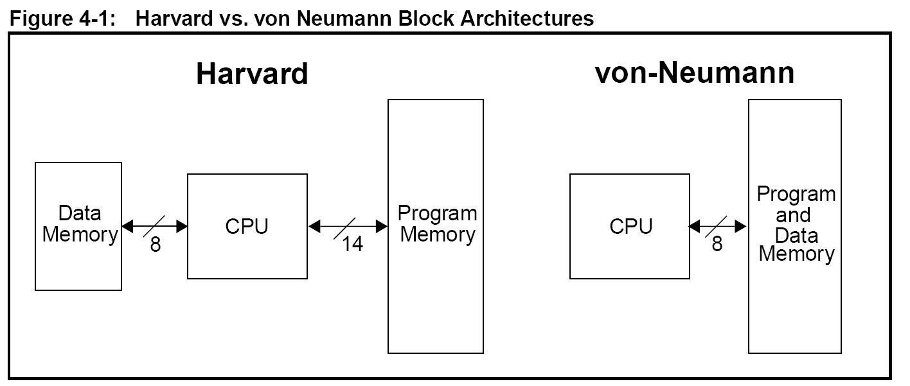
Data and program instructions are stored in different memory spaces.
Each memory space has a separate bus, which allows:
  Different timing, size, and structure for program instructions and data.
  Concurrent access to data and instructions.
  Clear partitioning of data and instructions (=> security)
  Data and instructions are both stored in a single main memory space
  The content of the memory is addressable by location (without regard to what is stored in that location – either data or instructions)
    Same timing/size/structure for accessing either data or instructions
    Non-concurrent access to data and instructions (rather, sequential)
    Allows data to be executed as instructions! (=>insecure)
Remove?
Notes:
Harvard Architecture
Assign data and program instructions to different memory spaces.
Each memory space has a separate bus.
This allows:
-> Different timing, size, and structure for program instructions and data.
-> Concurrent access to data and instructions.
-> Clear partitioning of data and instructions (=> security)
-> This makes it harder to program, because static data can be in the program space or in the data space.
-> If the program space and the data space are incompatible, copying data is no longer a (<start>,len) dump.

Slide 8
The MIPS Instruction Set
Used for most examples in textbook
Will be used as example language for the course
Stanford MIPS commercialized by MIPS Technologies (www.mips.com)
Large share of embedded core market
  Applications in consumer electronics, network/storage equipment, cameras, printers, …
Typical of many modern Instruction Set Architectures (ISA’s)
  See MIPS Reference Data tear-out card, and Appendixes B and E

Slide 9
Java vs. MIPS Assembly Language Statement
a = b + c; // assign sum of b and c to a
add a, b, c # Adds the values b and c and places the sum in a.
Note that add is the instruction
A is the destination
B is one of the operands
C is the other operand
All arithmetic operations have this form
Design Principle 1: Simplicity favours regularity
  Regularity makes implementation simpler
  Simplicity enables higher performance at lower cost
add is an assembly language mnemonic that represents the operation to be performed on the operands a, b, and c
People are much better using mnemonics than operation code-values (opcodes) to represent operations.
We use a program called an assembler to convert assembly language mnemonics into opcodes (machine instructions)
Note: we’re cheating a bit here; this is not real MIPs assembly language (coming soon)
We use compilers to convert Java/C/C++ to machine instructions.
Notes:
Note that add is the instruction
A is the destination
B is one of the operands
C is the other operand
All arithmetic operations have this form
Design Principle 1: Simplicity favours regularity
Regularity makes implementation simpler
Simplicity enables higher performance at lower cost

Slide 10
Another Java vs. MIPS Assembly Language Statement – multiple adds
a = b + c + d; // assign sum of b, c and d to a
How would you rewrite the above Java statement if you could only perform one addition per instruction?
Note that add is the instruction
A is the destination
B is one of the operands
C is the other operand
All arithmetic operations have this form
Design Principle 1: Simplicity favours regularity
  Regularity makes implementation simpler
  Simplicity enables higher performance at lower cost
Each line of assembly contains at most, 1 instruction.
  “Smaller is faster”
The MIPs add instruction has exactly 3 operands; no more and no less
  “Simplicity favors regularity”
Notes:
Note that add is the instruction
A is the destination
B is one of the operands
C is the other operand
All arithmetic operations have this form
Design Principle 1: Simplicity favours regularity
Regularity makes implementation simpler
Simplicity enables higher performance at lower cost

Slide 11
Stepwise addition
a = b + c + d; // assign sum of b, c and d to a
add t0, b, c # Adds the values b and c and places the sum in t0.
add a, t0, d # Adds the values t0 and d and places the sum in a.
Note that add is the instruction
A is the destination
B is one of the operands
C is the other operand
All arithmetic operations have this form
Design Principle 1: Simplicity favours regularity
  Regularity makes implementation simpler
  Simplicity enables higher performance at lower cost
Each line of assembly contains at most, 1 instruction.
  “Smaller is faster”
The MIPs add instruction has exactly 3 operands; no more and no less
  “Simplicity favors regularity”
Notes:
Note that add is the instruction
A is the destination
B is one of the operands
C is the other operand
All arithmetic operations have this form
Design Principle 1: Simplicity favours regularity
Regularity makes implementation simpler
Simplicity enables higher performance at lower cost

Slide 12
In Java, we use variables (or literals) to represent operands
In assembly, operands are restricted to a limited number of locations called registers (with exceptions to be discussed later)
Register:
  A hardware part of the central processing unit used as a storage location.
  The storage capacity of a register is generally a single word.
Word:
  The natural unit of data/instruction size (in bits) in a computer.
  A word normally corresponds to the size of a CPU register.
  In MIPs, a word is 32 bits

Slide 13
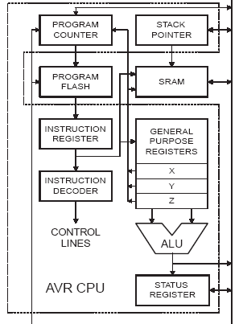
At right: a block diagram of a computer’s
Central Processing Unit (CPU).
Note: Although the areas not highlighted (Program Flash and SRAM) might sometimes be physically located on the same chip, they are generally not considered to be part of the CPU.
These two elements are often absent from the microprocessor chip and instead located on nearby chips.
They are combined on the same chip with the CPU primarily to reduce cost for simple systems.

Slide 14
MIPS Architecture
Arithmetic instructions use (mainly) register operands
MIPS has 32 32-bit registers
  Use for frequently accessed data
  Numbered 0 to 31
  These registers are given special mnemonic designations, and are by convention, used as follows:
    $zero (by definition, contains the value 0)
    $s0-$s7 (for saved values)
    $at, $t0-$t7, $t8-$t9 (for temporary values)
    $a0-$a3 (arguments)
    $v0-v1 (return values)
    and others, see p 78 (fig 2.1)
Also: see the green tear-off card that came with your text

Slide 15
Why registers?
Q: What is the speed of light in a vacuum?
Q: Do electrical signals always propagate at the speed of light?
Q: How far can an electrical signal propagate in 0.25 ns?

Slide 16
Problem
Java/C: f = (g + h)-(i + j);
  Assume f…j are in $s0…$s4
How might we do it in MIPs assembly?
What would a Java/C compiler produce?
li $t0, 6
ai $t1, 3
add $s0, $t0, $t1
Notes:
li $t0, 6
ai $t1, 3
add $s0, $t0, $t1

Slide 17
Fully worked register example
C/Java code:
f = (g + h) - (i + j);
  assume f, …, j in $s0, …, $s4
Equivalent MIPS assembly code:
add $t0, $s1, $s2
add $t1, $s3, $s4
sub $s0, $t0, $t1

Slide 18
Memory Operands
Main memory used for composite data
  Arrays, structures, dynamic data
To apply arithmetic operations
  Load values from memory into registers
  Store result from register to memory
Memory is byte addressed
  Each address identifies an 8-bit byte
Words are aligned in memory
  Address must be a multiple of 4
MIPS is Big Endian
  Most-significant byte at least address of a word
  c.f. Little Endian: least-significant byte at least address

Slide 19
Registers can only hold a small amount of data. The rest is kept in main memory.
0x00000009
0x00000008
0x00000007
0x00000006
0x00000005
Byte 3
MIPS Memory is organized and accessed in a linear array of (billions of) bytes
  Recall: a byte is 8 bits
  Each byte has a unique address
  In MIPS, a word is 4 bytes
  In MIPS, words must start at addresses that are multiples of 4
Byte 4
Byte 1
Word 2
Byte 2
Byte 3
0x00000004
0x00000003
0x00000002
0x00000001
0x00000000
Byte 4
Byte 1
Word 1
Byte 2
Why does the byte-ordering
appear backward???
Byte 3
Byte 4

Slide 20
MIPS is “big-endian”
Consider the integer value 305,419,896
  With hexadecimal and binary representations as:
  0x 12 34 56 78
  0b 00010010001101000101011001111000
  byte4 byte3 byte2 byte1
Note: sometimes the bytes
are numbered from 0-3 instead
of from 1-4
Bit 0
Bit 31

Slide 21
In a big-endian representation, the least significant byte has a higher address than the most significant byte
0x00000009
0x00000008
0x00000007
0x00000006
0x00000005
Byte 3
In our example of 305,419,896
(0x12345678), the bytes of the 32-bit word representing that value would appear as shown at the right
The address of the entire word is the address of the most signficant byte (MSB) – in this case the byte 0x12
Thus, the address of 0x12345678 is 0x00000000
  This is where the word starts in memory in this example
Byte 4
Byte 1
(LSB)
Word 2
Byte 2
Byte 3
0x00000004
0x00000003
0x00000002
0x00000001
0x00000000
Byte 4
(MSB)
0x78
0x12345678
0x56
0x34
0x12

Slide 22
Memory Operand Example 1
Java/C code:
g = h + A[8];
  g in $s1, h in $s2, base address of A in $s3
Compiled MIPS code:
  Index 8 requires offset of 32
    4 bytes per word!
lw $t0, 32($s3) # load word
add $s1, $s2, $t0
offset
base register

Slide 23
Memory Operand Example 2
Java/C code:
A[12] = h + A[8];
  Assume h in $s2, base address of A in $s3
Compiled MIPS code:
  Index 8 requires offset of 32
lw $t0, 32($s3) # load word
add $t0, $s2, $t0
sw $t0, 48($s3) # store word

Slide 24
Registers vs. Memory
Registers are much faster to access than memory
Operating on memory data requires loads and stores
  More instructions to be executed
Compiler must use registers for variables as much as possible
  Only “spill” to memory for less frequently used variables
  Register optimization is important!

Slide 25
Immediate Operands
Constant data specified in an instruction:
addi $s3, $s3, 4
No subtract immediate instruction
  Just use a negative constant
  addi $s2, $s1, -1
Design Principle 3: Make the common case fast
  Small constants are common
  Immediate operand avoids a load instruction

Slide 26
The Constant Zero
MIPS register 0 ($zero) is the constant 0
  Cannot be overwritten
Useful for common operations
  E.g., move values between registers
  add $t2, $s1, $zero # t2 = s1+0 = s1
Note: Some other instruction sets have a dedicated
MOV instruction to perform this operation.
Why did MIPS decide not to have a MOV?

