Slide 1
In software engineering, we sometimes distinguish between "practice" and "process".
By "practice", we mean "what" software engineers do (e.g., analyze requirements, create architectural and detailed designs, implement, verify).
By "process", we mean "how" software engineers do their work (e.g., plan, organize, measure, make and meet commitments, ensure quality, control, improve, adapt).

Slide 2
What do software engineering managers say they most want from software developers and teams?

Slide 3
What do software engineering managers say they most want from software developers and teams?
Predictability
Quality

Slide 4
If I were to give you a requirements specification for a medium-sized program, could you tell me in advance . . .
. . . how long it would take you to write the program?
. . . how many defects you would inject during its development?
. . . how many defects will remain when it is completed?

Slide 5
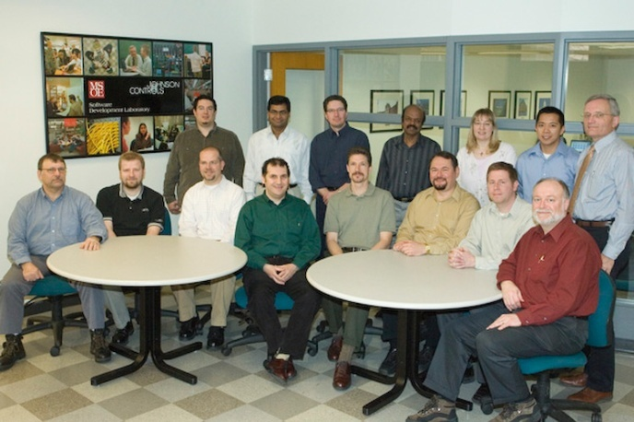
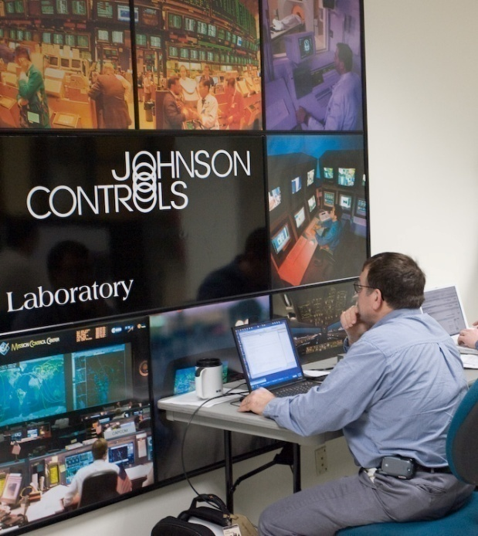
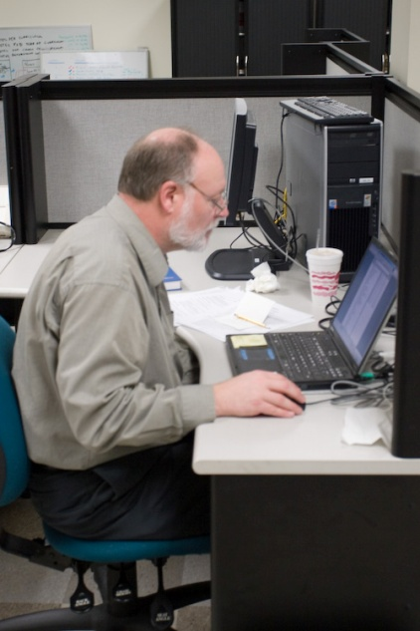
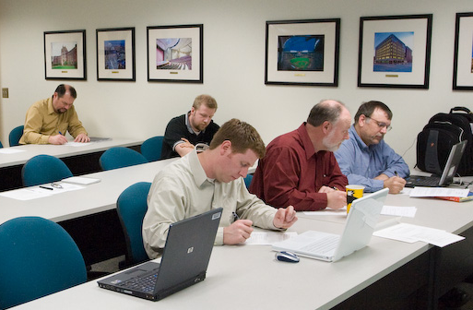
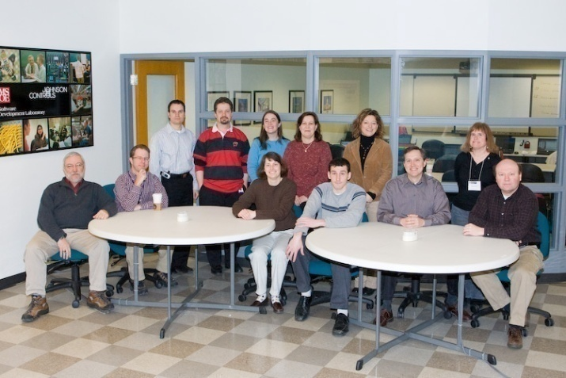
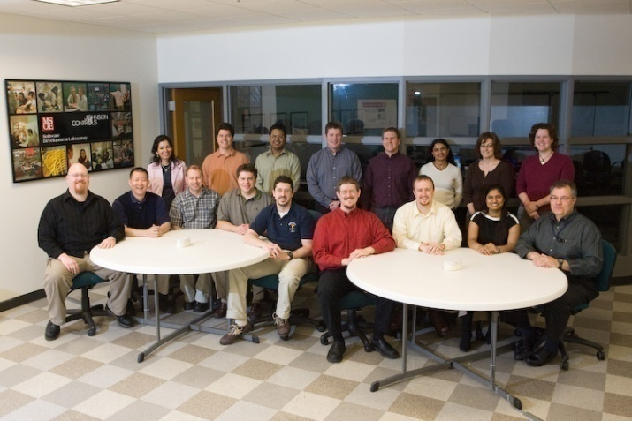
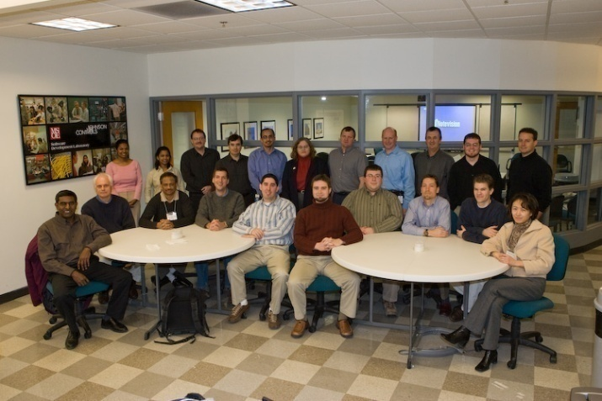
Who are these people?

Slide 6
Why do we need a Process?
Many developers do not know how to estimate
Management sets aggressive goals
Marketing makes promises to customers

Slide 7
Why do we need a Process?
Many organizations today cannot meet commitments with repeatability
  Project A completes without any problems
  Project B is a disaster
    Late
    Incomplete
    Not tested
Too many times, the result is
    Cancelled projects
    Management over-reaction

Slide 8
What is your current software development process? What is good and bad about it?
[Group exercise]

Slide 9
In this course, you will gain experience in using a defined software process and measuring your own performance.
The Personal Software Process (PSP) is designed to allow individual software engineers to improve their own work.
The Team Software Process (TSP) builds on the PSP to help self-directed software engineering teams to deliver high-quality products on predictable schedules.

Slide 10
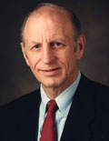

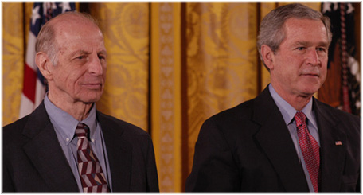
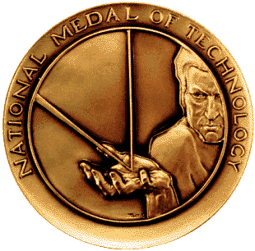
The PSP and TSP were developed by Watts Humphrey at the Software Engineering Institute (SEI).
In 2005, Humphrey was awarded the National Medal of Technology for his work in software process improvement.

Slide 11
Industry experience shows that the TSP can help teams achieve high levels of quality.
Total Delivered Defects/KLOC
N. Davis and J. Mullaney, The Team Software Process (TSP) in Practice: A Summary of Recent Results, Technical Report CMU/SEI-2003-TR-014, www.sei.cmu.edu/publications/.

Slide 12
By increasing predictability, the TSP helps teams to function more effectively.
CMM introduced
TSP introduced
[Source: AIS]

Slide 13
Data from PSP training courses show similar results for practicing software engineers and MSOE SE students.
SEI: 810 engineers
MSOE: 83 sophomore students

Slide 14
Yield is a measure of the percentage of defects removed by a specified point in the process.
SEI: 810 engineers
MSOE: 83 sophomore students

Slide 15
Testing time is a major cost in commercial software development; PSP course data shows a reduction in test time.
SEI: 810 engineers
MSOE: 83 sophomore students

Slide 16
Even with additional PSP planning and quality activities, overall productivity remains nearly constant.
SEI: 810 engineers
MSOE: 83 sophomore students

Slide 17

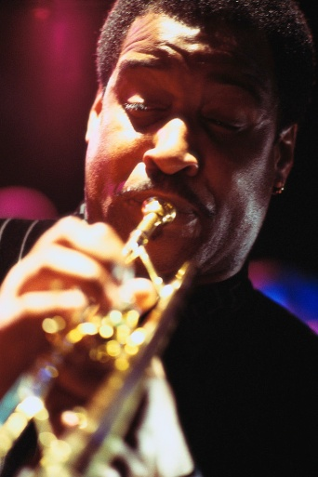




You can improve your own performance as a software engineer using disciplined methods, but it does take some effort.
MSOE sports photos courtesy of Dr. Eric Durant

Slide 18
Please complete the following assignment before the start of the next class.
Read textbook pages 1-34.
Download the Process Support Tool from the course website
Log into SVN to verify that you are set up correctly
  https://emerald.msoe.edu/svn/se280-<your-name>
  Ask right away if you have problems or questions about SVN
Bring your notebook computers to class

Slide 19
Here are a few references on SE process, PSP, and TSP.
W. Humphrey, PSP – A Self-Improvement Process for Software Engineers, A-W, 2005
W. Humphrey, Introduction to the Team Software Process, A-W, 2000
W. Humphrey, Winning with Software: An Executive Strategy, A-W, 2002
N. Davis & J. Mullaney, The Team Software Process in Practice: A Summary of Recent Results, SEI, 2003
  SEI/CMU-2003-TR-014 (www.sei.cmu.edu)
D. Suri and M. Sebern, “Incorporating software process in an undergraduate software engineering curriculum: challenges and rewards”, Proceedings of CSEE&T’04, 2004
M. Sebern, “The software development laboratory: incorporating industrial practice in an academic environment”, Proceedings of CSEE&T’05, 2005

