Slide 1
Team Launch Introduction

Slide 2
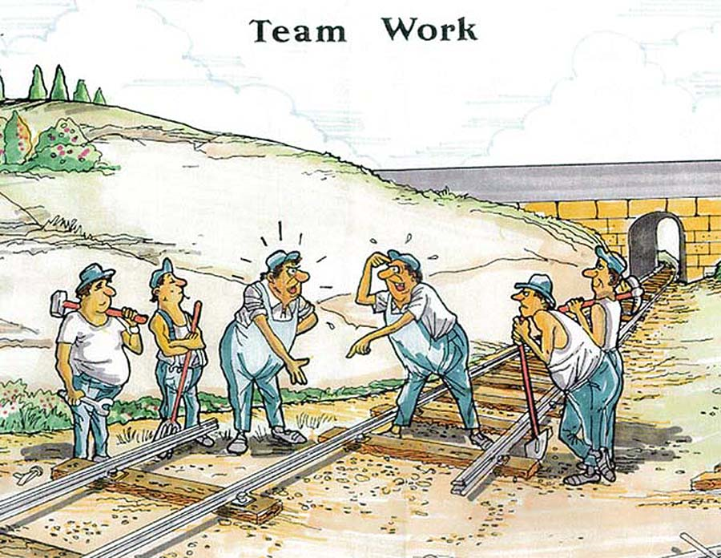
Real projects are large and complex, and most software is created by teams
Merely throwing people together does not result in a functioning team

Slide 3

The Team Launch is a process that ensures that teams
  Agree on goals
  Plan their projects
  Track their progress
  Coordinate activities
  Share a common process
  Communicate freely

Slide 4

Before you can have a team launch, you need a team.
Who is on the team?
  Full-time commitment
  Timing of assignment
  Software developers versus others
  Process-trained
  Common goals
Team leader
  Selected by management
  Unless very small team, little direct contribution to project "work"
  Leads and supports team members
Key training components (SE280 stuff)
  Planning (conceptual design, strategy)
  Measurements, reporting
  Quality
  Design
  Process execution/improvement

Slide 5
Team members should study team roles and consider which ones they are interested in.
Functional/external
  Customer interface manager
  Design manager
  Implementation manager
  Test manager
  Support manager
Internal
  Planning manager
  Process manager
  Quality manager
Other roles?

Slide 6
All team meetings depend on designated team members to play specific roles.
Meeting leader/facilitator
  Reviews meeting script/agenda
  Leads discussion
  Helps team achieve closure and decide on actions
Timekeeper
  Monitors progress against available time
Recorder
  Takes meeting minutes and records important information and action items

Slide 7
The most important product of the launch process is a cohesive and committed team.
Mutual respect, trust, and support
Joint commitment and ownership
Firm foundation (process data)

Slide 8

For a successful launch, important process and product data must be gathered ahead of time.
Product size
(relative-size tables?)
Development time and effort
Quality (defect) data
Test and inspection data (time, defects)
Don't wait until launch time to gather data or consult experts!

Slide 9
Humphrey suggests the following team launch process.
Day 1
Day 2
Day 3
Day 4
1. Establish
product and
business
goals
4. Build overall
and
near-term
plans
7. Conduct
risk
assessment
9. Hold
management
review
2. Assign roles
and define
team goals
5. Develop
the quality
plan
8. Prepare
management
briefing and
launch report
Launch
postmortem
3. Produce
development
strategy
and process
6. Build
individual &
consolidated
plans

Slide 10
When planning a launch, it is important to consider the logistical issues.
Launch location
  Team meeting room
  Team/management meeting area
Infrastructure
  Process support tools
  Design/planning tools
  Presentation tools
Scheduling
  Team meetings
    Days, daily schedule
  Management meetings
    Business management
    Marketing
    Technical management
    Others?

Slide 11


While the whole team is responsible for the conceptual design and development strategy, pre-work is very valuable.
Application domain and design experts play a major role
Draft conceptual design, work breakdown, development approach, process characteristics

Slide 12
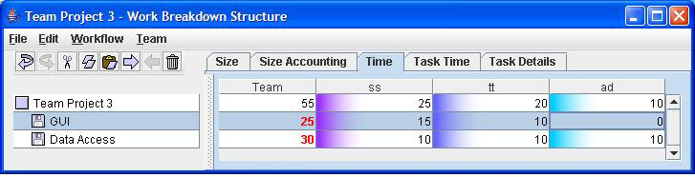
The team leader and planning manager must be familiar with the process support and planning tools to be used during launch.
Organizational project planning systems (e.g., MS Project)
Process Dashboard or other process tools

Slide 13

OK, so what happens after the launch?
In the "team working" (post-launch) part of the project, the team works together to accomplish the project goals.
Weekly team meetings
Role responsibilities
Team member ("engineer") work
Tracking, replanning, process improvement, data analysis, reporting

Slide 14
A typical agenda for a weekly team meeting looks like this.
Manager report
Role reports
Goals review
Risks review
Individual status reports
Team status overview
Current issues and action items

Slide 15
Can self-directed teams really solve problem when they arise? A real-world example may help.
Adapted from Willet (SEI), Boston SPIN talk, 2004

Slide 16

The team analyzed the situation.
Work hours on target
Completed tasks show severe underestimates
Detail tasks log shows most of problem is in Unit Test
Defect Fix Time by type shows main problem is legacy system defects

Slide 17
Based on the data analysis, the team took corrective action.
Performed inspections of legacy code
Looked at ways to increase task hours
Worked with management to increase the project team size
Result
  Team delivered on time
  A defect-free product
  Increased cost – management made decision

