Slide 1
Contact info
Instructor: Dr. Mark L. Hornick
http://faculty-web.msoe.edu/hornick/
email: hornick@msoe.edu
Office: DH434
Phone: 277-2417
Follow link to my schedule for Office Hours

Slide 2
Logistics
Class roster, attendance policy
Book, schedule, policies, grading
Course web site
Atlassian Jira accounts
Atlassian Bitbucket accounts

Slide 3
Textbook
Essential Scrum
A Practical Guide to the Most Popular Agile Process, Kenneth S. Rubin
Good reference on process framework – not a real textbook
Available on Kindle

Slide 4
How should we execute a project of moderate size (e.g. SE2030) for a small team?
How would you do it?
What are the steps?
What is your SE-2030 experience?
What is good/bad about it?
How long will it take?
How will you ensure quality?
Q: How do you define “quality”?

Slide 5
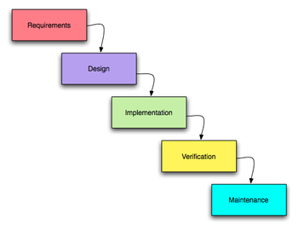
SE2030 Review: Software Life Cycle
Requirements Analysis
Plan – left for SE2800
High-level Design
Low-level (Detail) Design
Implementation
Unit Test
Integration
System Test
Deploy
Maintain

Slide 6
Curriculum Context
Software
Development Lab
SE1011, 1021 CS2852 programming skills
SE 2832
Verification
SE 3821
Requirements
SE 2030
Tools/Practices
SE 2800
SE Process I
SE 3800
SE Process II

Slide 7
Process Goals
Overwhelmingly, [software development] managers and stakeholders ask us for two things:
Predictability
+ Quality

Slide 8
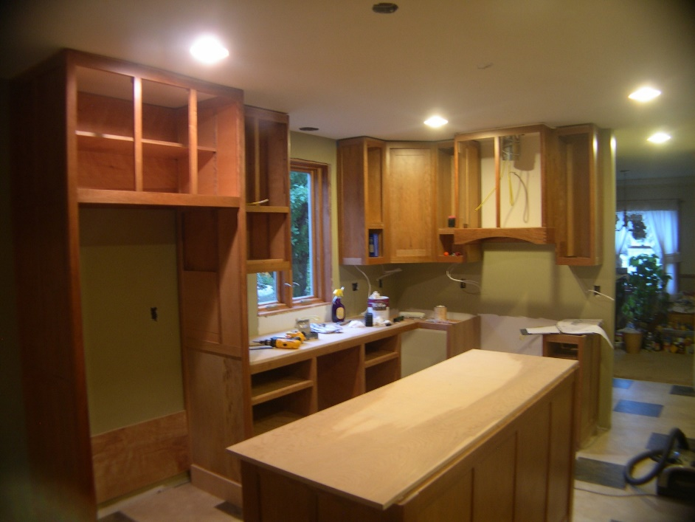
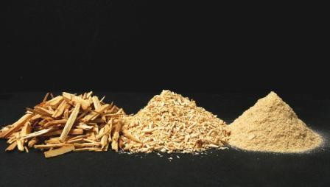
vs

Slide 9
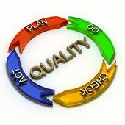
Practice vs Process
Practice = “what we do”
Analyze requirements, create architectural/detail designs, implement, test
Process = “how we do it” “how we measure what we do” “how we improve what we do”

Slide 10
Practice and Process Activities
Activity planning
Requirements analysis & specification
Architecture & high-level design (HLD)
HLD review
Detailed design
Detailed design review
Implementation (coding)
Code review/inspection
Unit testing
Integration testing
System testing
Size/effort estimation
Time tracking
Defect tracking
Quality analysis (#bugs, #bugs/kLOC)
Productivity analysis (#kLOC/hr)
There are many different ways to break down software development activities; this is just one way of doing it.

Slide 11
Course Goal
Get experience with one approach to software process
We’re not saying it’s the BEST approach or the ONLY approach you’ll ever use
Why Scrum/Iterative?
Widely used in industry
Well-suited for a lot of SW projects
In SE-2800, SDL, and Sr Design, you will learn/use an incremental process model based on Scrum

Slide 12
Tools
Atlassian
JIRA/Agile (plan/track)
Confluence (wiki)
Bitbucket
Git repository
JUnit
Test automation

Slide 13
Tool Setup
Second lab session
You will receive an email with an invitation to Atlassian OnDemand
Set up your account before lab
You MUST use your MSOE email and username!

Slide 14
Review
SE 2800: Software Process I
Introduction to software process
Practice vs. process
Practices: what needs to be done
Process: how & when
Tool Setup
Atlassian Jira
Bitbucket

