Slide 1
The Scrum Process Framework

Slide 2
What is Scrum?
A framework for organizing and managing work
Values and Principles (guidance: Agile Manifesto)
Best Practices (TBD by each organization)
Design
Coding
Reviews
RCS
*Build
*Test
*Doc
Process (assisted by tools such as Jira)
Planning/Estimating (User Stories, Product Backlog etc)
Executing (Roles, Responsibilities, Sprints, Daily Scrum)
Measuring/Tracking/Predicting (Burndowns etc)
Evaluating/Improving/Optimizing (Reviews and Retrospectives)

Slide 3
Product Backlog
A (prioritized?) inventory of yet-to-be-worked-on Product Backlog Items (PBIs)
These comprise the features of the product to be built (as well as other items to be discussed later)

Slide 4
Roles: The Development Team
A self-organizing, cross-functional team of technical people who collectively are responsible for all of the work necessary to produce working, validated assets.

Slide 5
Roles: Product Owner
The empowered central point of product leadership. One of the three roles on a Scrum team; the single voice of the stakeholder community to the Scrum team. The product owner defines what to do and in what order to do it.

Slide 6
Project Manager? aka whip-cracker or MS Project jockey
Found in traditional projects
Scrum has no formal concept of a project manager. The project manager is mentioned in the context of Scrum for comparative, or illustrative purposes only.

Slide 7
Role: Scrum Master
Coach, facilitator, impediment remover, and servant leader of the Scrum team. The ScrumMaster is one of the three roles on a Scrum team. The ScrumMaster provides process leadership and helps the Scrum team and the rest of the organization develop their own high-performance, organization-specific Scrum approach

Slide 8
Functional Manager? aka “pointy-haired boss”
Line manager or reporting manager.
Members of development teams might report to functional managers. Expertise is generally in bean counting or spreadsheet & powerpoint engineering.

Slide 9
Sprints
The fixed period of time during which the development team performs the tasks necessary to complete the items selected from the Product Backlog during sprint planning.
Typically a timebox between one week and a calendar month during which the Scrum team is focused on incrementally producing a potentially shippable product increment that meets the Scrum team’s agreed-upon definition of done

Slide 10
Sprint Tasks
The technical work that a development team performs in order to complete a PBI.
Each PBI likely requires 1 or more tasks to perform. Most tasks are defined to be small, representing no more than a few hours to a day or so of work.

Slide 11
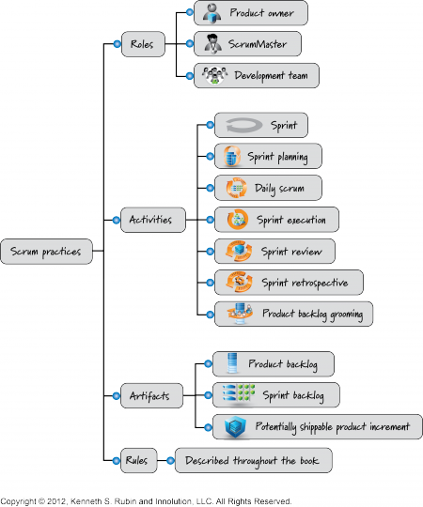
Summary of Scrum Practices

