Slide 1
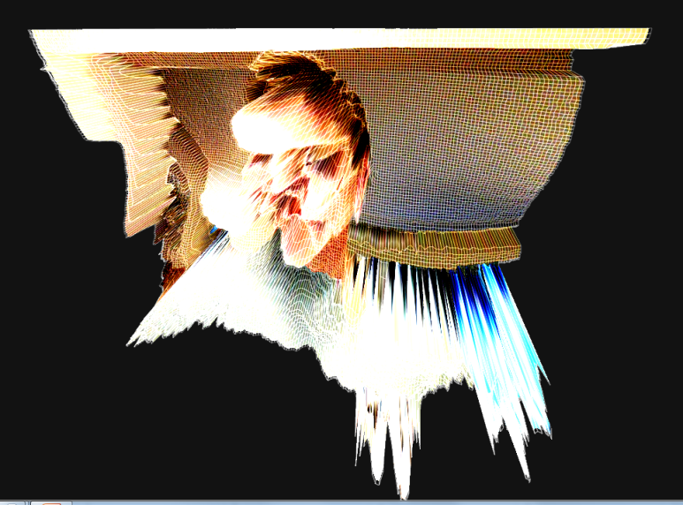
HTML5 Canvas
Slides by Jay Urbain, Ph.D.
Credits:
https://developer.mozilla.org/en-US/docs/HTML/Canvas/Tutorial
Core HTML5 Canvas, David Geary

Slide 2
HTML5 Graphics
The web has always been a visual medium, but a restricted one at best.
HTML developers were limited to CSS and JavaScript in order to produce animations or visual effects, or they would have to rely on a plugin like Flash.
HTML5 made the need for visual plugins obsolete
Flash has been declared dead by Adobe

Slide 3
HTML5 Graphics
With the addition of technologies like the canvas element, Web GL, and SVG images, this is no longer the case!
Many new features which deal with graphics on the web: 2D Canvas, WebGL, SVG, 3D CSS transforms, and SMIL.

Slide 4
Performance
JavaScript engines have become fast enough to run 3D games and manipulate video in realtime.
GPU accelerated compositing is being implemented in many browsers, meaning that even CSS transitions and transforms very smooth.

Slide 5
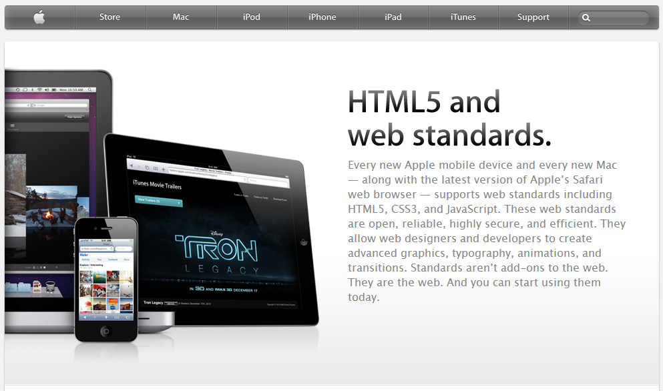
HTML5 Showcases
http://html5-showcase.com/

Slide 6
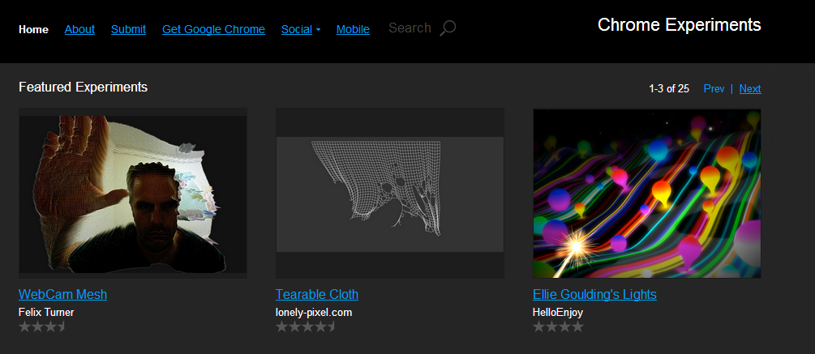
http://www.chromeexperiments.com/

Slide 7
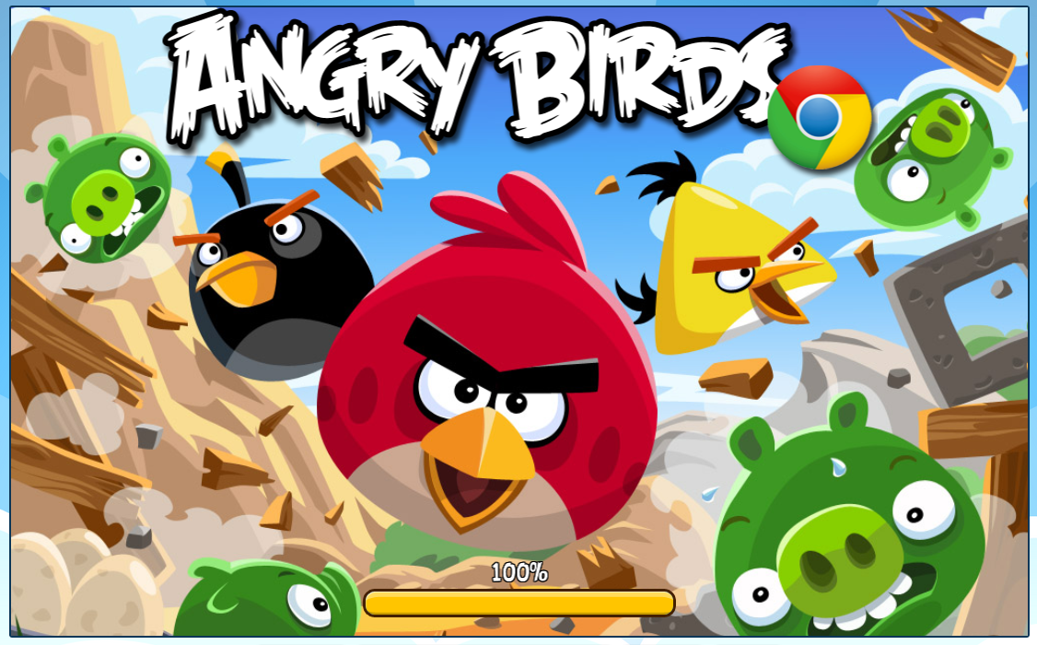
http://chrome.angrybirds.com/

Slide 8
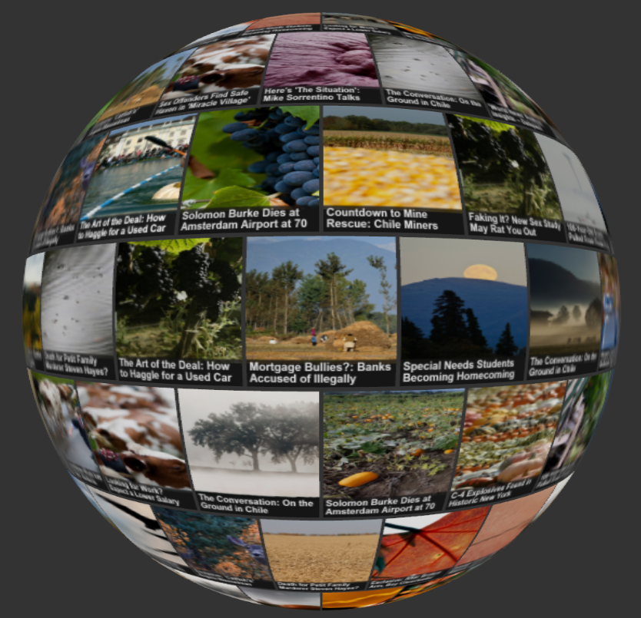
http://html5rocks.com/ http://www.html5rocks.com/en/tutorials/#type:demo http://studio.html5rocks.com/samples/globe/index.html

Slide 9
Canvas
http://www.w3schools.com/tags/ref_canvas.asp
Basic usage
Drawing shapes
Using images
Applying styles and colors
Transformations
Compositing
Basic animations
Optimizing the canvas

Slide 10
<canvas>
2D drawing platform for the browser
No plugins needed: just HTML and JavaScript
Represented by <canvas> element in an HTML5 document
<canvas> element is only a container for graphics
You must use a script to actually draw the graphics
<canvas id=“my_canvas_id” width=“150” height”150”></canvas>

Slide 11
Rendering Context
<canvas> creates a fixed size drawing surface that exposes one or more rendering contexts, which are used to create and manipulate the content:
2d context, 3d context
The <canvas> is initially blank. To draw something, a script needs to access the rendering context and draw on it.
The <canvas> element has a DOM method called getContext() used to obtain the rendering context and its drawing functions:
// get reference to <canvas> element
var canvas = document.getElementById(‘my_canvas’);
// get rendering context
var ctx = canvas.getContet(‘2d’);

Slide 12
Fallback for Old Browsers
Fallback content can be displayed in browsers that do not support <canvas>:
<canvas id=“my_canvas_id” width=“150” height”150”>
<img src=“images/nocanvas.png” width=“150” height”150” alt=“” />
<em>Canvas is not supported!</em>
</canvas>
Scripts can also check for <canvas> support:
// get reference to <canvas> element
var canvas = document.getElementById(‘my_canvas’);
if( canvas.getContext() ) {
var ctx = canvas.getContet(‘2d’);
// drawing code…
} else {
// canvas unsupported code…
}

Slide 13
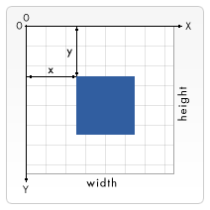
Canvas grid or coordinate space
Normally 1 unit in the grid corresponds to 1 pixel on the canvas.

Slide 14
Drawing Rectangles
Canvas only supports one geometric shape – rectangles.
All other shapes must be created by combining one or more paths, and adding lines or curves to the path.
Canvas provides a collection of path drawing function which make it possible to compose very complex shapes.
Functions that draw Rectangles – all three rectangle functions draw immediately to the canvas (unlike path functions).
fillRect(x, y, width, height): Draws a filled rectangle
strokeRect(x, y, width, height): Draws a rectangular outline
clearRect(x, u, width, height): Clears the specified area and makes it fully transparent.

Slide 15
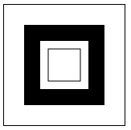
Drawing Rectangles
<!DOCTYPE html>
<html>
<body>
<canvas id="myCanvas" width="150" height="150" style="border:1px solid #000000;">
Your browser does not support the HTML5 canvas tag.
</canvas>
<script>
function draw() {
var ctx = document.getElementById('myCanvas').getContext('2d');
ctx.fillRect(25,25,100,100);
ctx.clearRect(45,45,60,60);
ctx.strokeRect(55, 55, 40, 40);
}
draw();
</script>
</body>
</html>

Slide 16
Intersecting rectangles with alpha transparency
<html>
<head>
<script type="application/javascript">
function draw() {
var canvas = document.getElementById('canvas');
if (canvas.getContext) {
var ctx = canvas.getContext("2d");
ctx.fillStyle = "rgb(200,0,0)";
ctx.fillRect (10, 10, 55, 50);
ctx.fillStyle = "rgba(0, 0, 200, 0.5)";
ctx.fillRect (30, 30, 55, 50);
}
}
</script></head>
<body onload="draw();">
<canvas id="canvas" width="150" height="150"></canvas>
</body>
</html>

Slide 17
Drawing with Paths
Internally, paths are stored as a list of sub-paths (lines, arcs, etc.) which together form a shape.
Steps for drawing paths:
beginPath() – Resets lists of sub-paths.
moveTo() and a set of lineTo() methods – Specify the paths to be drawn by creating a list of coordinates.
Besides lines, arcs, bezier, and quadratic curves can also be drawn.
closePath() – Tries to close the path by drawing a straight line from the current point to the start. If the shape has already been closed or there’s only one point in the list, this function does nothing.
stroke() or fill() methods = Draws the shape to the canvas. stroke() is used to draw an outline shape, fill() is used to paint a solid shape.

Slide 18
Creating a triangle with Paths
<html>
<head>
<script type="application/javascript">
function draw() {
var canvas = document.getElementById('canvas');
if (canvas.getContext) {
var ctx = canvas.getContext("2d");
ctx.beginPath();
ctx.moveTo(75,50);
ctx.lineTo(100,75);
ctx.lineTo(100,25);
ctx.fill();
}
}
</script>
</head>
<body onload="draw();">
<canvas id="canvas" width="150" height="150"></canvas>
</body>
</html>

Slide 19
Drawing a complex shape with Paths
arc(x, y, radius, startAngle, endAngle, anticlockwise)
Angles in the arc function are measured in radians, not degrees. To convert degrees to radians:
var radians = (Math.PI/180)*degrees.
<html>
<head>
<script type="application/javascript">
function draw() {
var canvas = document.getElementById('canvas');
if (canvas.getContext) {
var ctx = document.getElementById('canvas').getContext('2d');
ctx.beginPath();
ctx.arc(75,75,50,0,Math.PI*2,true); // Outer circle
ctx.moveTo(110,75);
ctx.arc(75,75,35,0,Math.PI,false); // Mouth (clockwise)
ctx.moveTo(65,65);
ctx.arc(60,65,5,0,Math.PI*2,true); // Left eye
ctx.moveTo(95,65);
ctx.arc(90,65,5,0,Math.PI*2,true); // Right eye
ctx.stroke();
}
}
</script>
</head>
<body onload="draw();"><canvas id="canvas" width="150" height="150"></canvas>
</body></html>

Slide 20
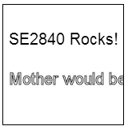
Draw Text
<!DOCTYPE html>
<html>
<body>
<canvas id="myCanvas" width="150" height="150" style="border:1px solid #000000;">
Your browser does not support the HTML5 canvas tag.
</canvas>
<script>
function draw() {
ctx.font="20px Arial";
ctx.fillText("SE2840 Rocks!", 7, 50);
ctx.strokeText("Mother would be proud", 7, 100);
}
draw();
</script>
</body>
</html>

Slide 21
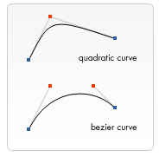
Other graphics primitives…
Bezier and quadratic curves
Used to draw complex organic shapes.
quadraticCurveTo(cp1x, cp1y, x, y) // BROKEN in Firefox 1.5
bezierCurveTo(cp1x, cp1y, cp2x, cp2y, x, y)
Rectangles
rect(x, y, width, height)
Making combinations
No limitation to the amount or type of paths you can use to create a shape.

Slide 22
Importing and Drawing Images
Importing images:
Need a reference to a JavaScript Image object or other canvas element as a source. (Note: not possible to use images by simply providing a URL/path to them).
Draw the image on the canvas using the drawImage() function.

Slide 23
Using Images
Using images on the same page
Access all images: document.images()
document.getElementsByTagName()
document.getElementById()
Using images from other domains
Use the crossOrigin attribute on an Image - you can request permission to load an image from another domain for use in your call to drawImage()
Using other canvas elements
document.getElementsByTagName()
document.getElementById()
Creating new Image object (from scratch) in our script

Slide 24
Creating a new image from scratch
var img = new Image(); // Create new img element
img.src = 'myImage.png'; // Set source path
Use onload event handler to wait for image to finish loading before calling drawImage:
img.onload = function(){
// execute drawImage statements here
};
img.src = 'myImage.png'; // Set source path

Slide 25
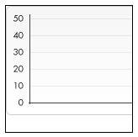
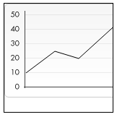
drawImage()
<script type="text/javascript">
function draw(){
var ctx = document.getElementById('canvas').getContext('2d');
// Create image object
var img = new Image();
img.src = 'images/backdrop.png'; // backdrop
// Wait for image to load
img.onload = function(){
ctx.drawImage(img,0,0);
// Draw lines
ctx.beginPath();
ctx.moveTo(30,96);
ctx.lineTo(70,66);
ctx.lineTo(103,76);
ctx.lineTo(170,15);
ctx.stroke();
};
}
</script>
file://D:/Dropbox/jpassionHTML5/html5_canvas/samples_html5/02b_image_create_Image_object.html

Slide 26
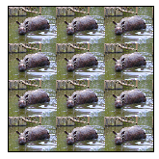
Scaling
DrawImage method variant adds two new parameters and it allows us to place scaled images on the canvas:
drawImage(image, x, y, width, height)
function draw() {
var ctx = document.getElementById('canvas').getContext('2d');
var img = new Image();
img.onload = function(){
for (var i=0;i<4;i++){
for (var j=0;j<3;j++){
ctx.drawImage(img,j*50,i*38,50,38);
}
}
};
img.src = '/files/4533/rhino.jpg';
}
D:\Dropbox\jpassionHTML5\html5_canvas\samples_html5\02c_image_scaling.html

Slide 27
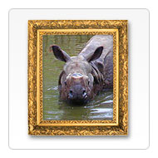
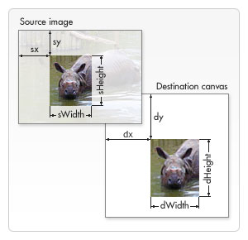
Slicing
drawImage method variant has eight new parameters.
drawImage(image, sx, sy, sWidth, sHeight, dx, dy, dWidth, dHeight)
function draw() {
var ctx = document.getElementById('canvas').getContext('2d');
// Draw slice
ctx.drawImage(
document.getElementById('source'),33,71,104,124,21,20,87,104);
// Draw frame
ctx.drawImage(
document.getElementById('frame'),0,0);
}
D:\Dropbox\jpassionHTML5\html5_canvas\samples_html5\02d_image_slicing.html

