Slide 1
Instructor Evaluation Time!
Do it!

Slide 2
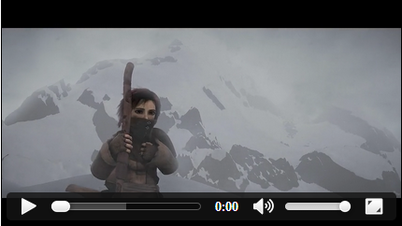
HTML5 Audio and Video
Credits:
Dr. Jay Urbain
https://developer.mozilla.org/en-US/docs/HTML/Using_HTML5_audio_and_video

Slide 3
History of Video Support in Browsers
2000: Had to install multiple plugins: RealPlayer, QuickTime, WMP
2004-2008: Flash becomes dominant
2009: HTML5 announces native video support
2015: HTML5 has ~91% user support
See caniuse.com

Slide 4
HTML5 Video
Runs natively in the browser
No plug-in required
Simpler coding
No need to have different coding for different formats
Can be manipulated just like any other DOM element
It’s a standard and has become widely adopted
Flash is dead (and iOS never supported it)
Smartphones support it

Slide 5
HTML5 Video Tags

Slide 6
MIME Types for Video Formats

Slide 7
Video Containers
A video file is a “container”, which contains
Video stream
Audio stream
Metadata (“table of contents”)
The streams are combined during video playback
Metadata includes
Title, subtitle, cover art, captioning info,…

Slide 8
If height and width are set, the space required for the video is reserved when the page is loaded. Without these attributes, the browser does not know the size of the video, and is likely to change during loading. The size can also be specified in %.
<!DOCTYPE html>
<html>
<body>
<video width="320" height="240" controls
poster=“mallard.jpg” autoplay>
<source src="http://www.w3schools.com/html/movie.mp4" type="video/mp4">
<source src="http://www.w3schools.com/html/movie.ogg" type="video/ogg">
Your browser does not support the video tag.
</video>
</body>
</html>
The controls attribute adds video controls, like play, pause, and volume.
The poster attribute indicates the first frame to appear. Autoplay – guess!
<video> allows multiple <source> elements. <source> elements can link to different video files. The browser will use the first recognized format
Insert text content between the <video> tags for browsers that do not support the <video> element.

Slide 9
Some Video Container File Formats
MP4 ( video_file.mp4)
H.264 (video codec format) + AAC (audio codec format)
Ogg (video_file.org, .ogv, or .ogg)
Theora (video codec format) + Vorbis (audio codec format)
WebM ( video_file.webm )
VP8 (video codec format) + Vorbis (audio codec format)

Slide 10
What is a Codec?
Codecs (Coders/Decoders) are algorithms used to encode and decode a particular video/audio stream so that they can played back
Why codecs ?
Raw media files too big to transmit over the internet
Example video codecs
H.264, VP8, Ogg Theora
Example audio codecs
AAC, MPEC-3, Ogg Vorbis

Slide 11
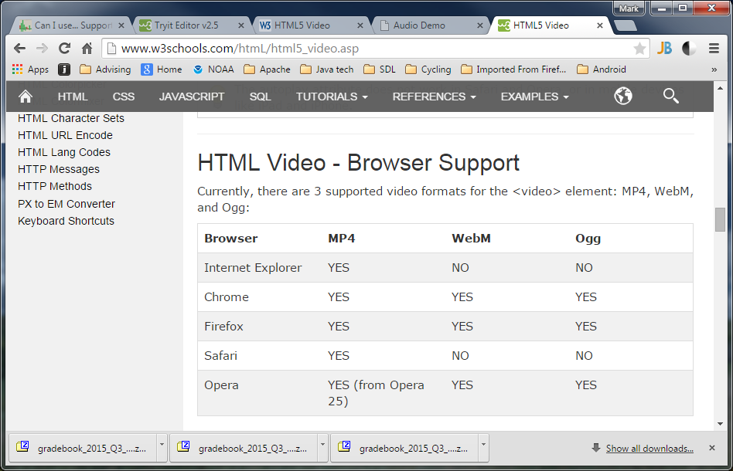
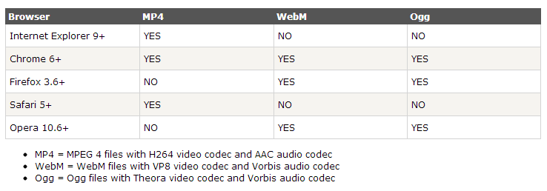
Video Formats and Browser Support Until recently, there was not a single Codec supported by all browsers!
See caniuse.com

Slide 12
<video> Demo
http://www.w3schools.com/html/tryit.asp?filename=tryhtml5_video_all

Slide 13
HTML5 <video> - DOM Methods and Properties
HTML5 has DOM methods, properties, and events for the <video> and <audio> elements.
Allows you to manipulate <video> and <audio> elements using JavaScript.
Demo:
http://www.w3.org/2010/05/video/mediaevents.html

Slide 14
HTML5 <track> subelement
Provides a standardized way to add subtitles, captions, screen reader descriptions and chapters to video and audio.
Tracks can be used for timed metadata.
The source data for each track element is a text file made up of a list of timed cues.
Cues can include data in formats such as HTML, JSON, or CSV.
http://www.html5rocks.com/en/tutorials/track/basics/treeOfLife/video/developerStories-en.webm
<video id="video" poster="movietime.jpg" width="640" height="480" controls >
<source src="sintel.ogv">
<track kind="captions" src="sintel-en.vtt" srclang="en"
label="English captions" default /> -->
</video>

Slide 15
Track kind and src attributes
http://www.html5rocks.com/en/tutorials/track/basics/
Attribute for kind can be subtitles, captions, descriptions, chapters or metadata.
The src attribute points to a text file that holds data for timed track cues.
Chrome supports WebVTT, which looks like this:
WEBVTT
introduction
00:02.000 --> 00:05.000
Is this LOTR:The Two Towers?
Lead character
00:06.000 --> 00:08.000
That's not Frodo!
Cue – text can include HTML
hours:minutes:seconds:milliseconds

Slide 16
Five types of tracks
Subtitles - Translations of the dialogue in the video
Captions - Transcription of the dialogue, sound effects, musical cues, and other audio information
Chapters - Used to create navigation within the video, Typically they're in the form of a list of chapters that the viewer can click on to go to a specific chapter.
Descriptions - Text descriptions of what's happening in the video
Metadata - Tracks that have data meant for javascript to parse and do something with. These aren't shown to the user

Slide 17
Cues support HTML:
See https://www.html5rocks.com/en/tutorials/track/basics/

Slide 18
HTML5 Audio
<!DOCTYPE html>
<html>
<body>
<audio controls loop autoplay>
<source src="http://www.w3schools.com/html/horse.ogg" type="audio/ogg">
<source src="http://www.w3schools.com/html/horse.mp3" type="audio/mpeg">
Your browser does not support the audio element.
</audio>
</body>
</html>

Slide 19
HTML5 Audio Tags

Slide 20
MIME Types for Audio Formats

Slide 21
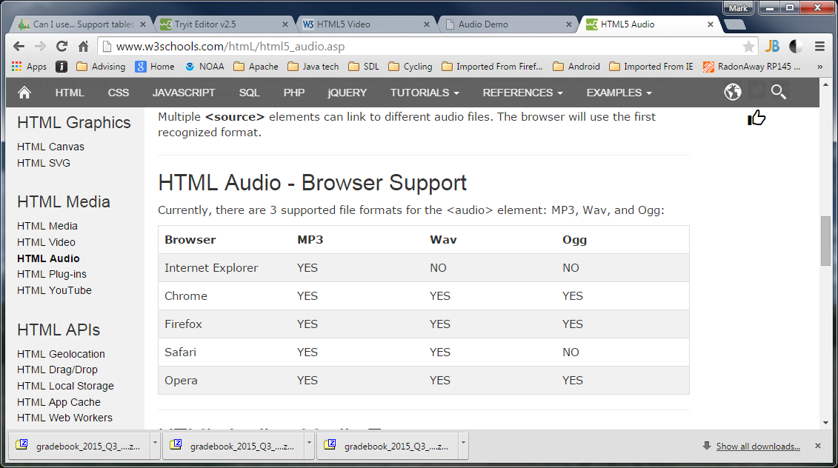
Audio Formats and Browser Support

Slide 22
<audio> attributes
The control attribute adds audio controls, like play, pause, and volume.
Insert text content between the <audio> tags for browsers that do not support the <audio> element.
<audio> allows multiple <source> elements.
<source> elements can link to different audio files. The browser will use the first recognized format.
<audio> tag supports the full range of standard attributes in HTML5.

Slide 23
<audio> attributes
New attributes for the <audio> tag:
controls - controls for the audio file will be included on the page
loop - the audio will loop and play again once it has finished
preload - this one has three parameters: auto, which plays once it has loaded, metadata, which only displays the data associated with the audio file, and none, which means it will not preload
src - the URL of the audio file you wish to play
Example:
<audio loop="loop" autoplay="autoplay" controls="controls">
<source src="music.ogg" />
<source src="music.mp3" />
</audio>
http://www.w3schools.com/html/tryit.asp?filename=tryhtml5_audio_all

