Slide 1
Servlet configuration and deployment

Slide 2
How does the Container “know” which Servlet to execute?
http://sapphire.msoe.edu:8080/Demo-Lab1/hello
There is no Servlet named “hello”

Slide 3
Introducing the Servlet Deployment Descriptor
<?xml version="1.0" encoding="UTF-8"?>
<web-app id="WebApp_ID" version="2.4" xmlns="http://java.sun.com/xml/ns/j2ee" xmlns:xsi="http://www.w3.org/2001/XMLSchema-instance" xsi:schemaLocation="http://java.sun.com/xml/ns/j2ee http://java.sun.com/xml/ns/j2ee/web-app_2_4.xsd">
<servlet>
<servlet-name>HelloWorld</servlet-name>
<servlet-class>test.HelloWorldServlet</servlet-class>
</servlet>
<servlet-mapping>
<servlet-name>HelloWorld</servlet-name>
<url-pattern>/hello</url-pattern>
</servlet-mapping>
<welcome-file-list>
<welcome-file>index.html</welcome-file>
<welcome-file>index.htm</welcome-file>
<welcome-file>index.jsp</welcome-file>
<welcome-file>default.html</welcome-file>
<welcome-file>default.htm</welcome-file>
<welcome-file>default.jsp</welcome-file>
</welcome-file-list>
</web-app>
HelloWorld is a friendly name we give to a Servlet – just an identifier.
test.HelloWorldServlet is the fully-qualified package name of the .class file that contains the Java byte code for the servlet.
/hello is the pattern that Tomcat recognizes as the url that it uses to invoke the execution of the servlet’s doGet() or doPost() methods.

Slide 4
The DD can specify how Tomcat loads, initializes, and manages Servlets
<?xml version="1.0" encoding="UTF-8"?>
...
<servlet>
<servlet-name>HelloWorld</servlet-name>
<servlet-class>test.HelloWorldServlet</servlet-class>
...
<!--0 means Tomcat should initialize the servlet when Tomcat itself starts, rather than waiting until the first client requests the servlet's services. If the value is a positive integer, it specifies the loading order of the servlets; thus the order of initialization can be controlled. If this element is absent, Tomcat waits until the servlet is needed.-->
<load-on-startup>0</load-on-startup>
...
</servlet>
...
</web-app>

Slide 5
Per-Servlet Initialization Parameters can be used in the place of constants
<?xml version="1.0" encoding="UTF-8"?>
...
<servlet>
<servlet-name>HelloWorld</servlet-name>
<servlet-class>test.HelloWorldServlet</servlet-class>
<!-- Here are parameters that only HelloWorldServlet can see -->
<init-param>
<param-name>max_value</param-name>
<param-value>10</param-value>
</init-param>
<init-param>
<param-name>welcome_message</param-name>
<param-value>hello world</param-value>
</init-param>
...
</servlet>
...
</web-app>
The parameter name is “max_value”
The parameter value is “10”
String value = getServletConfig.getInitParameter(“max_value”);

Slide 6
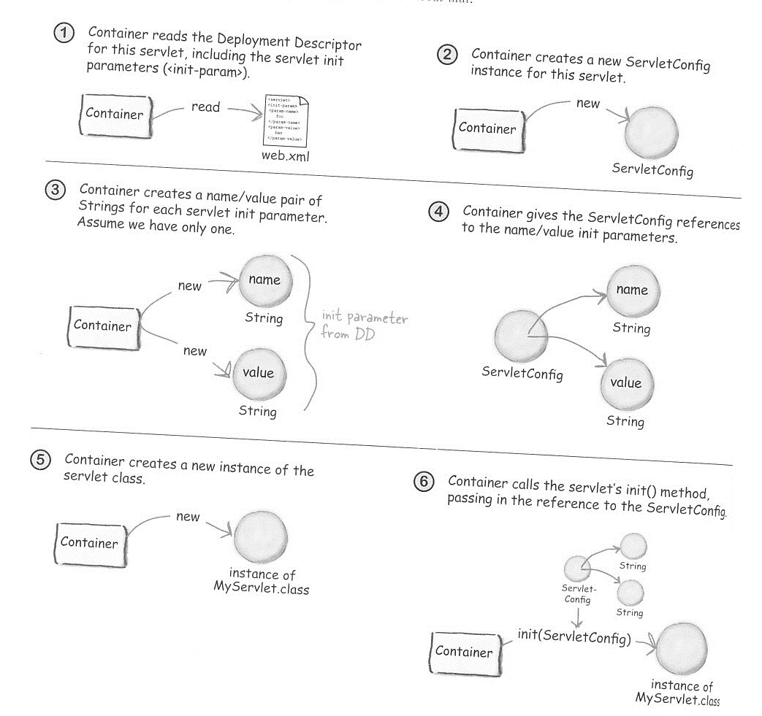
Servlet Initialization
Tomcat is the container
Note that after construction, the Servlet does not yet have references to ServletConfig!

Slide 7
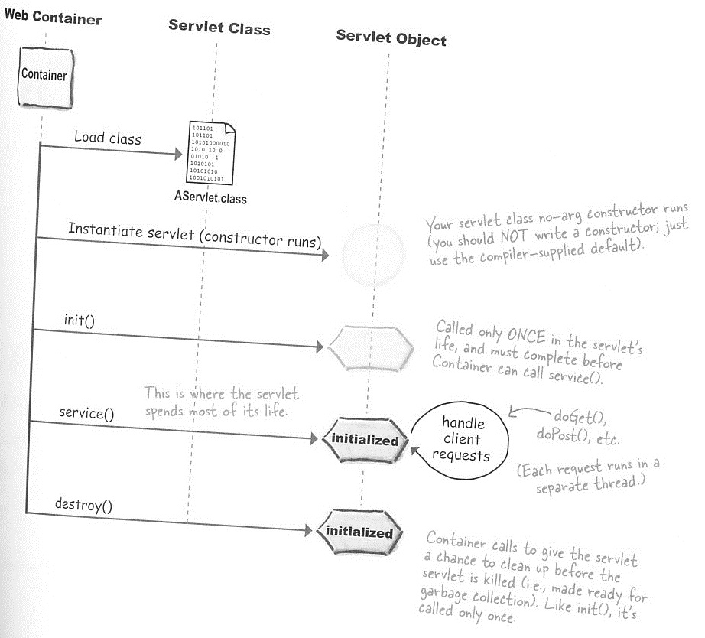
How Tomcat creates and calls a Servlet’s methods
Web Container (Tomcat)
Your servlet class no-arg ctor runs (you should NOT write a ctor; just use the compiler-supplied default.
Note that the Servlet’s constructor is NOT the place to perform initialization
Called only ONCE in the servlet’s life (and must complete before Container calls service()
This is where the servlet spends most of its life
The methods doGet() or doPost() are executed to process requests
Container calls destroy() to give the servlet a chance to clean up; like init(), destroy() is only called ONCE
Note: This diagram can be found in your textbook

Slide 8
Per-Application Context Parameters can be also used in the place of constants, but are shared among Servlets
<?xml version="1.0" encoding="UTF-8"?>
...
<servlet>
<servlet-name>HelloWorld</servlet-name>
<servlet-class>test.HelloWorldServlet</servlet-class>
...
</servlet>
<servlet>
... Some other servlet’s defn goes here
</servlet>
...
<!-- Here is a parameter that ALL Servlets in this web app can see -->
<context-param>
<param-name>lab1_version</param-name>
<param-value>2.1</param-value>
</context-param>
...
</web-app>
String version = getServletContext.getInitParameter(“lab1_version”);

Slide 9
Application-wide error pages can be defined to catch errors
<?xml version="1.0" encoding="UTF-8"?>
...
<servlet>
<servlet-name>HelloWorld</servlet-name>
<servlet-class>test.HelloWorldServlet</servlet-class>
...
</servlet>
...
<!-- catch exceptions thrown by the Servlets and post the specified error page --> <error-page>
<exception-type>java.lang.ArithmeticException</exception-type>
<location>/MathError.html</location>
<exception-type>java.lang.Throwable</exception-type>
<location>/Error.html</location>
<error-code>404</error-code>
<location>/NotFoundError.html</location>
</error-page>
...
</web-app>
You can also invoke the sendError() method on the response, telling the Container to generate the error explicitly: response.sendError(HttpServletResponse.SC_FORBIDDEN);
or:
response.sendError(404);

Slide 10
Default welcome page(s)
<?xml version="1.0" encoding="UTF-8"?>
<web-app id="WebApp_ID" version="2.4" xmlns="http://java.sun.com/xml/ns/j2ee" xmlns:xsi="http://www.w3.org/2001/XMLSchema-instance" xsi:schemaLocation="http://java.sun.com/xml/ns/j2ee http://java.sun.com/xml/ns/j2ee/web-app_2_4.xsd">
<servlet>
. . .
</servlet>
<welcome-file-list>
<welcome-file>index.html</welcome-file>
<welcome-file>index.htm</welcome-file>
<welcome-file>index.jsp</welcome-file>
<welcome-file>default.html</welcome-file>
<welcome-file>default.htm</welcome-file>
<welcome-file>default.jsp</welcome-file>
</welcome-file-list>
</web-app>
When just the base url is entered into a browser’s address bar, Tomcat will search for the files in the deployment folder in the order at left, and send the first one it finds back to the browser.

Slide 11
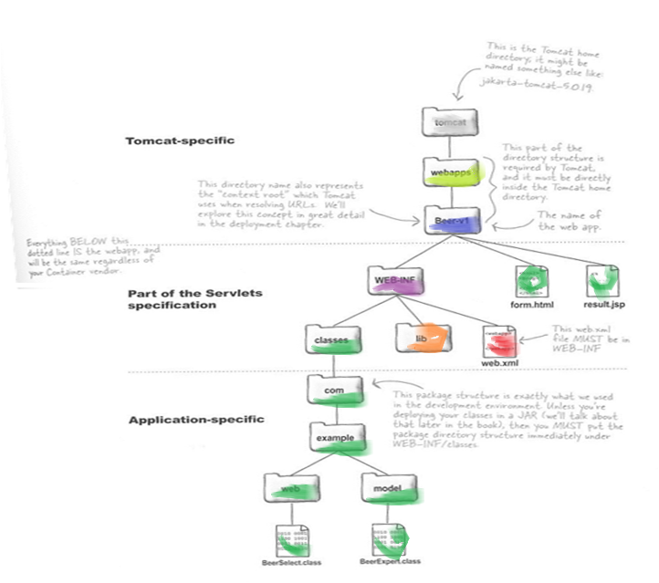
Deployment folder structure
This is the Tomcat home directory e.g. C:\Apache\Tomcat
This part of the directory structure is required and must be directly under the Tomcat home directory
This directory is the “context-root” used by Tomcat to resolve urls
The name of the web app
Everything below this line is your webapp
The web.xml file must go here.
This package/folder structure is as it appears in your development environment. It goes here directly under the WEB-INF folder.
Note: This diagram can be found in your textbook

