Slide 1
Dynamic HTML
Making web pages interactive with JavaScript

Slide 2
JavaScript “core API” defines only a few native objects – the remainder come from the hosting environment (i.e. the browser)
String – similar to the Java String class
Array – generic container/collection class
Math - like the Java Math class
Number, Boolean – wrapper classes similar to Java wrapper classes (Integer, Double etc)
var x = 123; // x is treated as a Number
var y = “123”; // y is treated as a String
var z = new Number(“123”); // z is a Number
Date – represents dates and times

Slide 3
Part 1: The Browser Object Model (BOM)

Slide 4
The BOM is a set of JavaScript-accessible objects that comprise various elements of a Browser
These are instances of classes defined by the Browser
i.e. they are not native to Javascript like String, Date, etc
That is, not part of the JavaScript core API objects
The BOM today has been standardized across current versions of browsers
Until very recently different browsers implemented BOM objects differently

Slide 5
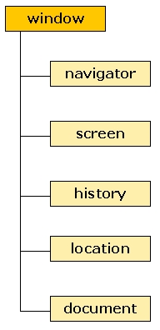
window is the top-level object in the BOM hierarchy
prompt(), and alert() are methods of the browser’s window object
You can call alert either with: window.alert(“Hello”);
Or just: alert(“Hello”);
window is a global object, which means you don’t need to use its name to access its properties and methods
Also: every global variable and function you define becomes part of the window object due to JavaScript object extension.

Slide 6
Some window methods and attributes
Methods:
alert() – posts a message dialog
confirm("question") - returns true or false
prompt("question", "default") - returns a String
open() - open a new browser window
close() – close a window
Properties (attributes)
defaultStatus – text in status bar
name – name of the window
opener – window that created this window
outerwidth, outerheight – window extents
Note: The window object contains many other methods and properties for various purposes – view them from within the browser debugger

Slide 7
Other BOM objects are children of the window object
Note: This list is not complete
Represents information about the Browser and the underlying OS
Information about the display capabilities of the client PC running the Browser
Information on recently visited sites
Information on current URL
Represents the current web page – the DOM

Slide 8
Some navigator methods and attributes
Methods:
javaEnabled() – returns true or false
Geolocation – new HTML5
Properties (attributes)
appCodeName – code name of the browser
appName - name of the browser
appVersion- platform and version of browser
cookieEnabled – true if cookies are enabled
userAgent – user-agent header sent to server

Slide 9
Some screen methods and attributes
Methods:
none
Properties (attributes)
availHeight, availWidth, height, width – metrics of display screen size
bufferDepth, colorDepth, pixelDepth – metrics of the color palette
deviceXDPI, deviceYDPI, logicalXDPI, logicalYDPI - number of dots per inch of the display screen
updateInterval – refresh interval

Slide 10
Some history methods and attributes
Methods:
back() – loads the previous URL in the history list
forward() – loads the next URL in the history list
go() – loads specific page in the history list
Properties (attributes)
length – number of elements in the history list

Slide 11
Some location methods and attributes
Methods:
assign() – loads a new document
reload() – reloads the current document
replace() – Replaces the current document with a new one
Properties (attributes)
host, hostname, href, pathname, port – hostname/port number/path/port/URL information
protocol – protocol of the current URL
hash, search – URL from the hash sign/question mark

Slide 12
Main headaches with BOM
Differences between browsers
Implementations of respective BOM models and the functions or attributes supported by the respective objects
Each new release of IE or Firefox has new features supported
Not every feature available in one browser will be supported in the other
Encouraging news:
IE and Firefox are complying with standards more than ever
Obsolete!
As of 2013, the info on this
page is obsolete!

Slide 13
Part 2: The Document Object Model
Note: The Document Object Model (DOM) is a child/subset of the BOM

Slide 14
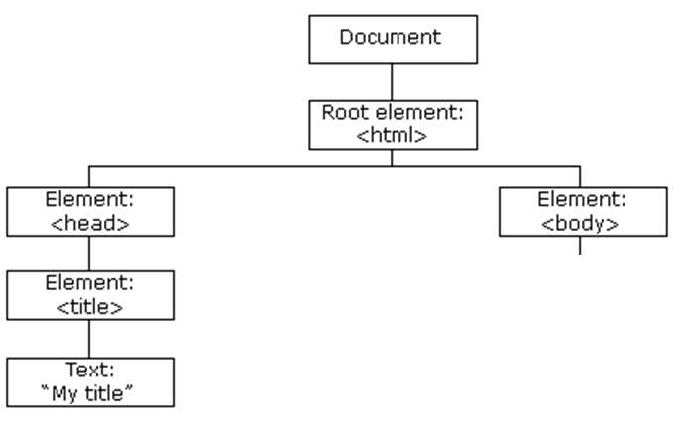
The Document Object Model (DOM) represents the objects that comprise a web page document
What SE2811 pattern
Does this remind you of?
The hierarchical structure of the DOM below the <body> element depends on the current web page content

Slide 15
All nodes have relationships to each other
Every node has a parent except for the document node
Most elements have descendant nodes
document
html
head
<p id=“par1”> Here is an<em id=“em1”>emphasized</em> word</p>
Here is an emphasized word
body
title
p
My title
Element node
Here is an
em
word
id=“par1”
Text node
emphasized
id=“em1”
Attribute node

Slide 16
Looking closer at an Element object within the <body>: Text and Attribute descendents
<p id=“par1”> Here is an<em id=“em1”>emphasized</em> word</p>
Here is an emphasized word
p
Element
Here is an
em
word
id=“par1”
Text
emphasized
id=“em1”
Attribute

Slide 17
Each Element, Attribute, or Text fragment in an HTML document is represented by a corresponding object in the DOM hierarchy
The DOM objects are programmatically accessible via Javascript
These objects are called nodes
Nodes can be dynamically accessed, added, deleted, or modified
Element node
Text node
p
Attribute node
Here is an
em
word
id=“par1”
Note: There is also a Comment node.
emphasized
id=“em1”

Slide 18
The DOM implemented by modern web browsers allows you to change virtually anything on a webpage
<p id=“par1”> Here is an<em id=“em1”>emphasized</em> word</p>
Here is an emphasized word
p
Element
Here is an
em
word
id=“par1”
Text
emphasized
id=“em1”
Attribute
Every element of a webpage can be accessed as a DOM object

Slide 19
Some document methods and attributes for accessing various subnodes
document Methods:
getElementById(id) – gets the Element in the document with a specified id
getElementsByTagName(tagName) – gets a collection of Elements with the specified tag name (e.g. “h1”)
getElementsByClassName(className) – gets a collection of Elements with the specified class name (e.g. “highlights”)
getElementByName() – gets a collection of Elements with the specified name (ex of named element: <form name=“form1"><input type="text"></form> )
querySelectorAll() – gets a collection of Elements with the specified selector pattern (e.g. “p em”)
querySelector() – gets the first Element with the specified selector pattern (e.g. “p em”) 2013 Note: Seems to be limited support for this method (fails on FF)
document Properties
anchors[ ], forms[ ], images[ ], links[ ] – collections of all objects of this type within the current document
body – the <body> Element object
documentElement– the <html> Element object
Note: The document object contains many other methods and properties for various other purposes – view them from within the browser debugger

Slide 20
JavaScript access to DOM nodes
let pars = document.getElementsByTagName(“p”);//array of all <p> nodes
let e = pars.item(0); // first <p>
e = pars[0]; // also first <p>
e = document.getElementById(“em1”);// specific element with #em1 id
getElementByID is one of the easiest ways to access an individual element
p
Element node
Here is an
em
word
id=“par1”
Text node
emphasized
id=“em1”
Attribute node

Slide 21
Navigating among nodes (this is tedious)
let p1 = document.getElementById(“par1”); // <p> node with id=“par1”
let first = p1.firstChild; // first child node: “Here is an”
let next = first.nextSibling; // next child: “em”
let last = p1.lastChild; // last child: “word”
let prev = last.prevSibling; // previous child: “em”
let parent = p1.parentNode; // whatever element contained <p>
Avoid; use ids!
p
Element node
Here is an
em
word
id=“par1”
Text node
emphasized
id=“em1”
Attribute node

Slide 22
Besides changing the existing HTML markup within a node, we can script the DOM to create entirely new nodes
let elm = document.createElement("p"); // creates free-standing <p>
let txt = document.createTextNode("Hello");
elm.appendChild(txt);
elm.setAttribute("id", “hellopar");
txt = document.createTextNode(" there.");
elm.appendChild(txt);
document.body.appendChild(elm); // put in <body>
body
Complex; Avoid!
p
id=“par1”
Hello
there.
<body>
<p id=“par1”>Hello there.</p>
</body>

Slide 23
Getting/Setting the HTML within a node
let p1 = document.getElementById(“par1”); // <p> node with id=“par1”
let markup = p1.innerHTML; // “Here is an<em id=“black>emphasized</em> word”
p1.innerHTML = “Here is some <em>new</em> text!”;
Use this approach whenever possible to modify the content of an html element!
p
Element node
Here is an
em
word
id=“par1”
Text node
emphasized
id=“em1”
Attribute node

Slide 24
The id or class of an existing element can be changed dynamically in order to modify the element’s appearance
let elm = document.getElementById(“par1”);
elm.setAttribute("id", “par2");
body
<style type=“text/css”>
#par1{ color:blue;}
#par2{ color:red;}
</style>
…
id=“par1”
p
<body>
<p id=“par1”>Hello there.</p>
</body>
id=“par2”
Hello
there.
<body>
<p id=“par2”>Hello there.</p>
</body>

Slide 25
All modern browsers implement the element’s style object
The style object contains the element’s CSS properties
You can use the style object to change any CSS property the element supports
Style property names generally correspond to CSS property names, with a few exceptions
In the case of CSS property names that contain a hyphen, remove the hyphen and capitalize the next letter for the corresponding style property
CSS property: “background-color”
Style object property: “backgroundColor”

Slide 26
Or style attributes can be modified directly via the style object
<style type=“text/css”>
#par1{ color:blue;}
#par2 { color:red;}
</style>
…
<script>
let elm = document.getElementById(“par1”);
elm.style.color=“green”;
</script>
…
body
p
id=“par1”
The <p> element’s id remains “par1”, but the style object is more specific than the CSS rule, so the CSS rule is overridden.
Hello
there.

Slide 27
The visibility and display style attributes affect whether the element is seen or not, but in different ways
var elm = document.getElementById(“error”); // gets error message
elm.style.display = “none”; // removes element from display process
elm.style.display = “block”; // includes element
elm.style.visibility = “hidden”; // hides
elm.style.visibility = “visible”; // shows
The display attribute, when set to “none”, causes the element to be removed from the display. Other elements will fill in the space left behind.
The visibility attribute, when set to “hidden”, causes the element to be kept in the display, but not shown. An empty space will appear where the element would otherwise appear.
This is a common approach to displaying or hiding web page error messages

