Slide 1
The HTML markup language
Are we there yet?

Slide 2
Reading
Be sure to complete the reading assignments before labs
Links to reading material are on the course website:
HTML Reference
CSS Reference

Slide 3
Markup languages
HTML is one type of markup language
Created in early 1990’s by Tim Berners-Lee as a foundation element of the World-Wide Web
The motivation was to create a means of distributing static documents within the research community
Markup languages were created in the 1960’s within the publishing industry as a means of describing page layouts (SGML – Standard Generalized Markup Language)

Slide 4
HTML HyperText Markup Language
HTML tags (markup) indicate what kind of structure your html document contains
Valid HTML documents incorporate a well-defined structure
The rules of HTML specify the sequence and order in which the markup tags appear in a valid HTML document
Check validity of a website at http://validator.w3.org

Slide 5
There are two main types of markup language
Procedural markup focuses on the presentation of a document
Font face and size specification, centering, highlighting, etc.
Nroff, troff, TEX, PostScript are procedural markup languages
Nroff variants were used on early Apple & IBM PCs
Descriptive markup focuses on the structure of a document
Title, headings, chapters, sections, body, etc.
SGML and XML are systems for defining descriptive markup languages

Slide 6
So, what kind of markup language is HTML?

Slide 7
History of HTML (written 2006)
HTML 1.0 (1993)
Not officially a standard at this point
No support for images
HTML 2.0 (1995)
Image support introduced (Netscape Navigator)
HTML 3.x (1995-1997)
Days of “Browser Wars” and proprietary extensions
Mixed procedural and descriptive markup (fonts, colors)

Slide 8
History of HTML, continued (updated 9/2007)
HTML 4.0 (12/1997)
W3C tries to bring order to the chaos
Separates descriptive structure (HTML) from procedural presentation (CSS)
HTML 4.01 (1999)
W3C proposals adopted by major browser authors
XHTML Version 1.0 (2000)
HTML is a grammar defined as an SGML application
XHTML is a grammar defined as an XML application
Same vocabulary as HTML 4.01…
But stricter syntactical rules
XHTML Version 1.1 (2007)

Slide 9
History of HTML, continued again (updated 9/2011)
XHTML Version 1.1 (2009)
Largely compatible with XHTML 1.0 and HTML 4, but with better support for East-Asian characters
Limited browser support; did not gain widespread acceptance
XHTML Version 1.2 (proposed)
Proposed support for limited access
No charter to execute actual development
XHTML Version 2 (proposed)
Major redesign
Charter expired end of 2009
HTML 5 (still under development, in Draft Standard state as of 3/2010)
Support for features previously left to plug-ins (e.g. audio, video, 2-D graphics)

Slide 10
Where are we today? (updated Spring 2013)
HTML5
Working draft as of 5/2012
Planned Recommendation 2014 (stable)
Expected Final signoff 2022!
XHTML Versions
Essentially dead!

Slide 11
HTML5 rules! (updated Spring 2014)
HTML5 has effectively subsumed HTML 4.01 and XHTML.
All modern browsers support HTML5
There is still a lot of extant HTML 4.01 and XHTML code

Slide 12
Basic HTML document structure
<!doctype html>
<html>
<head>
<meta charset=“UTF-8”>
<title>SE2840</title>
</head>
<body>
<h1>HTML syntax summary</h1>
<h2>or, all you need to know about HTML</h2>
<p>This is how you write
an HTML document.</p>
<p>The end.</p>
</body>
</html>
This directive tells the browser the content of the file is HTML
Defines the start of the HTML document
Tells the browser about your web page.
Tells the browser, in this case, we’re using the UTF-8 character set.
Tells the browser the title of the page; appears in browser titlebar.
The body encloses everything that appears within the browser window.
Tells the browser that this is a level-1 header.
Tells the browser that this is a paragraph, or normal block of text.
Note: beware of the “” that appear in these and other powerpoint slides;
They are not valid HTML double-quotes!

Slide 13
Tags specify the structural elements of an HTML document
Syntax:
<tag>element content </tag>
The opening and closing tags’ names match
The closing tag name is preceded with a “/”
Tag case does not matter in HTML5
Case didn’t matter in early HTML
Only lowercase was allowed in XHTML
Tags are often nested
Whitespace is ignored, but nested tags should be indented for clarity
Only certain tags can nest other tags (see HTML ref)

Slide 14
A browser parses and creates a nested data structure from an HTML document
<!doctype html>
<html>
<head>
<meta charset=“UTF-8”>
<title>SE2840</title>
</head>
<body>
<h1><strong>HTML</strong> syntax <em>summary</em></h1>
<p>or, all you need to know about <strong>HTML</strong></p>
<p><em>This</em> is how you write
an HTML document.</p>
<p>The <em>end</em>.</p>
</body>
</html>
html
body
head
h1
p
p
p
title
strong
em
em
em
strong
end
There are additional child elements (mostly not shown here) called “text nodes”

Slide 15
Inline vs. Block elements
Block elements are always displayed as if they had a linebreak before and after them
<p> used to designate a paragraph
<div> often used to nest multiple <p> elements
Inline elements appear within the flow of text on a page, often nested within <p> elements
<q> used for short “inline” quotations
<em> indicates emphasized text
<strong> indicates strongly emphasized text

Slide 16
Entity references
Since some characters, like < and > are part of the markup…
…so you have to use entity references when you need to include them in your content:
&lt; <
&gt; >
&quot; “ Note that this is not a regular quote
&apos; ‘
&amp; &

Slide 17
Element Attributes
Elements may often contain attributes which provide additional information about the element’s structure:
<tag attribute=“value”> content </tag>
An attribute‘s value must be enclosed in double quotes
<img src=“roscoe.jpg” alt=“photo of roscoe”>
<h1 id=“title1”> A Computer Haiku</h1>
<a href=“http://www.msoe.edu”> MSOE</a>

Slide 18
Empty elements
…are various elements containing no content, but instead act like directives:
<br> or <br/>
to explicitly break a line
<img src=“http://www.msoe.edu/images/logo.gif” alt=“MSOE logo”/>
Note that img is a “self-closing” tag

Slide 19
Modern HTML is structural markup
Describing only the content of a document, not the appearance
Presentation is left to Cascading Style Sheets

Slide 20
Some tags appear to specify presentation rather than structure…
<p>The <em>em</em> element indicates emphasized text</p> is rendered by a browser as:
The em element indicates emphasized text
<em> - emphasis
<strong> - strong emphasis
<b> - bold
<i> – italic
<s> or strike – strikethrough
<u> – underlined
…however, these tags really indicate structural parts of a document (e.g. an emphasized piece of text)
Q: So how does the browser know how to render any element (e.g. font, size, color)?

Slide 21
HTML Comments
<!-- this is a comment -->
Don’t place a comment
Inside a tag
Inside another comment
Good practice: Leave space after the opening <!-- and before the closing -->

Slide 22
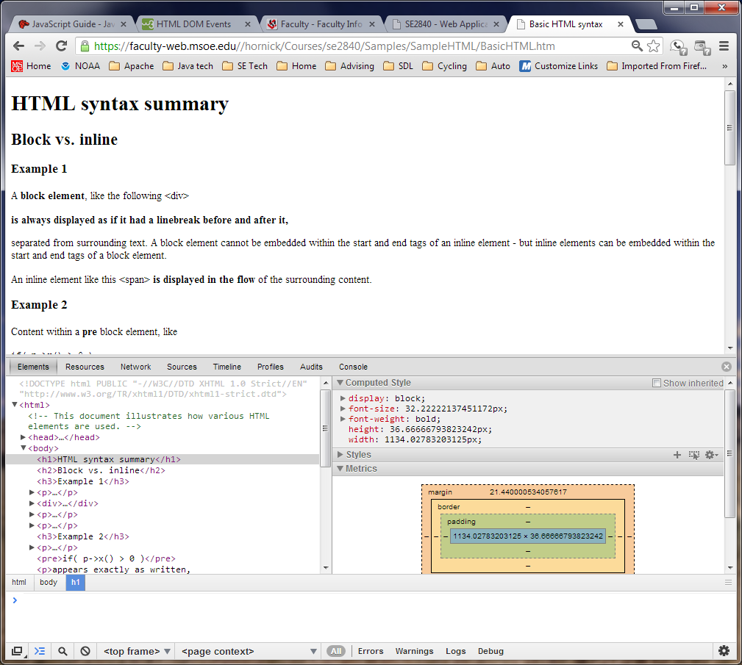
Chrome analysis tool

