Slide 1
SE-2840 Web Application Development

Slide 2
Contact info
Instructor: Dr. Mark L. Hornick
http://faculty-web.msoe.edu/hornick/
email: hornick@msoe.edu
Office: DH434
Phone: 277-2417
Follow link to my schedule for Office Hours

Slide 3
Things we’ll cover in this course:
Substrates and protocols of the www
HTML5 and CSS for web page content and appearance
Client-side JavaScript for validating forms and modifying content/appearance of web pages
Ajax for efficient client-server interactions
jQuery for efficient DOM queries
Web frameworks: Angular React
NodeJS web services
Geolocation
Databases

Slide 4
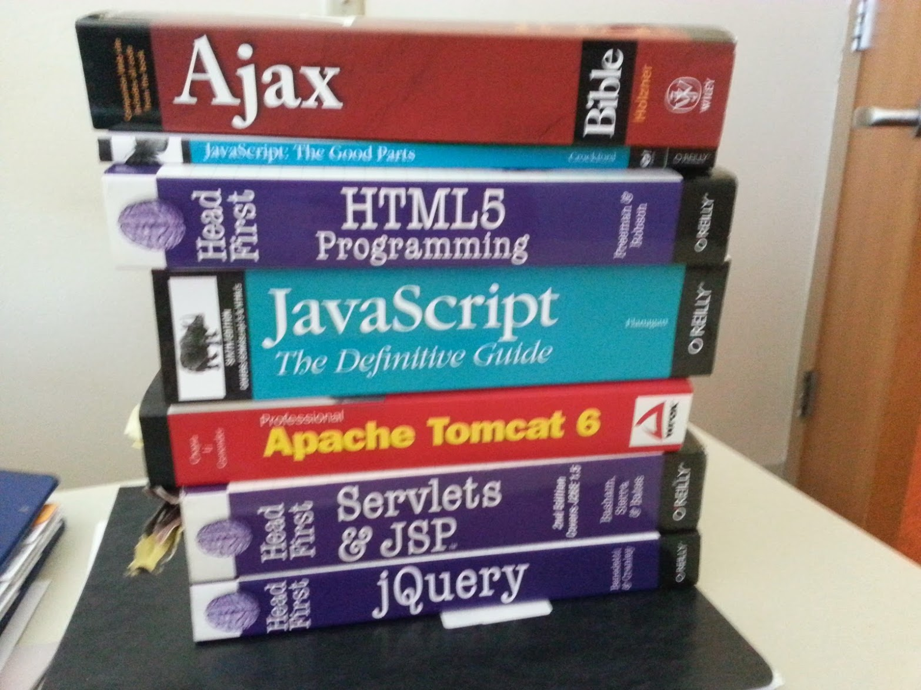
Stuff you should read

Slide 5
Things I assume you know :
Java - proficiency with core language elements, data structures, threading, IPC
This is all material you should have from SE1021, CS2852, SE2811, CS2911

Slide 6
Labs
Web page design using standard HTML/CSS
(2) Client-side scripting using Javascript/Ajax
jQuery and Bootstrap Javascript libraries
Web app using a public web service
(2) NodeJS-based web server
Geolocation
React-based client

Slide 7
Grading (Course Policies)
Review grading on course website
The grading formula applies only to those students who have successfully met the objectives of this course.
There is a 10% per business day late penalty for all written work and no work will be accepted more than one week late for credit.
You are encouraged to discuss assignments (lab and homework); but: everyone is responsible for doing and turning in their own work. (Sharing code is not allowed.)

