Slide 1
A JavaScript framework

Slide 2
Introductory topics
MVC
jQuery/DOM manipulation
Virtual DOM
Components
Babel
JSX
Webpack

Slide 3
React Executive Summary
Created/Backed by Facebook
First prototype with php in 2010
Open-sourced in 2013
Stable 2015
Adaptation 2016 - present
2019 stable release is 16
React allows you to write special HTML components that synchronizes with your JavaScript leaving you to write your application logic instead of manually updating the DOM.

Slide 4
Review
What is the Model-View-Controller pattern about?

Slide 5
What is React and what problem(s) does it address?
First, consider the structure of the web apps you have done so far:
Does the code present a clean implementation of the MVC pattern?
Where is the View implemented?
what code file(s)/module(s) create or modifie what is seen in the browser?
Where is the Controller implemented?
what code is responsible for getting data and deciding what data is to be displayed?
Where is the Model implemented?
what code is responsible for storing data?

Slide 6
HTML/jQuery approach mixes Controller and View
The typical paradigm is as follows:
Access a DOM element
Read its value
Send the value to the Model
OR
Read a value from the Model
Access a DOM element
Update its content with the value

Slide 7
Typical jQuery approach
$('#program').html(track.curriculum); $('#year').html(track.year); $('#quarter').html(track.term); $('#courselist').empty(); // clear the course list (note: managing the ui here) $('#courselist').append("<ul class='list-group'>"); // add the <ul> element track.courses.forEach((course, index) => { // iterate all courses // note html mixed with script (ui+control = low cohesion/bad code smell) $('#courselist > ul').append("<li class='list-group-item list-group-item-success'>" + course.id + " : " + course.desc + '</li>'); }); // end forEach
Green = UI markup
Blue=UI manipulation in control code
ALSO: Manipulating the DOM is slow and CPU intensive

Slide 8
Low cohesion! High coupling! Bad code smell!
Note that the JavaScript “knows” about the View, since it explicitly has to add a <li> element to the <ul>
This is an example of poor cohesion and tight coupling

Slide 9
React Motivation
Evolution has moved wep app architecture towards SPA (single page applications) , where the :
Server implements the Model (e.g. Phonebook)
Client (browser) implements the View and Controller
The Controller is responsible for
Getting data from the server and making it accessible to the view.
Extracting data from the view and posting it to the server
The View is responsible for
Deciding how to display components/elements and information to ensure a unified UI experience (desktop, tablets, phones)

Slide 10
React is one of many competing frameworks that attempt/promise to:
Decouple DOM manipulation from app logic (control)
Decouple client-side from server-side
Improve testability
Make common coding tasks easier
This is changing rapidly. To get the latest, google
“javascript mvc frameworks”

Slide 12
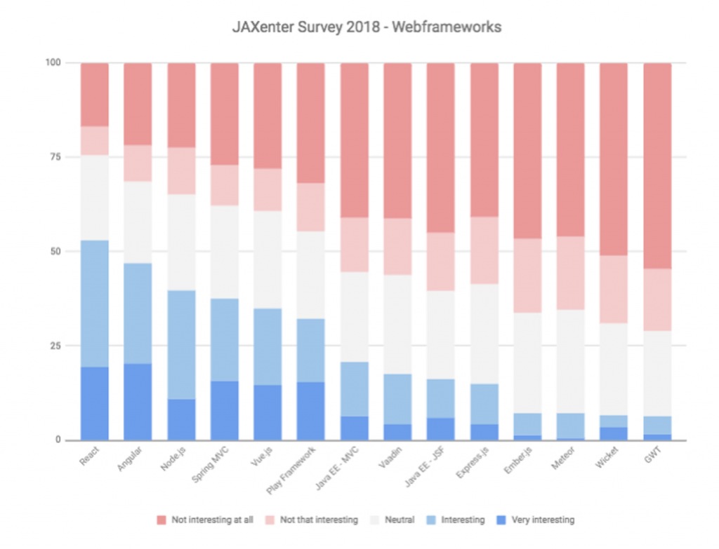
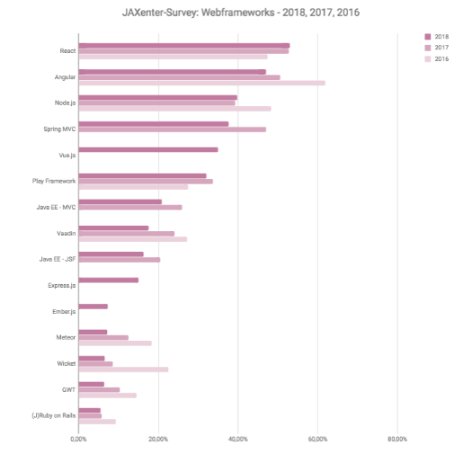

Slide 13
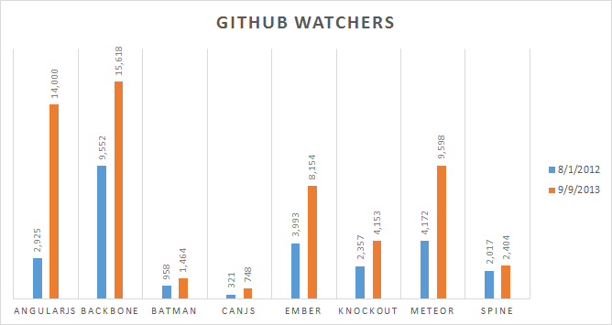

Slide 14
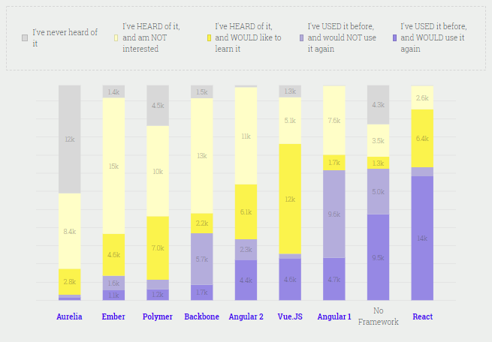
2017 survey results:
Google: “angularjs vs other frameworks” for many differing opinions

Slide 15
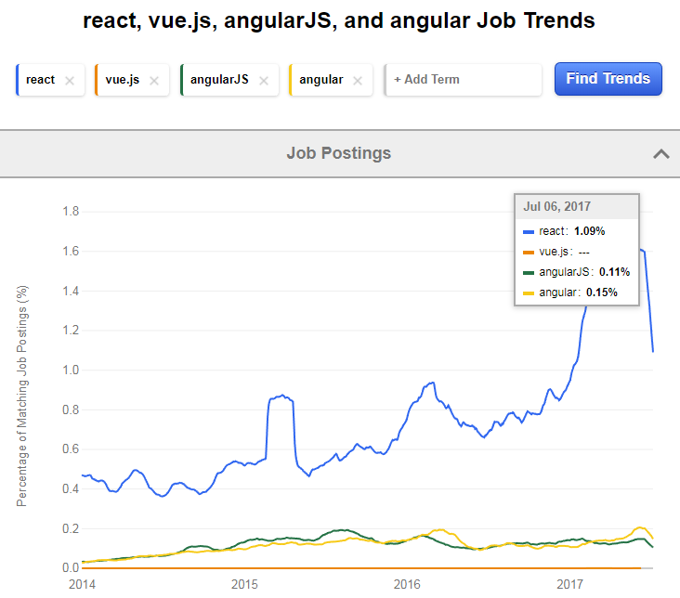

Slide 16
React (generally, web frameworks) are not perfect
Not a good fit for applications that require intensive and tricky DOM manipulation of the DOM (ie games, gui editors)
In such cases, it may be better to use a library that exposes a lower level of abstraction, like jQuery
Although React Canvas might be just as good
React has been accused of being a memory hog

Slide 17
Using React’s createElement() method to create a Virtual DOM element: <p id=‘p1’ class=‘text-primary’>Hello SE2840</p>
createElement(‘p’,
{‘id’:’p1’, ‘className’:’text-primary’}, ‘Hello SE2840’ )
Syntax: createElement( type, [props], […children] )
Type – tag name string (‘div’, ‘p’, etc)
Props – element properties as a Javascript object
Since ‘class’ is a js reserved word, we must use ‘className’
…children – an iterable (0 or more)
Creates/returns a ReactElement object

Slide 18
Using React’s createElement() method to create: <h1> <p class=‘text-primary’>Hello</p> </h1>
createElement(‘h1’,null, createElement(‘p’, {‘id’:’p1’, ‘className’:’text-primary’},’Hello’) )
Note that the nested createElement() is the 3rd argument to the first createElement()
The nesting of calls can be repeated as much as necessary.

Slide 19
Basic React approach: (nobody actually does this – for illustration purposes only!)
Include a couple of <scripts> into your html:
<!-- These are the React core modules --> <script src="https://unpkg.com/react@15.4.2/dist/react.js"></script> <script src="https://unpkg.com/react-dom@15.4.2/dist/react-dom.js"></script>
In the js file, use React’s createElement() method to build an VirtualDOM locally:
let listitems = []; track.courses.forEach( (course, index) => { let element = React.createElement("li", {key:index, 'className':'list-group-item list-group-item-info'}, (course.id + ' : ' + course.desc) ); listitems.push(element); } ); // end forEach let unsignedlist = React.createElement("ul", {'className': 'list-group'}, listitems ); // This tells React where to render the virtual DOM structure ReactDOM.render(unsignedlist, document.getElementById("courselist"));
HTML-like elements still in code;
We need to separate this out!
Use ReactDOM.render to display the VirtualDOM (much more efficient).

Slide 20
A much better React approach - (separate the control code from the view code)
Include a couple of <scripts> into your html:
<!-- These are the React core modules --> <script src="https://unpkg.com/react@15.4.2/dist/react.js"></script> <script src="https://unpkg.com/react-dom@15.4.2/dist/react-dom.js"></script>
Use ReactDOM.render to display the VirtualDOM (much more efficient).
$('#program').html(track.curriculum); $('#year').html(track.year); $('#quarter').html(track.term); // This tells React where to render the virtual DOM structure ReactDOM.render(<Courselist items={track.courses}/>, document.getElementById("courselist"));
But have the control code use Courselist, a custom view component that is defined elsewhere, and provide that component with data

Slide 21
A much better React approach (the view code)
Include a couple of <scripts> into your html:
<!-- These are the React core modules --> <script src="https://unpkg.com/react@15.4.2/dist/react.js"></script> <script src="https://unpkg.com/react-dom@15.4.2/dist/react-dom.js"></script>
Use JSX to define the view – almost identical to regular HTML (except ‘className’)
class Courselist extends React.Component { render() { return <ul className='list-group'> { // Javascript in the middle of JSX needs to be delimited with {} this.props.items.map((course, index) => <li key={index} className='list-group-item list-group-item-danger'> {course.id + ' : ' + course.desc} </li> ) } </ul> } // end render() }
JSX can embed Javascript to get at data (that is, the items array) provided by controller

Slide 22
But JSX is not Javascript, so we have to use the Babel transpiler to convert it to regular Javascript
The view code as transpiled by Babel:
class Courselist extends React.Component { render() { return React.createElement("ul", { className: "list-group" }, // Javascript in the middle of JSX needs to be delimited with {} this.props.items.map((course, index) => React.createElement("li", { key: index, className: "list-group-item list-group-item-danger" }, course.id + ' : ' + course.desc))); } // end render()
In our html file, we need to include the Babel-script rather than the original script containing the JSX

Slide 23
Lab 8 Tables must use the same React Component
You’ll be developing a React Component to represent both tables
The “buses on route” table contained
(rt, vid, spd, lat, lon, dist)
The “speeding bus” table contained columns
(rt, vid, spd, lat, lon, tmstmp)
Write your Component to conform to the “speeding bus” format
Both tables will display the same data format
The same information is in both Ajax responses from your Node server (although the “buses on route” response has more information)
MAKE SURE ONLY THE TABLE SCROLLS

