Slide 1
Java Server Pages

Slide 2
HTML/JSPs are intended to be used as the views in an MVC-based web application
Model – represents an application’s state, business logic, or data
View – responsible for
getting input from the user
displaying output to the user
Controller –
accepts input from a view
instructs the model to perform actions on the input
decides what view to display for output
does not generally generate HTML
Model (“regular” java classes)
Input from views
Controller (java servlets)
Changes to model
User input
displays
View (HTML)

Slide 3
JSP code looks a lot like HTML, with the addition of scripting elements
<%@ page language="java" contentType="text/html; charset=utf-8"
pageEncoding=“utf-8"%>
<!DOCTYPE html>
<html>
<head>
<meta charset=“utf-8">
<title>Page title</title>
</head>
<body>
<h1>Hello, World!</h1>
<p>Today is:
<%
// The code within this tag is a java scriptlet - plain old java.
Date d = new Date(); // d is a local variable, as is df (below)
DateFormat df = new SimpleDateFormat("EEEE, d MMMMM yyyy HH:mm:ss z");
// out is a predefined PrintWriter output stream
out.println(df.format(d));
%>
</p>
</body>
</html>
JSP’s look almost like HTML to non-Java webpage authors
Files containing JSP code end with .jsp instead of .html

Slide 4
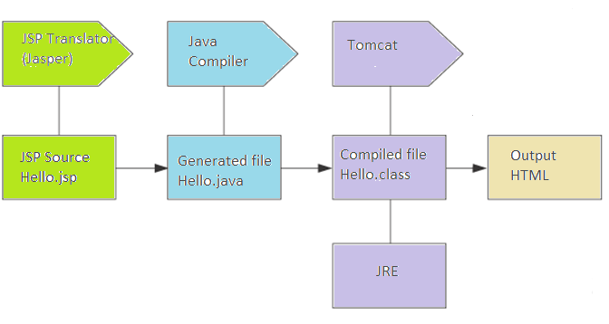
JSP’s are automatically translated into Servlets
Eclipse compiles jsps into a well-hidden workspace folder:
D:\Workspace\.metadata\.plugins\org.eclipse.wst.server.core\tmp0\work\Catalina\localhost\Example2015\org\apache\jsp

Slide 5
JSP’s are translated into Servlets having the methods:
_ jspService()
This is where the translated HTML and your scripting code gets put
jspDestroy()
You can override this in a <%! … %> declaration
jspInit()
Similar in function to the regular init() method
You can override this too in a <%! … %> declaration

Slide 6
There are 6 different kinds of JSP elements
<% out.println(“hello”); %> Scriptlets
<%@ page import=“java.util.*” %> Directives
<%= “hello” %> Expressions
<%! int count = 0; %> Declarations
<%-- A JSP comment --%> Comments
${ …} Expression Language code

Slide 7
Scriptlets contain plain old java code
<%
// The code within this tag is a java scriptlet - plain old java.
java.util.Date d = new java.util.Date();
java.text.DateFormat df = new java.text.SimpleDateFormat("EEEE, d MMMMM yyyy HH:mm:ss z");
// out is a predefined PrintWriter output stream
out.println("Today is " + df.format(d)); // out: an implicit object
%>
Every JSP Servlet has a _jspService() method that is generated by the JASPER translator.
_jspService() is the method called by Tomcat as a substitute for the doGet() and doPost() methods of regular servlets.
Scriptlet code you write in a .jsp file becomes the body of the _jspService() method.

Slide 8
A JSP has access to various implicit objects
request – an HttpServletRequest
response – an HttpServletResponse
out – a JspWriter (same api as PrintWriter)
session – an HttpSession
config – a ServletConfig (for this JSP)
application – a ServletContext
page – an Object used for custom tags
pageContext – a PageContext (similar to config)
exception – a Throwable (available to error pages only)

Slide 9
Directives tell the translator what to do
<%@ page language="java" contentType="text/html; charset=ISO-8859-1"
pageEncoding="ISO-8859-1"%>
<%@ page import="java.util.*, java.text.*" %>
Three types of directives: page, include, taglib
The page directive can have 10 additional attributes:
isThreadSafe[true], contentType[text/html], errorPage,
isErrorPage[true if referred], session[true],
autoFlush[true], buffer, info,
IsELIgnored, extends

Slide 10
Expressions become the argument to out.print()
<%= “hello” %>
Is the same as
<% out.print(“hello”); %>
Note the absence of the semicolon in the expression.
The expression can evaluate to any type of object, which is then rendered to a String value in the usual Java way.

Slide 11
Declarations
<%! private int count = 0; %>
<%! // a helper method called from scriplet code
private int doubleCount() {
count = count*2;
return count;
}
%>
Normally, scriptlet code (i.e. <% … %>) gets put into the body of the _jspService() method.
Declarations are inserted before the body of the _jspService() method.
Thus, Declarations can be used to declare Servlet class attributes and methods.

Slide 12
Comments
<%-- A JSP comment --%>
<!-- An HTML comment -->
HTML comments are passed into the generated HTML
JSP comments are removed.

Slide 13
JSP Servlets can have init parameters like regular servlets
<?xml version="1.0" encoding="UTF-8"?>
...
<servlet>
<servlet-name>HelloWorld</servlet-name>
<jsp-file> /hello.jsp </jsp-file>
<init-param>
<param-name>max_value</param-name>
<param-value>10</param-value>
</init-param>
</servlet>
<servlet-mapping>
<servlet-name>HelloWorld</servlet-name>
<url-pattern>/hello</url-pattern>
</servlet-mapping>
...
</web-app>
Note that the tag <jsp-file> replaces the <servlet-class> tag

Slide 14
Be careful of how JSP’s handle sessions
The _jspService() method will automatically call getSession() and return a HttpSession to the implicit session reference
A new session may be created if one doesn’t yet exist – is that always what you want?
To suppress this, use:
<%@ page session=“false" %>
Or, use a Session Listener to create the session data.

Slide 15
Dispatching a Request from a Servlet to a JSP
To make a regular Servlet get a JSP to handle outputting a response, insert the following in the Servlet’s doGet() or doPost() methods:
RequestDispatcher view = request.getRequestDispatcher(“/view.jsp");
view.forward( request, response );

Slide 16
You can add attributes to an HttpServletRequest, effectively enabling you to “pass” arguments to the JSP
RequestDispatcher view = request.getRequestDispatcher(“view.jsp");
// add an attribute to be attached to the request
request.setAttribute(“foo”, “bar”);
// Now, view.jsp will be able to get “bar” from the “foo” attribute attached to the request
view.forward( request, response );

Slide 17
Remember: You can’t forward a Request if you’ve already committed a Response
If your Servlet (or JSP) has already generated output, you’ll get an IllegalStateException:
PrintWriter pw = response.getWriter();
pw.println(“<html”>); // start of output…
…
RequestDispatcher view = request.getRequestDispatcher("view.jsp");
view.forward( request, response ); // IllegalStateException!

