Slide 1
The MEAN stack is used as a basis for many modern web applications
Mongo
Express
AngularJS
NodeJS
https://www.mongodb.com/blog/post/the-modern-application-stack-part-1-introducing-the-mean-stack
Note: More recently, the MERN stack has been growing popular (as React overtakes Angular): Mongo, Express, React, and NodeJS

Slide 2
MongoDB
A persistent data store

Slide 3
What is a database?
Like a file, a database is used to persistently store information outside of an application
The app can stop or crash, but the data persists and is still available after restart
Unlike a file, a database is (highly) structured, allowing for easy manipulation (CRUD)
Create (putting items in)
Read (retrieving items via search queries)
Update (searching for & modifying existing items)
Delete (searching for & deleting items)
Database files are also highly robust and optimized
All transactions are atomic
Crash-resistant
Fast (in-memory caches)

Slide 4
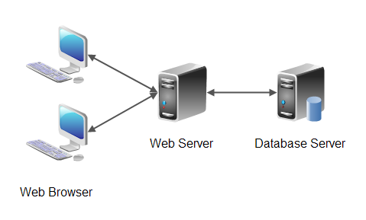
A database is often implemented as a separate application hosted on a separate physical server
Custom protocol over TCP (e.g. MWP)
http
The web server and db server can coexist on the same physical computer/server in many cases (we will use this approach in SE2840)

Slide 5
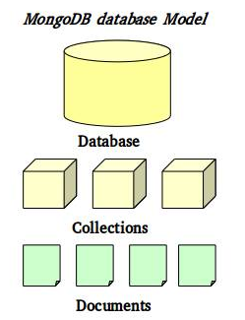
Mongo database server
A
A MongoDB server may host many individual databases (A,B,C)
Each database may maintain many collections
B
Each collection may contain many documents (i.e. items)
C

Slide 6
Installation
Install mongo; see https://docs.mongodb.com/manual/tutorial/install-mongodb-on-windows/
Install using msiexec.exe
Do not install as a service! (uncheck “install as a service” checkbox)
2. Create an empty folder to contain the mongo database files; e.g. c:\mongo\data Any folder is OK as long as it is not write-restricted
3. Start mongo server: "C:\Program Files\MongoDB\Server\4.0\bin\mongod.exe" --dbpath c:\mongo\data Note: Include the quotes!
4. In a separate terminal window, run the mongo client shell to interactively access the database:
"C:\Program Files\MongoDB\Server\4.0\bin\mongo.exe“
Note: Include the quotes!
Use "help" at command prompt for available commands
(e.g. show dbs, use phonebook, use bustracker, db.buses.drop(); db.dropDatabase(), etc See following slides.

Slide 7
Interacting with the Mongo Server
Mongodb
Network
Protocol (port 27107)
Mongo Server
NodeJS-Mongo Driver (mongoose)
NodeJS App1
NodeJS App2
MNP Driver
Command-line App (mongo.exe)
PyMongo Driver
Python App
Apps use the drivers’ APIs
Mongod.exe
Other apps (Python, Java, etc) can also use Mongo through various Drivers (PyMongo, etc)
Many applications can use the Mongo server simultaneously with no danger of overwriting data

Slide 8
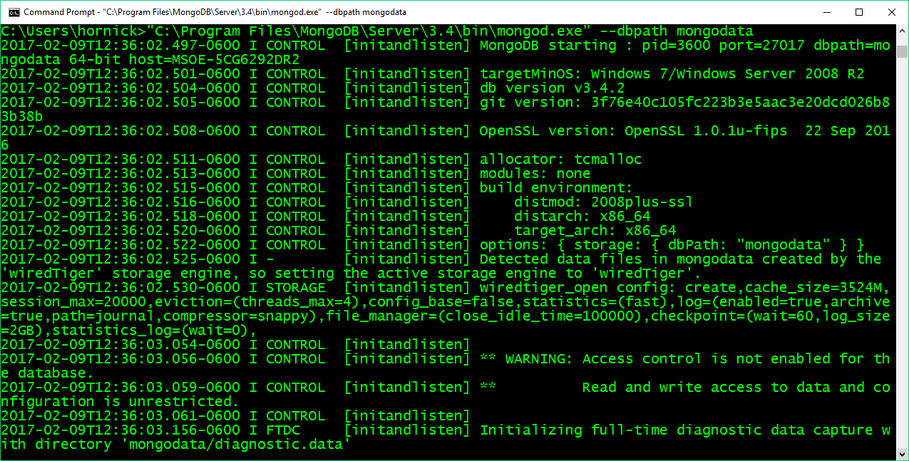
Starting the MongoDB server (mongod.exe)
Starting the server results in a lot of informational messages being displayed to the console.

Slide 9
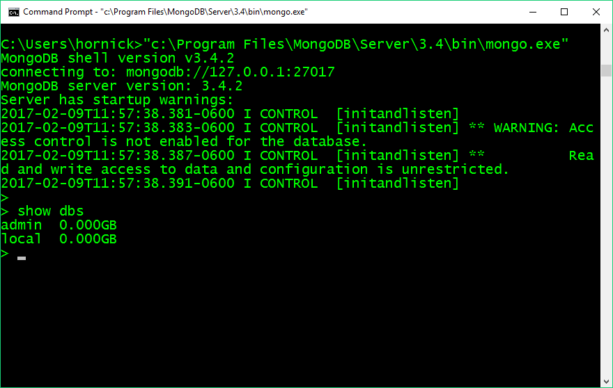
Command-line viewer (mongo.exe)
The show dbs command displays the databases being hosted by the mongo server. In this case, there are some default databases shown: “admin” and “local” (and “config” in v4.0)
These are created automatically whenever you create a new mongo server.

Slide 10
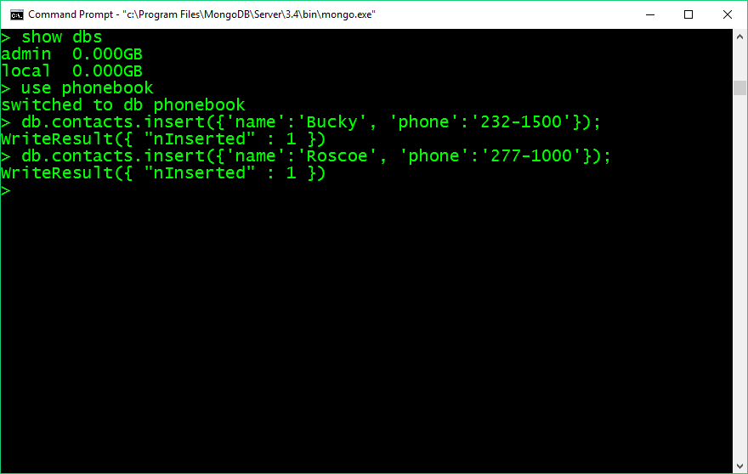
Creating a new database
The use phonebook command creates a new empty database named “phonebook”.
You can create as many databases as you want (within reason).
To switch between databases, type use <db>, where <db> is the database you want to use.
Remember, subsequent commands will apply to the database you “use”.

Slide 11
Creating/inserting documents into a db collection
Here, the phonebook database is being used.
The db.contacts.insert() command inserts a new document into the “contacts” collection of the “phonebook” (currently used) database.
A database can have multiple collections, and each collection can have multiple documents.
A document is a single entry in a collection; in Mongo, a document is a Javascript object

Slide 12
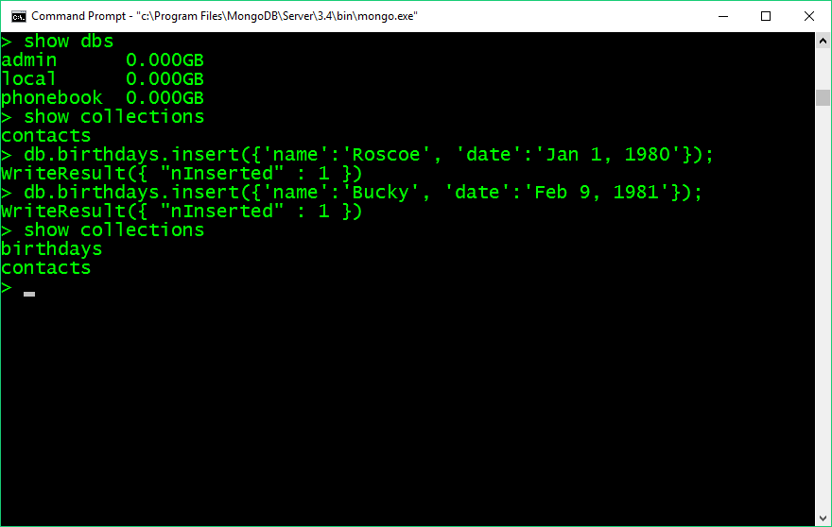
Viewing databases and collections
Now there are 3 databases, including the new “phonebook” db.
The show collections command displays the current collections.
Another collection (“birthdays”) is created just by
inserting a document into it
The db.contacts.count() command displays the number of documents in a collection

Slide 13
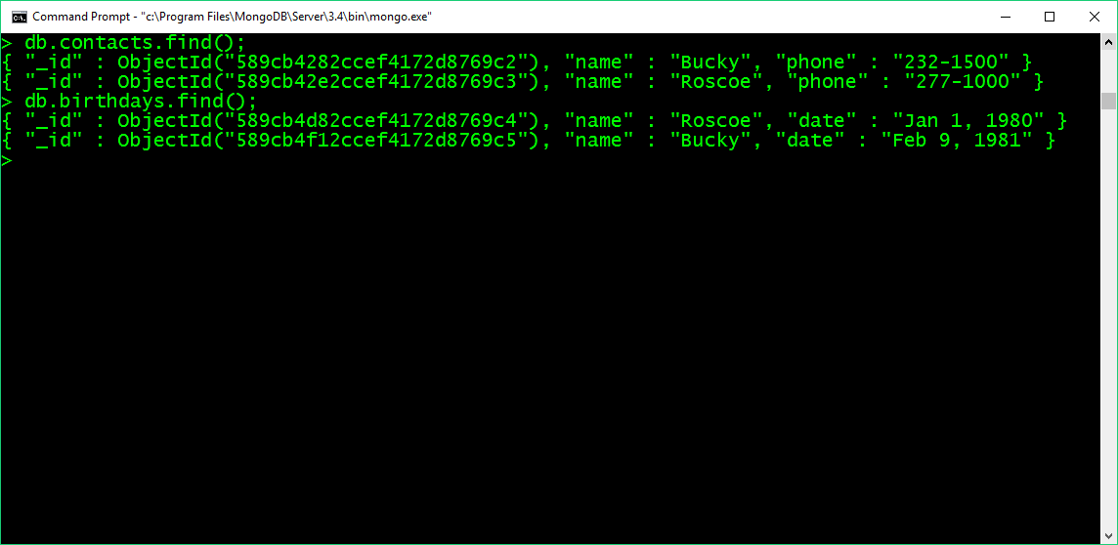
Searching and Viewing documents/records in a collection
The db.contacts.find() command displays all of the documents in the “contacts” collection.
The db.contacts.find( {“name”:”Bucky”} ) command searches and displays all documents that match the specified query.
The db.contacts.find( {“name”:/c/} ) command uses the
Regular Expression /c/ to find all documents that contain “c” in the name.
The db.contacts.find( {“name”:”Bucky”} ).count() command displays the number of documents that match the query. Each document is a Javascript representation of the data that was inserted – but note that Mongo prefixes each document with a unique id.

Slide 14
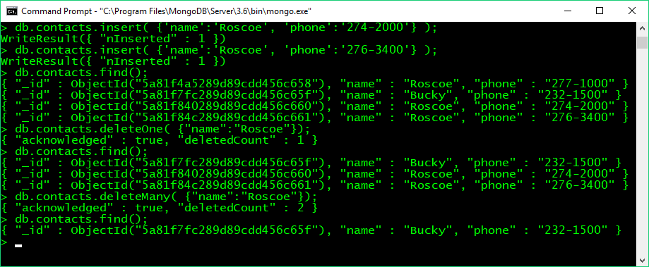
Deleting documents/records in a collection
The db.contacts.deleteOne(…) command deletes the first document
matching the specified query from the “contacts” collection. The db.contacts.delectMany(…) command deletes all documents
matching the specified query from the “contacts” collection. .

Slide 15
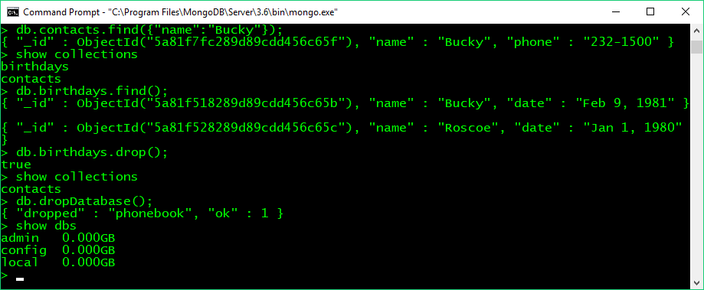
Deleting collections and entire databases
The db.birthdays.drop() command deletes the “birthdays” collection from the current database. The db.dropDatabase() command deletes the current database itself
from the server .

