Slide 1
Java Servlet-based web apps
Servlet Architecture

Slide 2
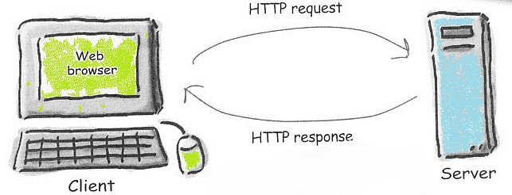
Recall: The interaction between web clients and servers is structured around HTTP Request and Response messages
Server is running a web server app,
like Apache or Microsoft IIS.

Slide 3
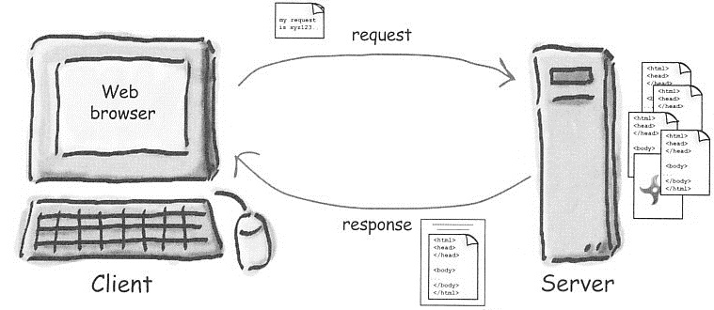
In the simplest scenario, the Server responds to a browser GET request by returning a pre-written, static HTML file
HTTP GET
request
HTML file maintained on
Server, returned to the
Browser as the HTTP
response “payload”
Note: This diagram can
be found in your textbook

Slide 4
Eclipse J2EE demo

Slide 5
A web server can employ a Helper App when it needs to go beyond serving static web pages
HTTP GET or POST request
(may include parameters)
parameters
CGI
Helper app
CGI* programs can be written
in Perl, Python, PHP, C, or – Java
*Common Gateway Interface

Slide 6
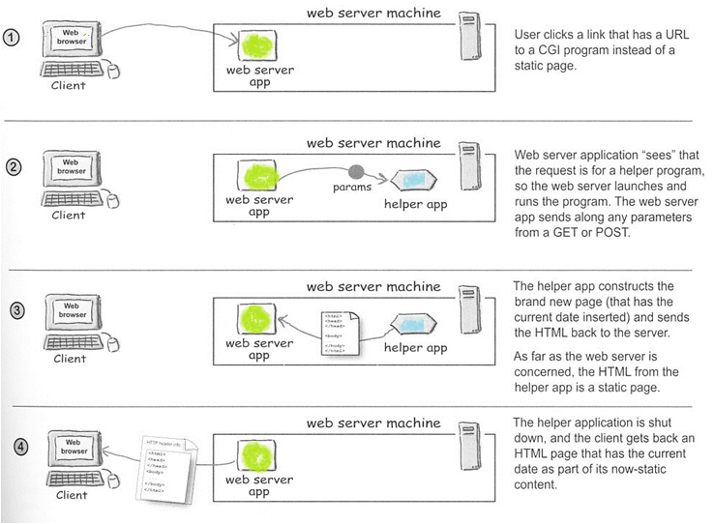
How it works in general
User enters a URL (or clicks a link) to a CGI program rather than a static page
Web server “sees” that the request is for a helper program, so the server runs the helper, sending along any parameters sent from the Client.
The helper app constructs the brand new (dynamic) page and sends the HTML back to the server.
Note: This diagram can
be found in your textbook

Slide 7
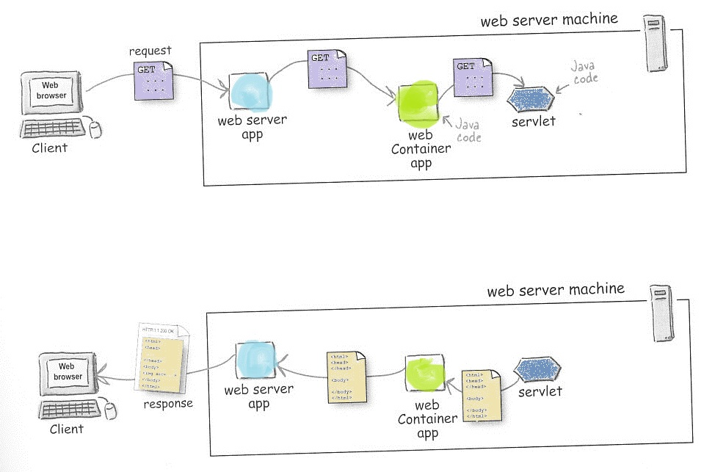
How it works for Java Servlets
Web server app is commonly Apache
Web container app is Tomcat
Servlets are run by Tomcat
Note: This diagram can
be found in your textbook

Slide 8
What does a Container like Tomcat do?
Communication
  Creates server-side sockets
  Listens for client connections
  Determines client HTTP request type and “decodes” HTTP headers
Servlet Lifecycle management
  Figures out which Servlet should be used to process a specific request
  Handles Servlet class loading
  Handles Servlet instantiation/construction
  Handles Servlet initialization
Servlet execution support
  Launches/manages threads that service each incoming request
  Handles Servlet service() method (doGet and doPost) invocation
  Creates and passes Request and Response objects to the Servlet
Supports Security
Supports JSP

Slide 9
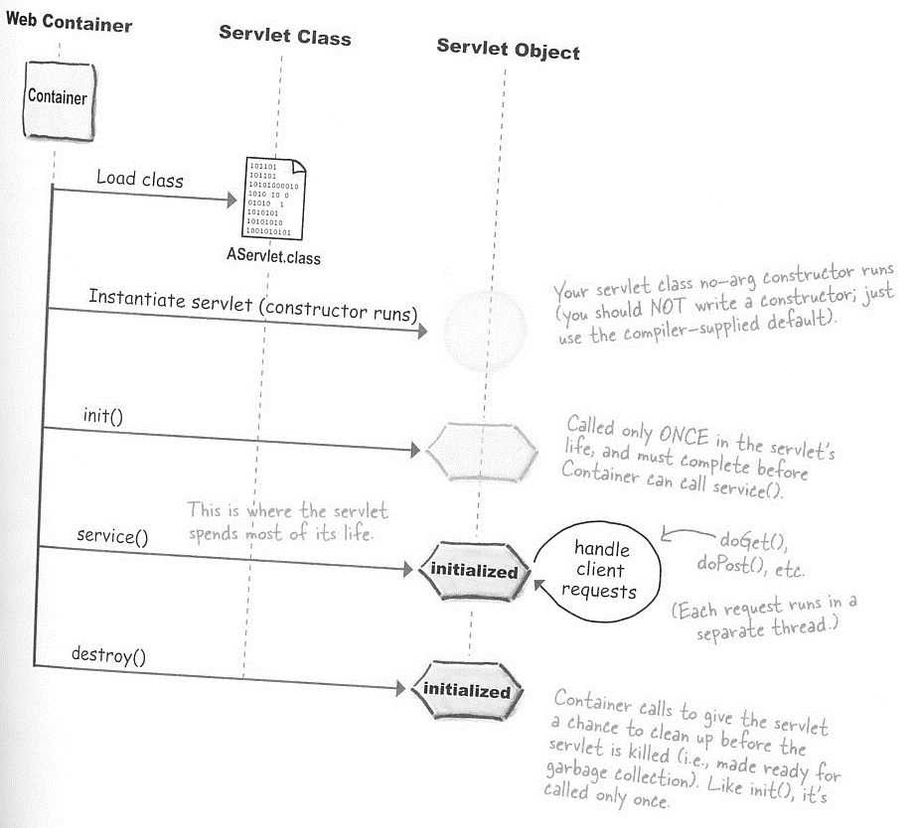
How Tomcat manages Servlets
Web Container
(Tomcat)
Loading can be done upon
Tomcat startup, or deferred until later
Your servlet class no-arg ctor runs (you should NOT write a ctor; just use the compiler-supplied default.
Called only ONCE in the servlet’s life (and must complete before Container calls service()
This is where the servlet spends most of its life
The methods doGet() or doPost() are executed to process requests
Container calls destroy() to give the servlet a chance to clean up; like init(), destroy() is only called ONCE

Slide 10
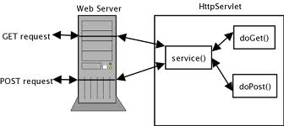
Tomcat invokes a Servlet’s service() method, but your HTTPServlet-derived class should only override doGet() or doPost()
The service() method is given an
implementation in the HTTPServlet
base class, where the doGet() and doPost() methods are called.
You must override these methods in your HttpServlet-derived class

Slide 11
A Servlet is just a Java class that implements some specific interfaces (defined by the Java Servlet Specifications) that are used by the Container
All Servlets must implement these 5 methods
Abstract class. Implements most of the basic servlet methods
Implements the service() method and calls doGet(), doPost() etc as appropriate

Slide 12
NOTE
The Java classes pertaining to Servlets are not part of the standard SE
  They are part of the Java EE specification
Implementation of the 1.x SE is provided in the 1.x JDK/JRE System Library
  This is the library you are probably most familiar with
  rt.jar is the main jarfile in this library
Container vendors supply the implementation of the classes that are part of the Servlet specification
  Tomcat comes with its own Servlet libraries
  servlet-api.jar implements the Servlet-related classes

Slide 13
Parameters: HTML <form> tag element
…and the name of the Web Resource that will process the form data if it is submitted
The opening <form> tag – all form elements go between the opening and closing tag.
<form action="http://<url>" method=“post">
<!-- form elements go here -->
</form>
The method attribute specifies which HTTP message will be used to send the data in the form to the server – default is “get”
The required action attribute specifies the url of where to send the form’s data.
Note: See the examples
on the course website

Slide 14
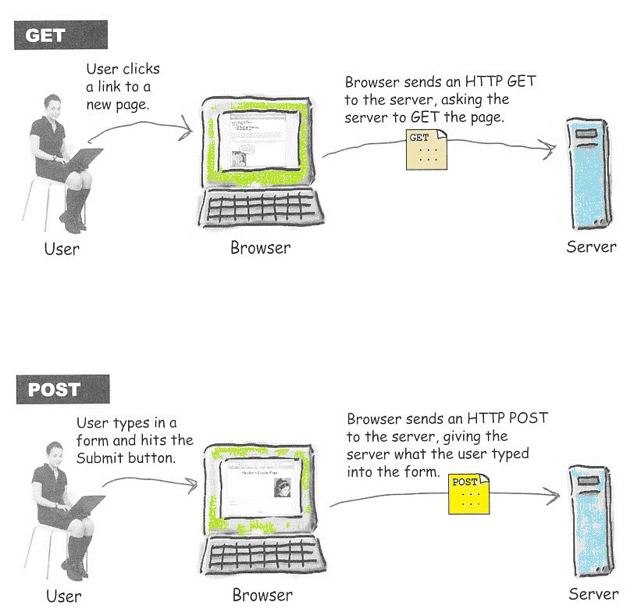
GET vs. POST scenarios
Note: This diagram can
be found in your textbook

Slide 15
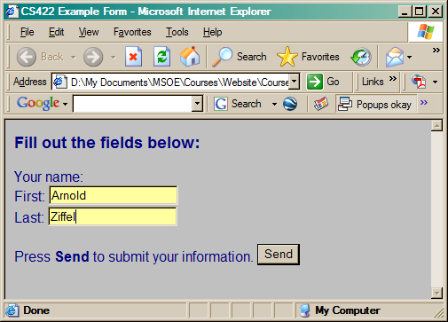
get specifies that a HTTP GET message should be used, which appends the form data to the end of the url
http://<domain>/<resource>?firstname=Arnold&lastname=Ziffel
get requests have a limit of 256 characters
The data is plainly visible in the url (insecure!)
You can bookmark a page that is the result of submitting a form
Use GET only to submit small amounts of insensitive data which the server app will NOT use to modify its internal state

Slide 16
post specifies that a HTTP POST message should be used, which appends the form data to the end of the HTTP POST header
There is no limit on the size of the data packet that can be sent to the server
You cannot bookmark a url that was generated as a POST message, since the form data is not in the url
A post request can be encrypted (using HTTPS) in order to protect sensitive data, such as a credit card numbers or passwords
Use POST to send form data that
  Is sensitive (use encryption in that case)
  If the data is large (>256 bytes)
  Will change the state of the web application
Note: Detailed explanation on pp 112-114 in your text.
Be sure to read it!

Slide 17
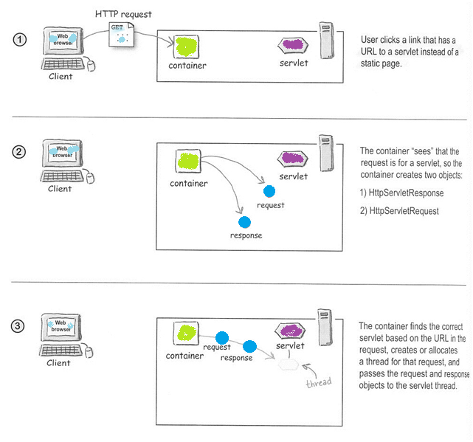
Servlet execution – Part 1 of 2
These contain all kinds of
useful stuff

Slide 18
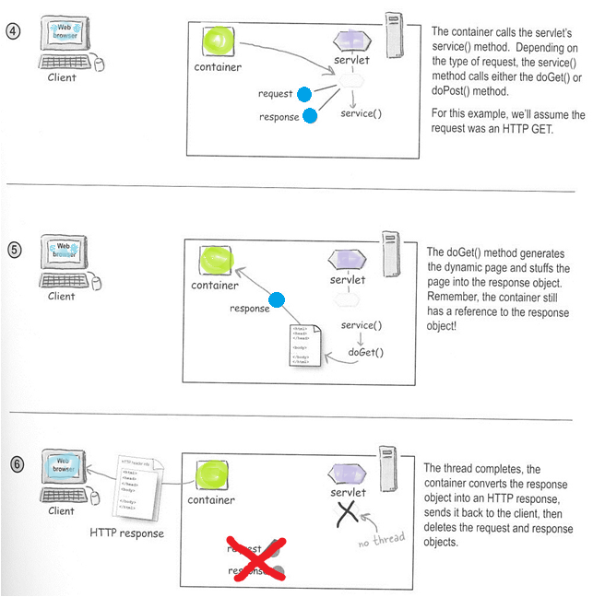
Servlet execution – Part 2 of 2
Note: This diagram can
be found in your textbook

Slide 19
The HTTP Request Wrapper Class
These methods are about HTTP things like headers, sessions, and cookies
A reference to an HTTPServletRequest is created by the Container
and passed to the doGet() and doPost() methods of an HTTPServlet

Slide 20
The HTTP Response Wrapper Class
These methods are also about HTTP things like headers, sessions, and cookies
A reference to an HTTPServletResponse is created by the Container
and passed to the doGet() and doPost() methods of an HTTPServlet

