Slide 1
Bootstrap
A framework for CSS

Slide 2
What is Bootstrap?
Bootstrap is a free front-end framework for faster and easier web development, including HTML and CSS based design templates for
typography,
forms,
buttons,
tables,
navigation,
modals,
image carousels
…and more
Bootstrap was developed by Mark Otto
and Jacob Thornton at Twitter, and released as an open source product in August 2011 on GitHub.
In June 2014 Bootstrap was the
No.1 project on GitHub!
It is not the only such framework; another is Materialize by Google (2015).

Slide 3
Bootstrap enhances HTML and CSS to make styling websites easier and consistent
For example, Bootstrap provides 7 styles of Buttons:
Bootstrap uses predefined HTML classes (along with predefined CSS rules) to provide this styling

Slide 4
Additional Bootstrap button classes
Bootstrap provides four button size classes
…and classes to indicate active (pressed) or disabled (unclickable) states:

Slide 5
Examples from w3schools.com

Slide 6
To use Bootstrap
<!DOCTYPE html> <html lang="en"> <head> <title>Bootstrap Example</title> <meta charset="UTF-8"> <meta name="viewport" content="width=device-width, initial-scale=1"> <script src="https://code.jquery.com/jquery-3.4.1.min.js" integrity="sha256-CSXorXvZcTkaix6Yvo6HppcZGetbYMGWSFlBw8HfCJo="
crossorigin="anonymous"></script> <link rel="stylesheet" href="https://maxcdn.bootstrapcdn.com/bootstrap/3.3.7/css/bootstrap.min.css" integrity="sha384-BVYiiSIFeK1dGmJRAkycuHAHRg32OmUcww7on3RYdg4Va+PmSTsz/K68vbdEjh4u"
crossorigin="anonymous"> <link rel="stylesheet" href="https://maxcdn.bootstrapcdn.com/bootstrap/3.3.7/css/bootstrap-theme.min.css"
integrity="sha384-rHyoN1iRsVXV4nD0JutlnGaslCJuC7uwjduW9SVrLvRYooPp2bWYgmgJQIXwl/Sp"
crossorigin="anonymous"> <script src="https://maxcdn.bootstrapcdn.com/bootstrap/3.3.7/js/bootstrap.min.js" integrity="sha384-Tc5IQib027qvyjSMfHjOMaLkfuWVxZxUPnCJA7l2mCWNIpG9mGCD8wGNIcPD7Txa"
crossorigin="anonymous"></script> </head> <body> <div class="container-fluid"> <h1>My First Bootstrap Page</h1> <p class="text-info bg-info" >This is some text</p> </div> </body> </html>
Enclose the entire web page content in a <div> (or <section>) that uses the predefined container or container-fluid class

Slide 7
Bootstrap also gives you the ability to easily create responsive designs
Responsive web sites automatically adjust themselves to look good on all devices, from small phones to large desktops.

Slide 8
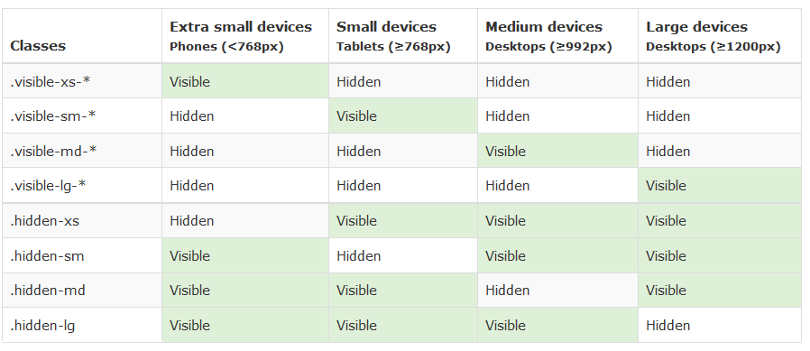
Bootstrap’s responsive utilities
These classes are used to show and/or hide content by device via media queries.

Slide 9
Example responsive output

