Slide 1
Composite Classes
Last updated 3/23/20

Slide 2
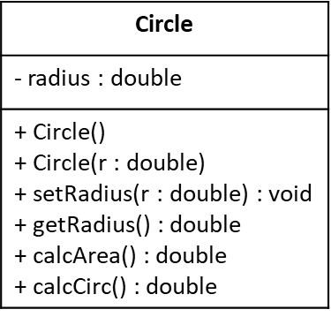
Composite Classes
Composite Classes
Since objects are just like variables – objects can be member variables inside objects
Cylinder
height : double base
+ Cylinder() + Cylinder(r : double, h : height) + setBaseRadius(r : double) : void + setHeight(h : double) : void + getBaseRadius() : double + getHeight() : double + calcVolume() : double + calcSurfaceArea() : double
class Cylinder{
// member data
private:
double height;
Circle base;
// member functions
public:
Cylinder();
Cylinder(double r, double h);
void setBaseRadius(double r);
void setHeight(double h);
double getBaseRadius(void);
double getHeight(void);
double calcVolume(void);
double calcSurfaceArea(void);
}; // end Cylinder class

Slide 3
Composite Classes
Composite Classes
Since objects are just like variables – objects can be member variables inside objects
Cylinder
height : double base
+ Cylinder() + Cylinder(r : double, h : height) + setBaseRadius(r : double) : void + setHeight(h : double) : void + getBaseRadius() : double + getHeight() : double + calcVolume() : double + calcSurfaceArea() : double
#include "Cylinder.h"
#define PI 3.14159
Cylinder::Cylinder() {
base.setRadius(1);
height = 1;
return;
}
Cylinder::Cylinder(double r, double h){
base.setRadius(r);
height = h;
return;
}
void Cylinder::setRadius(double r){
base.setRadius(r);
return;
}
void Cylinder::setHeight(double h){
height = h;
return;
}
double Cylinder::getRadius(void){
return base.getRadius();
}
double Cylinder::getHeight(void){
return height;
}
double Cylinder::calcVolume(void){
return base.calcArea() * height;
}
double Cylinder::calcSurfaceArea(void){
return (2*base.calcArea() + 2*PI*base.calcArea()*height);
}

