Slide 1

Exceptions
Last updated 4/15/20

Slide 2
Exceptions
Motivation
  What are we going to do if something breaks?
  Exception : signals an error or unexpected event during program execution
    divide by 0
    type or class error

Slide 3
Exceptions
Simple – user error exceptions
/*
simple.cpp
*
Created on: Apr 24, 2019
Author: johnsontimoj
*/
#include <iostream> using namespace std;
int main(void){ int foo;
foo = 0;
while((foo < 1) || (foo > 100)){
cout << "Please enter a value between 1 and 100: "; cin >> foo;
}
cout << "Thank you, you entered: " << foo << endl; return 0;
}
Please enter a value between 1 and 100: -5
Please enter a value between 1 and 100: 105
Please enter a value between 1 and 100: 5 Thank you, you entered: 5
Please enter a value between 1 and 100: 3.5 Thank you, you entered: 3
Please enter a value between 1 and 100: p
SYSTEM FREEZES !

Slide 4

Exceptions
Simple – user error exceptions
  Treat all input as a string – convert to ints
/*
simple2.cpp
*
Created on: Apr 24, 2019
Author: johnsontimoj
*/
#include <iostream> using namespace std;
#include <cstring>
int main(void){ int foo; string foo_str; foo = 0;
while((foo < 1) || (foo > 100)){
cout << "Please enter a value between 1 and 100: "; cin >> foo_str;
// atoi converts a char array to an int
// object.c_str converts a c-string to a character array foo = atoi(foo_str.c_str());
}
cout << "Thank you, you entered: " << foo << endl; return 0;
}
Please enter a value between 1 and 100: -5
Please enter a value between 1 and 100: 105
Please enter a value between 1 and 100: 5 Thank you, you entered: 5
Please enter a value between 1 and 100: 3.5 Thank you, you entered: 3
Please | enter | a | value | between | 1 | and | 100: | p
Please | enter | a | value | between | 1 | and | 100: | q
Please | enter | a | value | between | 1 | and | 100: | r
Please | enter | a | value | between | 1 | and | 100: | this
Please enter a Thank you, you |  |  | value between entered: 5 |  | 1 | and | 100: | 5

Slide 5
Exceptions
Complex exceptions
  throw
    When an error occurs – throw an exception
      Transfers the program to an “exception handler”
      The current function is aborted
  Exception handler
    try
      Contains functions or code that might create an exception
    catch
      Looks for an exception
      Executes IFF the correct type of exception is thrown

Slide 6
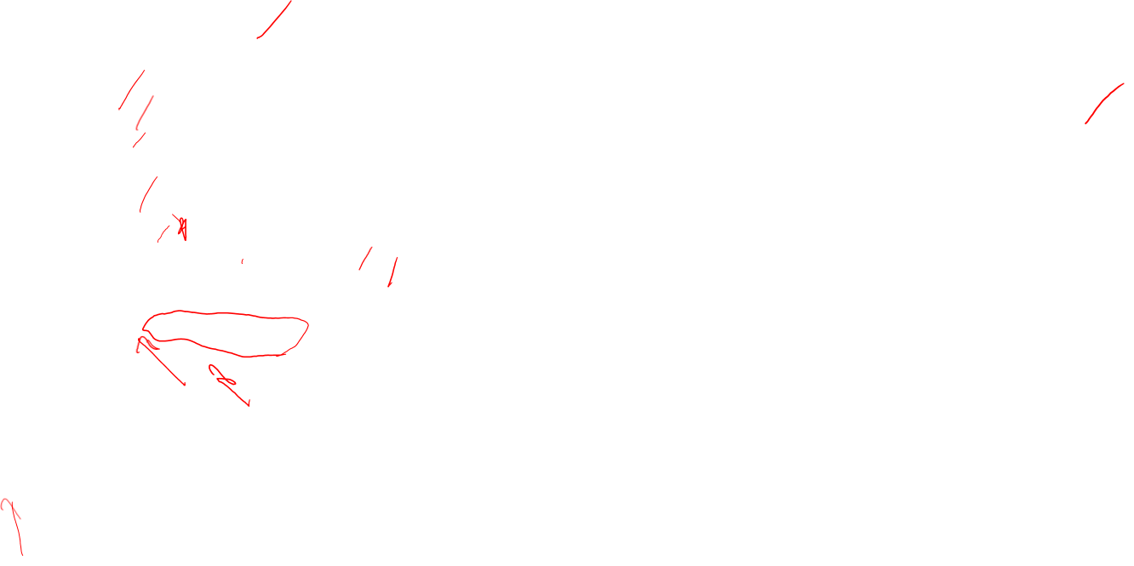
Exceptions
Complex exceptions - handler
/*
throw.cpp
*
Created on: Apr 25, 2019
Author: johnsontimoj
*/
#include <iostream> using namespace std;
double divide(int num, int denom); int main(void){
int numerator;
int denominator; double result;
while(1){
cout << "please enter a numerator and denominator: "; cin >> numerator;
please enter a numerator and denominator: 2 3 the result is: 0.666667
please enter a numerator and denominator: 0 3 the result is: 0
please enter a numerator and denominator: 2 0 ERROR - Divide by zero - terminating function please enter a numerator and denominator: 2 2 the result is: 1
cin >> denominator;
try{
result = divide(numerator, denominator); cout << "the result is: " << result << endl;
code that might cause
an exception
}
catch(const char * exception_string){
cout << exception_string;
what to do exception i
if a const char * s thrown
}
}
}
double divide(int num, int denom){ if(denom == 0)
throw "ERROR - Divide by zero - terminating function \n";
return (static_cast<double>(num) / denom);
}
string literal
type is const char *

Slide 7
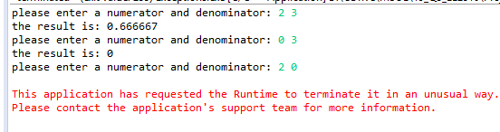
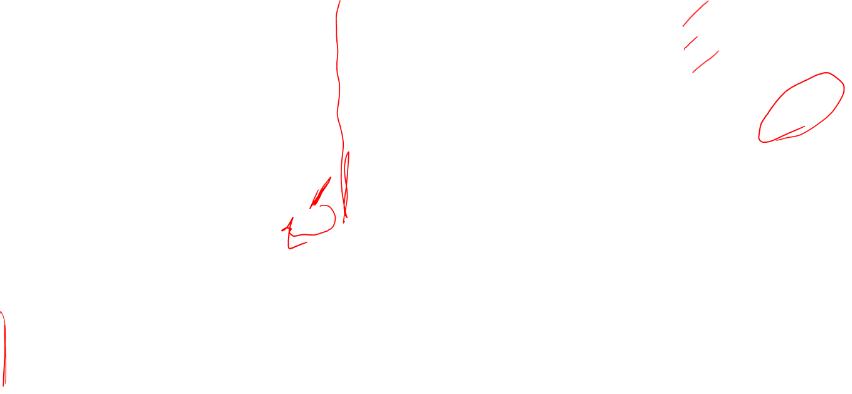
Exceptions
Complex exceptions – handler failure
/*
throw.cpp
*
Created on: Apr 25, 2019
Since the type of the exception thrown
* Author: johnsontimoj
*/
does not match the type of the catch
#include <iostream> using namespace std;
Program aborts
double divide(int num, int denom);
int main(void){ int numerator; int denominator; double result;
while(1){
cout << "please enter a numerator and denominator: "; cin >> numerator;
cin >> denominator;
try{
result = divide(numerator, denominator); cout << "the result is: " << result << endl;
code that might cause
an exception
}
catch(int exception_int){
cout << exception_int;
}
what to do if an int
}
}
exception is thrown
double divide(int num, int denom){ if(denom == 0)
throw "ERROR - Divide by zero - terminating function \n";
string literal
type is const char *
}
return (static_cast<double>(num) / denom);

Slide 8
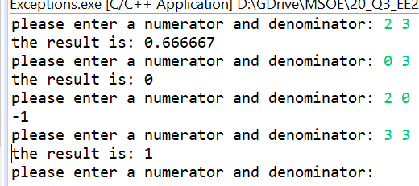
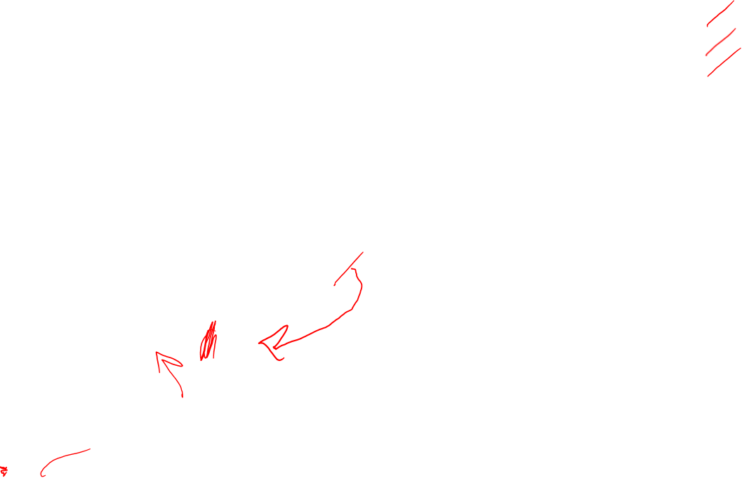
Exceptions
Complex exceptions – handler failure
code that might cause
an exception
what to do if an int
exception is thrown
type is int

Slide 9
Exceptions
Class / Object exceptions
  Create an empty class to use as the exception type
    Throw, try, catch just like before

Slide 10
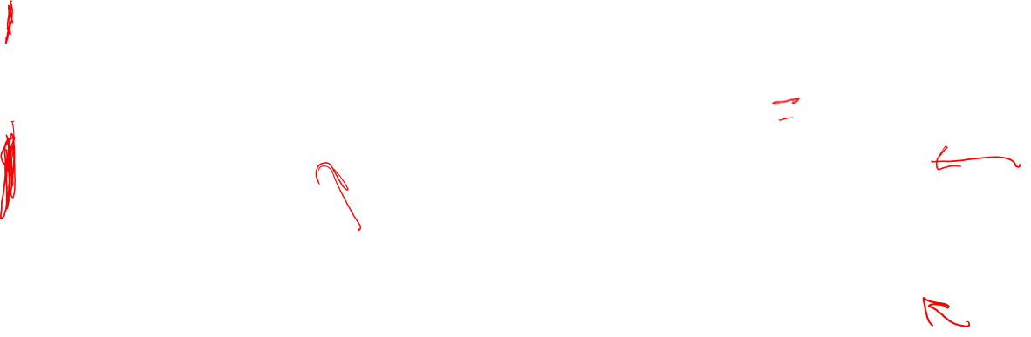
Exceptions
Class / Object exceptions
/*
Rect1.h
*
Created on: Apr 25, 2019
/*
Rect1.cpp
*
Created on: Apr 25, 2019
Author: johnsontimoj
*/
#include "Rect1.h" Rect1::Rect1() {
setWidth(0.0); setLength(0.0);
}
void Rect1::setWidth(double w){ if(w >= 0)
width = w;
else
throw NegativeDimension(); return;
}
void Rect1::setLength(double l){ if(l >= 0)
length = l;
else
throw NegativeDimension(); return;
}
double Rect1::getWidth(void){ return width;
}
double Rect1::getLength(void){ return length;
}
double Rect1::calcArea(void){ return (width * length);
}
* Author: johnsontimoj
*/
#ifndef RECT1_H_
#define RECT1_H_
class Rect1 {
private:
double width; double length;
public:
// Exceptions
class NegativeDimension{
// empty class for exceptions
};
// Constructor
Rect1();
// Setters
void setWidth(double w); void setLength(double l);
// getters
double getWidth(void);
double getLength(void);
// calculations
double calcArea(void);
};
#endif /* RECT1_H_ */
calling the default constructor
causes a reference to an object
of type NegativeDimension to
be returned
Empty class but a default
constructor is automatically made

Slide 11
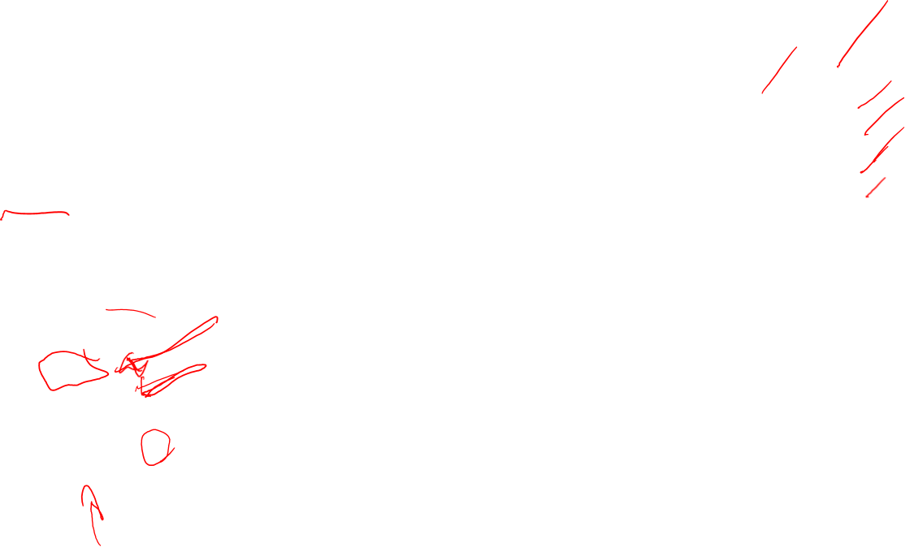
Exceptions
Class / Object exceptions
/*
rect1_test.cpp
*
Created on: Apr 25, 2019
Author: johnsontimoj
*/
#include "Rect1.h"
#include<iostream> using namespace std;
Enter the rectangles width and length: 2 3
The area of the rectangle is: 6
int main(void){ double width; double length;
Enter the rectangles width and length: -2 4
ERROR - negative value for width or length
Enter the rectangles width and length: 2 -4
// create a rectangle Rect1 myRect;
ERROR - negative value for width or length
Enter the rectangles width and length: 2 4
The area of the rectangle is: 8
// get values
Enter the rectangles width and length:
while(1){
cout << "Enter the rectangles width and length: "; cin >> width >> length;
//Attempt to update my rectangle
try{
myRect.setWidth(width); myRect.setLength(length);
cout << "The area of the rectangle is: " << myRect.calcArea() << endl;
}
catch(Rect1::NegativeDimension &){
cout << "ERROR - negative value for width or length" << endl;
}
}
return 0;
}
note: need the fully qualified name

Slide 12
Exceptions
Class / Object exceptions
  Can have multiple exception types (classes)

Slide 13
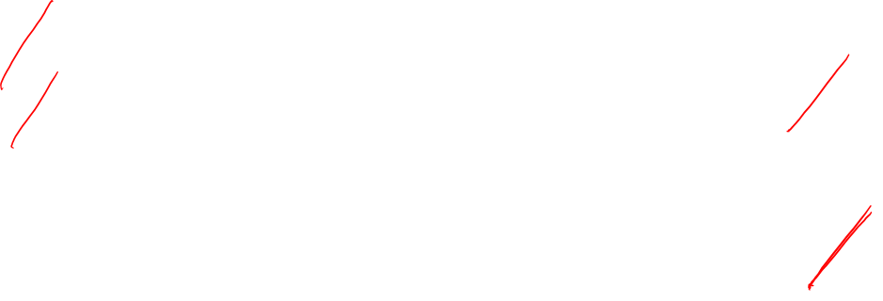
Exceptions
Class / Object exceptions
/*
/*
Rect2.h
*
Created on: Apr 25, 2019
* Author: johnsontimoj
*/
#ifndef RECT2_H_
#define RECT2_H_
class Rect2 { private:
double width;
double length;
public:
// Exceptions
class NegativeWidth{
// empty class for exceptions
};
class NegativeLength{
// empty class for exceptions
};
// Constructor
Rect2();
// Setters
void setWidth(double w); void setLength(double l);
// getters
double getWidth(void); double getLength(void);
// calculations
double calcArea(void);
};
#endif /* RECT2_H_ */

Slide 14

Exceptions
Class / Object exceptions
/*
rect2_test.cpp
*
Created on: Apr 25, 2019
Author: johnsontimoj
*/
#include "Rect2.h"
#include<iostream> using namespace std;
Enter the rectangles width and length: 2 3
int main(void){ double width; double length;
The area of the rectangle is: 6
Enter the rectangles width and length: -2 3
ERROR - negative value for width
// create a rectangle
Rect2 myRect;
Enter the rectangles width and length: 2 -3
ERROR - negative value for length
// get values
while(1){
cout << "Enter the rectangles width and length: "; cin >> width >> length;
Enter the rectangles width and length: 2 3
The area of the rectangle is: 6
Enter the rectangles width and length:
//Attempt to update my rectangle
try{
myRect.setWidth(width); myRect.setLength(length);
cout << "The area of the rectangle is: " << myRect.calcArea() << endl;
}
catch(Rect2::NegativeWidth &){
cout << "ERROR - negative value for width" << endl;
}
catch(Rect2::NegativeLength &){
cout << "ERROR - negative value for length" << endl;
}
}
return 0;
}
note: need the fully qualified name

Slide 15
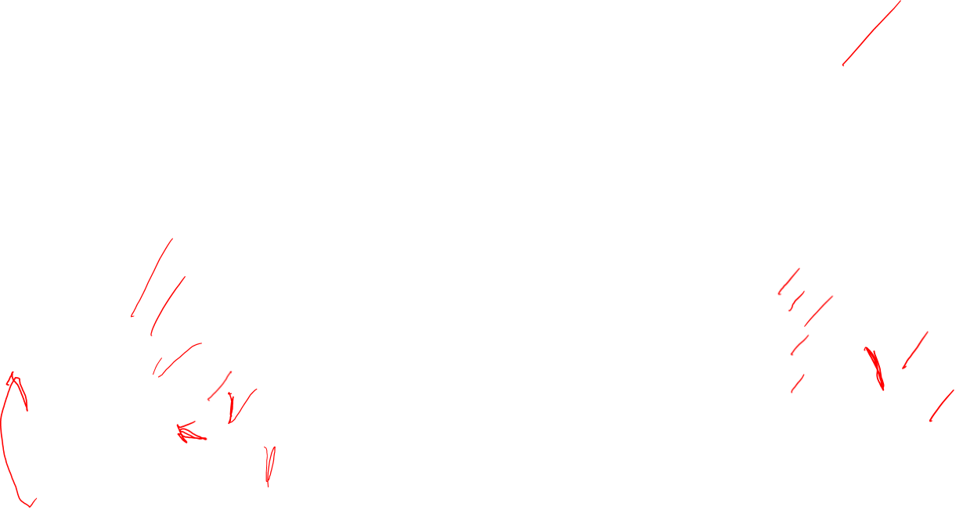
Exceptions
Class / Object exceptions
  Can attempt to recover from an exception
/*
rect2_test2.cpp
*
Created on: Apr 25, 2019
Author: johnsontimoj
*/
cout << "Enter the rectangles length "; cin >> length;
try_again = true;
//Attempt to recover if necessary
while(try_again){
try{
myRect.setLength(length);
try_again = false;// no exception thrown
}
catch(Rect2::NegativeLength &){
cout << "Please enter a non-negative value for length: "; cin >> length;
}
}
cout << "The area of the rectangle is: " << myRect.calcArea() << endl;
}
return 0;
}
#include "Rect2.h"
#include<iostream> using namespace std;
int main(void){ double width; double length; bool try_again;
// create a rectangle
Rect2 myRect;
// get values
while(1){
cout << "Enter the rectangles width "; cin >> width;
try_again = true;
Enter the rectangles width 2 Enter the rectangles length 3 The area of the rectangle is: 6 Enter the rectangles width -2
Please enter a non-negative value for width: 2 Enter the rectangles length -3
Please enter a non-negative value for length: 3 The area of the rectangle is: 6
//Attempt to recover if necessary
while(try_again){ try{
myRect.setWidth(width);
try_again = false;// no exception thrown
}
catch(Rect2::NegativeWidth &){
cout << "Please enter a non-negative value for width: "; cin >> width;
}
}

Slide 16
Exceptions
Class / Object exceptions
  Can return information from an exception
  Provide the exception class with member variables

Slide 17
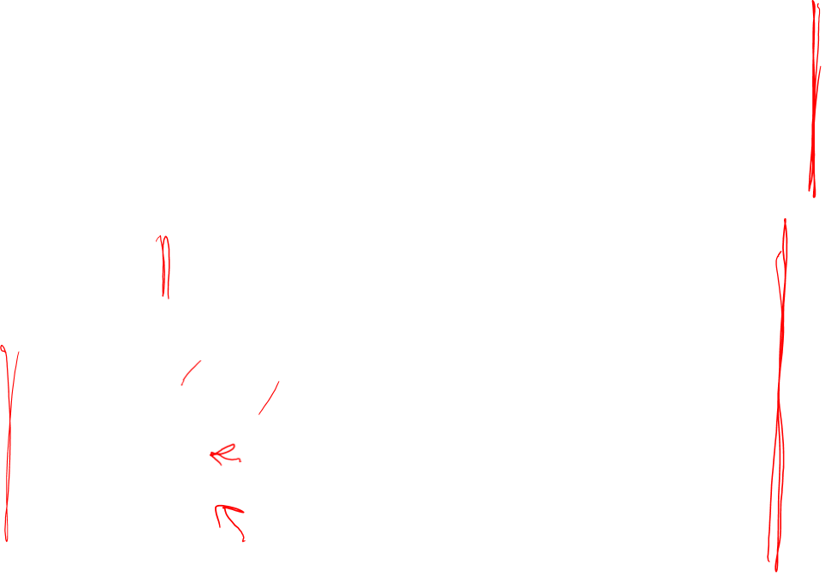
Exceptions
Class / Object exceptions
  Can return information from an exception
/*
Rect3.h
*
Created on: Apr 25, 2019
Author: johnsontimoj
*/
#ifndef RECT3_H_
#define RECT3_H_
class NegativeLength{ private:
double value;
public:
NegativeLength(double val){
value = val;
}
double getValue(){ return value;
}
};
// Constructor
Rect3();
// Setters
void setWidth(double w); void setLength(double l);
// getters
double getWidth(void); double getLength(void);
// calculations
double calcArea(void);
};
#endif /* RECT3_H_ */
class Rect3 { private:
double width; double length;
exception clas class declarati and a way to s
ses:
on has a value et/get the value
public:
// Exceptions
class NegativeWidth{ private:
double value; public:
NegativeWidth(double val){
value = val;
}
double getValue(){ return value;
}
};

Slide 18
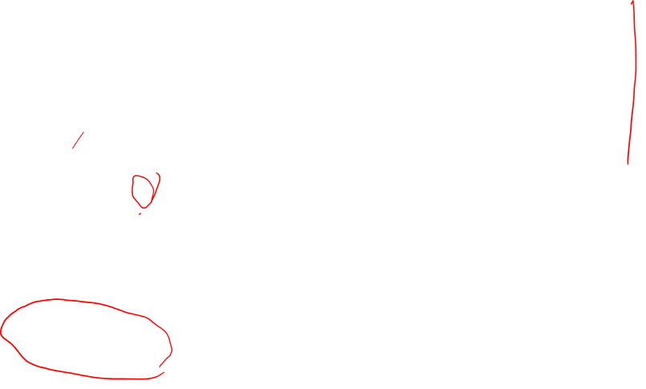
Exceptions
Class / Object exceptions
  Can return information from an exception
/*
Rect3.cpp
*
Created on: Apr 25, 2019
Author: johnsontimoj
*/
#include "Rect3.h"
double Rect3::getWidth(void){ return width;
}
double Rect3::getLength(void){ return length;
}
double Rect3::calcArea(void){
return (width * length);
}
Rect3::Rect3() { setWidth(0.0); setLength(0.0);
}
void Rect3::setWidth(double w){ if(w >= 0)
width = w;
else
throw NegativeWidth(w); return;
}
void Rect3::setLength(double l){ if(l >= 0)
length = l;
else
throw NegativeLength(l); return;
}
passing values when the exception class is thrown

Slide 19

Exceptions
Class / Object exceptions
  Can return information from an exception
/*
* rect3_test.cpp
*
cout << "Enter the rectangles length "; cin >> length;
try_again = true;
//Attempt to recover if necessary
while(try_again){ try{
myRect.setLength(length);
try_again = false;// no exception thrown
}
catch(Rect3::NegativeLength & exptn){
cout << "You entered " << exptn.getValue() << endl;
cout << "Please enter a non-negative value for length: "; cin >> length;
}
Created on: Apr 25, 2019
Author: johnsontimoj
*/
#include "Rect3.h"
#include<iostream> using namespace std;
int main(void){ double width;
double length; bool try_again;
catch – creates an object of type
}
cout << "The area of the rectangle is: " << myRect.calcArea() << endl;
}
Negative… with name exptn
// create a rectangle
Rect3 myRect;
}
return 0;
// get values
exptn is used in output
while(1){
cout << "Enter the rectangles width "; cin >> width;
try_again = true;
Enter the rectangles width 2 Enter the rectangles length 3 The area of the rectangle is: 6 Enter the rectangles width -2 You entered -2
Please enter a non-negative value for width: 2 Enter the rectangles length -3
You entered -3
Please enter a non-negative value for length: 3 The area of the rectangle is: 6
Enter the rectangles width
//Attempt to recover if necessary
while(try_again){ try{
myRect.setWidth(width);
try_again = false;// no exception thrown
}
catch(Rect3::NegativeWidth & exptn){
cout << "You entered " << exptn.getValue() << endl;
cout << "Please enter a non-negative value for width: "; cin >> width;
}
}
EE
2510
18
© tj

