Slide 1

Friends
Last updated 3/31/20

Slide 2
Friends
Motivation
  Normally only functions within a class can access the classes private member variables or private member functions
    Must use public functions to modify these (setters/getters/…)
  Suppose we want to grant some other class direct access to private member variables and functions
    We call these friends
    The granting Class must declare the friendship

Slide 3

Friends
Format
  In the granting Class declarations
        friend returnType grantedClass::functionName(params)
    Example: Grant the Box class the ability to modify the radius of a sphere directly
        In Sphere.h
        …
        friend void Box::setSphereR(double r);
        …
      Forward declare the Sphere Class in the box declarations
        Allows the compiler to recognize the Sphere variables
        In Box.h
        class Sphere; // forward declaration for friend functions

Slide 4

Friends
Example
  Create a Rectangle class/object that can modify the private member variable of a Circle class/object to set the radius to the largest value that will fit into the rectangle

Slide 5

Friends
CircleF.cpp
Example
CircleF.h
private

Slide 6

Friends
RectangleF.cpp
Example
RectangleF.h
Accessing the
private variable
of Circle

Slide 7
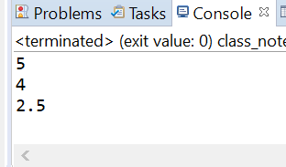

Friends
Example

