Slide 1

Vectors
Last updated 3/31/20

Slide 2
Vectors
Motivation
  Arrays have a limitation in that they must have a fixed size
  The Standard Template Library has a data type called vector
    A vector is a type of sequence container
    Vectors hold a sequence of values or elements
    Vectors are not limited to a fixed size
    Vectors can use the array subscript operator [ ]
    Vectors can have elements added to or removed at any time
    Vectors can report their current size
    Vectors are passed to functions by value by default
      Unlike Arrays whitch are passed by reference by default

Slide 3
Vectors
Syntax
  #include <vector>
  creating vectors
    vector<type> name;
    vector<type> name(initial size);
    vector<type> name(initial size, initial value); // initializes all values
    vector<type> name{list of element values}; // initializes values with {}
    vector<type> name(vector); // initializes from another vector

Slide 4
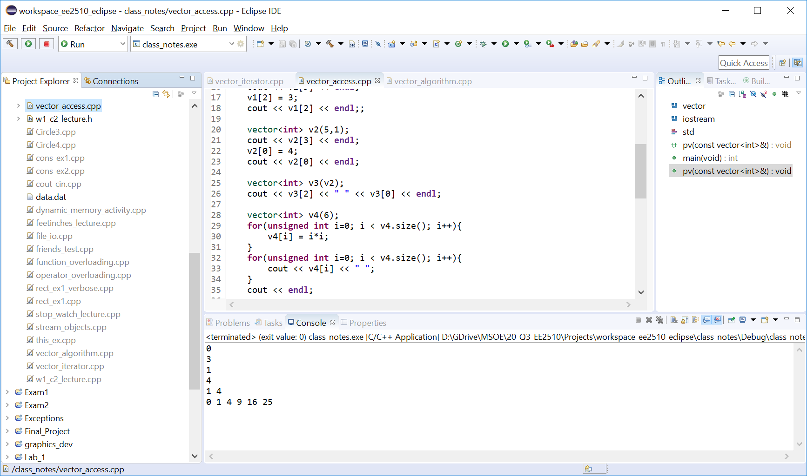
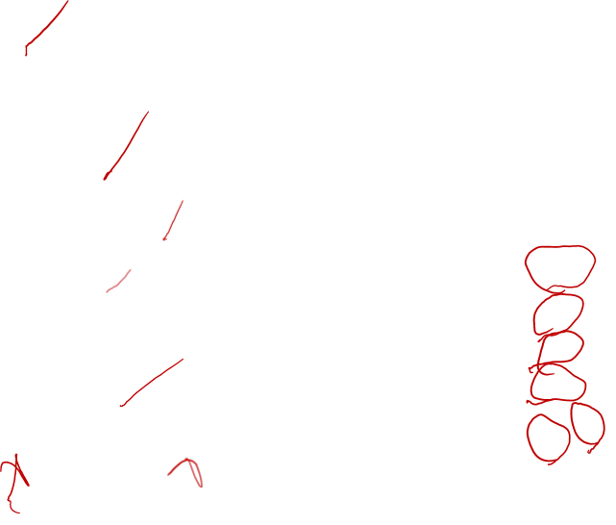
Vectors
Accessing Vector elements
  Just like arrays

Slide 5
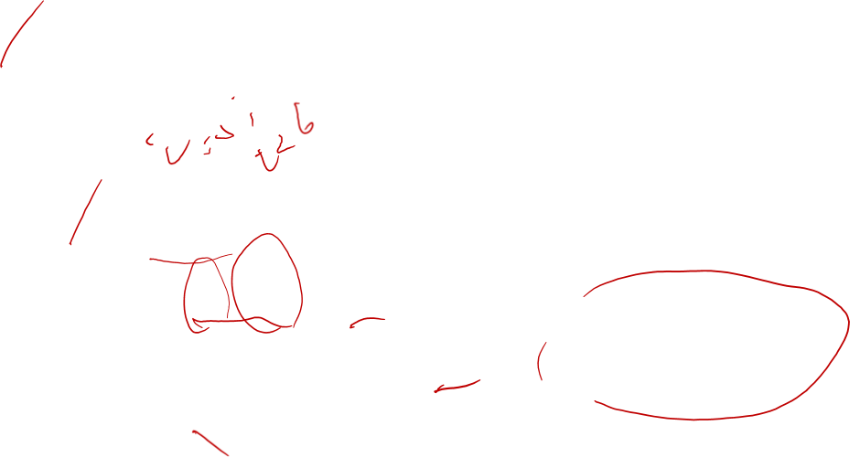
Vectors
Accessing Vector elements
  Size of the vector
    objectName.size()
Note: unsigned int because
size() returns an unsigned int
and the compiler whines about
a mismatch

Slide 6
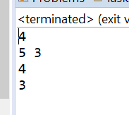
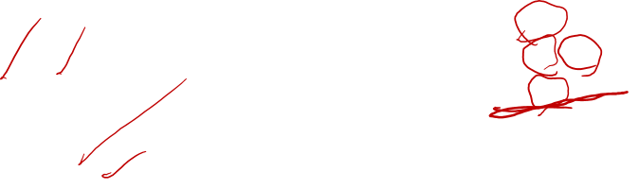
Vectors
Add/remove elements from a vector
    objectName.push_back() // adds one element to vector
    objectName.push_back(value) // adds element with value
    objectName.pop_back() // removes last element in vector

Slide 7
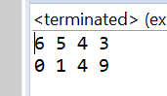
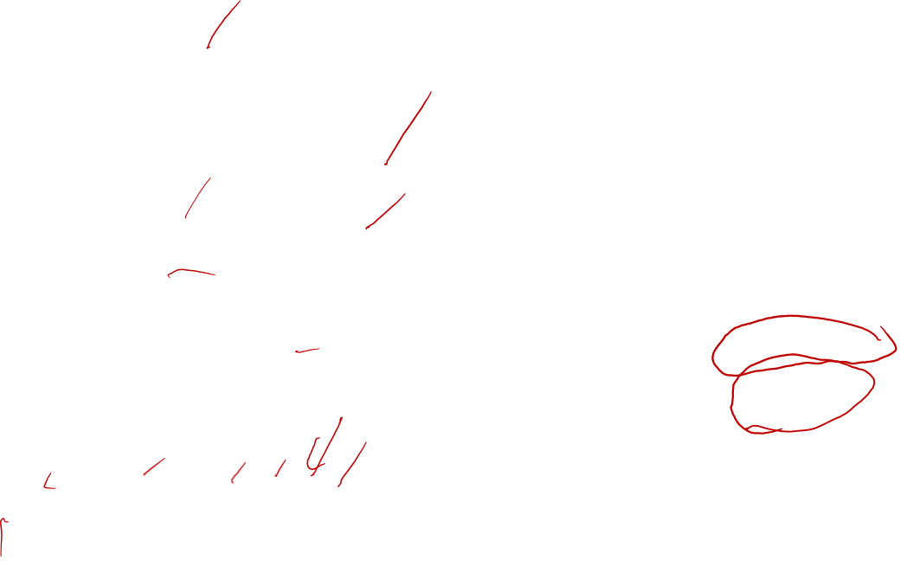
Vectors
Passing vectors to functions

Slide 8
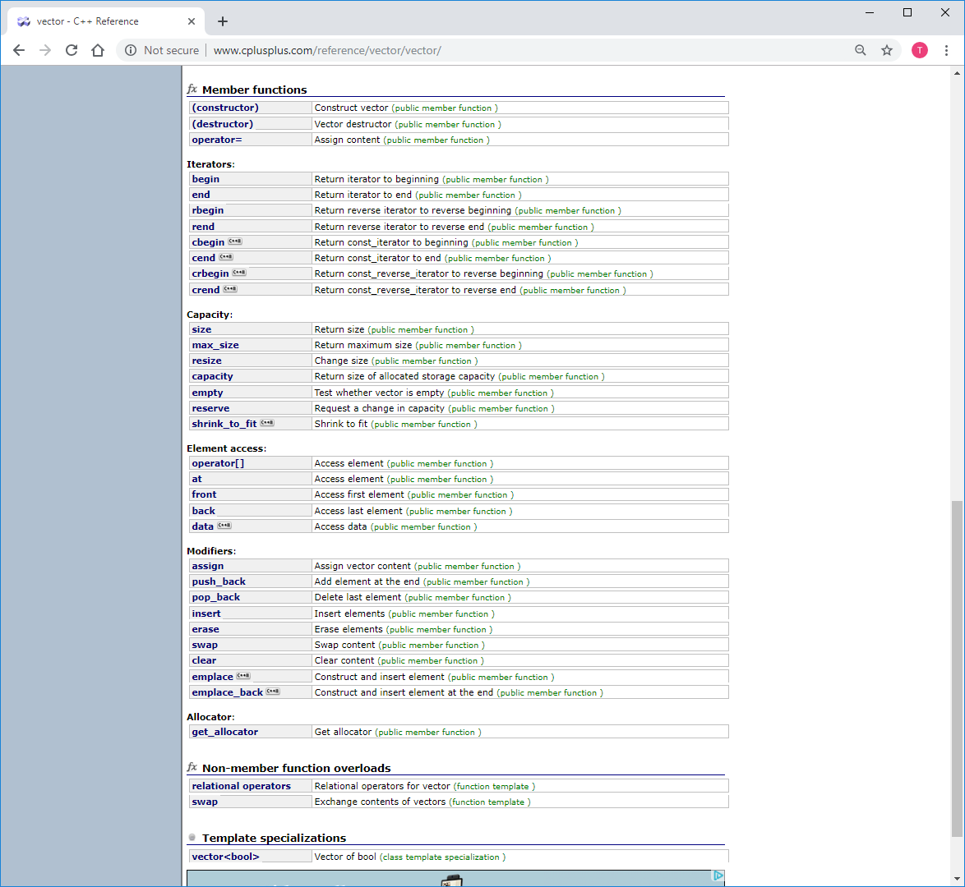
Vectors

Slide 9
Vectors

Slide 10
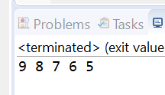
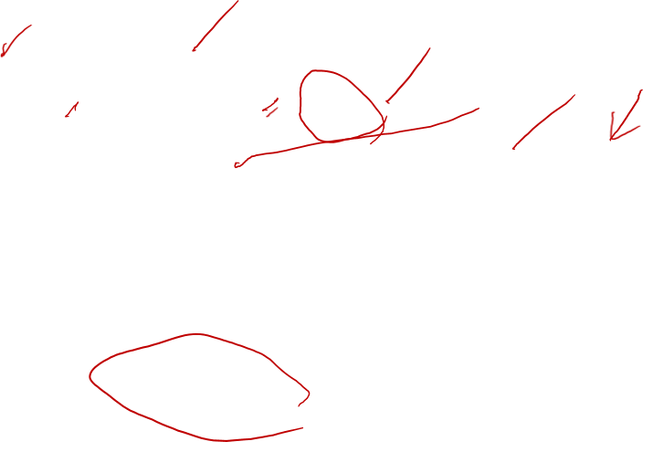
Vectors
Using Iterators
  Iterators are a type intended to work with various container classes (like vector)
  Operate very much like pointers
Offer benefits when using container class objects
vector<int> vect1(10);
vector<int>::iterator itr;
for(itr=vect1.begin(); itr!=vect1.end(); itr++)
cout << *itr << " ";

Slide 11
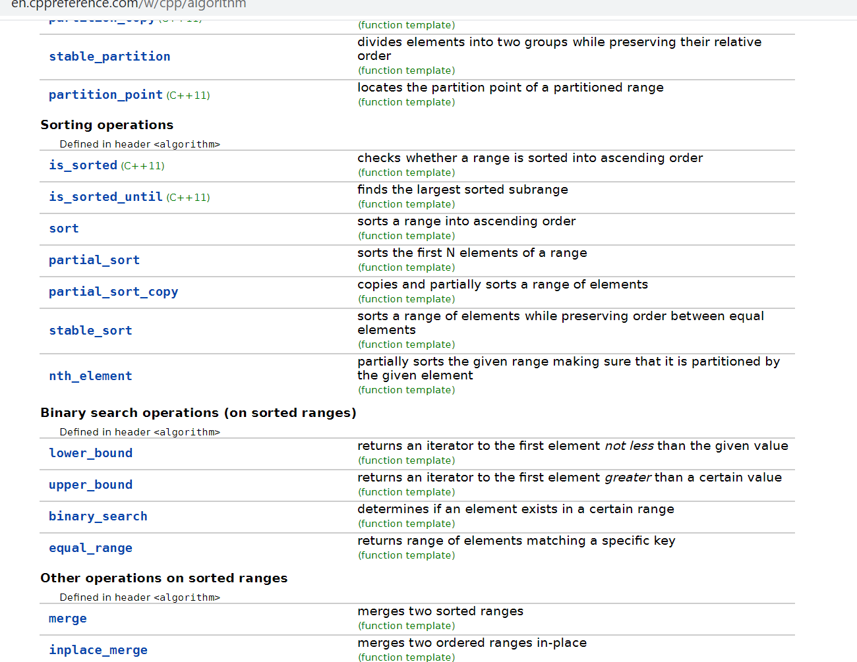
Vectors
Using the Algorithm library
  #include <algorithm>
…
…

Slide 12
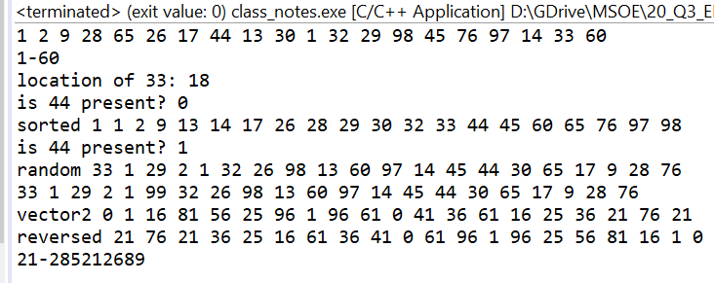
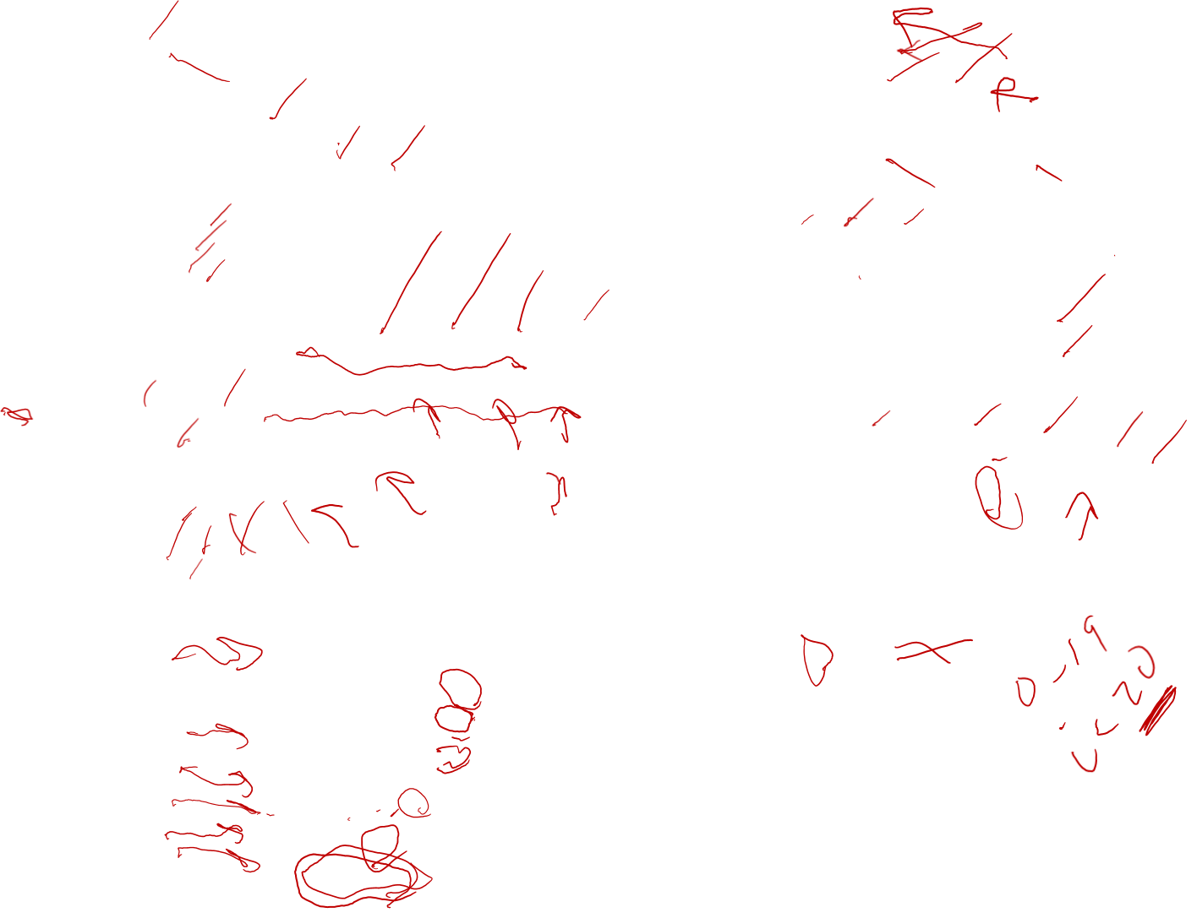
Vectors
Using the Algorithm library

