Slide 1
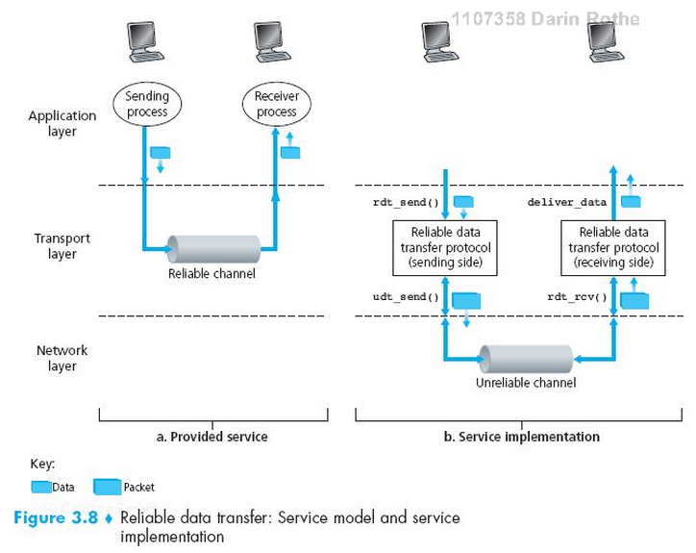
TCP as a Reliable Transport

Slide 2
How things can go wrong…
Lost packets
Corrupted packets
Reordered packets
…Malicious packets…

Slide 3
Requirements for Reliability
Error Detection
Receiver Feedback
Retransmission

Slide 4
Requirements for Reliability
Error Detection
Checksum
Receiver Feedback
ACK – acknowledgment
NAK – negative acknowledgment
Also missing ACK
Retransmission
Sender resends segment with NAK or missing ACK

Slide 5
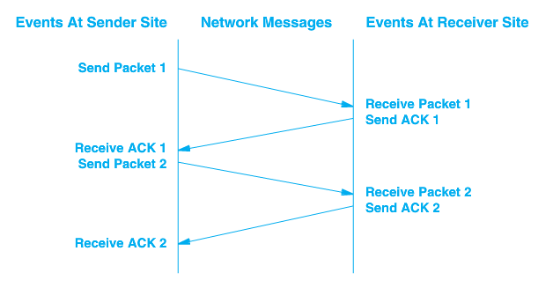
Stop and Wait
RTT –
Round
Trip
Time

Slide 6
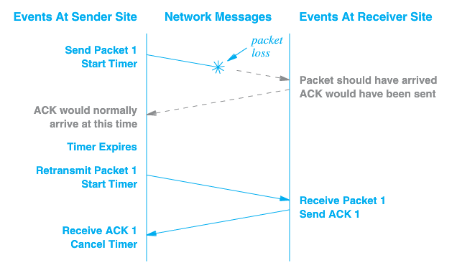
Packet Loss

Slide 7
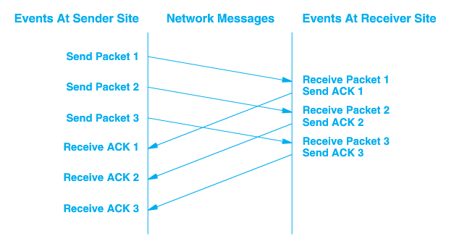
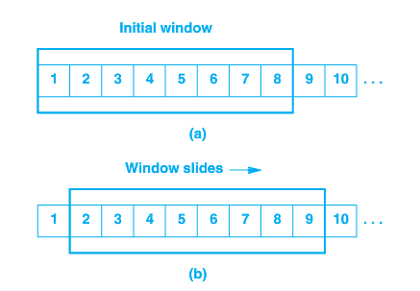
Sliding Window - Pipelined
Requires Buffering on each end

Slide 8
TCP Data Transfer Specifics
Data transferred as a stream of octets
Data is transferred in segments, but acknowledged at the octet level
Full duplex – data can be transferred in either direction, or both
Both endpoints of connection must maintain buffers/windows for both sending and receiving

Slide 9
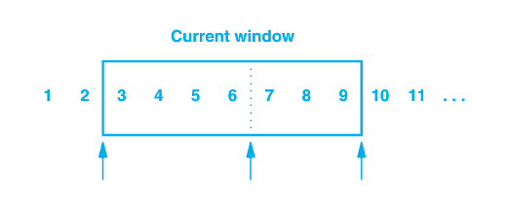
Sender’s Window
1, 2 have been sent and acknowledged
3 – 6 sent but not acknowledged
7 – 9 have not been sent but can be without delay
10 and higher will not be sent until window moves

Slide 10
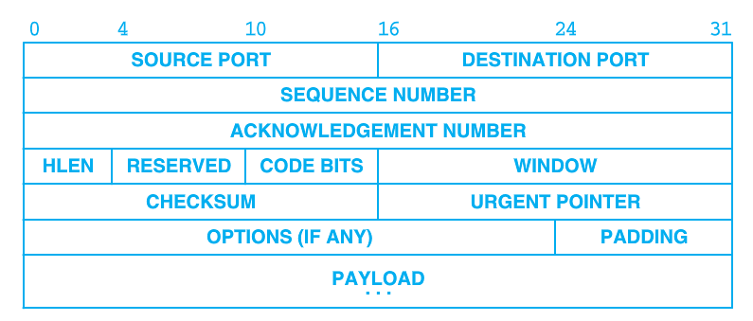
Window Advertisement
Window size can vary over time
Receiver sends a windows size with acknowledgement that indicates how many octets it is willing to accept
Allows flow control
An advertisement of 0 will halt transfer

Slide 11
Acknowledgement
Acknowledgements are cumulative
Acknowledgement of any octet implies receipt of all previous octets
++ Simple
++ Lost acknowledgements will not necessarily result in retransmission

Slide 12
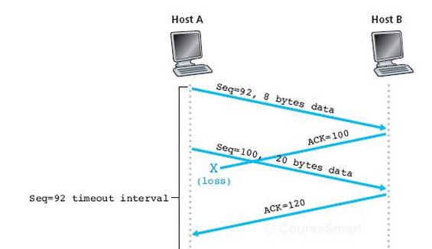
Acknowledgement
Acknowledgements are cumulative
Acknowledgement of any octet implies receipt of all previous octets

Slide 13
Acknowledgement
Acknowledgements are cumulative
Acknowledgement of any octet implies receipt of all previous octets
Think (30 s)
Pair (30 s)
Shair
What if timeout was here?

Slide 14
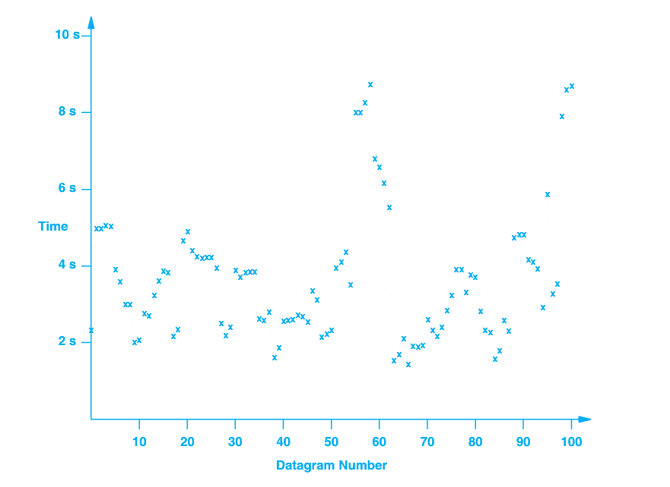
Timeout and Retransmission
What do we use for a timeout?
LAN – round-trip time for ACK might be ms
Internet – 100x
Varies over time

Slide 15
Adaptive Retransmission
Round-trip time (RTT) is monitored for each transmission/ACK
0 ≤ α < 1
Recommended value of α = 0.128 [RFC 6298]
Recommended β is 0.25

Slide 16
Congestion Control
Flow control is a function of the receiver and its ability to accept data
Congestion control is implemented by the sender to avoid excessive unsuccessful transmission (collapse)

Slide 17
New Variable - cwnd
Congestion window
Un-acknowledged bytes
cwnd – congestion window
rwnd – receive window
We can send up to cwnd bytes per RTT period

Slide 18
cwnd
Average transmission rate is roughly cwnd/RTT bytes/sec
By manipulating cwnd, transmission rate can be controlled

Slide 19
Congestion Detection
Essentially loss of segments
Retransmission on timeout
Fast retransmit on duplicate ACK
Adjust cwnd
Decrease when a segment is lost
Increase when [consistent] ACKs are received
Continue to increase until a segment is lost, then backoff

Slide 20
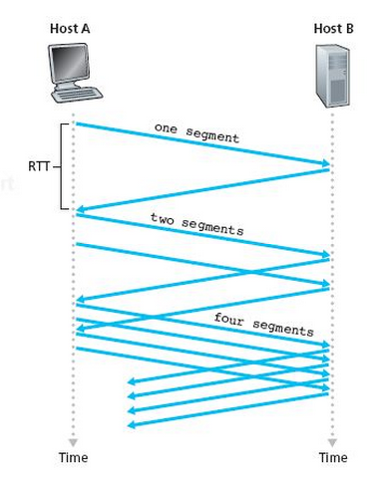
TCP Slow Start
Start with a small cwnd (one MSS)

Slide 21
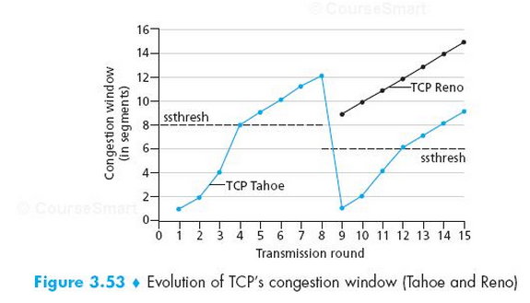
cwnd Over Time

Slide 22
Lab Tomorrow
Wireshark
Your TCP Server / Client (from Lab #2)

Slide 23
The content of this video is based in part on lecture slides from a very good textbook, and used with the author’s permission:
Computer Networking: A Top-Down Approach, 6e, by Jim Kurose and Keith Ross
Publisher: Pearson, 2013
It is also based on slides provided by Dr. Darrin Rothe

