Slide 1
CS2910 Week 9, Class 1
Today
Quiz on SMTP
TCP: Flow control vs. Congestion Control
TCP startup, error recovery, and shut-down
Before 8am Thursday:
Watch video. Take quiz. (see links online)

Slide 2
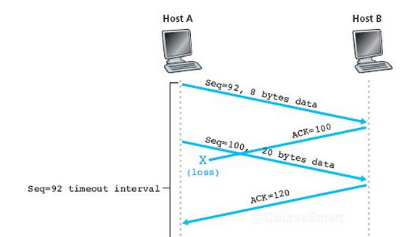
Acknowledgement
Acknowledgements are cumulative
Acknowledgement of any octet implies receipt of all previous octets
Think (30 s)
Pair (30 s)
Shair
What if timeout was here?

Slide 3
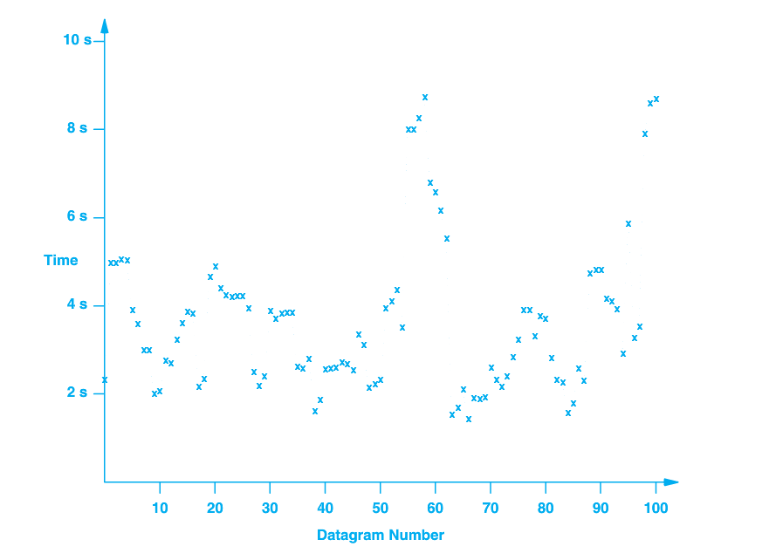
Timeout and Retransmission
What do we use for a timeout?
LAN – round-trip time for ACK might be ms
Internet – 100x
Varies over time

Slide 4
Adaptive Retransmission
Round-trip time (RTT) is monitored for each transmission/ACK
0 ≤ α < 1
Recommended value of α = 0.128 [RFC 6298]
Recommended β is 0.25

Slide 5
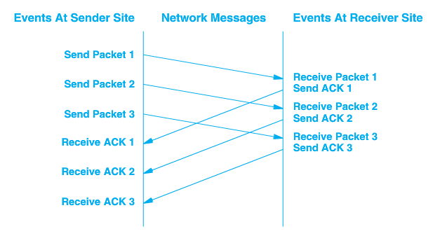
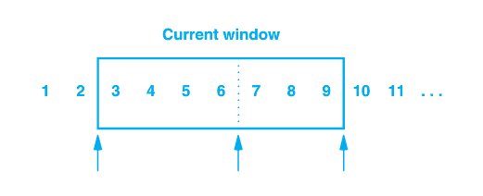
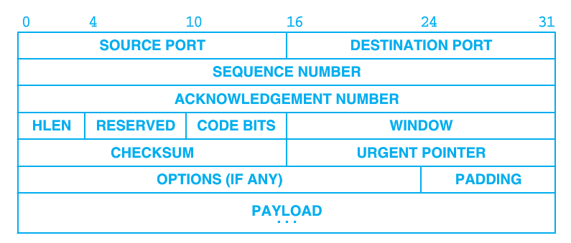
Sliding Window - Pipelined
Requires buffering on each end
Remaining space on receiver in last acknowledgement

Slide 6
Sliding Window supports Flow Control
Won't over-fill receiver's buffer
Waits for receiving application to be ready
This is one reason to call recv even before we have gotten the whole message

Slide 7
Flow vs. Congestion Control
Flow control is a function of the receiver and its ability to accept data
Congestion control is a function of the network and its ability to carry messages
Congestion control avoids sending more data than the network can handle, resulting in collapse of the network

Slide 8
New Variable - cwnd
Two windows
Un-acknowledged bytes
cwnd – congestion window
rwnd – receive (flow control) window

Slide 9
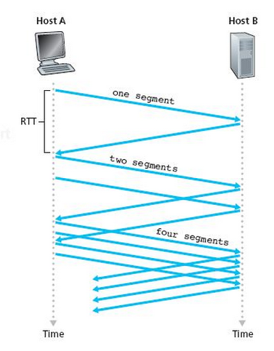
cwnd
We can send up to cwnd bytes per RTT period
Average transmission rate is roughly cwnd/RTT bytes/sec
By manipulating cwnd, transmission rate can be controlled

Slide 10
Congestion Detection
If segments lost, maybe we are sending too many
Adjust cwnd
Decrease when a segment is lost
Increase when [consistent] ACKs are received
Continue to increase until a segment is lost, then backoff

Slide 11
TCP Slow Start
Start with a small cwnd (one MSS)

Slide 12
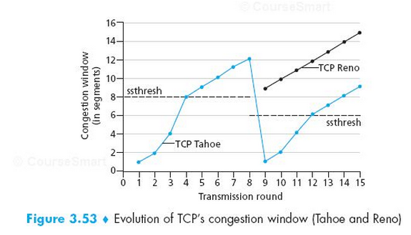
cwnd Over Time

Slide 13
Challenge: How to avoid accidental message?
What if a TCP message from a previous connection gets stuck in a router for a while, but then eventually gets delivered later?
How to avoid it being mistaken for the newer message?

Slide 14
Exercise: TCP sequence & acknowlegement numbers
TCP sequence numbers actually start at a random number
To establish the number, the sender sends the random first sequence number.
The receiver replies with the sequence number + 1
After this, the current sequence number is always first number + 1 + total number of bytes sent/received

Slide 15
Starting a TCP sequence
Client
Server
SYN, SEQ = 368
ACK, ACK = 369
SEQ = 369, 10 bytes data
ACK, ACK = 379
SEQ = 379, 10 bytes data
ACK = 389

Slide 16
Server also can send data
Client
Server
SYN, SEQ = 824
ACK, ACK = 825
SEQ = 825, 30 bytes data
ACK, ACK = 855
SEQ = 855, 20 bytes data

Slide 17
All together now…
Client
Server
SYN, SEQ = 368
ACK, ACK = 369
Three-way Handshake
SYN, SEQ = 824
SEQ = 369, 10 bytes data
ACK, ACK = 825
SEQ = 825, 30 bytes data
ACK, ACK = 379
SEQ = 379, 10 bytes data
ACK, ACK = 855
SEQ = 855, 20 bytes data
ACK = 389

Slide 18
Multiple pending messages
Client
SYN, SEQ = 368
ACK, ACK = 369
SEQ = 369, 10 bytes data
SEQ = 379, 20 bytes data
ACK, ACK = 369

Slide 19
Closing a TCP connection
Client
Server
FIN
ACK
FIN
ACK

Slide 20
Exercise
Fill in the blanks of the sample TCP message below

Slide 21
A very brief history of the internet
1957 – Sputnik launched, ARPA formed
1962 – ARPA forms IPTO to create ARPAnet
1969 – First packet switched network at UCLA
1983 – TCP/IP first deployed
1986 – NSFNET created (& many others)
1991 – NSFNET allows commercial activities. e-Bay, Google, Amazon …
2000's – Facebook, Twitter, Youtube, …
Source: Kurose & Ross, 6th, Ed, Section 1.7 and
http://www.calvin.edu/academic/rit/webBook/chapter3/Introduction/arpanet.htm

Slide 22
The content of this lecture is based in part on lecture slides from a very good textbook, and used with the author’s permission:
Computer Networking: A Top-Down Approach, 6e, by Jim Kurose and Keith Ross
Publisher: Pearson, 2013
It is also based on slides provided by Dr. Darrin Rothe

