Slide 1
CS2911
Week 10, Class 2
Today
Tomorrow
  Class: Bring laptops
  4pm: Turn in anything left outstanding
Final Exam: Monday, 11am
Notes:
17q1 7-1 1-7,9-24

Slide 2
Please return 6th edition
(For the one student who is borrowing it)

Slide 3
Outcomes
Describe the unique role of the network layer
Describe how routers guide (that is, "route") data through the network
Describe the unique role of the link layer
Give examples of situations where media access control (MAC) is used
Describe the differences between a router and a switch
Describe the unique role of the physical layer
Name a protocol at each network layer

Slide 4
Final Exam
CS 2911 011 Yoder Monday 11:00 am - 1:00 pm L311
CS 2911 012 Yoder Monday 11:00 am - 1:00 pm L311
CS 2911 021 Yoder Monday 11:00 am - 1:00 pm L310
Notes:
Official Verson

Slide 5
Final Exam
Monday, 11:00 am – 1:00 pm
Morning class: L311
Afternoon class: L310

Slide 6
Note on Certificate Revoking
(Just for fun!)
If you discover your private key is stolen, you would "revoke" your certificate.
But no one will know unless they ask you (or the CA that issued the certificate)
That's what Certificate Revocation Lists are for.
And OSCP (Online Certificate Status Protocol)
But no one uses these 100% reliably yet...
Chrome actually doesn't use either!

Slide 7
Note on certificate signing
Anyone can register a domain
This may require your physical address, but a hacker could probably fake that and get away with it
Therefore, anyone can get a certificate signed by a certificate authority
This is why hostname checking is so important!
ssl_socket = context.wrap_socket(sock,
server_hostname="usbank.com")

Slide 8
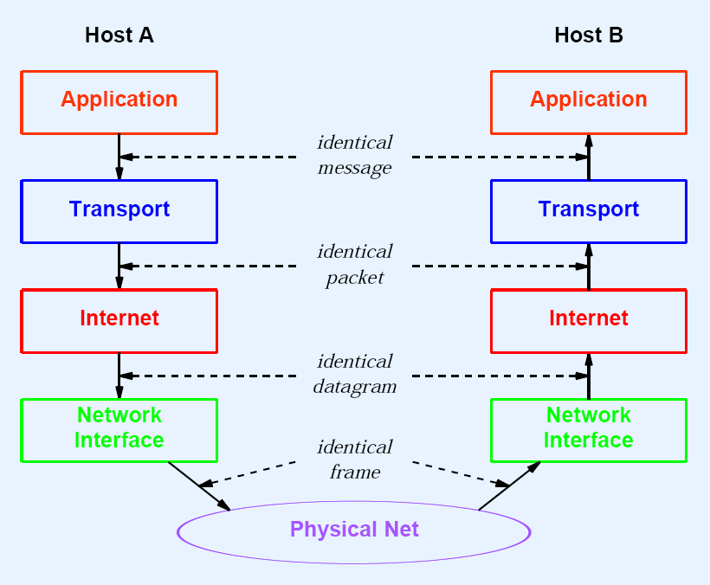

Slide 9
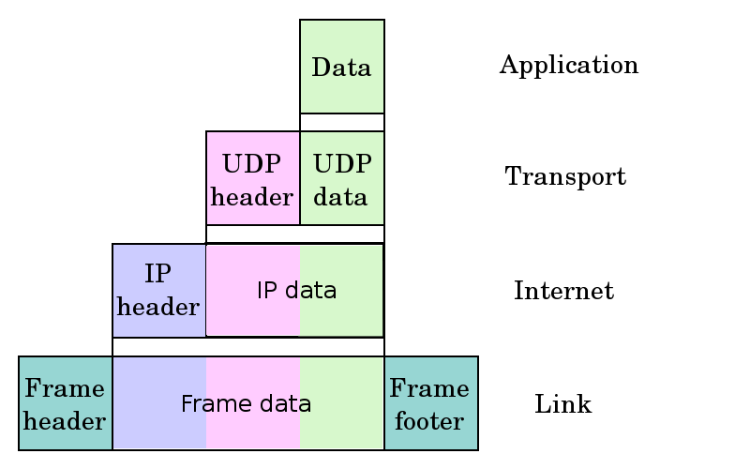
Protocol Layering
Notes:
From Dr. Rothe and the web, I assume

Slide 10
Terminology
TCP/IP – transport/network
UDP/IP – transport/network
IP = Internet Protocol

Slide 11
Internet Protocol
Based on “packet-switching”
  vs.
“circuit-switching”
Notes:
From Dr Rothe

Slide 12
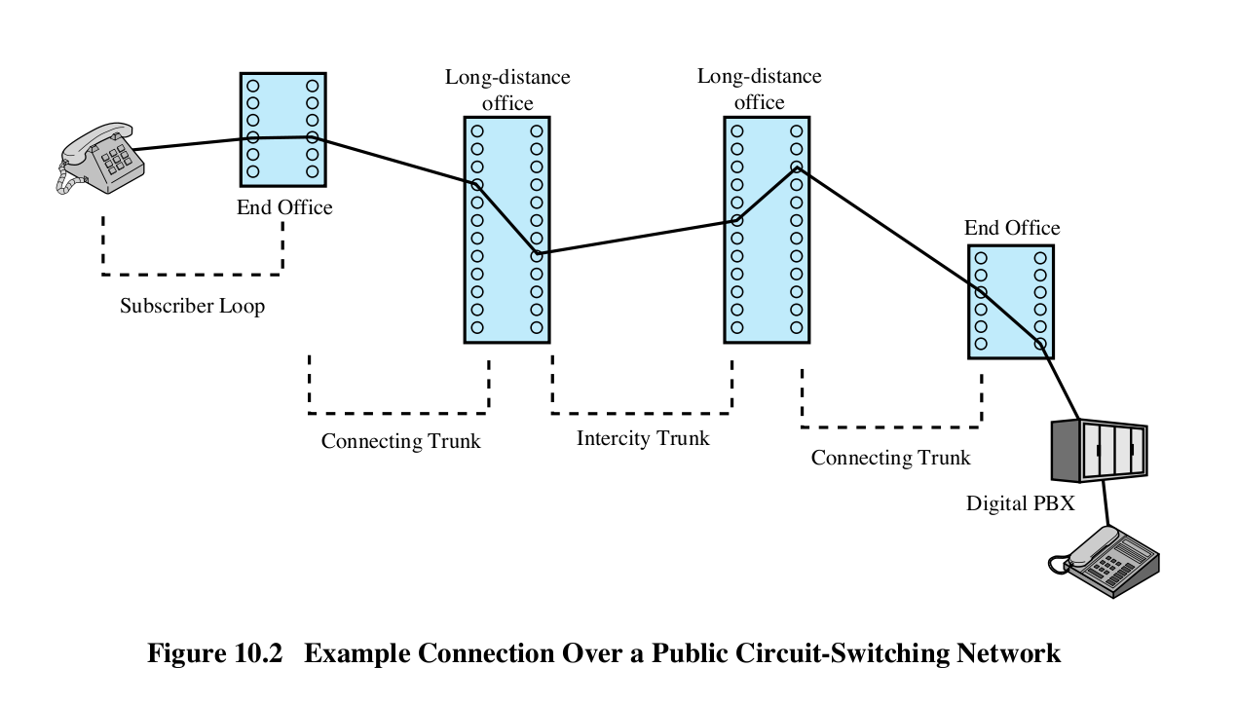
POTS (Plain old telephone service)
1876 until 1988
http://pld.cs.luc.edu/telecom/mnotes/pots.html
https://en.wikipedia.org/wiki/Plain_old_telephone_service
Notes:
From Dr Rothe

Slide 13
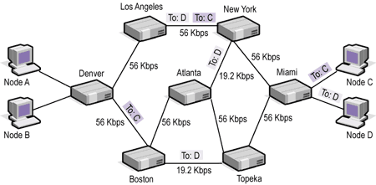
Packet Switching
http://www.webclasses.net/Courses/TCP-IP/7.0/DemoBuild/units/unit01/sec04a.html
Notes:
From Dr Rothe
No dedicated line
Instead, message broken up into (you guessed it!) packets which are sent through the network individually.
Different packets may take a different route through the network (See To: C vs To: D in figure)
Packets all share a line (Again, see To: C vs To: D in figure)
The NETWORK layer is responsible for making sure packets get to their destination.
It does this by …

Slide 14
Routing Algorithm (IP Layer)
If destination address is on same network
  Send directly
If destination address is not on same network
  Consult routing table
    Send to correct router (gateway)
  Not in routing table
    Send to default gateway
Notes:
From Dr Rothe

Slide 15
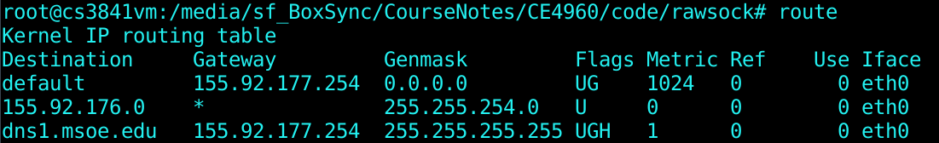
Screenshot…
Direct Delivery
Indirect Delivery
On windows cmd prompt: route print, * replaced with "On-link"
Notes:
From Dr Rothe

Slide 16
C:\Users\yoder>route print
===========================================================================
Interface List
19...02 50 41 00 00 01 ......PANGP Virtual Ethernet Adapter
18...12 4a 7d a6 ac 8f ......Microsoft Virtual WiFi Miniport Adapter #2
17...12 4a 7d a6 ac 8e ......Microsoft Virtual WiFi Miniport Adapter
15...10 4a 7d a6 ac 92 ......Bluetooth Device (Personal Area Network)
14...10 4a 7d a6 ac 8e ......Intel(R) Dual Band Wireless-N 7260
13...58 20 b1 7b f5 d0 ......Intel(R) Ethernet Connection I217-LM
1...........................Software Loopback Interface 1
24...00 00 00 00 00 00 00 e0 Microsoft ISATAP Adapter
20...00 00 00 00 00 00 00 e0 Microsoft ISATAP Adapter #2
10...00 00 00 00 00 00 00 e0 Microsoft Teredo Tunneling Adapter
12...00 00 00 00 00 00 00 e0 Microsoft 6to4 Adapter #2
21...00 00 00 00 00 00 00 e0 Microsoft ISATAP Adapter #3
22...00 00 00 00 00 00 00 e0 Microsoft ISATAP Adapter #5
23...00 00 00 00 00 00 00 e0 Microsoft ISATAP Adapter #6
===========================================================================
IPv4 Route Table
===========================================================================
Active Routes:
Network Destination Netmask Gateway Interface Metric
0.0.0.0 0.0.0.0 155.92.79.254 155.92.65.125 20
127.0.0.0 255.0.0.0 On-link 127.0.0.1 306
127.0.0.1 255.255.255.255 On-link 127.0.0.1 306
127.255.255.255 255.255.255.255 On-link 127.0.0.1 306
155.92.64.0 255.255.240.0 On-link 155.92.65.125 276
155.92.65.125 255.255.255.255 On-link 155.92.65.125 276
155.92.79.255 255.255.255.255 On-link 155.92.65.125 276
224.0.0.0 240.0.0.0 On-link 127.0.0.1 306
224.0.0.0 240.0.0.0 On-link 155.92.65.125 276
255.255.255.255 255.255.255.255 On-link 127.0.0.1 306
255.255.255.255 255.255.255.255 On-link 155.92.65.125 276
===========================================================================
Persistent Routes:
None
IPv6 Route Table
===========================================================================
Active Routes:
If Metric Network Destination Gateway
1 306 ::1/128 On-link
12 1020 2002::/16 On-link
12 276 2002:9b5c:417d::9b5c:417d/128
On-link
14 276 fe80::/64 On-link
14 276 fe80::5c65:69bf:8faf:232f/128
On-link
1 306 ff00::/8 On-link
14 276 ff00::/8 On-link
===========================================================================
Persistent Routes:
None

Slide 17






Multiple access links, protocols
two types of “links”:
point-to-point
  PPP for dial-up access
  point-to-point link between Ethernet switch, host
broadcast (shared wire or medium)
  old-fashioned Ethernet
  upstream HFC
  802.11 wireless LAN
shared RF
(satellite)
humans at a
cocktail party
(shared air, acoustical)
shared wire (e.g.,
cabled Ethernet)
shared RF
(e.g., 802.11 WiFi)
Notes:
Provided by Kurose & Ross

Slide 18
Layering
Notes:
Slide may be from our text's accompanying slides (I got it from Dr. Rothe's slides, which are often from the text)
Though our text does not use "Network Interface" for the link layer, so who knows…

Slide 19
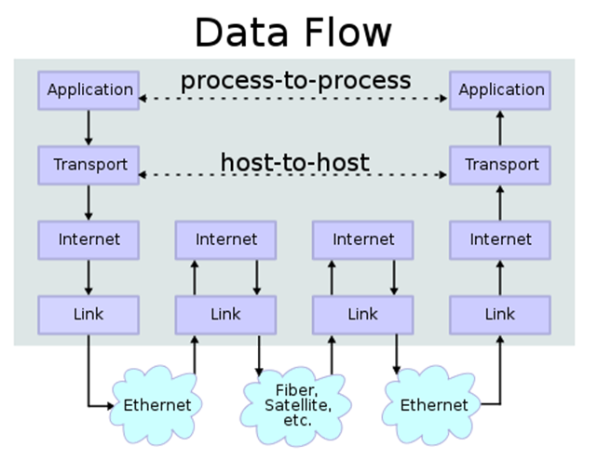
Notes:
From Dr. Rothe and the web, I assume

Slide 20

Encapsulation
source
message
M
application
transport
network
link
physical
segment
H_{t}
M
H_{t}
datagram
H_{n}
H_{n}
H_{t}
M
frame
H_{l}
H_{n}
H_{t}
M
link
physical
switch
destination
H_{n}
H_{t}
M
network
link
physical
M
application
transport
network
link
physical
H_{l}
H_{n}
H_{t}
M
H_{n}
H_{t}
M
H_{t}
M
H_{n}
H_{t}
M
H_{l}
H_{n}
H_{t}
M
router
Notes:
From Kurose-Ross

Slide 21
https://ebay.com
"your connection to this site is not secure"
Why?

Slide 22


Acknowledgement
The content of this video is based in part on lecture slides from a very good textbook, and used with the author’s permission:
Computer Networking: A Top-Down Approach, 7th edition, by Jim Kurose and Keith Ross
Publisher: Pearson, 2017

Slide 23
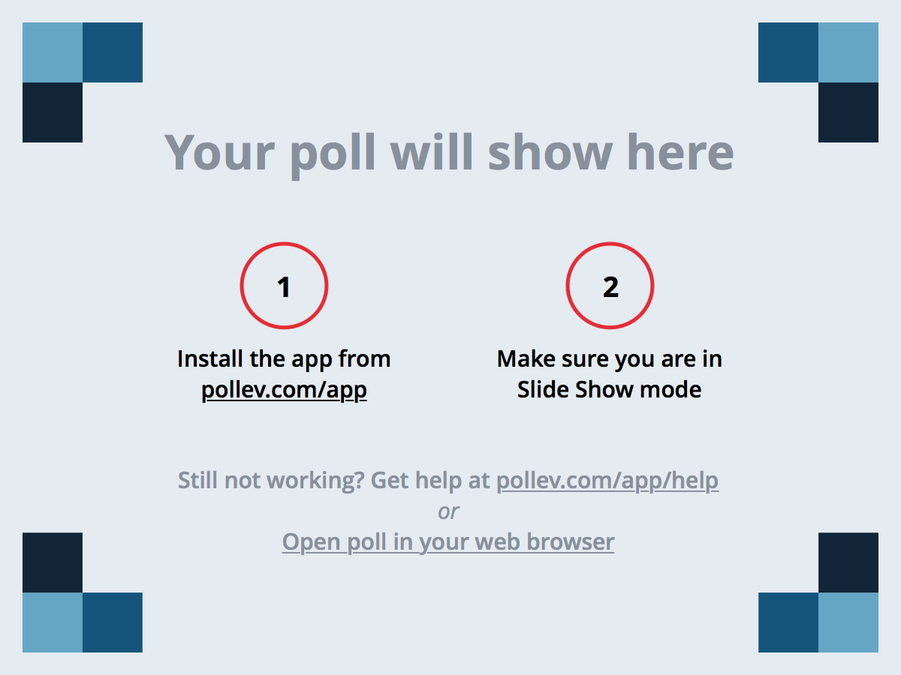
Notes:
Poll Title: What was the muddiest point? (CS2911)
https://www.polleverywhere.com/free_text_polls/zIp2tH2IVWjXv4H

