Slide 1
CS2911 Week 7, Class 1
Today
Return Labs 5 and 6
Review Muddiest Point
TCP
Muddiest Point
Week 7, Monday: Half-Exam 2
Outcomes: Half-Exam 1 + Unicode & UTF-8
Notes:
17q1 7-1 1-7,9-24

Slide 2
Muddiest Point 6-2
If you remove the muddiest points from the hand outs, could you save them somewhere else so that we can see them when we are studying? It is helpful to review questions other students have, and see if I can answer them before a test. | Muddiest Point
When is your baby comming? | Baby
How is the best way to test the code for lab 7? | Lab 7

Slide 3
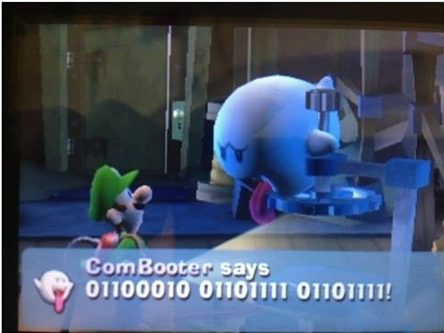
Muddiest Point 6-3
What text is sent in base-64? What text is sent encrypted? | Lab 7
"Silly Nintendo"

Slide 4
Outcomes
Be familiar with the layout of the TCP header
Describe the purpose of the following TCP header fields:
Source Port, Dest Port,
Sequence number, Acknowledgement number
Receive window
Checksum
Explain how sequence and acknowledgement numbers are calculated
Describe the behavior of the 3-way handshake

Slide 5
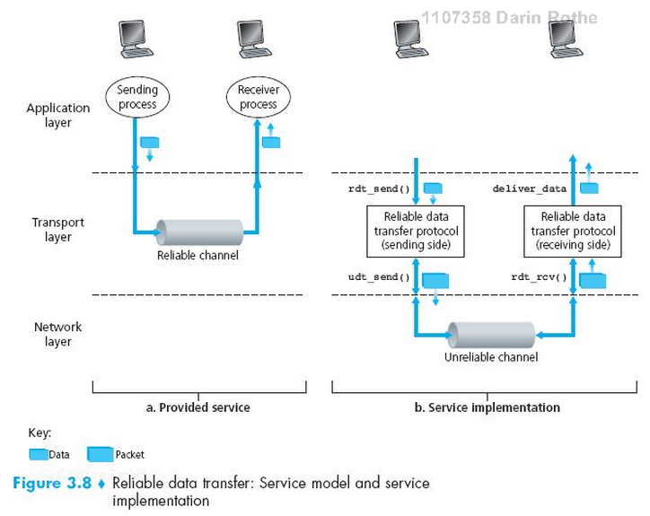
TCP as a Reliable Transport

Slide 6
How things can go wrong…
Lost packets
Corrupted packets
Reordered packets
…Malicious packets…

Slide 7
Requirements for Reliability
Error Detection
Receiver Feedback
Retransmission

Slide 8
Requirements for Reliability
Error Detection
Checksum
Receiver Feedback
ACK – acknowledgment
NAK – negative acknowledgment
Missing ACK
Retransmission
Sender resends the segment requested in the NAK or which had the ACK missing

Slide 9
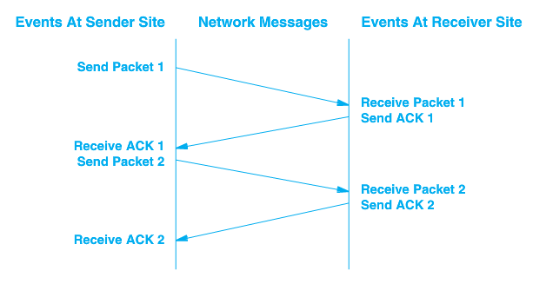
Stop and Wait
RTT –
Round
Trip
Time

Slide 10
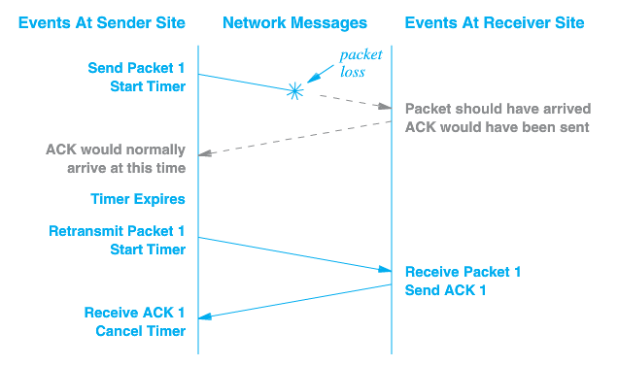
Packet Loss

Slide 11
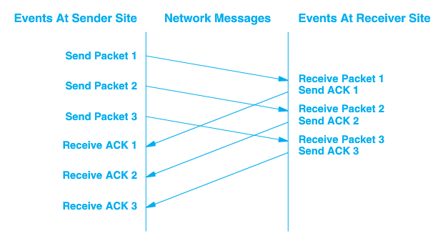
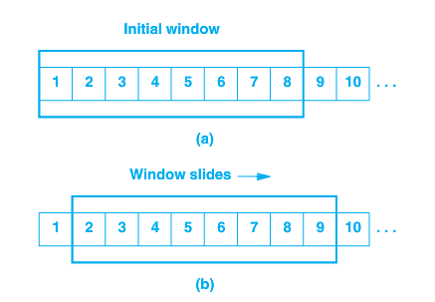
Sliding Window - Pipelined
Requires Buffering on each end

Slide 12
TCP Data Transfer Specifics
Data transferred as a stream of octets
Data is transferred in segments, but acknowledged at the octet level
Full duplex – data can be transferred in either direction, or both
Both endpoints of connection must maintain buffers/windows for both sending and receiving

Slide 13
Acknowledgement
Acknowledgements are cumulative
Acknowledgement of any octet implies receipt of all previous octets
++ Simple
++ Lost acknowledgements will not necessarily result in retransmission

Slide 14
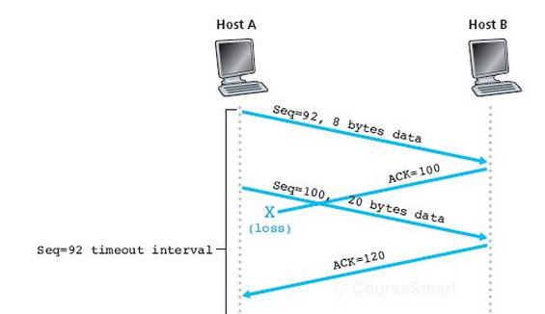
Acknowledgement
Acknowledgements are cumulative
Acknowledgement of any octet implies receipt of all previous octets

Slide 15
Acknowledgement
Acknowledgements are cumulative
Acknowledgement of any octet implies receipt of all previous octets
Think (30 s)
Pair (30 s)
Shair
What if timeout was here?

Slide 16
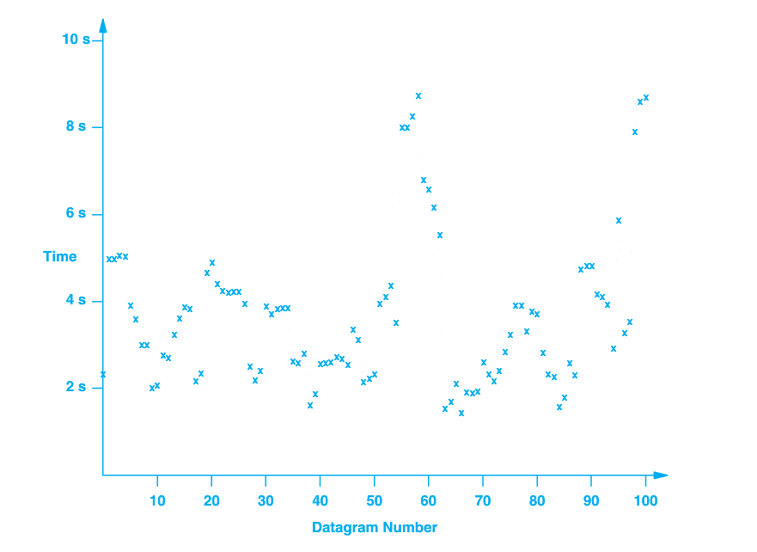
Timeout and Retransmission
What do we use for a timeout?
LAN – round-trip time for ACK might be ms
Internet – 100x
Varies over time

Slide 17
Adaptive Retransmission
Round-trip time (RTT) is monitored for each transmission/ACK
0 ≤ α < 1
Recommended value of α = 0.128 [RFC 6298]
Recommended β is 0.25

Slide 18
Exercise: TCP sequence & acknowlegement numbers
TCP sequence numbers actually start at a random number
To establish the number, the sender sends the random first sequence number.
The receiver replies with the sequence number + 1
After this, the current sequence number is always first number + 1 + total number of bytes sent/received

Slide 19
Starting a TCP sequence
Client
Server
SYN, SEQ = 368
ACK, ACK = 369
SEQ = 369, 10 bytes data
ACK, ACK = 379
SEQ = 379, 10 bytes data
ACK = 389

Slide 20
Server also can send data
Client
Server
SYN, SEQ = 824
ACK, ACK = 825
SEQ = 825, 30 bytes data
ACK, ACK = 855
SEQ = 855, 20 bytes data

Slide 21
All together now…
Client
Server
SYN, SEQ = 368
ACK, ACK = 369
Three-way Handshake
SYN, SEQ = 824
SEQ = 369, 10 bytes data
ACK, ACK = 825
SEQ = 825, 30 bytes data
ACK, ACK = 379
SEQ = 379, 10 bytes data
ACK, ACK = 855
SEQ = 855, 20 bytes data
ACK = 389

Slide 22
Multiple pending messages
Client
SYN, SEQ = 368
ACK, ACK = 369
SEQ = 369, 10 bytes data
SEQ = 379, 20 bytes data
ACK, ACK = 369

Slide 23
Closing a TCP connection
Client
Server
FIN SEQ = 835
ACK = 836
FIN SEQ = 529
ACK = 530
Notes:
17q1: example sequence and acknowledgement numbers added after morning class
Note that the ACK to the FIN also counts as 1 "virtual byte"

Slide 24
Exercise
Fill in the blanks of the sample TCP message below

Slide 25
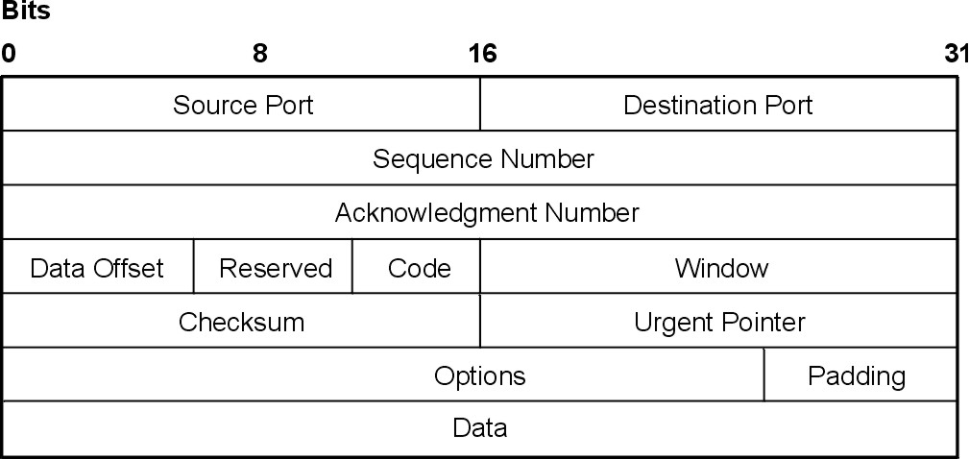
TCP Header format
http://ps-2.kev009.com/wisclibrary/aix51/usr/share/man/info/en_US/a_doc_lib/aixbman/commadmn/tcp_protocols.htm

Slide 26
Formatting of Field Values
Like UDP, all fields are stored in raw binary in a big-endian order (most significant byte first)
Some have more bits than others

Slide 27
Sliding Window - Pipelined
Requires Buffering on each end

Slide 28
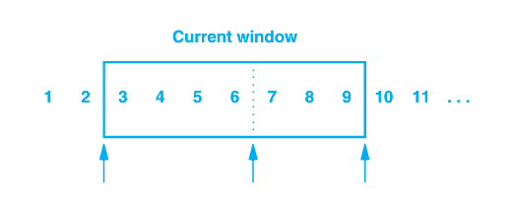
Sender’s Window
1, 2 have been sent and acknowledged
3 – 6 sent but not acknowledged
7 – 9 have not been sent but can be without delay
10 and higher will not be sent until window moves

Slide 29
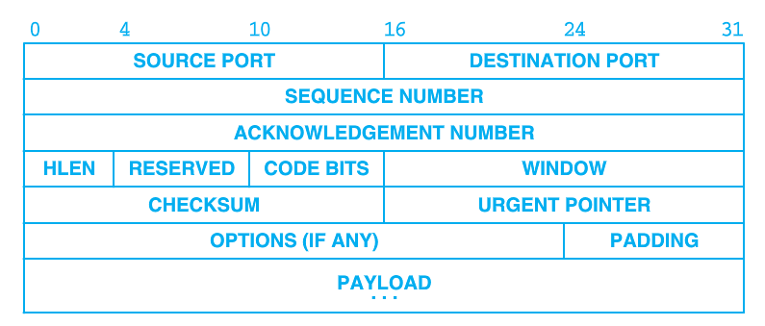
Window Advertisement
Window size can vary over time
Receiver sends a windows size with acknowledgement that indicates how many octets it is willing to accept
Allows flow control
An advertisement of 0 will halt transfer

Slide 30
Sliding Window - Pipelined
Requires buffering on each end
Remaining space on receiver in last acknowledgement

Slide 31
Sliding Window supports Flow Control
Won't over-fill receiver's buffer
Waits for receiving application to be ready
This is one reason to call recv even before we have gotten the whole message

Slide 32
Flow vs. Congestion Control
Flow control is a function of the receiver and its ability to accept data
Congestion control is a function of the network and its ability to carry messages
Congestion control avoids sending more data than the network can handle, resulting in collapse of the network

Slide 33
New Variable - cwnd
Two windows
Un-acknowledged bytes
cwnd – congestion window
rwnd – receive (flow control) window
Notes:
Note that this is NOT a new field in the headers – convenient!

Slide 34
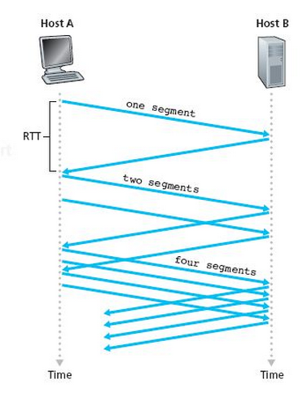
cwnd
We can send up to cwnd bytes per RTT period
Average transmission rate is roughly cwnd/RTT bytes/sec
By manipulating cwnd, transmission rate can be controlled

Slide 35
Congestion Detection
If segments lost, maybe we are sending too many
Adjust cwnd
Decrease when a segment is lost
Increase when [consistent] ACKs are received
Continue to increase until a segment is lost, then backoff

Slide 36
TCP Slow Start
Start with a small cwnd (one MSS)

Slide 37
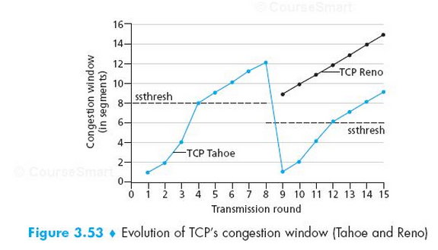
cwnd Over Time

Slide 38
Challenge: How to avoid accidental message?
What if a TCP message from a previous connection gets stuck in a router for a while, but then eventually gets delivered later?
How to avoid it being mistaken for the newer message?

Slide 39
A very brief history of the internet
1957 – Sputnik launched, ARPA formed
1962 – ARPA forms IPTO to create ARPAnet
1969 – First packet switched network at UCLA
1983 – TCP/IP first deployed
1986 – NSFNET created (& many others)
1991 – NSFNET allows commercial activities. e-Bay, Google, Amazon …
2000's – Facebook, Twitter, Youtube, …
Source: Kurose & Ross, 6th, Ed, Section 1.7 and
http://www.calvin.edu/academic/rit/webBook/chapter3/Introduction/arpanet.htm

Slide 40
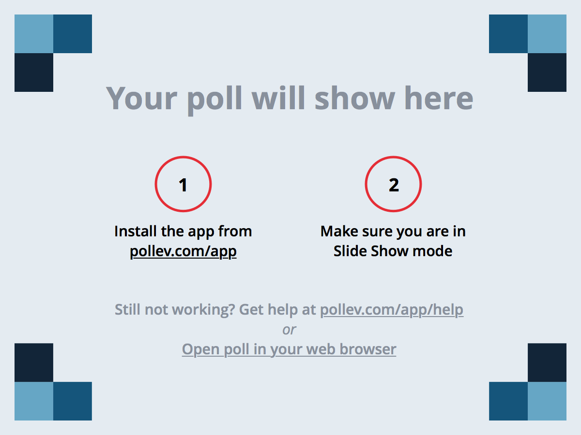
Notes:
Poll Title: What was the muddiest point? (CS2911) https://www.polleverywhere.com/free_text_polls/zIp2tH2IVWjXv4H

Slide 41
Acknowledgement
The content of this video is based in part on lecture slides from a very good textbook, and used with the author’s permission:
Computer Networking: A Top-Down Approach, 7th edition, by Jim Kurose and Keith Ross
Publisher: Pearson, 2017
It is also based on slides provided by Dr. Darrin Rothe

