Slide 1
CS2911 Week 8, Class 2
Today
Muddiest Point
Questions on Videos
RSA
Muddiest Point
Notes:
17q1 7-1 1-7,9-24

Slide 2
DDoS attack on DNS provider Dyn
Just for fun:
What is a distributed Denial of Service attack?
What is a bot-net?
How many Mirai-infected devices were used in the attack on Dyn?
How many Mirai-infected devices are there in the world?

Slide 3
Standard Symmetric Block Cipher Algorithms
DES, Triple DES (Data Encryption Standard)
NSA
AES (Advanced Encryption Standard)
NIST, but note NSA involvement in other algorithms published by NIST
Blowfish
Not standard. Self-published algorithm
Why not write your own? (Because …)

Slide 4
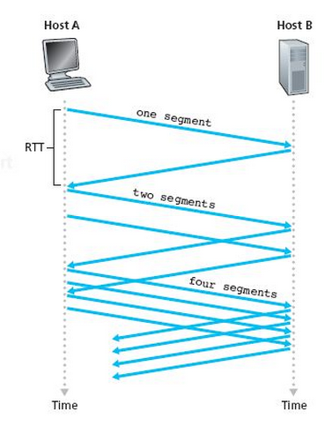
TCP Slow Start
Start with a small cwnd (one MSS)

Slide 5
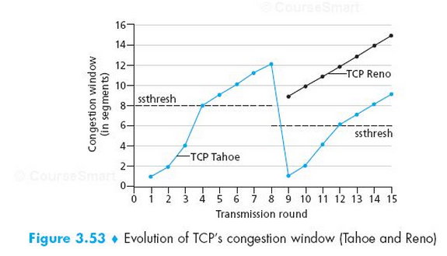
cwnd Over Time
Notes:
Note that Wikipedia actually cite our text
https://en.wikipedia.org/wiki/TCP_congestion_control#TCP_Tahoe_and_Reno
to explain what happens in this condition!
The text is more complete here – it says 3 segments are added to the halved ssthresh.

Slide 6
Muddy Point: TCP Tahoe vs TCP Reno
Tahoe: (original version)
If packet lost, go back to slow start
Reno: (new version)
If packet lost, go straight to new tthresh (+ 3)
Both:
Set tthresh to half of the cwind when congestion occurred
Notes:
Technically, they only behave this way if the packet lost was detected by 3 duplicate ACKs. If a timeout occurs, both go back to slow start.

Slide 7
Big Picture: How is Lab 9 code used in real life?
Lots of people use the web to secure sensitive information like credit cards and social security numbers.
All web protocols (HTTPS, SMTP, IMAP, …) use TLS to secure data.
TLS uses public-private key algorithms to exchange symmetric keys.
RSA is the public-private key algorithm that TLS uses the most often
Lab 9 is about RSA. When you complete this lab, you will see how RSA can be turned into a program to encrypt/decrypt data.

Slide 8
Key Length Comparison (bits)
RSA | Diffie-Hellman | Eliptic Curve | Sym- metric | "Crack-able date" (2003 estimates)
1024 | 1024 | 160 | 80 | 2006 - 2010
2048 | 2048 | 224 | 112 | 2030
3072 | 3072 | 256 | 128 | SECRET
 |  | 384 |  | TOP SEC
Notes:
Source: Various Wikipedia articles

Slide 9
Standard Symmetric Block Cipher Algorithms
DES, Triple DES (Data Encryption Standard)
NSA
AES (Advanced Encryption Standard)
NIST, but note NSA involvement in other algorithms published by NIST
Blowfish
Not standard. Self-published algorithm
Why not write your own? (Because …)

Slide 10
Muddiest Points

Slide 11
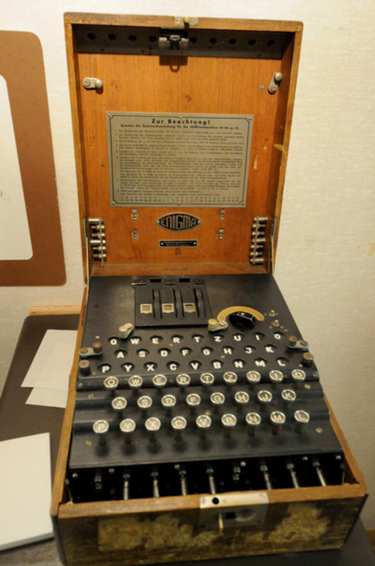
WWII Encryption: The Enigma Machine
A story of a known-plaintext attack
http://www.cnet.com/pictures/breaking-the-nazis-enigma-codes-at-bletchley-park-photos/2/

Slide 12
WWII Encryption: The Enigma and the Bomb
Mavis Batey

Slide 13
Notes:
Poll Title: What was the muddiest point of the quarter? https://www.polleverywhere.com/free_text_polls/NudT706GZ8kvjJR

Slide 14
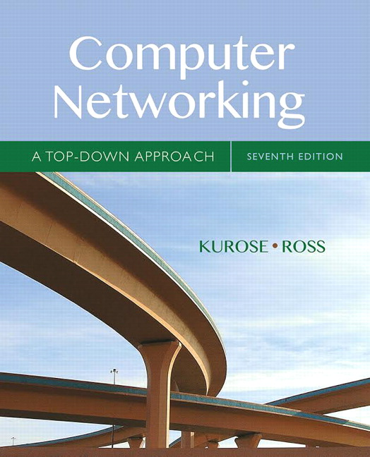
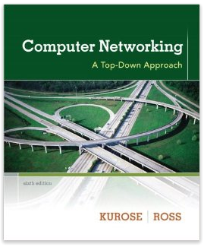
Acknowledgement
The content of this video is based in part on lecture slides from a very good textbook, and used with the author’s permission:
Computer Networking: A Top-Down Approach, 7th edition, by Jim Kurose and Keith Ross
Publisher: Pearson, 2017
It is also based on slides provided by Dr. Darrin Rothe

