Slide 1
CS2911 Week 9, Sometime
Today
TCP
Week 10, Tuesday
Class climate evaluations!
TCP concluded
Credit: Many slides in this deck by Dr. Rothe and the authors of our textbook
Notes:
18q1

Slide 2
Outcomes
Be familiar with the layout of the TCP header
Describe the purpose of the following TCP header fields:
Source Port, Dest Port,
Sequence number, Acknowledgement number
Receive window
Checksum
Calculate sequence and acknowledgement numbers
Describe the behavior of the 3-way handshake

Slide 3
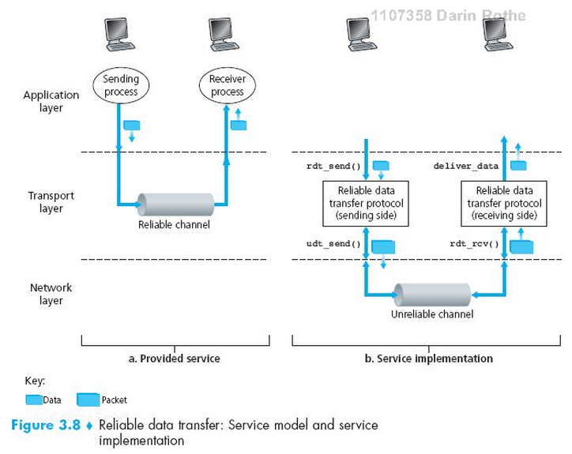
TCP as a Reliable Transport

Slide 4
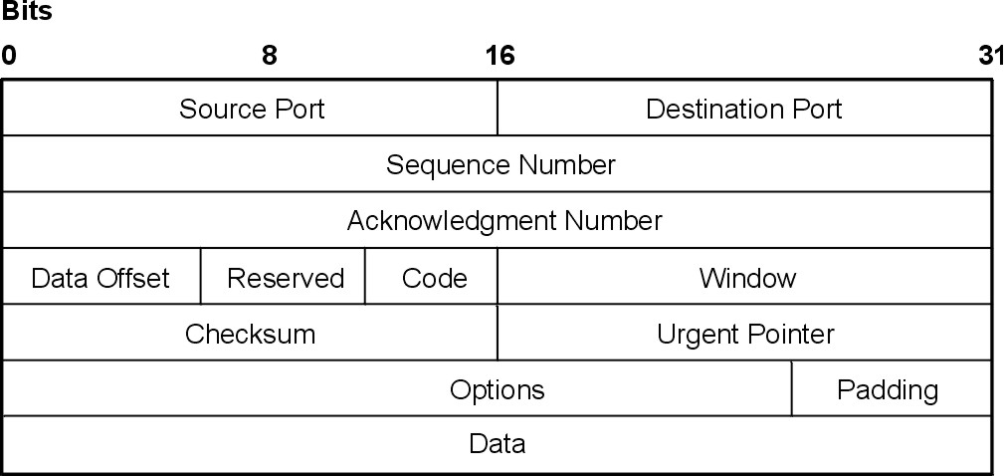
TCP Header format
http://ps-2.kev009.com/wisclibrary/aix51/usr/share/man/info/en_US/a_doc_lib/aixbman/commadmn/tcp_protocols.htm

Slide 5
Formatting of Field Values
Like UDP, all fields are stored in raw binary in a big-endian order (most significant byte first)

Slide 6
How things can go wrong…
Corrupted packets
Lost packets
Reordered packets
…Malicious packets…
Notes:
In these slides, we do not consider security issues – only the basics to overcome unintentional network errors

Slide 7
Requirements for Reliability
Error Detection
Receiver Feedback
Retransmission

Slide 8
Requirements for Reliability
Error Detection
Checksum
Receiver Feedback
ACK – acknowledgment
NAK – negative acknowledgment
Missing ACK
Retransmission
Sender resends the segment requested in the NAK or which had the ACK missing

Slide 9
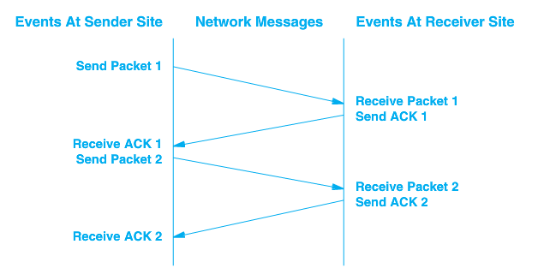
Stop and Wait
RTT –
Round
Trip
Time

Slide 10
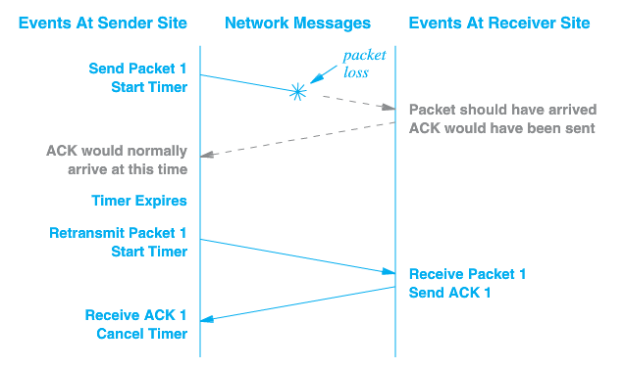
Packet Loss
Notes:
No way to send a NAK in this case

Slide 11
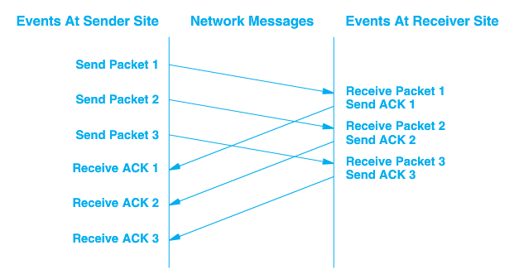
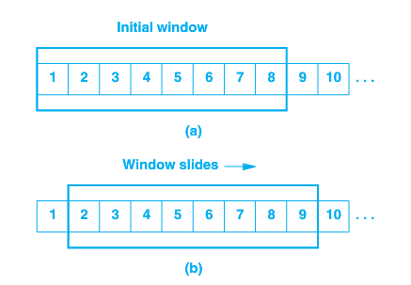
Sliding Window - Pipelined

Slide 12
TCP Data Transfer Specifics
Data transferred as a stream of octets (bytes)
Data is transferred in segments, but acknowledged at the octet level
Full duplex – data can be transferred in either direction, or both
Both endpoints of connection must maintain buffers/windows for both sending and receiving

Slide 13
Acknowledgement
Acknowledgements are cumulative
Acknowledgement of any octet implies receipt of all previous octets
Simple
Lost acknowledgements will not necessarily result in retransmission
Notes:
Skipped slide 12 (transfer specifics) and ended with this slide 18q1-wk9-2-011

Slide 14
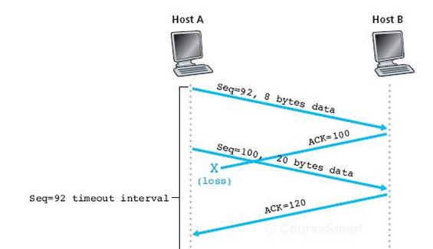
Acknowledgement
Acknowledgements are cumulative
Acknowledgement of any octet implies receipt of all previous octets

Slide 15
Acknowledgement
Acknowledgements are cumulative
Acknowledgement of any octet implies receipt of all previous octets
Think (30 s)
Pair (30 s)
Shair
What if timeout was here?

Slide 16
Exercise: TCP sequence & acknowlegement numbers
TCP sequence numbers actually start at a random number
To establish the number, the sender sends the random first sequence number.
The receiver replies with the sequence number + 1
After this, the current sequence number is always first number + 1 + total number of bytes sent/received

Slide 17
Starting a TCP sequence
Client
Server
SYN, SEQ = 368
ACK, ACK = 369
SEQ = 369, 10 bytes data
ACK, ACK = 379
SEQ = 379, 10 bytes data
ACK = 389

Slide 18
Server also can send data
Client
Server
SYN, SEQ = 824
ACK, ACK = 825
SEQ = 825, 30 bytes data
ACK, ACK = 855
SEQ = 855, 20 bytes data

Slide 19
All together now…
Client
Server
SYN, SEQ = 368
ACK, ACK = 369
Three-way Handshake
SYN, SEQ = 824
SEQ = 369, 10 bytes data
ACK, ACK = 825
SEQ = 825, 30 bytes data
ACK, ACK = 379
SEQ = 379, 10 bytes data
ACK, ACK = 855
SEQ = 855, 20 bytes data
ACK = 389

Slide 20
Multiple pending messages
Client
SYN, SEQ = 368
ACK, ACK = 369
SEQ = 369, 10 bytes data
SEQ = 379, 20 bytes data
ACK, ACK = 369

Slide 21
Closing a TCP connection
Client
Server
FIN SEQ = 835
ACK = 836
FIN SEQ = 529
ACK = 530
Notes:
17q1: example sequence and acknowledgement numbers added after morning class
Note that the ACK to the FIN also counts as 1 "virtual byte"

Slide 22
Closing a TCP connection
Client
Server
FIN, SEQ = 835
ACK, ACK = 529
SEQ = 529
ACK, ACK = 836
FIN, SEQ = 529
ACK, ACK = 836
SEQ = 836
ACK, ACK = 530
Notes:
17q1: example sequence and acknowledgement numbers added after morning class
Note that the ACK to the FIN also counts as 1 "virtual byte"

Slide 23
Exercise
Fill in the blanks of the sample TCP message below

Slide 24
Sliding Window - Pipelined
Notes:
Just like stop and wait, the sliding window requires a buffer on either end.
But now the sender can send as many messages as will fill the buffer. This is the window.

Slide 25
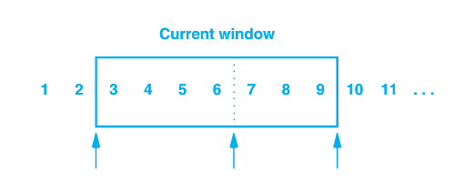
Sender’s Window
1, 2 have been sent and acknowledged
3 – 6 sent but not acknowledged
7 – 9 have not been sent but can be without delay
10 and higher will not be sent until window moves

Slide 26
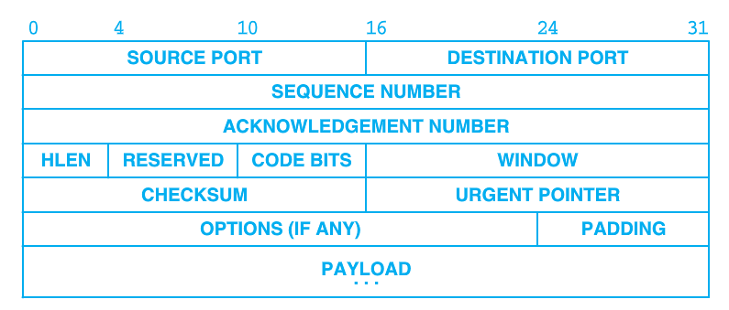
Window Advertisement
Window size can vary over time
Receiver sends a windows size with acknowledgement that indicates how many octets it is willing to accept
Allows flow control
An advertisement of 0 will halt transfer
Notes:
Receive is willing to accept as many bytes as will fit in its buffer

Slide 27
Sliding Window - Pipelined
Requires buffering on each end
Remaining space on receiver in last acknowledgement

Slide 28
Sliding Window supports Flow Control
Won't over-fill receiver's buffer
Waits for receiving application to be ready
This is one reason to call recv even before we have gotten the whole message
Notes:
So the purpose of the flow control window is to make sure we don’t send more packets than the receiver can handle.
In your experience, do different servers operate at different speeds, or is the bottleneck somewhere else? (If somewhere else, where?)

Slide 29
Flow vs. Congestion Control
Flow control is a function of the receiver and its ability to accept data
Congestion control is a function of the network and its ability to carry messages
Congestion control avoids sending more data than the network can handle, resulting in collapse of the network
Notes:
Last slide for 18q1-011

Slide 30
New Variable - cwnd
Two windows
Un-acknowledged bytes
cwnd – congestion window
rwnd – receive (flow control) window
Notes:
Note that this is NOT a new field in the headers – convenient!

Slide 31
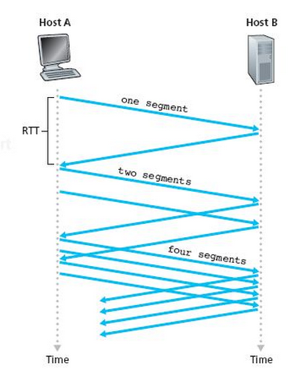
cwnd
We can send up to cwnd bytes per RTT period
Average transmission rate is roughly cwnd/RTT bytes/sec
By manipulating cwnd, transmission rate can be controlled
Notes:
Stopped roughly here 18q1-031
Suppose the window is open and I send a message.
Then I can send enough messages to fill the whole window.
But after that, I will wait for the first message to be ack’d before I can send any more messages – just like with flow control. In flow control, we are making sure we don’t fill a buffer on the receiver. Here, we are making sure we don’t spit too many packets onto the network so that it doesn’t collapse.
So I will send on average cwnd/RTT bytes/sec

Slide 32
Congestion Detection
If segments lost, maybe we are sending too many
Adjust cwnd
Decrease when a segment is lost
Increase when ACKs are received
Continue to increase until a segment is lost, then backoff
Notes:
[consistent] ACks

Slide 33
TCP Slow Start
Start with a small cwnd (one MSS)

Slide 34
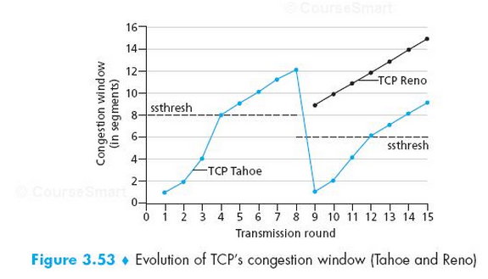
cwnd Over Time
Notes:
Tahoe – slow start, but not fast recovery (and not what is described in the Congestion Avoidance section on p. 273 of the 7th Ed – see p. 276, first para for explicit statement of this)
Reno – slow start, but including fast recovery and Congestion Avoidance. Note that if a timeout occurs, Fast Recovery would also drop back to 1 MSS per round trip
See (7th Ed) pp. 275-276 within Sec 3.7

Slide 35
Challenge: How to avoid accidental message?
What if a TCP message from a previous connection gets stuck in a router for a while, but then eventually gets delivered later?
How to avoid it being mistaken for the newer message?

Slide 36
A very brief history of the internet
1957 – Sputnik launched, ARPA formed
1962 – ARPA forms IPTO to create ARPAnet
1969 – First packet switched network at UCLA
1971 – First emails with @ signs
1983 – TCP/IP first deployed
1986 – NSFNET created (& many others)
1989 – HTTP starts with just GET
1991 – NSFNET allows commercial activities. e-Bay, Google, Amazon …
2000's – Facebook, Twitter, Youtube, …
Source: Kurose & Ross, 6th, Ed, Section 1.7 and
http://www.calvin.edu/academic/rit/webBook/chapter3/Introduction/arpanet.htm
http://www.livinginternet.com/e/ei.htm Wiki: HTTP

Slide 37
Acknowledgement
The content of this video is based in part on lecture slides from a very good textbook, and used with the author’s permission:
Computer Networking: A Top-Down Approach, 7th edition, by Jim Kurose and Keith Ross
Publisher: Pearson, 2017

Slide 38
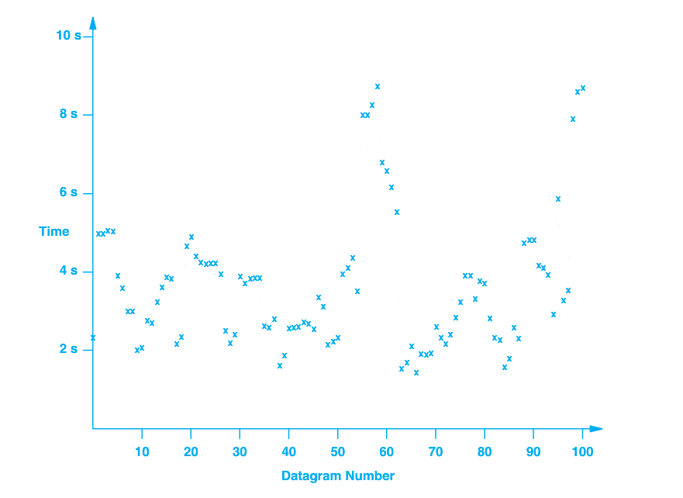
Timeout and Retransmission
What do we use for a timeout?
LAN – round-trip time for ACK might be ms
Internet – 100x
Varies over time

Slide 39
Adaptive Retransmission
Round-trip time (RTT) is monitored for each transmission/ACK
0 ≤ α < 1
Recommended value of α = 0.128 [RFC 6298]
Recommended β is 0.25
Notes:
Last slide for 18q1-021

