Slide 1
CS2911
Week 1, Class 1
Upcoming
  Introductions
  Syllabus
  Safety Review
  Binary encodings
  Lab 1 starts!
Notes:
19q1: print 1,12,13,16-19,22-26
20q1-1-Lab(2-4)-021: 21-26,28-31
20q1-1-Lab(2-4)-041: 9-12,21-26,28,30 (31 is duplicate of previous slide)

Slide 2
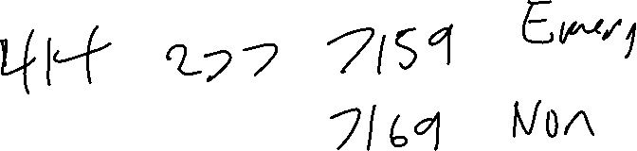
Safety Review
Take notes

Slide 3
Syllabus and Class Layout
http://faculty-web.msoe.edu/yoder/cs2911
    Syllabus
    Free resources for students
    Lab schedule
    Teams of two
    Python Coding Standard
    Instructional Vocabulary for ESL students

Slide 4
Introductions
Find someone you don’t know and learn
  Their name
  One interesting thing they did this summer
Be prepared to tell this to the rest of the class
Just 2 minutes… make sure you all get a turn!

Slide 5
Mental Health
More than 25% of college students have been diagnosed or treated by a professional for a mental health condition within the past year
Suicide is the 3rd leading cause of death on college campuses.
64% of young adults who are no longer in college are not attending college because of a MH related reason.
Notes:
Source: MSOE’s wellness center.

Slide 6
Binary Encodings
You can store anything as 1's and 0's
Exercise: Brainstorm the types of things that you might want to send over the internet

Slide 7
How do we send these things over the internet?
You may need a few sheets of paper to hold your notes on this

Slide 8
021

Slide 9
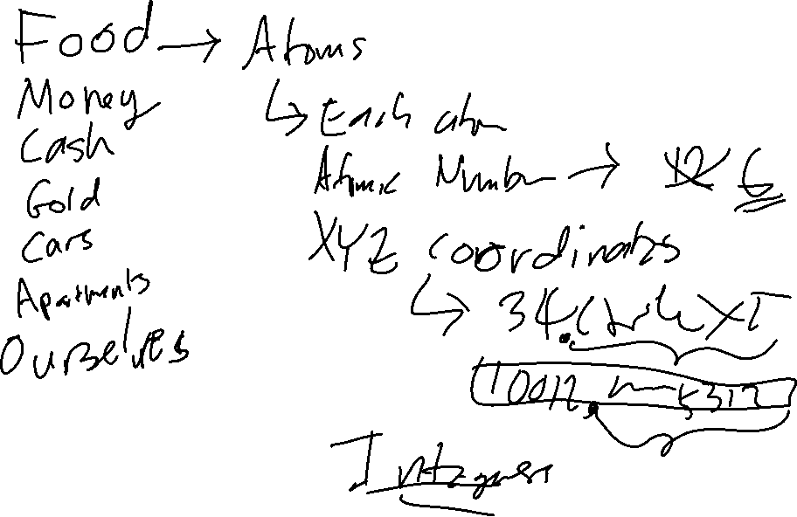

Slide 10
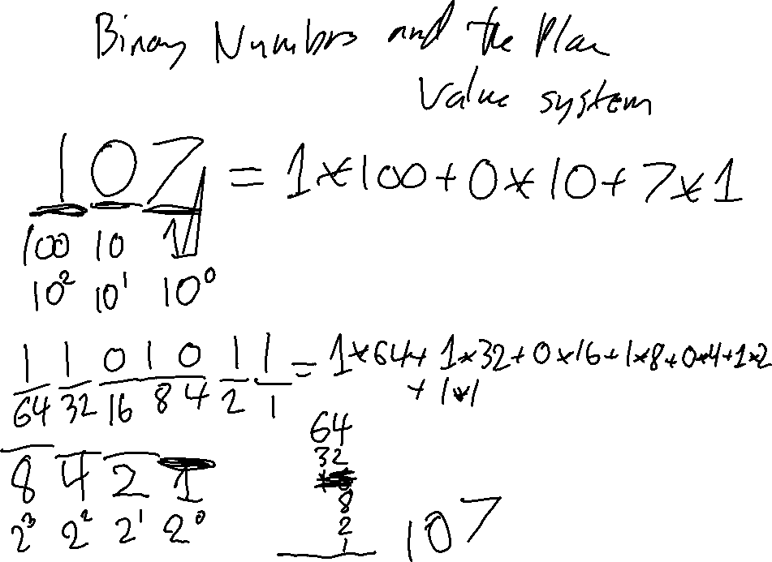

Slide 11
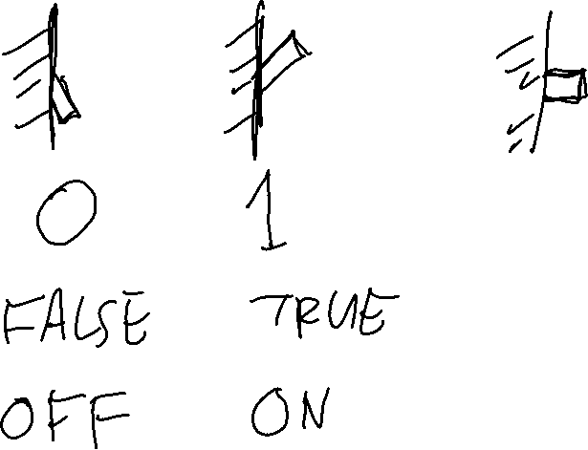

Slide 12
041

Slide 13
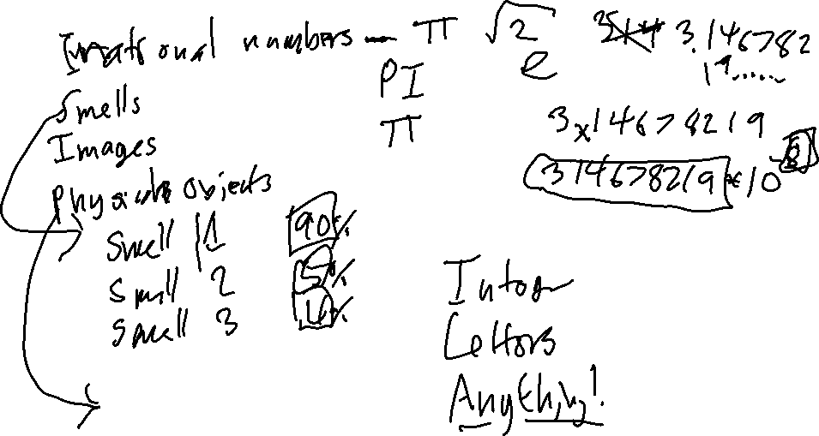
How do we send these things over the internet?

Slide 14
How do we send these things over the internet?

Slide 15
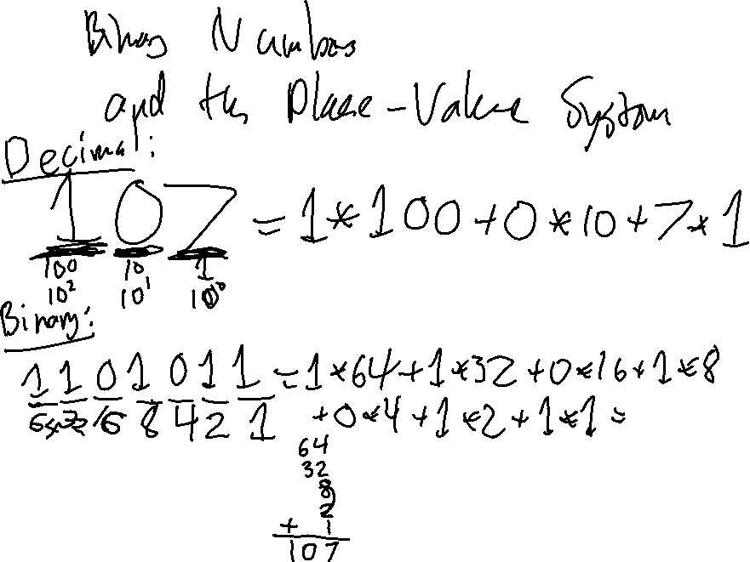

Slide 16
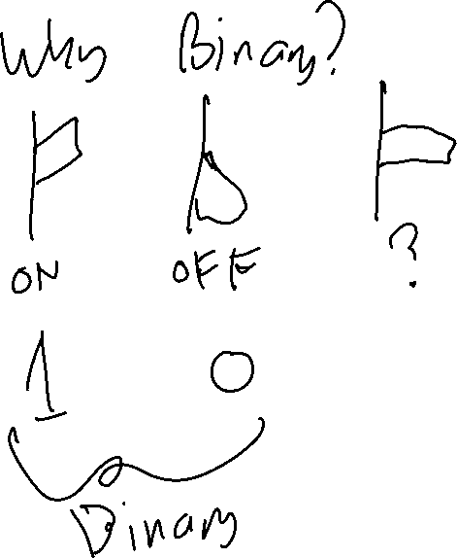

Slide 18
What's a byte?
A byte is 8 bits.
So 1000₁₀ can be written with two bytes:
0000 0011 1110 1000
How do you write this in hexadecimal?

Slide 19
Representing characters with bytes
‘A’
ASCII characters:
0100 0001 ‘A’
0100 0010 ‘B’
0110 0001 ‘a’
0011 0000 ‘0’
0011 0001 ‘1’
0000 1101 ‘\r’ CR (Carriage return)
0000 1010 ‘\n’ LF (Line feed, New line)
0010 0000 ‘ ’ (Space)
0100 0001
Byte
nibble

Slide 20
Required
ASCII characters
Hex code | Char |  | Hex code | Char |  | Hex code | Char |  | Hex code | Char
0d | '\r' CR |  | 30 | '0' |  | 41 | 'A' |  | 61 | 'a'
 |  |  | 31 | '1' |  | 42 | 'B' |  | 62 | 'b'
0a | '\n' LF |  | … | … |  | 43 | 'C' |  | 63 | 'c'
 |  |  | 38 | '8' |  | 44 | 'D' |  | 64 | 'd'
20 | ' ' SP |  | 39 | '9' |  | 45 | 'E' |  | 65 | 'e'
Notes:
17q1 added after class, "Hex code" added day of Lab 3

Slide 21
Exercise: Suppose the ASCII characters ‘A’, CR, and LF are stored in a bytes object. Write the hexadecimal shorthand for the contents of the bytes object.
Exercise: How do you write the ASCII string "Cab" in hexadecimal shorthand?

Slide 22
UDP Header
 | Byte | 0 |  |  |  |  |  |  |  | 1 |  |  |  |  |  |  |  | 2 |  |  |  |  |  |  |  | 3
Byte | Bit | 0 | 1 | 2 | 3 | 4 | 5 | 6 | 7 | 8 | 9 | 10 | 11 | 12 | 13 | 14 | 15 | 16 | 17 | 18 | 19 | 20 | 21 | 22 | 23 | 24 | 25 | 26 | 27 | 28 | 29 | 30 | 31
0 | 0 | Source port |  |  |  |  |  |  |  |  |  |  |  |  |  |  |  | Destination port
4 | 32 | Length |  |  |  |  |  |  |  |  |  |  |  |  |  |  |  | Checksum
Wikipedia: User Datagram Protocol

Slide 23
You are now ready to finish Lab 2!
Overview Lab 2 – see website

Slide 24
Questions about Lab 2?
What we've discussed today
Python code in lab assignment
Role of UDP in network stack
…

Slide 25
CS2911
Week 1, Class 2
Today
  Syllabus
  Introductions
Lab
  Safety Review
  Binary encodings
  Lab 1 starts!
Notes:
print 1,12,13,16-19,22-26

Slide 26
Questions?

Slide 27
Symbols

Slide 28
Exercise: Complete the hexadecimal columns
Binary | Hexadecimal
0000 | 0
0001 | 1
0010 | 2
0011
0100
0101
0110
0111
Binary | Hexadecimal
1000
1001
1010
1011
1100
1101
1110
1111 | f

Slide 29
Binary | Octal
000 | 0
001 | 1
010 | 2
011 | 3
100 | 4
101 | 5
110 | 6
111 | 7
Binary | Octal | Decimal
1000 | 10 | 8
1001 | 11 | 9
1010 | 12 | 10
1011 | 13 | 11
1100 | 14 | 12
1101 | 15 | 13
1110 | 16 | 14
1111 | 17 | 15

Slide 30
What's a byte?
A byte is 8 bits.
Exercise: Consider the hexadecimal byte-dump
e8 02 1a ff
Circle the first byte in this dump
Write this byte in binary

Slide 31
Exercise
Exercise: What does the byte 0x62 mean if interpreted as an ASCII character?
Exercise: What does the byte 0x62 mean if interpreted as a binary number?

Slide 32
Exercise
Exercise: What does the byte 0x44 mean if interpreted as an ASCII character?
Exercise: What does the byte 0x44 mean if interpreted as a binary number?

Slide 33
Big endian / little endian
1000₁₀ can be written with the bytes
big endian: most significant byte first
0000 0011 1110 1000 (03 e8)
little endian: least significant byte first
1110 1000 0000 0011 (e8 03)
Network order is BIG ENDIAN (whew!)
Intel machines are LITTLE ENDIAN

Slide 34
Exercise
Convert the number 700 to binary
Write 700 in big-endian format (in binary)
Convert the binary to hexadecimal shorthand
Write 700 in little-endian (hexadecimal shorthand)
Repeat for 443, 587 (these are ports we will use later in the quarter)

Slide 35
Exercise 1: How many values can you represent with 1 bit? 2? 3? 4? 5? 6? 7? 8? 9? 10? n bits?
Exercise 2: How many bits can you represent with a single decimal digit (0-9)?

Slide 36
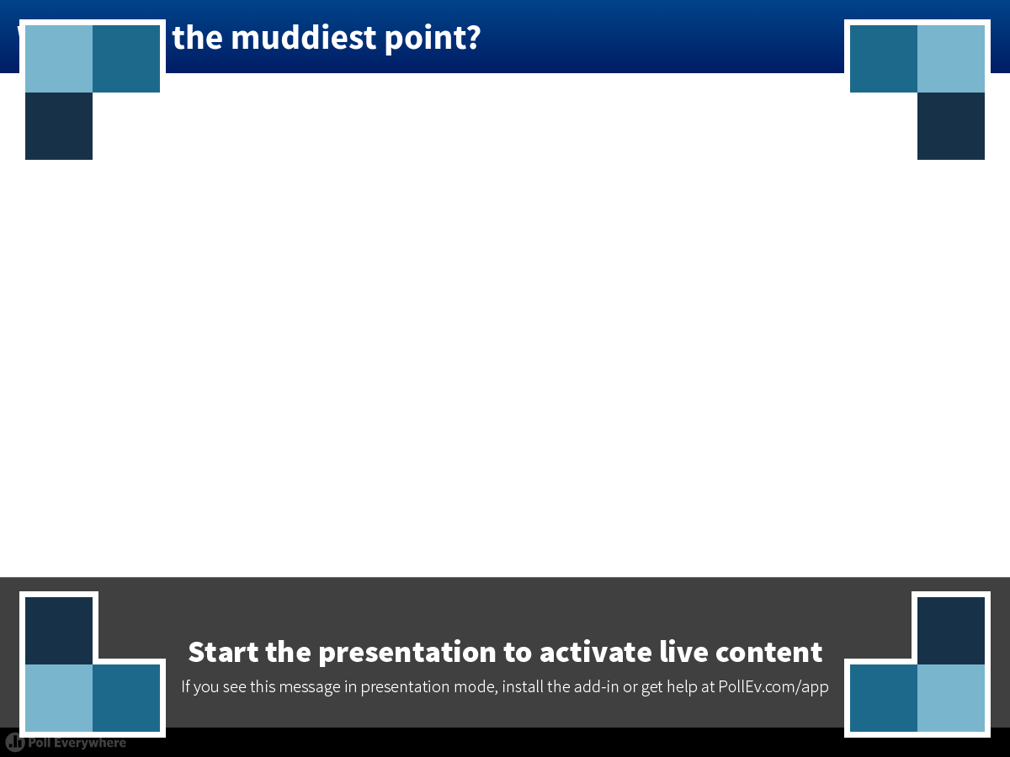
Notes:
Poll Title: What was the muddiest point?
https://www.polleverywhere.com/free_text_polls/zIp2tH2IVWjXv4H

Slide 37
Exercise
Exercise: What does the byte 0x44 mean if interpreted as an ASCII character?
Exercise: What does the byte 0x44 mean if interpreted as a binary number?

Slide 38
Binary | Octal
000 | 0
001 | 1
010 | 2
011 | 3
100 | 4
101 | 5
110 | 6
111 | 7
Binary | Octal
unused | 8
unused | 9

Slide 39
Big endian / little endian
1000₁₀ can be written with the bytes
big endian: most significant byte first
0000 0011 1110 1000
little endian: least significant byte first
1110 1000 0000 0011
Ex: What do these look like in hexadecimal?
Network order is BIG ENDIAN (whew!)
Intel machines are LITTLE ENDIAN

Slide 40
Exercise 1: How many values can you represent with 1 bit? 2? 3? 4? 5? 6? 7? 8? 9? 10? n bits?
Exercise 2: How many bits can you represent with a single decimal digit (0-9)?

Slide 41
Wireshark Demo
See Wireshark

Slide 42

Acknowledgement
This course is based on the text
Computer Networking: A Top Down Approach
7th edition
Jim Kurose, Keith Ross
Addison-Wesley
Notes:
Book image added later

