Slide 1
CS2911 – Network Protocols
Binary Numbers and
The Place-Value System
Dr. Yoder
Binary Numbers

Slide 2
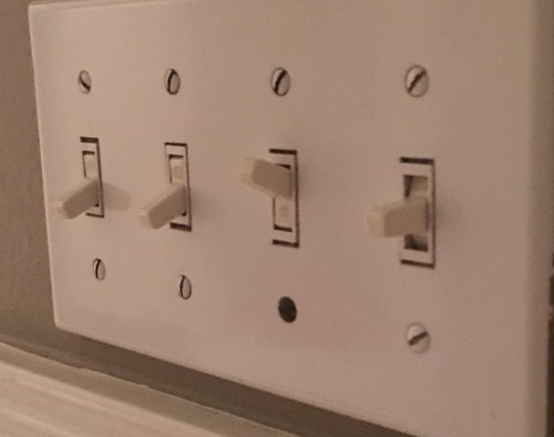
Have you ever tried to set a switch half-way up?
Notes:
https://www.reddit.com/r/mildlyinteresting/comments/d5x9va/my_light_switch_is_half_way_up/

Slide 3
Binary Numbers
Why base 2?

Slide 4
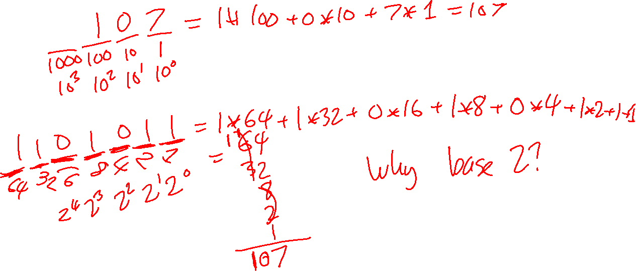
Decimal Numbers
The Place-Value System

Slide 5
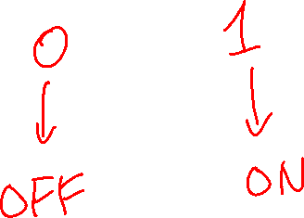
Binary Numbers
Why base 2?

Slide 6
Binary Numbers

