Slide 1

Parsing Structured Messages
CS2911
Dr. Josiah Yoder

Slide 2

def next_byte():
"""
Read the next byte from the sender.
If the byte is not yet available,
this method blocks (waits) until the
byte becomes available. If there are
no more bytes, this method blocks
indefinitely.
:return: the next byte, as a bytes
object with a single byte in it
"""
Notes:
This method is needed because the sender may want to send multiple messages through the same connection, and there is no “next message” mechanism in the Internet.
And furthermore, even when reading a file, most programs read the file without relying on the “end of file” marker. E.g., image file you wrote how many bytes there are in the header.

Slide 3
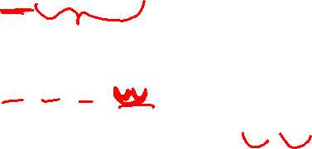
Encoding Message Length
Field at start of message
03 31 0d 0a
Special code at end of message
31 0d 0a 00
HTTP header lines: 0d 0a
Predetermined size
UDP header

Slide 4

Parsing Messages
Field at start of message
Read the amount specified by the field
Special code at end of message
Keep reading until you find the code
Predetermined size
Read the predetermined amount

Slide 5
Parsing Structured Messages
Creating an Example Message
CS2911
Dr. Josiah Yoder

Slide 6
Example
This example attempts to compactly transmit a story with many 4 digit numbers while also indicating when the book is finished.
Each block contains text followed by a number. The text begins with a single byte specifying (as a raw binary number) how many characters (bytes) of ASCII text there are. Two raw binary bytes indicate the value of the number. The last block has a text length of zero and omits the number bytes.
Notes:
So if there are 255 bytes, these

Slide 7
Parser Design
Write an example message
Brainstorm steps to read it
Write pseudo-code
Write Python code
This example attempts to compactly transmit a story with many 4 digit numbers while also indicating when the book is finished.
Each block contains text followed by a number. The text begins with a single byte specifying (as a raw binary number) how many characters (bytes) of ASCII text there are. Two raw binary bytes indicate the value of the number. The last block has a text length of zero and omits the number bytes.

Slide 8
The story
Cab 1025 had
fade 2000
This example attempts to compactly transmit a story with many 4 digit numbers while also indicating when the book is finished.
Each block contains text followed by a number. The text begins with a single byte specifying (as a raw binary number) how many characters (bytes) of ASCII text there are. Two raw binary bytes indicate the value of the number. The last block has a text length of zero and omits the number bytes.

Slide 9
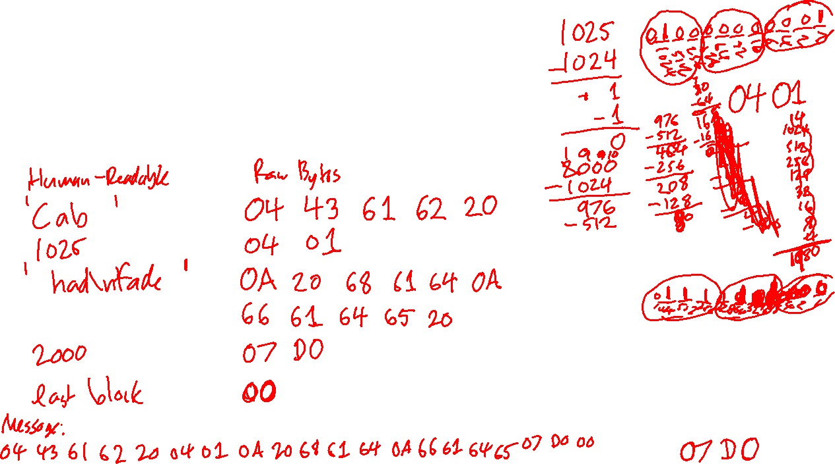
1. Write an example message
book='Cab 1025 had\nfade 2000'
This example attempts to compactly transmit a story with many 4 digit numbers while also indicating when the book is finished.
Each block contains text followed by a number. The text begins with a single byte specifying (as a raw binary number) how many characters (bytes) of ASCII text there are. Two raw binary bytes indicate the value of the number. The last block has a text length of zero and omits the number bytes.

Slide 10
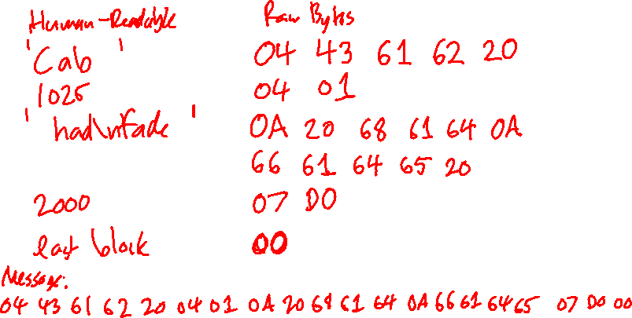
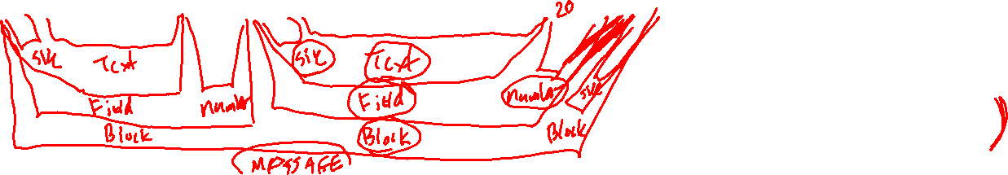
2. Brainstorm how to read it
This example attempts to compactly transmit a story with many 4 digit numbers while also indicating when the book is finished.
Each block contains text followed by a number. The text begins with a single byte specifying (as a raw binary number) how many characters (bytes) of ASCII text there are. Two raw binary bytes indicate the value of the number. The last block has a text length of zero and omits the number bytes.

Slide 11
Parsing Structured Messages
Psuedocode and Implementation
CS2911
Dr. Josiah Yoder

Slide 12
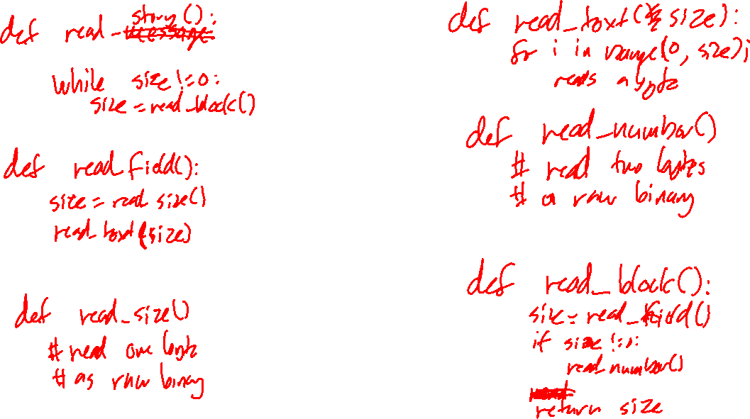
3. Write the psuedocode

Slide 13
4. Write the Python code
This example attempts to compactly transmit a story with many 4 digit numbers while also indicating when the book is finished.
Each block contains text followed by a number. The text begins with a single byte specifying (as a raw binary number) how many characters (bytes) of ASCII text there are. Two raw binary bytes indicate the value of the number. The last block has a text length of zero and omits the number bytes.

Slide 14
Example
Consider the following message format:
A message holds several numbers. Each number is stored with a variable number of bytes; a single byte sent before each number stores how many bytes are in the remainder of the number. Both this size and the number itself are stored as raw binary numbers (in network order). After the last number, a “0” size byte is sent to indicate the message is over.

Slide 15
Exercise
Consider the following format:
A message consists of “lumps”. Each lump consists only of (1) a single size byte and (2) data bytes. The size byte is encoded as an ASCII decimal digit. This number tells the number of data bytes in the remainder of the lump. The last lump stores a 0 in the size byte.
Give an example of such a message in hexadecimal shorthand and the data it carries

Slide 16
Exercise
Consider the following format:
A message consists of “lumps”. Each lump consists only of (1) a single size byte and (2) data bytes. The size byte is encoded as an ASCII decimal digit. This number tells the number of data bytes in the remainder of the lump. The last lump stores a 0 in the size byte.
Brainstorm a list of as many sub-methods for a program to parse this file as you can.

Slide 17
Exercise
Consider the following format:
A message consists of “lumps”. Each lump consists only of (1) a single size byte and (2) data bytes. The size byte is encoded as an ASCII decimal digit. This number tells the number of data bytes in the remainder of the lump. The last lump stores a 0 in the size byte.
Write pseudocode to read in the file and stop before reading past the end.

Slide 18
Exercise
Consider the following format:
A message consists of “lumps”. Each lump consists only of (1) a single size byte and (2) data bytes. The size byte is encoded as an ASCII decimal digit. This number tells the number of data bytes in the remainder of the lump. The last lump stores a 0 in the size byte.
Write Python code to read in the file and stop before reading past the end.

Slide 19
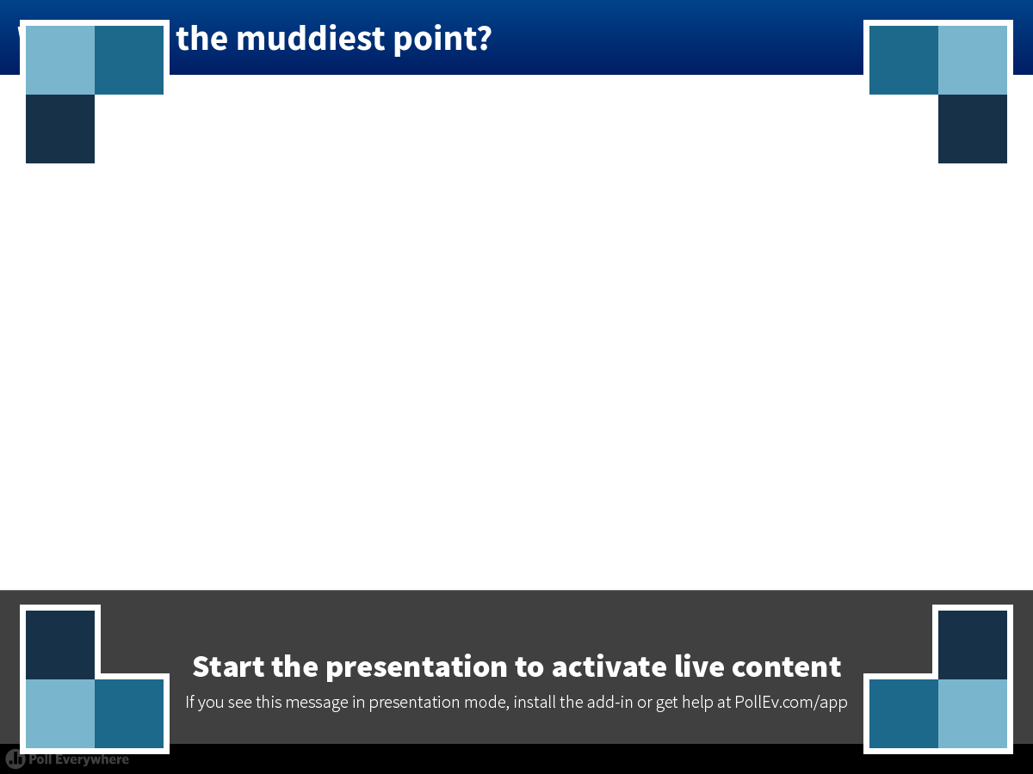
Notes:
Poll Title: What was the muddiest point?
https://www.polleverywhere.com/free_text_polls/zIp2tH2IVWjXv4H

Slide 20
Example
Consider the following format:
A message consists of several bytes telling the size, followed by that many data bytes. The number of size bytes can vary, and a null byte (b’\x00’) marks the end of the size. The size is stored as a raw binary number.
(This format cannot hold arbitrarily-sized messages, e.g. a 256-byte message could not be used because the size would include a zero byte before it is terminated)
Notes:
s

Slide 21
Example
Consider the following message format:
A message holds several numbers. Each number is stored with a variable number of bytes; a null byte (b’\x00’) marks the end of each number. The number itself is stored as a raw binary number (in network order). Zeros and numbers containing null bytes cannot be sent. After the last number, a second null byte marks the end of the message.

Slide 22

Acknowledgement
This course is based on the text
Computer Networking: A Top Down Approach
7th edition
Jim Kurose, Keith Ross
Addison-Wesley
Notes:
Book image added later

Slide 23
For more videos, visit
https://faculty-web.msoe.edu/yoder/cs2911/Videos

