Slide 1
CS2911
Week 3, Class 2
Today
  The Internet Stack
  Packet Encapsulation
Tomorrow
  UDP and TCP
Notes:
And Week 3, Class 1
19q1: Print 1-2,8-17

Slide 2
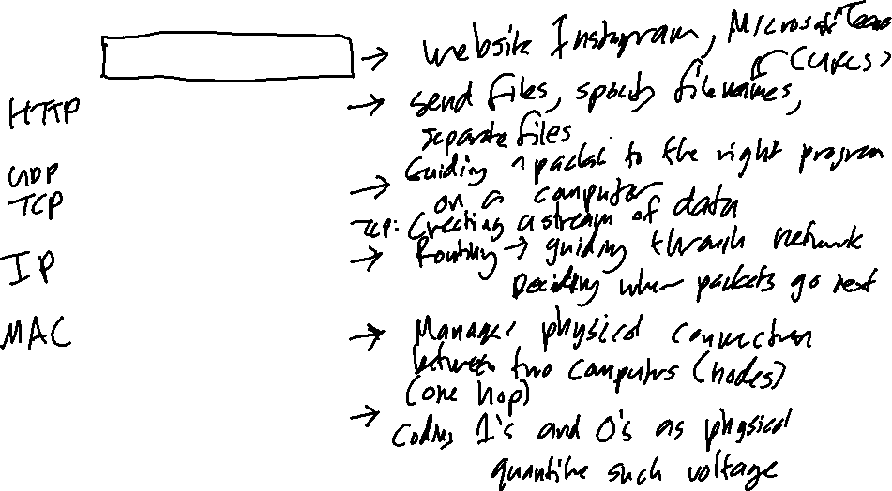
Network Layers
Internet protocol stack
Application
Transport
Network
Link
Physical

Slide 3
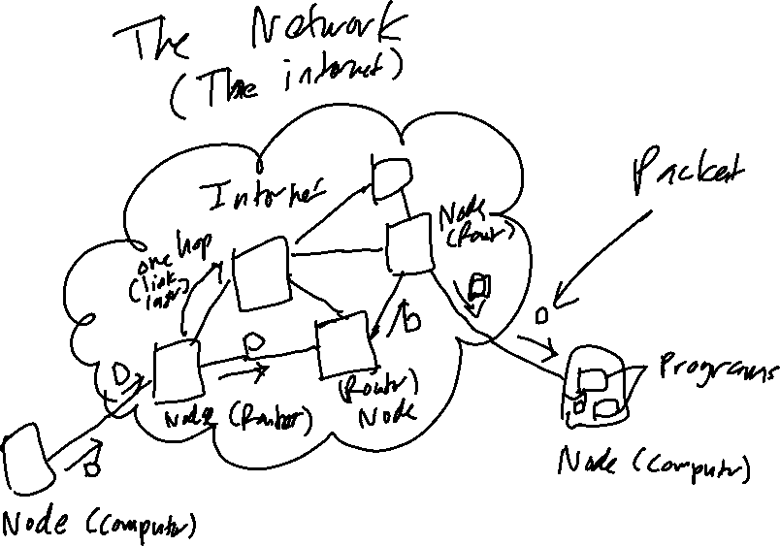

Slide 4
Nested Packets
Ethernet Packet

Slide 5
Nested Packets
Ethernet
Header
Ethernet Payload

Slide 6
Nested Packets
Ethernet
Header
IP
Header
IP Payload

Slide 7
Nested Packets
Ethernet
Header
IP
Header
TCP
Header
TCP Payload

Slide 8
Nested Packets
Ethernet
Header
IP
Header
TCP
Header
HTTP
Header
HTTP
Payload

Slide 9
Nested Packets
Ethernet
Header
Ethernet Payload
Ethernet
Header
IP
Header
IP Payload
Ethernet
Header
IP
Header
TCP
Header
TCP Payload
Ethernet
Header
IP
Header
TCP
Header
HTTP
Header
HTTP
Payload

Slide 10
UDP
Transport-layer protocol
Uses Network Layer to send a single packet at application's request
Provides checksum
  Detects errors in packet
Guides packet to right program
  Demultiplexing
See Chapter 3: Transport Layer

Slide 11
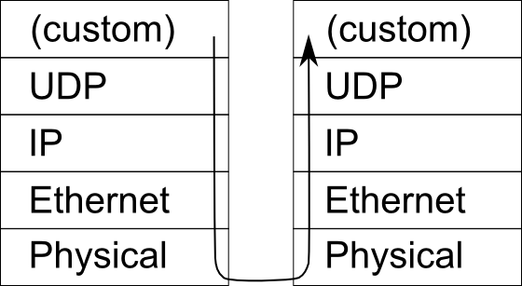
UDP demultiplexing
80
17
22
See Chapter 3: Transport Layer

Slide 12
UDP Client in Python
import socket # All socket code needs this
client_socket = socket.socket(socket.AF_INET, socket.SOCK_DGRAM)
# message must be bytes or bytearray, not str
client_socket.sendto(message, (server_name, server_port))
client_socket.close()
See Chapter 2: Application Layer
Notes:
In the slides that follow, italic variables are ones that are not included in this example.

Slide 13
UDP Server in Python
server_socket = socket.socket(socket.AF_INET, socket.SOCK_DGRAM)
server_socket.bind((server_interface,
server_port))
message,client_address = server_socket.
recvfrom(1500)
server_socket.close()
See Chapter 2:
Application Layer
Notes:
# 1500: Maximum size of packet in most networks
To demo: Blocking and non-blocking behavior of recvfrom() method
To demo: queueing behavior of UDP messages
Is queuing guaranteed, rather than merging? I think so.
http://stackoverflow.com/questions/22519247/for-how-long-do-the-recv-functions-buffer-in-udp
Are packets guaranteed to make it through?
No

Slide 14
TCP features
Stream of data:
  Guaranteed delivery
  In-order delivery
Multiple connections through same server port
See Chapter 2: Application Layer
Notes:
Exactly like UDP, but adds these features

Slide 15
Transport Layer Protocols
UDP
TCP
User Datagram Protocol
App sees datagrams
Built on IP datagram
Simply passes packet to network layer
Packet may not arrive
May reorder packets
Provides checksum
Connectionless
Transport Control Protocol
App sees streams
Built on IP datagram
Breaks stream into packets and reassembles
Guaranteed delivery
Stream remains in order
Provides checksum
Maintains multiple connections through the same port

Slide 16
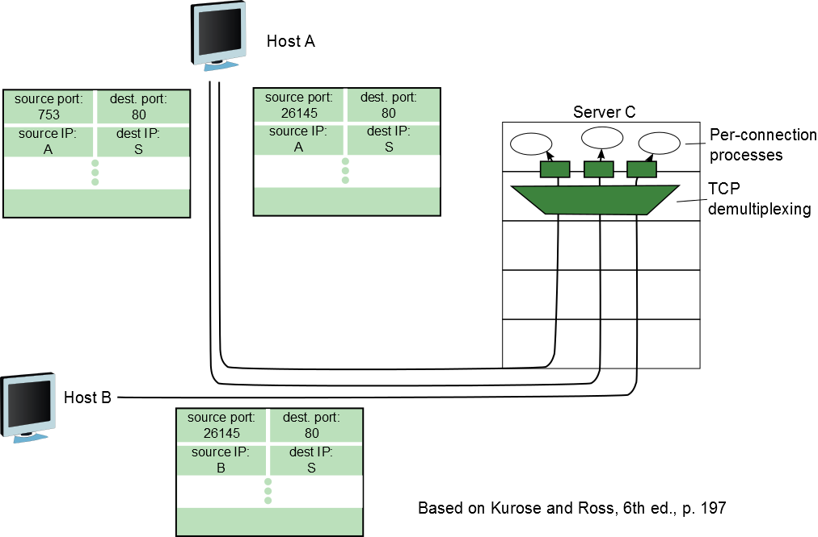
TCP demultiplexing
7th edition: p. 199, Fig 3.5, Sec. 3.2

Slide 17
TCP Client in Python
tcp_socket = socket.socket(socket.AF_INET, socket.SOCK_STREAM)
tcp_socket.connect((server_host,server_port))
tcp_socket.sendall(message)
response = tcp_socket.recv(response_size)
tcp_socket.close()
See Chapter 2: Application Layer
Notes:
Note: response_size is NOT the size of the internal buffer used to store received data. Whatever information the sender says will be stored in a large buffer on the local machine. Instead, it is the maximum size of response (in bytes)
18q1: sendall added after class

Slide 18
TCP Server in Python
listen_socket = socket.socket(socket.AF_INET, socket.SOCK_STREAM) listen_socket.bind((listen_interface,listen_port))
listen_socket.listen(1) # Num of conn. to accept
data_socket, sender_address = listen_socket.
accept()
data = data_socket.recv(response_size)
data_socket.sendall(response_data)
data_socket.close()
listen_socket.close()
See Chapter 2: Application Layer
Notes:
18q1: sendall added after class

Slide 19
TCP connection
listen_socket.bind((listen_host,listen_port))
  What python type is (listen_host,listen_port)?
listen_host can be empty string ('') to listen on all interfaces
Department offices example
Notes:
17q1: added after morning class: "Instead of data_socket.recv, simply use the next_byte calls you already have in your code."

Slide 20
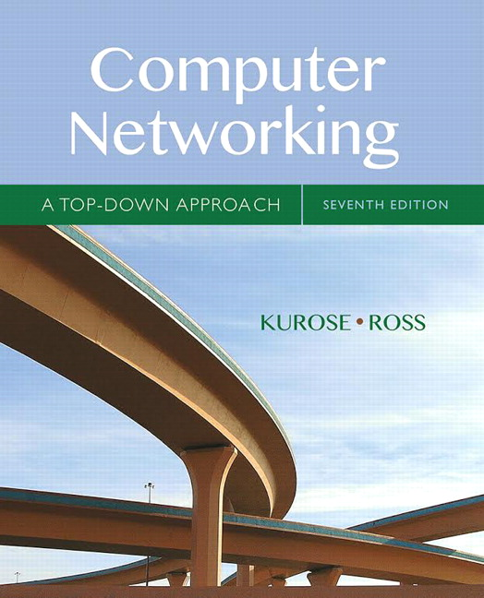
Acknowledgement
This course is based on the text
Computer Networking: A Top Down Approach
7th edition
Jim Kurose, Keith Ross
Addison-Wesley
Notes:
Book image added later

