Slide 1
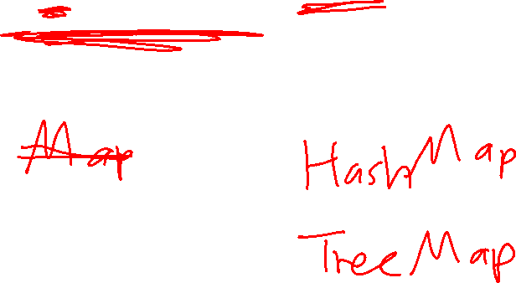
CS2911
Week 5, Class 1 (041) or 2 (021)
Today
  Map (dict) objects in Python
  Email Protocols
Notes:
17q1 6-1 1,3,5,6,7,11-16
18q1 6-1 1-4,6-11,13-14

Slide 2

Introduction to Python
Python
Java
ages = dict()
OR ages = {}
ages["Nancy"] = 5
ages["Bob"] = 10
print "B:",ages["Bob"]
for k,v in ages.items():
print k+": "+str(v)
Map<String,Integer> ages = new HashMap<>();
ages.put("Nancy", 5);
ages.put("Bob", 10);
S.o.pl("B: "+ages.get("Bob"));
for(Map.Entry<String,Integer>
e: ages.entrySet()) {
S.o.pl(e.getKey()+": " +e.getValue());
}

Slide 3
Dictionaries
A Python Dictionary is like a Map in Java
You can use an object as an "index" for an item. The index object is called a "key" and the object stored is called a "value"
You can use any object – they don't have to be integers, and they aren't stored sequentially in memory
You can iterate through all the entries in a dictionary, or look up an item by its key

Slide 4
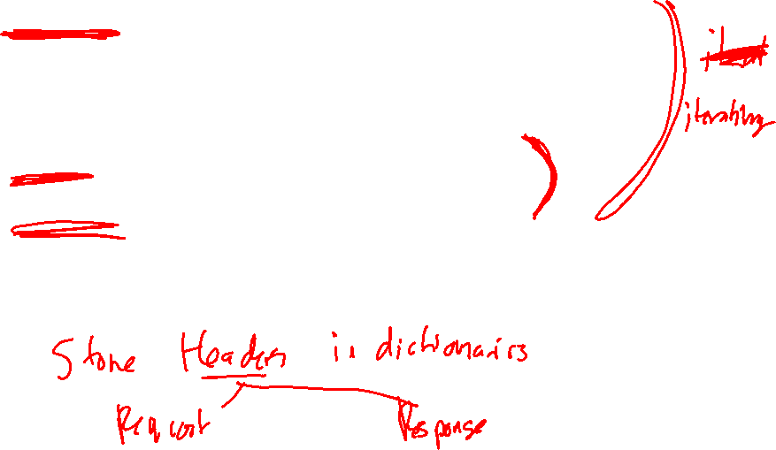
Some important methods
items() returns a list of all keys and values, where each item is a tuple holding (key, value)
keys() returns a list of all keys
values() returns a list of all values
has_key(k) returns true if the value is stored in the list

Slide 5
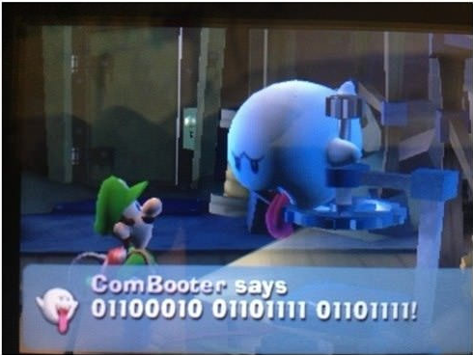
Student-provided
Question and Humor
Fall 2016 6-3
What text is sent in base-64? What text is sent encrypted? | Lab 7
"Silly Nintendo"

Slide 6

Acknowledgement
This course is based on the text
Computer Networking: A Top Down Approach
7th edition
Jim Kurose, Keith Ross
Addison-Wesley

