Slide 1
Notes from the HTTP Standard Headers Exercise
--
And Intro to Chunking

Slide 2
Morning Section (021)

Slide 3
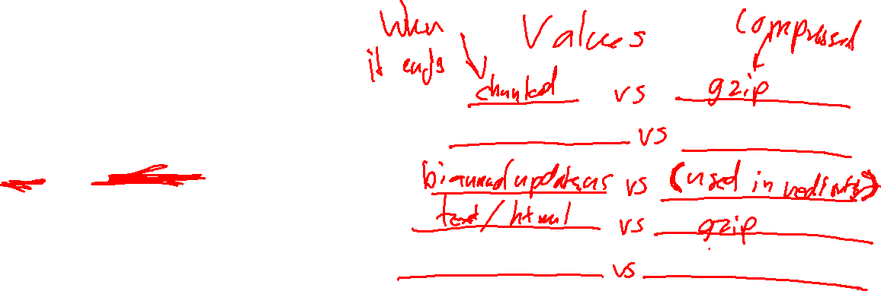
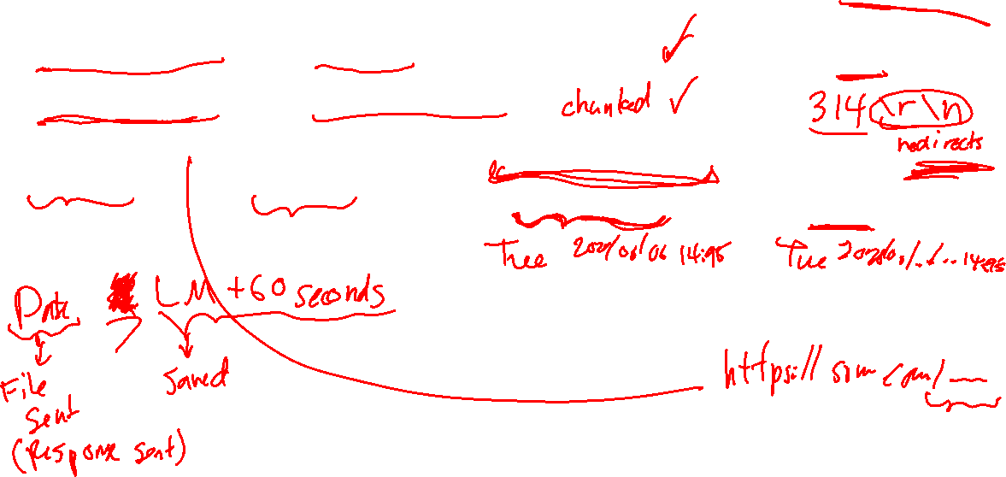
Transfer-Encoding vs. Content-Encoding
Transfer-Encoding vs. Content-Length
Host vs. Location
Content-Type vs. Content-Encoding
Date vs. Last-Modified

Slide 4
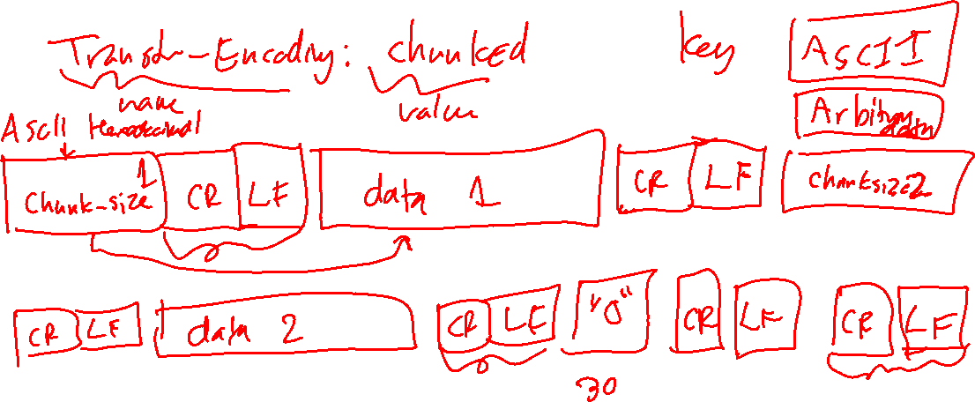

Slide 5
Afternoon Section (041)

Slide 6
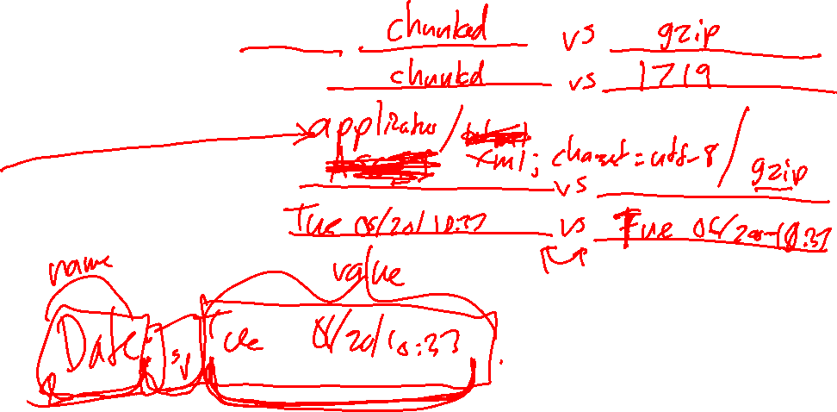
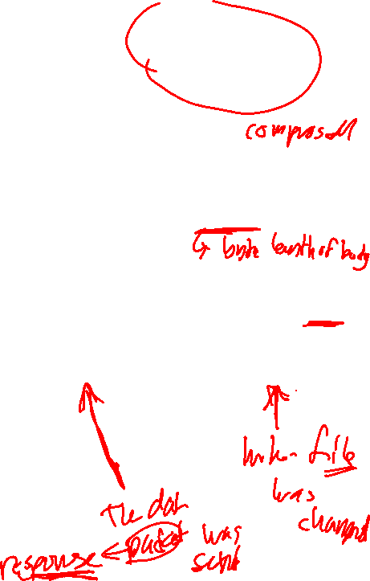
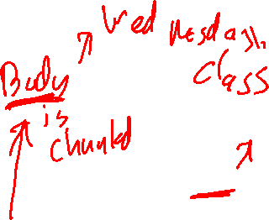
Transfer-Encoding vs. Content-Encoding
Transfer-Encoding vs. Content-Length
Host vs. Location
Content-Type vs. Content-Encoding
Date vs. Last-Modified

Slide 7
