Slide 1
Who Runs the Internet?

Slide 2
The IETF, IAB, RIRs, ccTLD ROs, ICANN, ISOC, and W3C
https://www.icann.org/news/announcement-2-2014-03-14-en
Notes:
https://www.icann.org/news/announcement-2-2014-03-14-en
"The leaders of the Internet technical organizations responsible for coordination of the Internet infrastructure (IETF, IAB, RIRs, ccTLD ROs, ICANN, ISOC, and W3C), welcome the US Government's announcement of the suggested changes related to the IANA functions contract."

Slide 3
Who runs the internet today?
The IETF – Internet Engineering Task Force
  IAB – Internet Architecture Board -- committee of the IETF
ICANN – Internet Corporation for Assigned Names and Numbers
  IANA – Internet Assigned Numbers Authority
RIRs – Regional Internet registry
ccTLD ROs -- Country Code Top-Level Domain (registry operators?)
W3C – Industrial consortium
ISOC -- ??

Slide 4
Who owns the internet?
IP Addresses
https://www.highspeedinternet.com/resources/the-top-ten-owners-of-the-internet
The page above is out of date – Level 3 is now owned by Lumen.
Perhaps similar summaries could be made from the APIs here:
https://api.asrank.caida.org/v2/docs

Slide 5
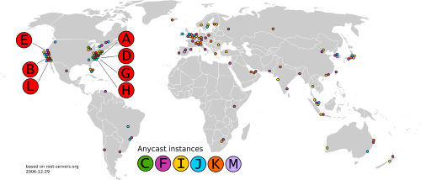
Who owns the internet?
Root servers
There are twelve root-server hosting organizations (in 2020)
Verisign
USC-ISI
Cogent
UMD
NASA Ames
ISC
https://root-servers.org/faq/
DISA DoD NIC
ARL
Netnod
RIPE NCC
ICANN
WIDE
https://en.wikipedia.org/wiki/Root_name_server

Slide 6
This topic quickly goes beyond the scope of this course…
https://en.wikipedia.org/wiki/Great_Firewall

Slide 7
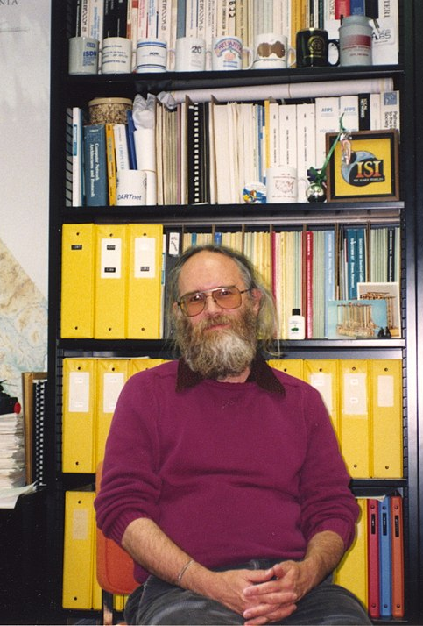
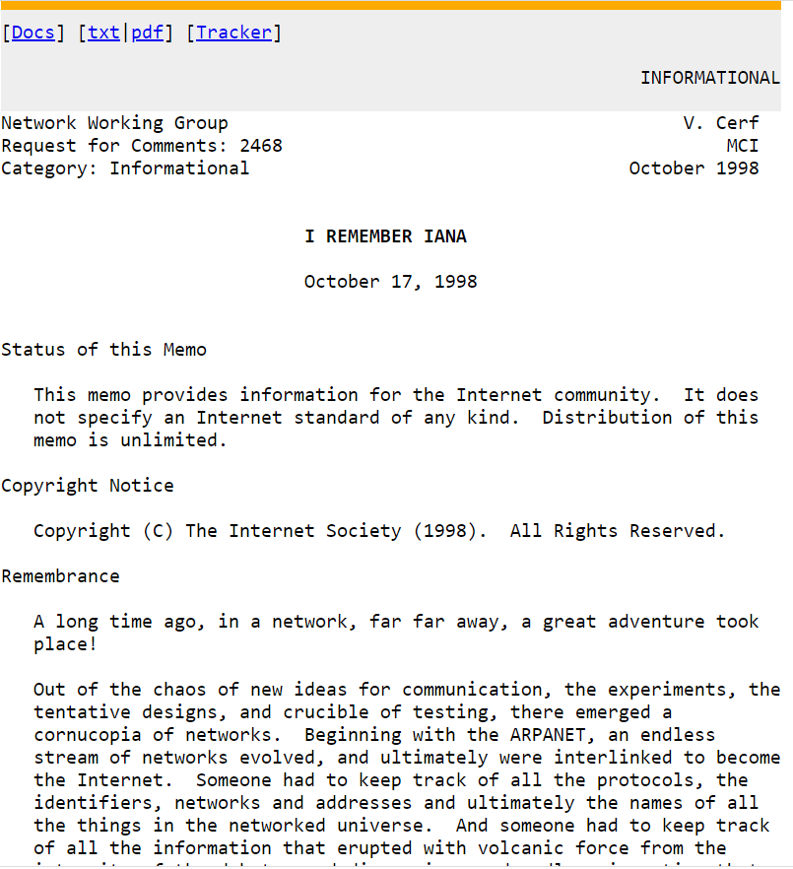
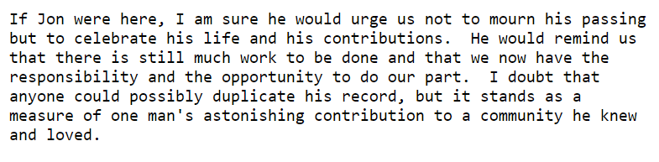
A tribute to John Postel, the first IANA
https://tools.ietf.org/html/rfc2468
https://www.internetsociety.org/grants-and-awards/postel-service-award/ten-year-tribute-jon-postel/
https://en.wikipedia.org/wiki/Jon_Postel

Slide 8
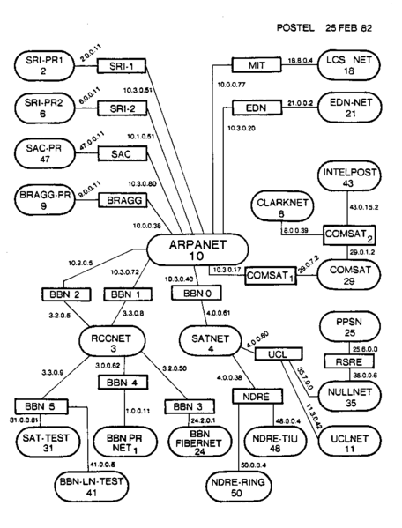
A map of the internet
Created by John Postel around the time Dr. Yoder was born.
https://en.wikipedia.org/wiki/History_of_the_Internet
Notes:
https://en.wikipedia.org/wiki/File:Internet_map_in_February_82.png

